Slide 1
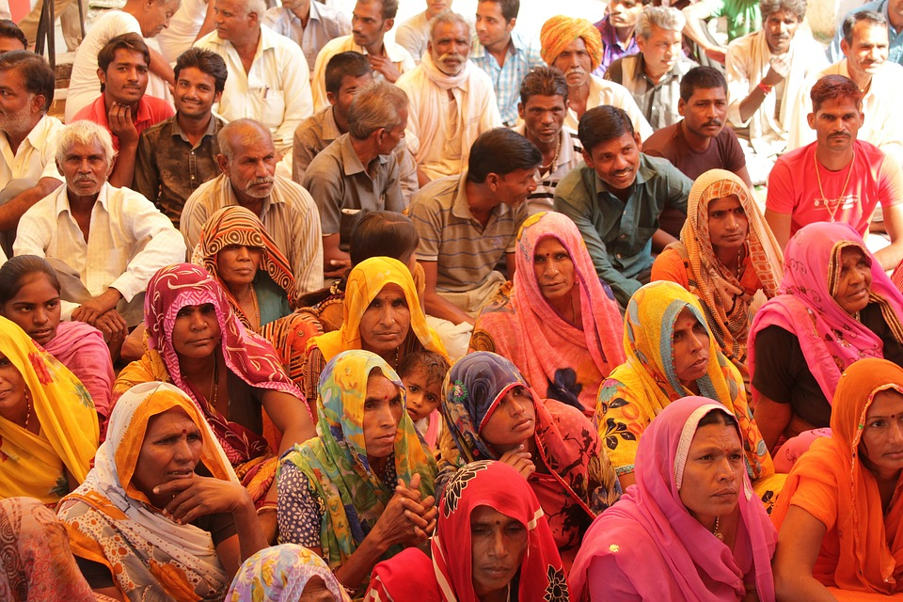
Behind the Weavers
Notes:
Notes for Teacher – The teacher can encourage the students to suggest any other occupations related to weaving other than mentioned in the ppt.
Suggestions: <Ideas/ Images/ Animations / Others – To make better representation of the content > Source of Multimedia Objects (Image/audio/ Video/Animation) used in this slide -
https://pixabay.com/photos/group-villagers-village-people-4180266/

Slide 2
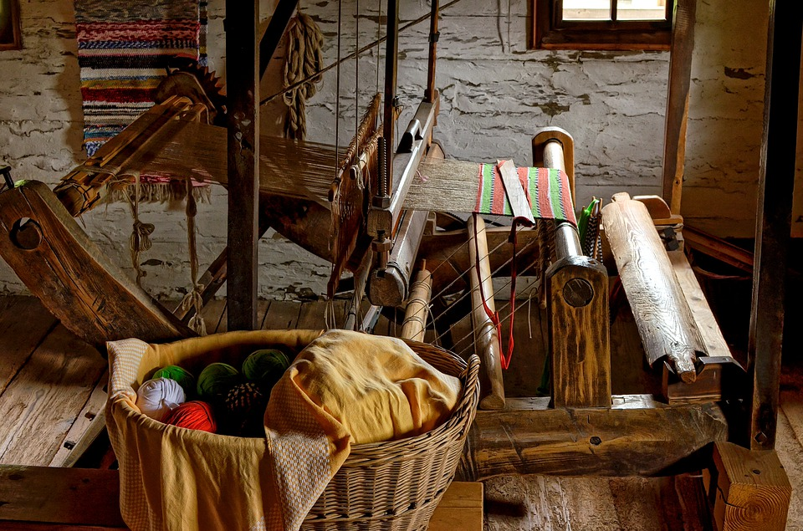
Behind Weaving
Handloom weaving and the occupations associated with it provided livelihood for millions of Indians.
Notes:
Notes for Teacher - < Information for further reference or explanation >
Suggestions: <Ideas/ Images/ Animations / Others – To make better representation of the content > Source of Multimedia Objects (Image/audio/ Video/Animation) used in this slide -
https://pixabay.com/photos/loom-weaving-material-clothes-4458048/

Slide 3
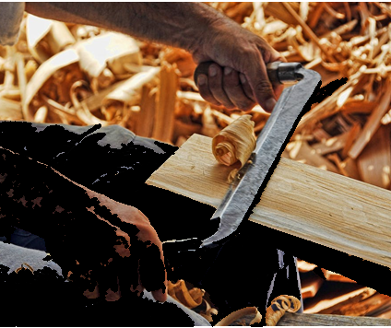
Carpenters
Charkha (spinning wheel) and looms that the weavers need were made with the help of carpenters.
Notes:
Notes for Teacher - < Information for further reference or explanation >
Suggestions: <Ideas/ Images/ Animations / Others – To make better representation of the content > Source of Multimedia Objects (Image/audio/ Video/Animation) used in this slide -
https://www.pexels.com/photo/blade-carpenter-carpentry-craft-461086/

Slide 4
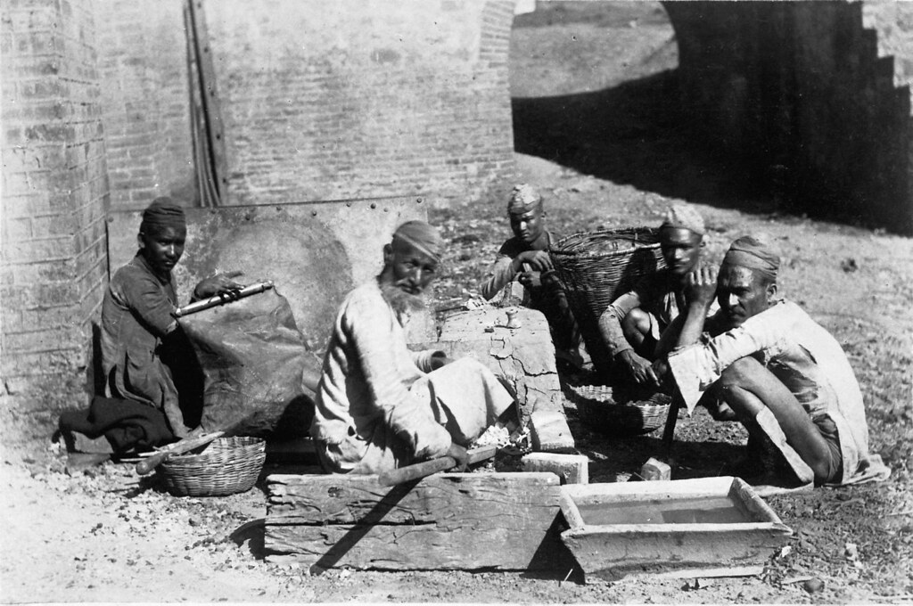
Blacksmith
Takli (spindles) , shuttles and other necessary metal parts for weaving were made by blacksmiths.
Notes:
Notes for Teacher - < Information for further reference or explanation >
Suggestions: <Ideas/ Images/ Animations / Others – To make better representation of the content > Source of Multimedia Objects (Image/audio/ Video/Animation) used in this slide -
Blacksmith:
https://www.flickr.com/photos/59292810@N07/6347672654
"Carl Gustaf Wittenströms Indien" by Tekniska museet is licensed under CC BY 2.0

Slide 5
Dyers
Dyers known as rangrez helped the weavers in colouring the thread and in dyeing coloured fabric.
Notes:
Notes for Teacher - < Information for further reference or explanation >
Suggestions: <Ideas/ Images/ Animations / Others – To make better representation of the content > Source of Multimedia Objects (Image/audio/ Video/Animation) used in this slide -
https://pixabay.com/photos/dyeing-color-factory-wool-fabric-15039/

Slide 6
Printers
Skilled block printers known as Chhipigars supported the weavers by printing beautiful motifs on the woven fabric.
Notes:
Notes for Teacher - < Information for further reference or explanation >
Suggestions: <Ideas/ Images/ Animations / Others – To make better representation of the content > Source of Multimedia Objects (Image/audio/ Video/Animation) used in this slide -
https://pixabay.com/photos/printing-textiles-dyes-craftsman-453747/

Slide 7
MM Index
Slide# | Thumbnail | Source and Attribution
1 |  | https://pixabay.com/photos/group-villagers-village-people-4180266/
2 |  | https://pixabay.com/photos/loom-weaving-material-clothes-4458048/
3 |  | https://www.pexels.com/photo/blade-carpenter-carpentry-craft-461086/
4 |  | Blacksmith: https://www.flickr.com/photos/59292810@N07/6347672654 "Carl Gustaf Wittenströms Indien" by Tekniska museet is licensed under CC BY 2.0
5 |  | https://pixabay.com/photos/dyeing-color-factory-wool-fabric-15039/
6 |  | https://pixabay.com/photos/printing-textiles-dyes-craftsman-453747/

