Slide 1
Industrialization and India during British rule
Notes:
Notes for Teacher - < Information for further reference or explanation >
Suggestions: <Ideas/ Images/ Animations / Others – To make better representation of the content >
Source of Multimedia Objects (Image/audio/ Video/Animation) used in this slide -
1. <Short Description> - <SOURCE URL>

Slide 2
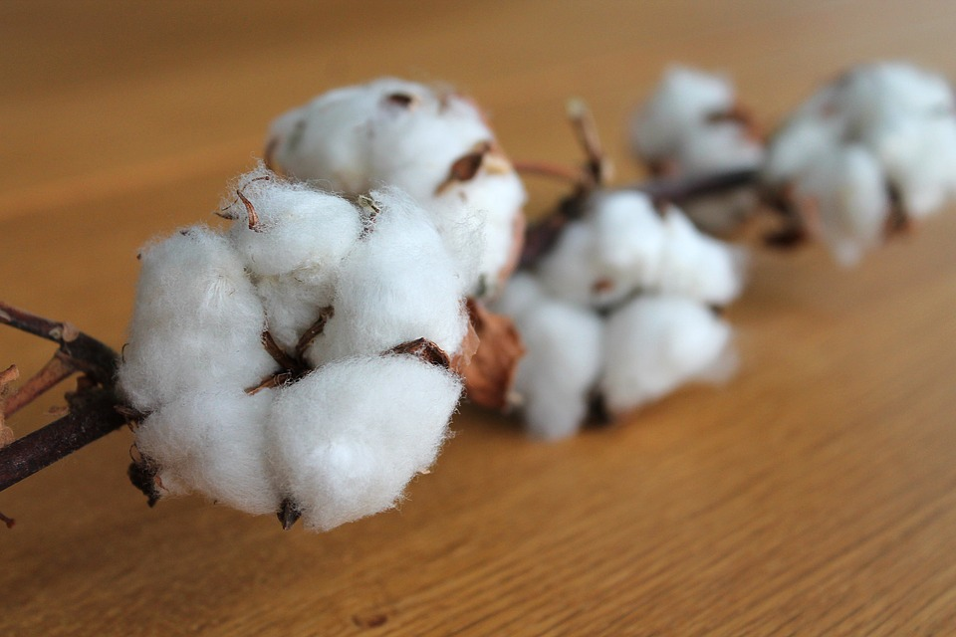
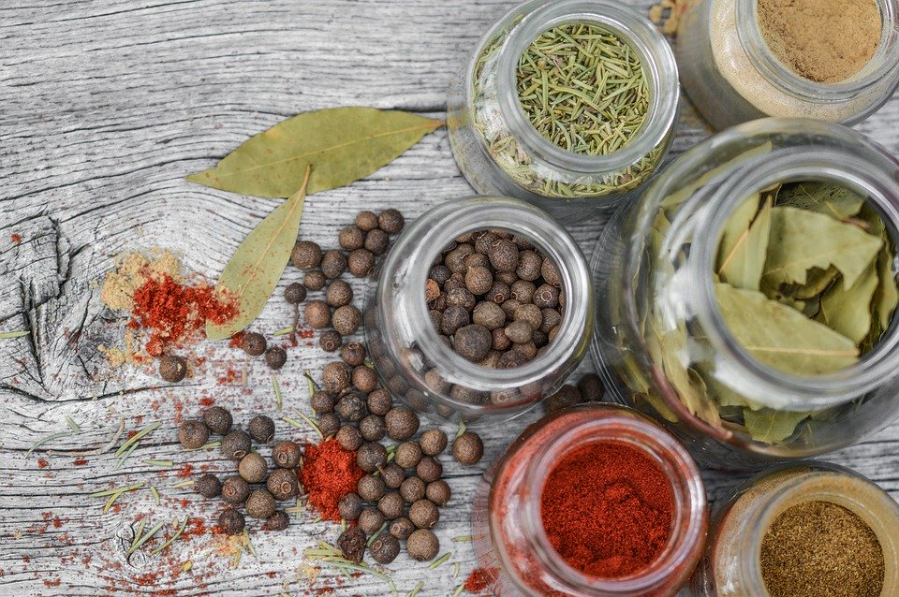
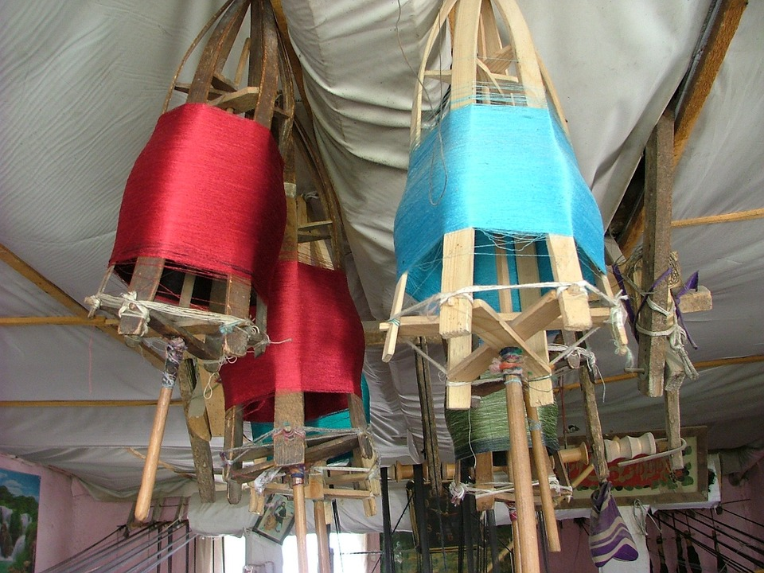
Think and Answer
Q1: Take a look at these images of some farm products exported by India during British rule.
Which of these could be used as raw material for their industries?
Answer: Cotton
Notes:
Notes for Teacher – Please have a discussion with students on each question before clicking on the answer in the ppt. Please have many students answer each question to ensure engagement and participation.
Suggestions: <Ideas/ Images/ Animations / Others – To make better representation of the content > Source of Multimedia Objects (Image/audio/ Video/Animation) used in this slide -
Cotton: https://pixabay.com/photos/cotton-branch-cotton-plant-branch-1271038/
Spice: https://pixabay.com/photos/spices-jar-cooking-rustic-pepper-2548653/
Silk: https://pixabay.com/photos/silk-mill-silk-weaving-4870/

Slide 3
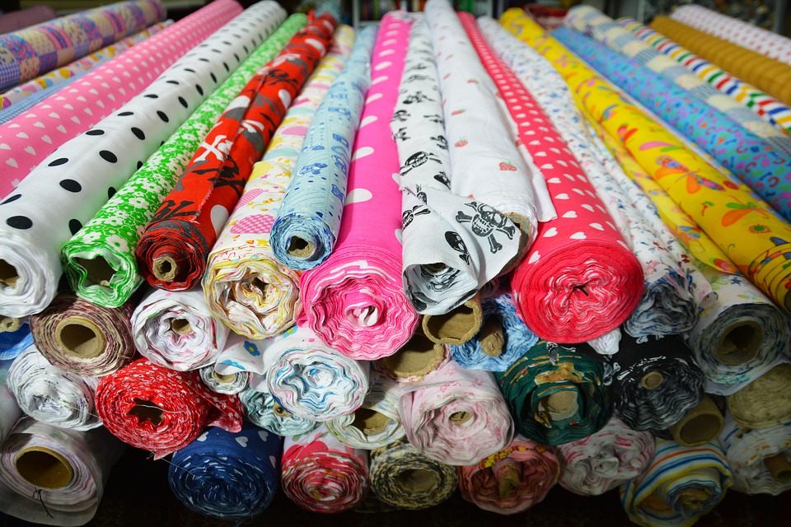
Think and Answer
Q2: How was cotton used by the British to develop industries?
Britain imported raw materials at cheap rates.
Britain exported finished goods at higher price.
Notes:
Notes for Teacher – Please give sufficient time for the students to respond. Reveal the answer using “on click” after relevant answer is said.
Suggestions: <Ideas/ Images/ Animations / Others – To make better representation of the content > Source of Multimedia Objects (Image/audio/ Video/Animation) used in this slide –
Cotton: https://pixabay.com/photos/cotton-branch-cotton-plant-branch-1271038/
Fabric: https://pixabay.com/photos/fabric-cloth-fashion-textile-1237805/
Money bag: https://openclipart.org/detail/298986/bag-of-gold-coins

Slide 4
Video Time
Let us watch a feature on
INDUSTRIAL REVOLUTION
Notes:
Notes for Teacher – The teacher can play the video ‘Industrial revolution’ provided
Suggestions: <Ideas/ Images/ Animations / Others – To make better representation of the content > Source of Multimedia Objects (Image/audio/ Video/Animation) used in this slide -

Slide 5
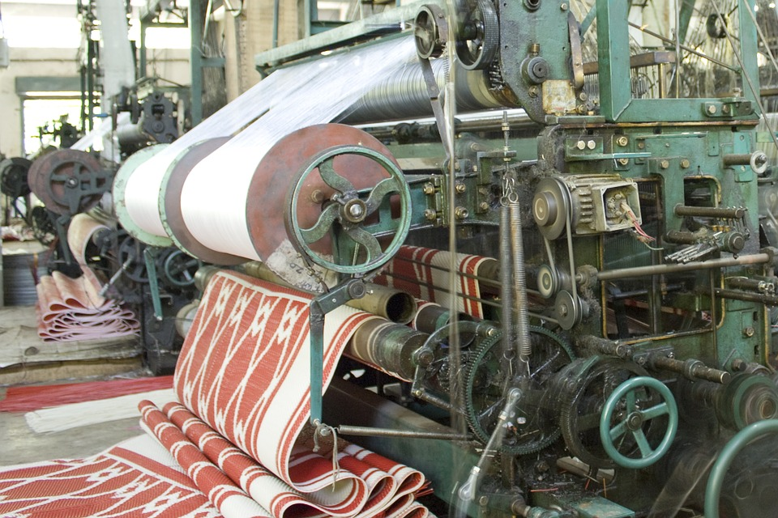
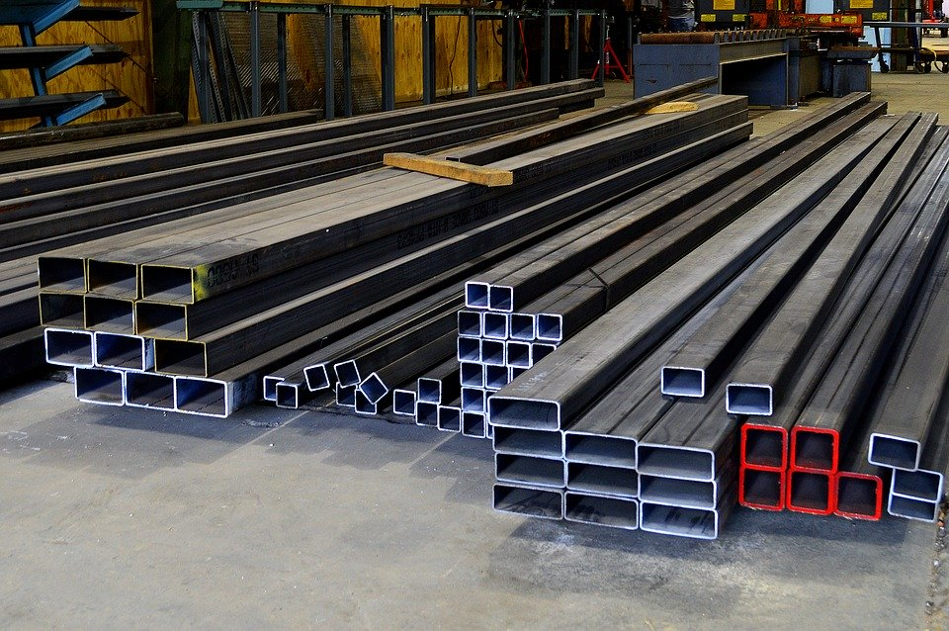
Think and Answer
Q3: According to the video what were the two basic areas/ industries that benefited through use of machines?
Suggested Answer: Textile/Iron and steel
Notes:
Notes for Teacher – Please have a discussion with students on each question before clicking on the answer in the ppt. Please have many students answer each question to ensure engagement and participation.
Suggestions: <Ideas/ Images/ Animations / Others – To make better representation of the content > Source of Multimedia Objects (Image/audio/ Video/Animation) used in this slide –
Textile: https://pixabay.com/photos/factory-weaving-machine-textile-831011/
Iron and steel: https://pixabay.com/photos/steel-materials-raw-channel-metal-2839316/

Slide 6
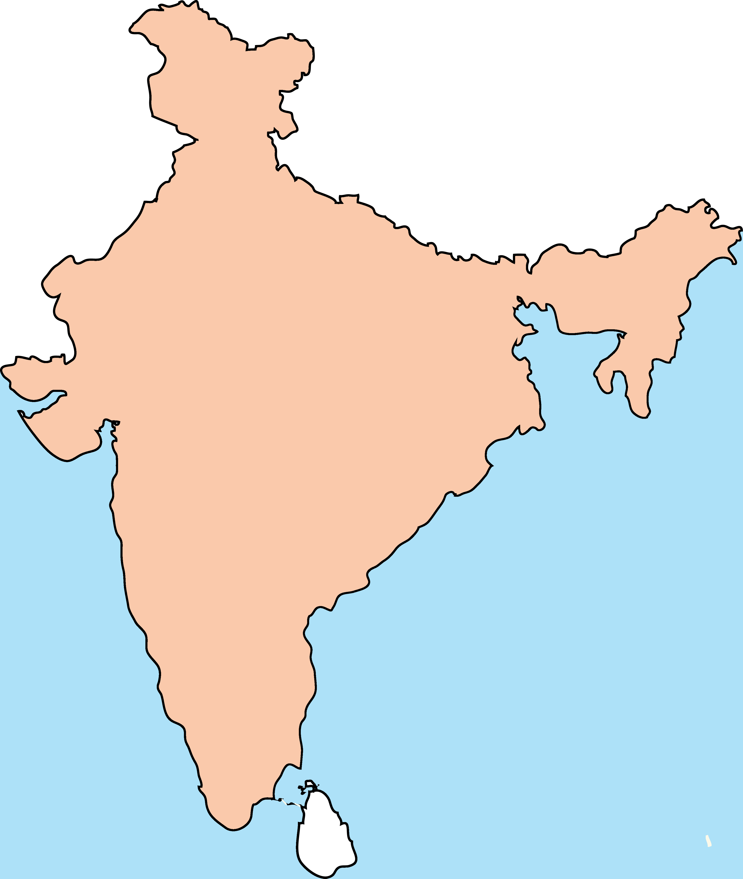
Think and Answer
Q4: How did Britain benefit from colonies like India?
Suggested Answer:
India provided
cheap raw materials for the British industries.
a vast market for selling the finished machine made products from Britain.
Notes:
Notes for Teacher – Please give sufficient time for the students to respond. Reveal the answer using “on click” after relevant answer is said.
Suggestions: <Ideas/ Images/ Animations / Others – To make better representation of the content > Source of Multimedia Objects (Image/audio/ Video/Animation) used in this slide –
Cotton: https://pixabay.com/photos/cotton-branch-cotton-plant-branch-1271038/
Fabric: https://pixabay.com/photos/fabric-cloth-fashion-textile-1237805/
India: SSSVV Gallery Keyword: India outline

Slide 7
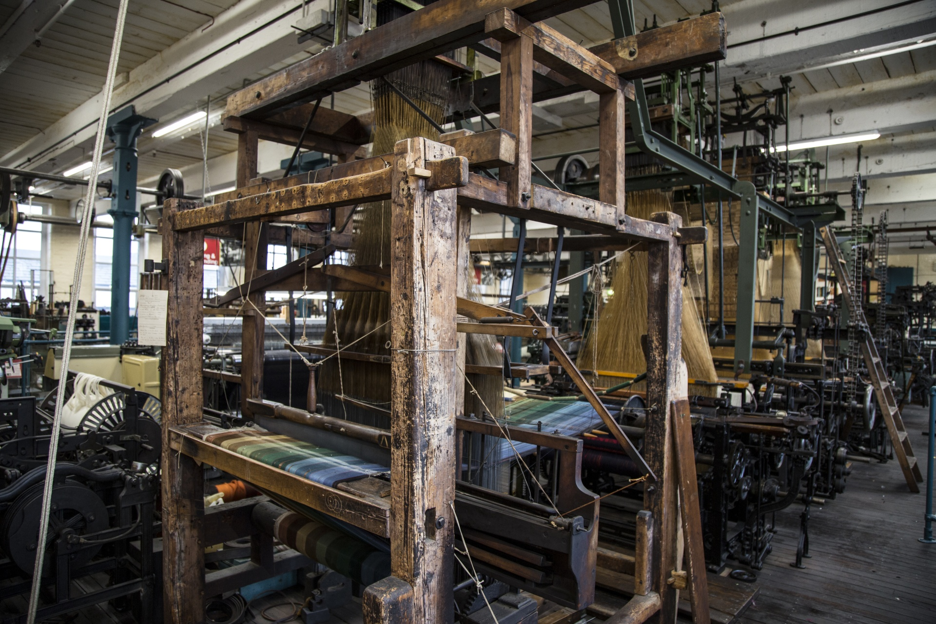
Give Reason
Q5: Do you think industrialization affected the handloom weaving occupation in India?
Yes,
Machine made textiles were preferred to handloom textiles.
Many handloom weavers lost their jobs due to lesser demand.
No,
1. The print and colour of handloom industry was unique and could not be produced otherwise.
2. Customisation was possible for handloom but not for machine made clothes.
Notes:
Notes for Teacher - < Information for further reference or explanation >
Suggestions: <Ideas/ Images/ Animations / Others – To make better representation of the content > Source of Multimedia Objects (Image/audio/ Video/Animation) used in this slide -
https://www.publicdomainpictures.net/en/view-image.php?image=205780&picture=textile-industry

Slide 8
MM Index
Slide# | Thumbnail | Source and Attribution
2 |  | Spice: https://pixabay.com/photos/spices-jar-cooking-rustic-pepper-2548653/
2,3,6 |  | Cotton: https://pixabay.com/photos/cotton-branch-cotton-plant-branch-1271038/
2 |  | Silk: https://pixabay.com/photos/silk-mill-silk-weaving-4870/
3,6 |  | Fabric: https://pixabay.com/photos/fabric-cloth-fashion-textile-1237805/
5 |  | Textile: https://pixabay.com/photos/factory-weaving-machine-textile-831011/
5 |  | Iron and steel: https://pixabay.com/photos/steel-materials-raw-channel-metal-2839316/
3 |  | Money bag: https://openclipart.org/detail/298986/bag-of-gold-coins
6 |  | India Map: SSSVV gallery Keyword: India outline
7 |  | https://www.publicdomainpictures.net/en/view-image.php?image=205780&picture=textile-industry
Notes:
Notes for Teacher - < Information for further reference or explanation >
Suggestions: <Ideas/ Images/ Animations / Others – To make better representation of the content > Source of Multimedia Objects (Image/audio/ Video/Animation) used in this slide -

