Slide 1
British bring technology to Cotton Textile Industry
Notes:
Notes for Teacher - < Information for further reference or explanation >
Suggestions: <Ideas/ Images/ Animations / Others – To make better representation of the content > Source of Multimedia Objects (Image/audio/ Video/Animation) used in this slide -

Slide 2
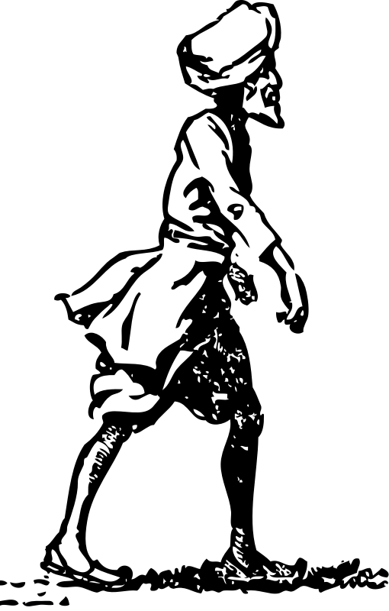
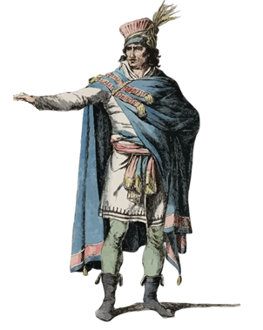
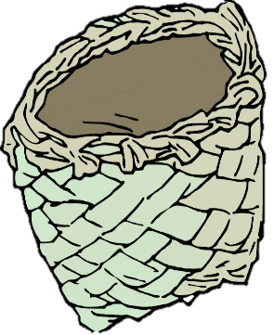
Indian Textiles during the 18th century
The Europeans paid in silver coins and bought cotton and silk textiles from Indian weavers.
But when East India Company gained political power they collected revenue taxes from the local people and bought Indian goods.
Notes:
Notes for Teacher - The teacher can refer to the following links to give more details on the silver coins used by the Europeans during 18th century
https://en.wikipedia.org/wiki/Spanish_dollar
https://en.wikipedia.org/wiki/Global_silver_trade_from_the_16th_to_19th_centuries
Suggestions: <Ideas/ Images/ Animations / Others – To make better representation of the content > Source of Multimedia Objects (Image/audio/ Video/Animation) used in this slide -
https://openclipart.org/detail/223362/vintage-french-male-model
https://openclipart.org/detail/19224/sikh-followed-by-partridge
https://openclipart.org/detail/323025/a-maori-flax-bag-and-bone-tiki
https://openclipart.org/detail/302069/money-bag-6
https://pixabay.com/photos/ruble-coins-money-russia-silver-627224/

Slide 3
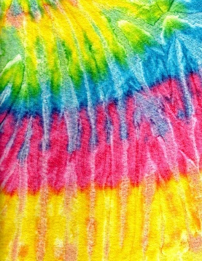
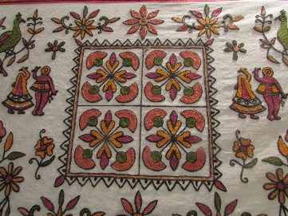
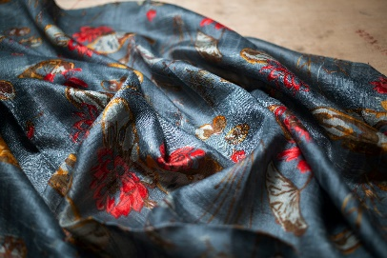
Indian Textiles during the 18th century
India was the World’s largest producer of the cotton textiles.
Around 60% of the total East India Company sales was from Indian Textiles.
The preference of Indian textiles became a threat to British weavers
Notes:
Notes for Teacher - < Information for further reference or explanation >
Suggestions: <Ideas/ Images/ Animations / Others – To make better representation of the content > Source of Multimedia Objects (Image/audio/ Video/Animation) used in this slide -
India Map: SSSVV gallery keyword: India Map
https://pxhere.com/th/photo/997447
https://pxhere.com/en/photo/776930
https://www.pexels.com/photo/printed-piece-of-fabric-2933636/
https://www.pexels.com/photo/fabric-flower-pattern-sunlight-408303/

Slide 4
Calico Act
The British Parliament passed Calico Act in 1720 to benefit the local weavers.
This act banned the import of printed cotton textiles especially from India.
IMPORTS OF PRINTED COTTON
The local weavers imitated the Indian designs and gained profits.
Notes:
Notes for Teacher - < Information for further reference or explanation >
Suggestions: <Ideas/ Images/ Animations / Others – To make better representation of the content > Source of Multimedia Objects (Image/audio/ Video/Animation) used in this slide -

Slide 5
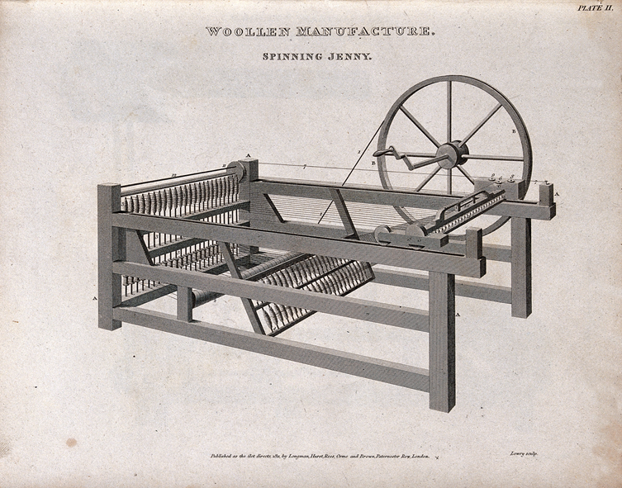
Innovations in Britain.
Manual spinning wheel that produced one spindle of thread at a time.
In 1764, John Kaye invented spinning jenny that produced several spindles at a time.
Notes:
Notes for Teacher - < Information for further reference or explanation >
Suggestions: <Ideas/ Images/ Animations / Others – To make better representation of the content > Source of Multimedia Objects (Image/audio/ Video/Animation) used in this slide -
https://pixabay.com/photos/khadi-coarse-cloth-garag-india-233560/
https://commons.wikimedia.org/wiki/File:Textiles;_a_spinning_jenny._Engraving_by_W._Lowry,_1811._Wellcome_V0024143.jpg

Slide 6
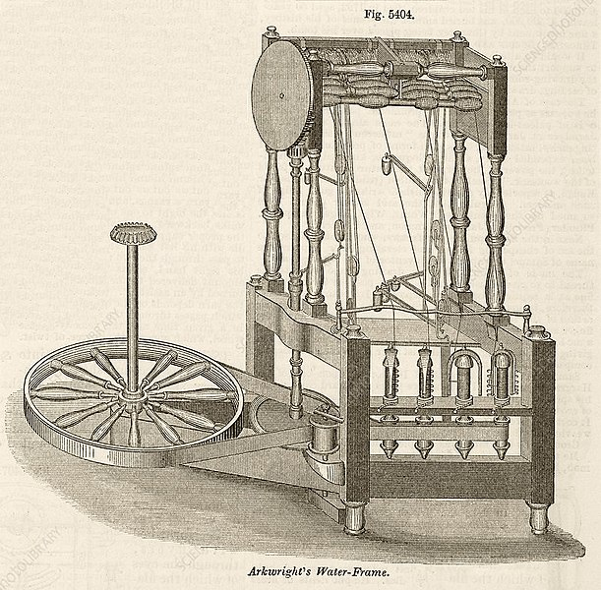
Innovations in Britain.
Spinning Frame
In 1786, Richard Arkwright invented the steam powered spinning frame to spin threads in huge quantities at cheaper rates.
Notes:
Notes for Teacher - < Information for further reference or explanation >
Suggestions: <Ideas/ Images/ Animations / Others – To make better representation of the content > Source of Multimedia Objects (Image/audio/ Video/Animation) used in this slide -
https://commons.wikimedia.org/wiki/File:Spinning_frame01.jpg

Slide 7
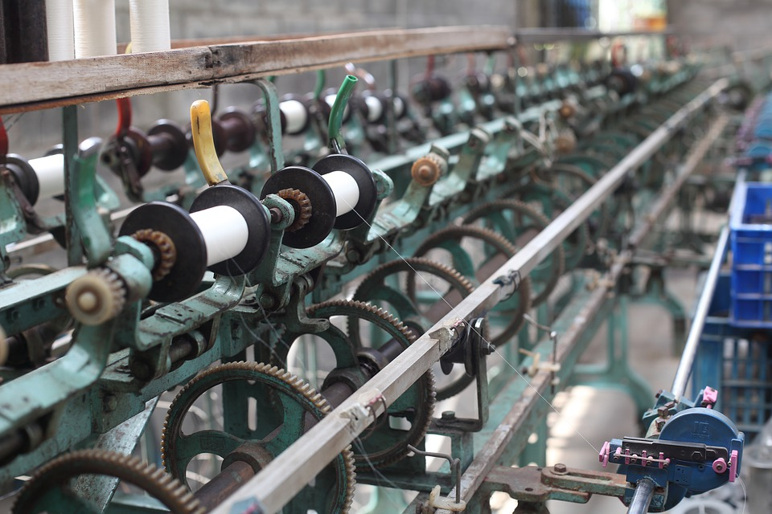
Prominent Britain.
Britain was called the ‘Workshop of the world’ due to rapid industrialization.
Notes:
Notes for Teacher - < Information for further reference or explanation >
Suggestions: <Ideas/ Images/ Animations / Others – To make better representation of the content > Source of Multimedia Objects (Image/audio/ Video/Animation) used in this slide –
https://pixabay.com/photos/silk-factory-spools-textile-sewing-4823846/

Slide 8
MM Index
Slide# | Thumbnail | Source and Attribution
3 |  | https://pxhere.com/th/photo/997447
3 |  | https://pxhere.com/en/photo/776930
3 |  | https://www.pexels.com/photo/printed-piece-of-fabric-2933636/
3 |  | https://www.pexels.com/photo/fabric-flower-pattern-sunlight-408303/
2 |  | https://openclipart.org/detail/223362/vintage-french-male-model
2 |  | https://openclipart.org/detail/19224/sikh-followed-by-partridge
2 |  | https://openclipart.org/detail/323025/a-maori-flax-bag-and-bone-tiki
2 |  | https://openclipart.org/detail/302069/money-bag-6
2 |  | https://pixabay.com/photos/ruble-coins-money-russia-silver-627224/
5 |  | https://pixabay.com/photos/khadi-coarse-cloth-garag-india-233560/
5 |  | https://commons.wikimedia.org/wiki/File:Textiles;_a_spinning_jenny._Engraving_by_W._Lowry,_1811._Wellcome_V0024143.jpg
7 |  | https://pixabay.com/photos/silk-factory-spools-textile-sewing-4823846/
6 |  | https://commons.wikimedia.org/wiki/File:Spinning_frame01.jpg
Notes:
Notes for Teacher - < Information for further reference or explanation >
Suggestions: <Ideas/ Images/ Animations / Others – To make better representation of the content > Source of Multimedia Objects (Image/audio/ Video/Animation) used in this slide –

