Slide 1
Cotton Mills in India
Notes:
Notes for Teacher - < Information for further reference or explanation >
Suggestions: <Ideas/ Images/ Animations / Others – To make better representation of the content > Source of Multimedia Objects (Image/audio/ Video/Animation) used in this slide -

Slide 2
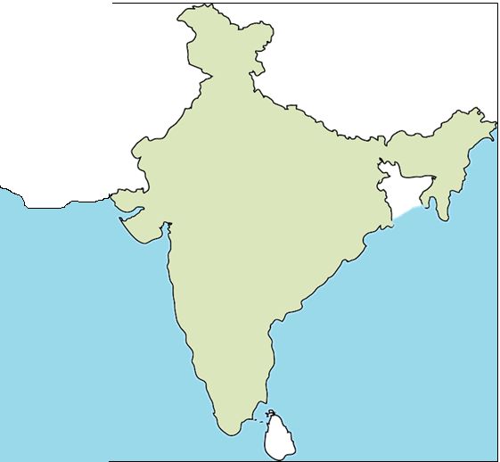
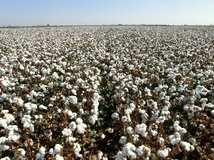
BOMBAY AND COTTON TRADE
Bombay(now Mumbai) was an important port for cotton textiles trade.
The black soil of western India was suitable for growing cotton.
Hence trade was easily possible from Bombay.
The first cotton mill was setup in Bombay
Notes:
Notes for Teacher - < Information for further reference or explanation >
Suggestions: <Ideas/ Images/ Animations / Others – To make better representation of the content > Source of Multimedia Objects (Image/audio/ Video/Animation) used in this slide -
India map: SSSVV gallery; keyword: India map
Cotton field; https://www.peakpx.com/618861/white-cotton-flower-field
Ship: https://openclipart.org/detail/234104/woodcargo-vessel

Slide 3
MILLS COMING UP IN INDIA
The first cotton spinning mill was set up in Bombay
Mills were set up in Kanpur
1854
1861
1862
1900
Mills were set up in Ahmedabad
There were around 84 mills in Bombay run by Gujarati and Parsi traders.
This resulted in demand for labour in the cities.
Notes:
Notes for Teacher - < Information for further reference or explanation >
Suggestions: <Ideas/ Images/ Animations / Others – To make better representation of the content > Source of Multimedia Objects (Image/audio/ Video/Animation) used in this slide -

Slide 4
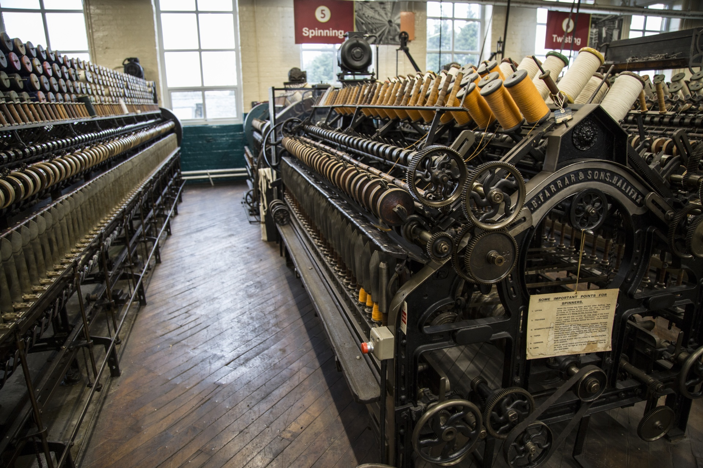
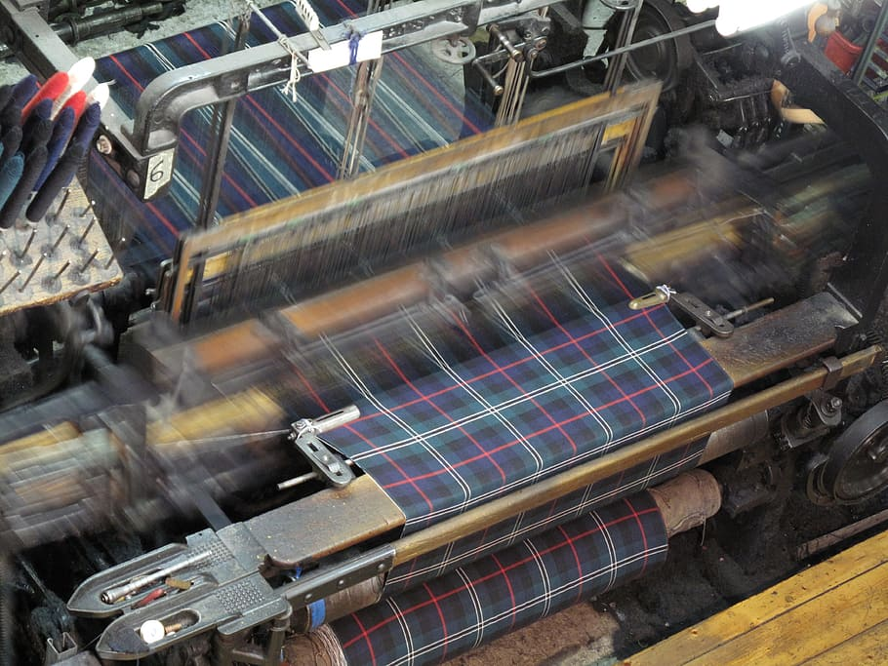
DEMAND FOR LABOUR
IN COTTON MILLS
Handloom spinners and weavers
Shifted from the villages to work in the mills.
Artisans
Labourers
Farmers
Women worked in
Men worked in
SPINNING DEPARTMENT
WEAVING DEPARTMENT
Notes:
Notes for Teacher - < Information for further reference or explanation >
Suggestions: <Ideas/ Images/ Animations / Others – To make better representation of the content > Source of Multimedia Objects (Image/audio/ Video/Animation) used in this slide -
Spinning:https://www.publicdomainpictures.net/en/view-image.php?image=205770&picture=industria-textile
Weaving: https://www.pxfuel.com/en/free-photo-oyyea

Slide 5
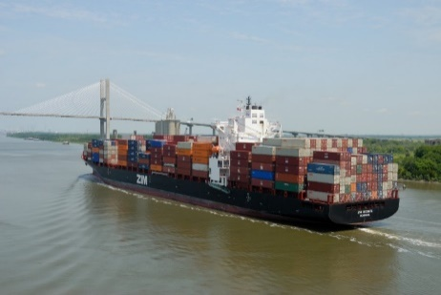
Indian Cotton Mills Had Problems
The cotton mills could not develop during British rule. They faced problems within few decades.
Cheaper imports of cotton cloth from Britain.
TAX
Absence of protection to the local industry under British rule.
Notes:
Notes for Teacher - < Information for further reference or explanation >
Suggestions: <Ideas/ Images/ Animations / Others – To make better representation of the content > Source of Multimedia Objects (Image/audio/ Video/Animation) used in this slide -
Import: https://pxhere.com/en/photo/534507
Stamp: https://pixabay.com/illustrations/stamp-template-red-empty-pattern-814699/

Slide 6
DEVELOPMENT OF COTTON MILLS IN INDIA
Only during the first world war Indian textile industry gained recognition.
The imports from Britain reduced.
Indian mills supplied cloth for the military.
Notes:
Notes for Teacher - < Information for further reference or explanation >
Suggestions: <Ideas/ Images/ Animations / Others – To make better representation of the content > Source of Multimedia Objects (Image/audio/ Video/Animation) used in this slide -

Slide 7
MM Index
Slide# | Thumbnail | Source and Attribution
2 |  | India map: SSSVV gallery; keyword: India map
2 |  | Cotton field; https://www.peakpx.com/618861/white-cotton-flower-field
2 |  | Ship: https://openclipart.org/detail/234104/woodcargo-vessel
4 |  | Spinning:https://www.publicdomainpictures.net/en/view-image.php?image=205770&picture=industria-textile
4 |  | Weaving: https://www.pxfuel.com/en/free-photo-oyyea
5 |  | Import: https://pxhere.com/en/photo/534507
5 |  | Stamp: https://pixabay.com/illustrations/stamp-template-red-empty-pattern-814699/
Notes:
Notes for Teacher - < Information for further reference or explanation >
Suggestions: <Ideas/ Images/ Animations / Others – To make better representation of the content > Source of Multimedia Objects (Image/audio/ Video/Animation) used in this slide -

