Slide 1
Decline Of Traditional Smelting In India
Notes:
Notes for Teacher - < Information for further reference or explanation >
Suggestions: <Ideas/ Images/ Animations / Others – To make better representation of the content > Source of Multimedia Objects (Image/audio/ Video/Animation) used in this slide -
1. <Short Description> - <SOURCE URL>

Slide 2
Smelting Wootz
Smelting was very common in India till 19th century. The raw materials were easily available.
Charcoal from Forest
Iron ore from the nearby lands
Wootz steel
Notes:
Notes for Teacher - < Information for further reference or explanation >
Suggestions: <Ideas/ Images/ Animations / Others – To make better representation of the content > Source of Multimedia Objects (Image/audio/ Video/Animation) used in this slide -
Trees: https://openclipart.org/detail/228975/trees
Animation created using shapes: Anuradha Ramkumar; ramji.anu@gmail.com

Slide 3
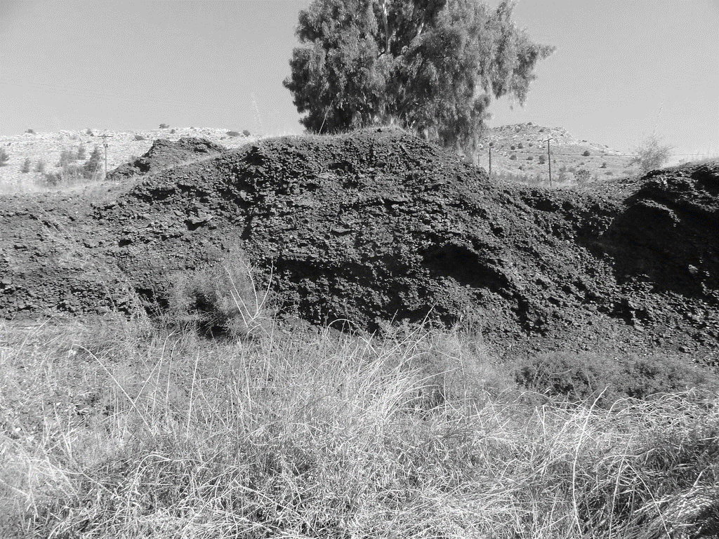
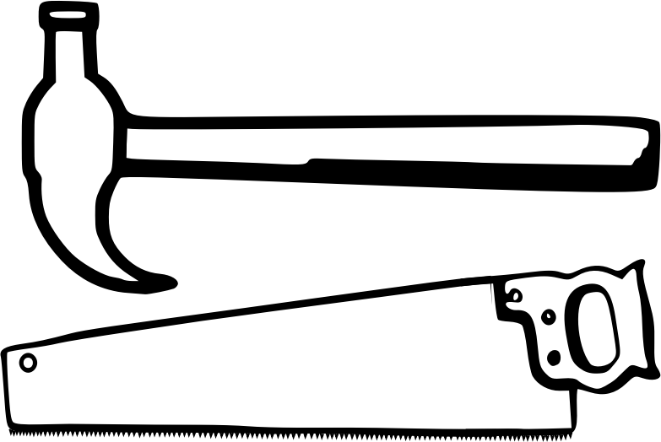
Smelting – Common Occupation For Many Centuries Before British Rule
The geological survey of India found large deposits of slag heaps in central, west and south India
These were many centuries old and proves that smelting was an ancient occupation in India.
The iron and steel were widely used to make implements and armoury.
Notes:
Notes for Teacher - < Information for further reference or explanation >
Suggestions: <Ideas/ Images/ Animations / Others – To make better representation of the content > Source of Multimedia Objects (Image/audio/ Video/Animation) used in this slide -
https://www.flickr.com/photos/37309275@N00/22721747939 (Attribution- Michael Homan)
Armour: https://openclipart.org/detail/306030/various-arms
Hammer: https://openclipart.org/detail/183613/hammer-and-saw

Slide 4
Problems In Traditional Smelting
A Smelter is a person who works in a smelting unit or the owner of the unit.
By the late nineteenth century, the smelters had to face many problems in the British rule.
Problems of the local smelters
Need for wootz reduced
New forest laws
Huge Taxes
Imports from Britain
Notes:
Notes for Teacher – The teacher can explain each point of the problems of the local smelters referring to the asset doc.
Suggestions: <Ideas/ Images/ Animations / Others – To make better representation of the content > Source of Multimedia Objects (Image/audio/ Video/Animation) used in this slide -

Slide 5
Traditional Smelters Abandoned Their Furnaces
Thus smelting which was once the most common occupation for many centuries declined.
Many smelters abandoned their furnaces and left their places in search of new jobs.
Notes:
Notes for Teacher - < Information for further reference or explanation >
Suggestions: <Ideas/ Images/ Animations / Others – To make better representation of the content > Source of Multimedia Objects (Image/audio/ Video/Animation) used in this slide -

Slide 6
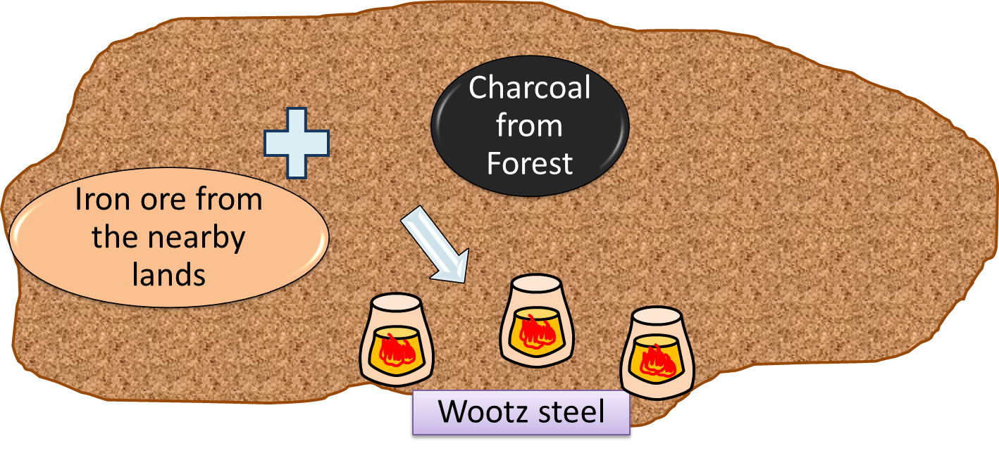
MM Index
Slide# | Thumbnail | Source and Attribution
3 |  | https://www.flickr.com/photos/37309275@N00/22721747939 (Attribution- Michael Homan)
5 |  | Created using shapes: Anuradha Ramkumar ;ramji.anu@gmail.com
2 |  | Trees: https://openclipart.org/detail/228975/trees
2 |  | Created using shapes: Anuradha Ramkumar ;ramji.anu@gmail.com
3 |  | Hammer: https://openclipart.org/detail/183613/hammer-and-saw
3 |  | Armour: https://openclipart.org/detail/306030/various-arms

