Slide 1
Influential India
Notes:
Notes for Teacher - < Information for further reference or explanation >
Suggestions: <Ideas/ Images/ Animations / Others – To make better representation of the content >
Source of Multimedia Objects (Image/audio/ Video/Animation) used in this slide -
1. <Short Description> - <SOURCE URL>

Slide 2
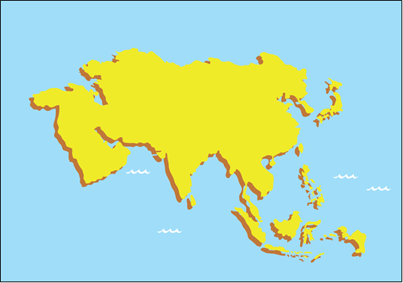
Indian Textiles
ASIA
NW
W - WEST
C
W
NW- NORTH WEST
C - CENTRAL
E
SE
E - EAST
SE – SOUTH EAST
India had rich trade with west, central and southeast Asian nations during 16th and 17th Centuries.
Notes:
Notes for Teacher - < Information for further reference or explanation >
Suggestions: <Ideas/ Images/ Animations / Others – To make better representation of the content > Source of Multimedia Objects (Image/audio/ Video/Animation) used in this slide -
Asia Map: SSSVV gallery key word: Asia

Slide 3
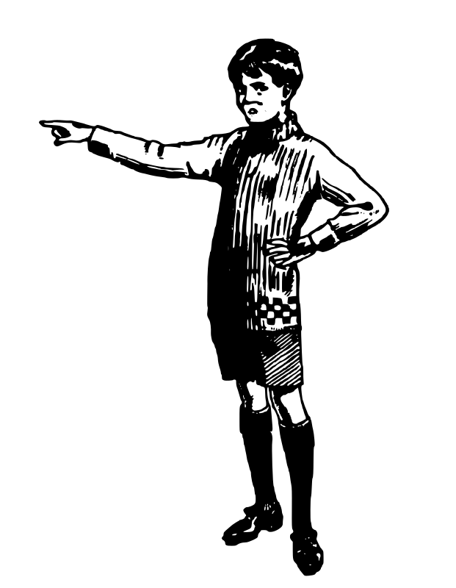
Indian Textiles during the 17th century
1Yard = 3 feet
It took two years to receive the finished goods after placing orders.
Each ‘piece good’ measured 20 yards long and 1 yard wide.
The East India Company ordered these as ‘piece goods’.
India exported 98 varieties of cotton and silk clothes
Notes:
Notes for Teacher - < Information for further reference or explanation >
Suggestions: <Ideas/ Images/ Animations / Others – To make better representation of the content > Source of Multimedia Objects (Image/audio/ Video/Animation) used in this slide –
https://openclipart.org/detail/319720/little-boy-points

Slide 4
Wide Range in Indian Textiles
Paithani
Palampore
Pashmina
Plain
Printed
Checks
Cotton
Indian
Fabrics
Muslin
Patola
Stripes
Silk
Painted
Wool
Bandhana
Chintz
Jamdani
Notes:
Notes for Teacher - < Information for further reference or explanation >
Suggestions: <Ideas/ Images/ Animations / Others – To make better representation of the content > Source of Multimedia Objects (Image/audio/ Video/Animation) used in this slide -

Slide 5
Indian Craftsmanship in Textiles
Advanced colour-fast dyeing techniques
Indian craftsmen were the most sought after in textile industry.
Artistically hand-painted, Embroidered, block-painted
Exquisite designs
Unique colour combinations.
Notes:
Notes for Teacher - < Information for further reference or explanation >
Suggestions: <Ideas/ Images/ Animations / Others – To make better representation of the content >
Source of Multimedia Objects (Image/audio/ Video/Animation) used in this slide -

Slide 6
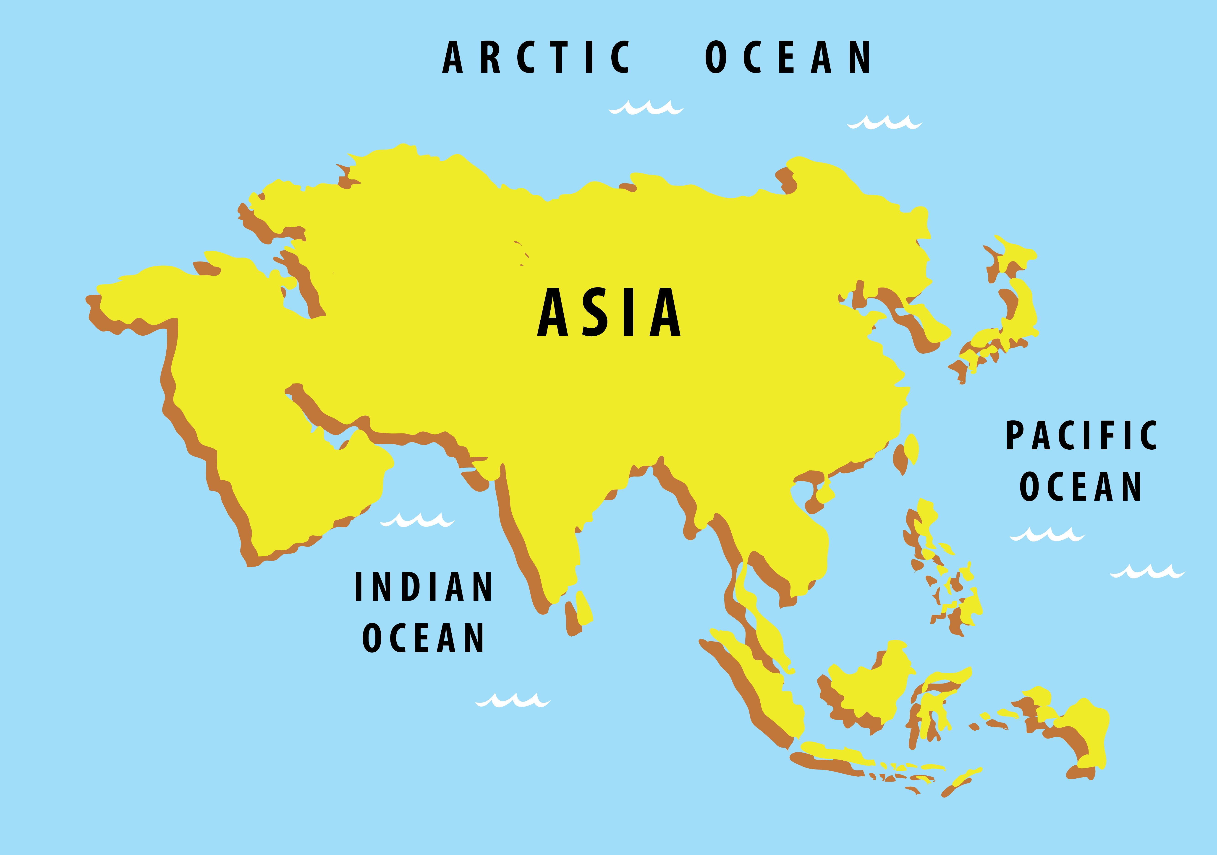
MM Index
Slide# | Thumbnail | Source and Attribution
2 |  | Asia Map: SSSVV gallery key word: Asia
3 |  | https://openclipart.org/detail/319720/little-boy-points
Notes:
Notes for Teacher - < Information for further reference or explanation >
Suggestions: <Ideas/ Images/ Animations / Others – To make better representation of the content >
Source of Multimedia Objects (Image/audio/ Video/Animation) used in this slide -

