Slide 1
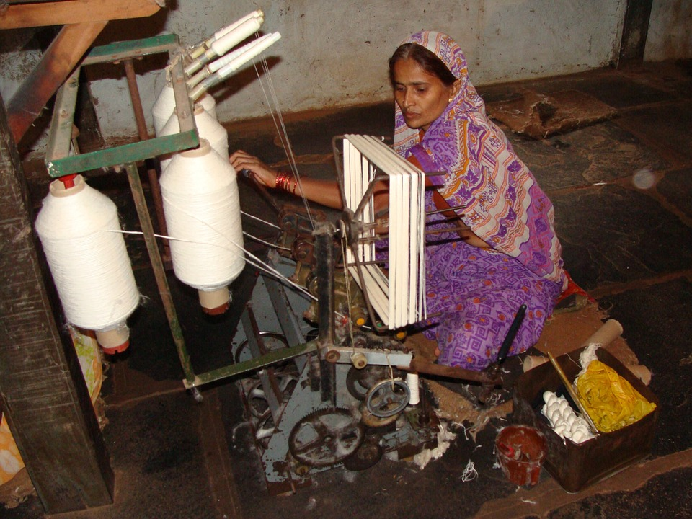
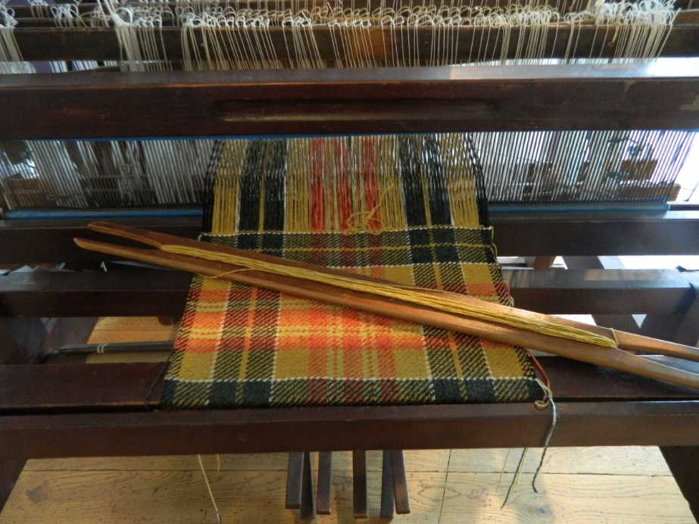
Spinning and Weaving
Notes:
Notes for Teacher - < Information for further reference or explanation >
Suggestions: <Ideas/ Images/ Animations / Others – To make better representation of the content > Source of Multimedia Objects (Image/audio/ Video/Animation) used in this slide -
https://pixabay.com/photos/khadi-coarse-cloth-garag-india-233580/
https://pxhere.com/ko/photo/1381700

Slide 2
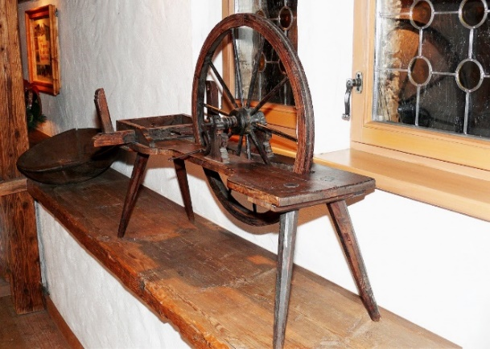
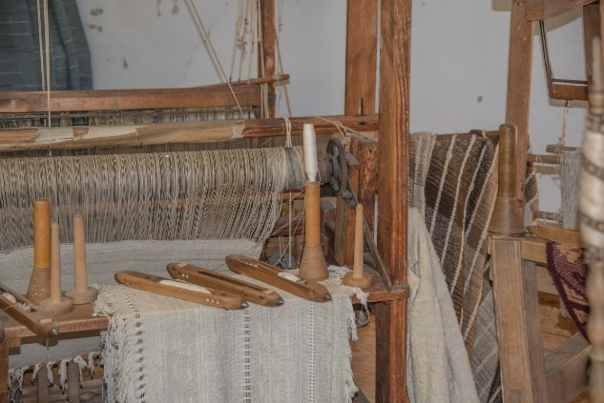
Fabric Making
Spinning
Process of producing threads from cotton
Process of interlacing threads vertically and horizontally at the right angles to produce fabric.
Weaving
Some weavers community include Julahas or Momins of north India, the Tantis of Bengal, and Sale, Devangs and Kaikollars of south India.
Notes:
Notes for Teacher - < Information for further reference or explanation >
Suggestions: <Ideas/ Images/ Animations / Others – To make better representation of the content > Source of Multimedia Objects (Image/audio/ Video/Animation) used in this slide -
Spinning: https://pxhere.com/en/photo/1293965
Weaving: https://pxhere.com/en/photo/768810

Slide 3
Spinning
The thread is spun on the charkha.
The thread is rolled on the takli.
Notes:
Notes for Teacher - < Information for further reference or explanation >
Suggestions: <Ideas/ Images/ Animations / Others – To make better representation of the content > Source of Multimedia Objects (Image/audio/ Video/Animation) used in this slide -
https://pixabay.com/photos/khadi-coarse-cloth-garag-india-233560/
https://pixabay.com/photos/loom-weaving-thread-craft-pattern-4564228/
https://pxhere.com/en/photo/1116407

Slide 4
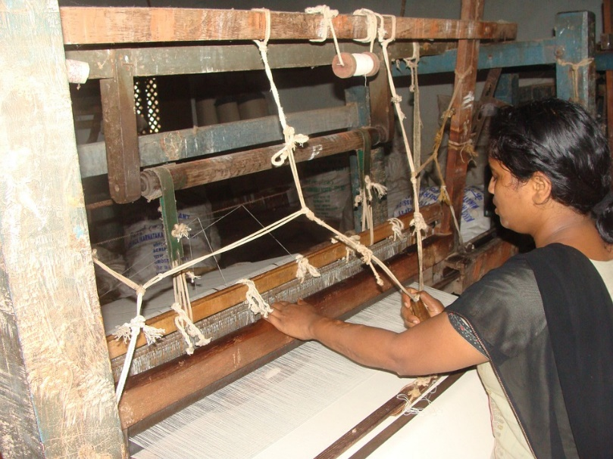
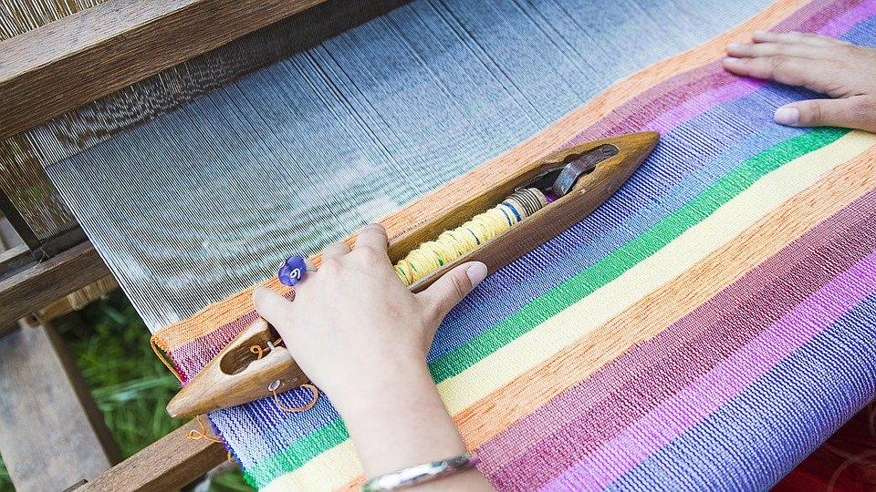
Weaving
By changing the way of weaving threads various fabric appearances are created.
Notes:
Notes for Teacher - < Information for further reference or explanation >
Suggestions: <Ideas/ Images/ Animations / Others – To make better representation of the content > Source of Multimedia Objects (Image/audio/ Video/Animation) used in this slide -
https://pixabay.com/photos/cotton-spinning-khadi-coarse-cloth-233561/
https://pixabay.com/photos/weaving-loom-weaving-traditional-2571179/

Slide 5
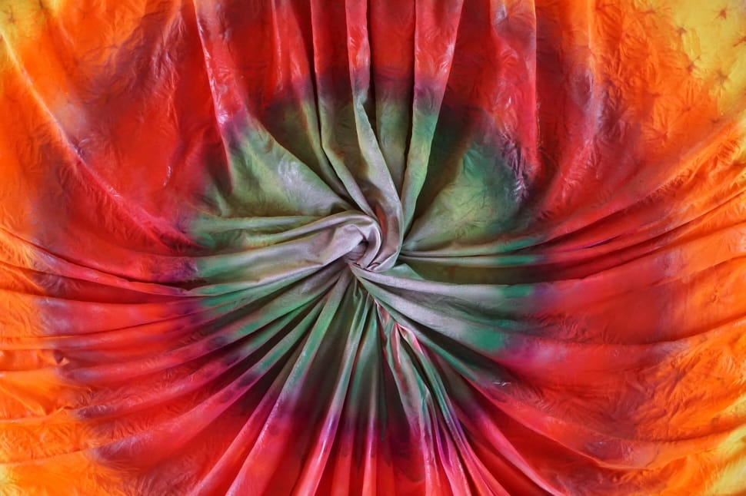
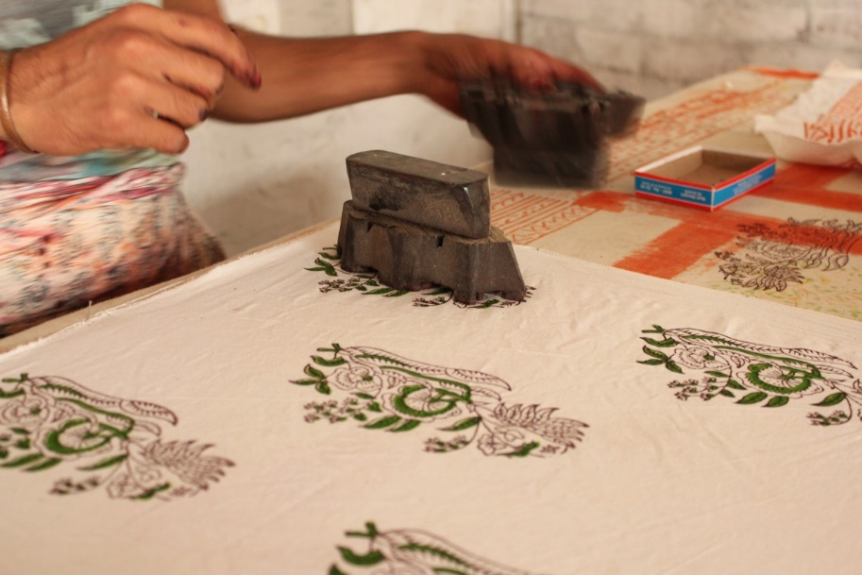
Dyeing and Printing
The process of weaving is followed by dyeing or printing.
Dyeing
Block Printing
Notes:
Notes for Teacher - < Information for further reference or explanation >
Suggestions: <Ideas/ Images/ Animations / Others – To make better representation of the content > Source of Multimedia Objects (Image/audio/ Video/Animation) used in this slide -
https://www.peakpx.com/483078/teal-red-orange-yellow-textile
https://pxhere.com/en/photo/934726

Slide 6
MM Index
Slide# | Thumbnail | Source and Attribution
1 |  | https://pixabay.com/photos/khadi-coarse-cloth-garag-india-233580/
1 |  | https://pxhere.com/ko/photo/1381700
2 |  | Weaving: https://pxhere.com/en/photo/768810
2 |  | Spinning: https://pxhere.com/en/photo/1293965
3 |  | Charkha: https://pixabay.com/photos/khadi-coarse-cloth-garag-india-233560/
3 |  | Charkha 2: https://pixabay.com/photos/loom-weaving-thread-craft-pattern-4564228/
3 |  | Takli: https://pxhere.com/en/photo/1116407
4 |  | Weaving: https://pixabay.com/photos/cotton-spinning-khadi-coarse-cloth-233561/
4 |  | Loom: https://pixabay.com/photos/weaving-loom-weaving-traditional-2571179/
5 |  | Dyeing: https://pxhere.com/en/photo/934726
5 |  | Printing: https://www.peakpx.com/483078/teal-red-orange-yellow-textile
Notes:
Notes for Teacher - < Information for further reference or explanation >
Suggestions: <Ideas/ Images/ Animations / Others – To make better representation of the content > Source of Multimedia Objects (Image/audio/ Video/Animation) used in this slide -

