Slide 1
The Handloom Weaving Loses Its Importance
Notes:
Notes for Teacher - < Information for further reference or explanation >
Suggestions: <Ideas/ Images/ Animations / Others – To make better representation of the content > Source of Multimedia Objects (Image/audio/ Video/Animation) used in this slide -

Slide 2
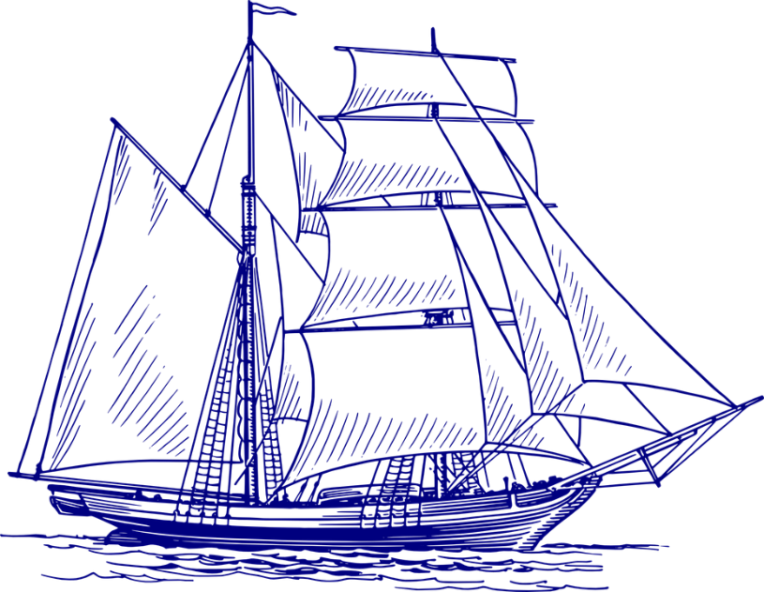
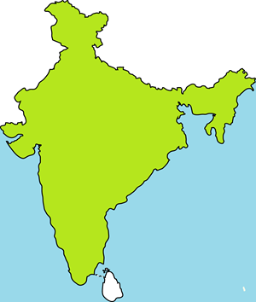
British dominating in Indian Textiles
Industrialization in Britain had effects on Indian textile production
Their machine made cloth was produced on large scale in less time and was cheap.
Britain sold their cloth in Indian markets in 1830s
This adversely affected Indian handloom textile production in 19th Century
Notes:
Notes for Teacher - < Information for further reference or explanation >
Suggestions: <Ideas/ Images/ Animations / Others – To make better representation of the content > Source of Multimedia Objects (Image/audio/ Video/Animation) used in this slide -
https://pixabay.com/vectors/sailing-ship-ship-sailing-vessel-312417/
https://pixabay.com/vectors/currency-dollar-euro-exchange-rate-3727015/
https://pixabay.com/vectors/building-map-storage-game-playing-48716/
Load: Created using shapes

Slide 3
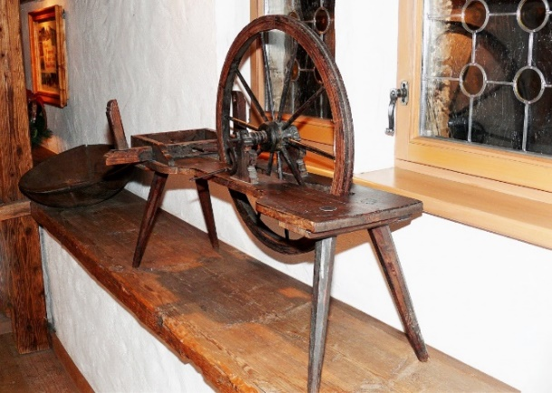
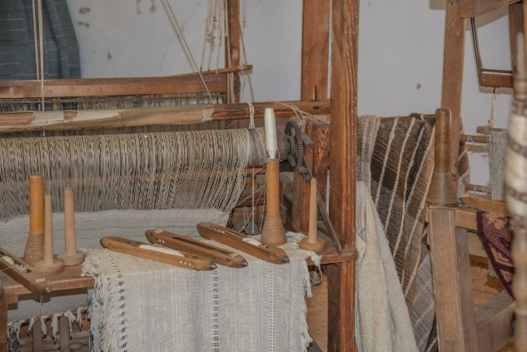
Indian Textiles Production Affected
The Indian weaving industry had to compete with British textiles in the local and world markets
Heavy duties were imposed on Indian textiles in England. This made exporting difficult.
The British textiles gradually suppressed the Indian textiles production.
Notes:
Notes for Teacher - < Information for further reference or explanation >
Suggestions: <Ideas/ Images/ Animations / Others – To make better representation of the content > Source of Multimedia Objects (Image/audio/ Video/Animation) used in this slide -
Spinning: https://pxhere.com/en/photo/1293965
Weaving: https://pxhere.com/en/photo/768810

Slide 4
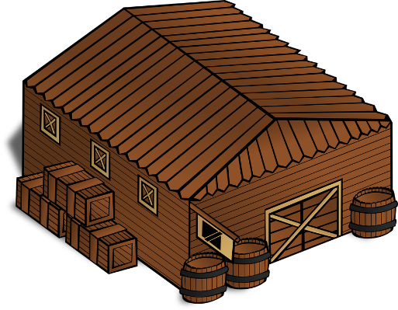
British dominating in Indian Textiles
The British abolished the use of AURANGS
AURANG means ‘warehouse’ in Persian
Workshop to collect and sell goods
The European agents stopped their orders
NO ORDERS
NO ADVANCE
By 1880s two-thirds of all cotton cloths worn by Indians were from Britain. The traditional spinning and weaving lost importance.
NO WEAVING
Notes:
Notes for Teacher - < Information for further reference or explanation >
Suggestions: <Ideas/ Images/ Animations / Others – To make better representation of the content > Source of Multimedia Objects (Image/audio/ Video/Animation) used in this slide -
https://pixabay.com/vectors/sailing-ship-ship-sailing-vessel-312417/
https://pixabay.com/vectors/currency-dollar-euro-exchange-rate-3727015/
https://pixabay.com/vectors/building-map-storage-game-playing-48716/
Load: Created using shapes

Slide 5
Plight Of Spinners And Weavers
British dominated Indian cotton textiles
Spinners
and weavers were forced to starve.
Indian weavers lost jobs.
Many spinners and weavers especially from Bengal lost their livelihoods.
Notes:
Notes for Teacher - < Information for further reference or explanation >
Suggestions: <Ideas/ Images/ Animations / Others – To make better representation of the content > Source of Multimedia Objects (Image/audio/ Video/Animation) used in this slide -

Slide 6
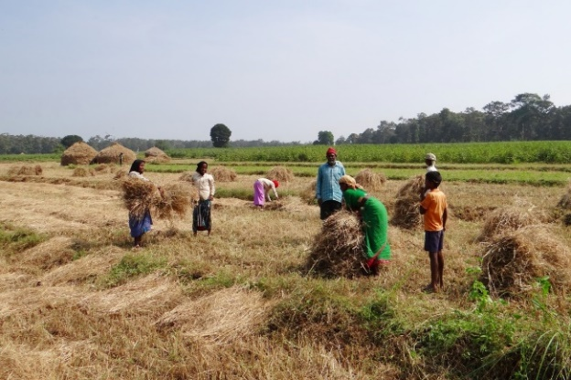
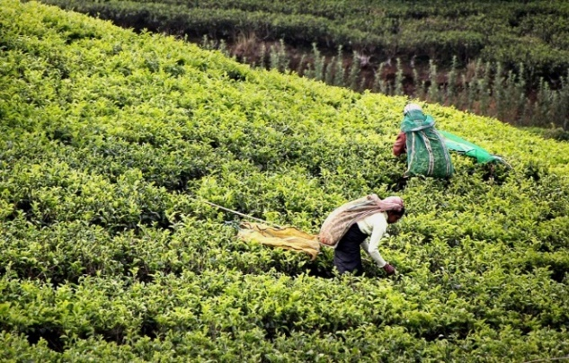
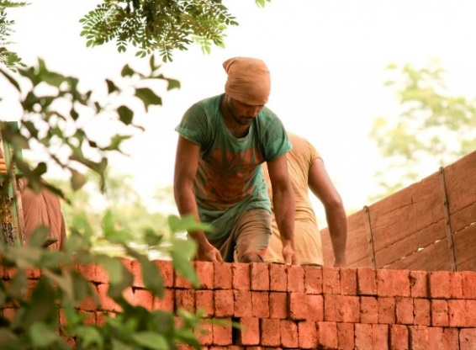
Plight Of Spinners And Weavers
Many spinners and weavers changed their occupations.
agricultural labourers
plantation workers
migrant labourers
Notes:
Notes for Teacher - < Information for further reference or explanation >
Suggestions: <Ideas/ Images/ Animations / Others – To make better representation of the content > Source of Multimedia Objects (Image/audio/ Video/Animation) used in this slide -
https://pxhere.com/ja/photo/1114339
https://pxhere.com/en/photo/1121730
https://pixabay.com/photos/tea-harvest-tee-tea-plantation-2132767/
Weaving: https://www.pxfuel.com/en/free-photo-oyyea

Slide 7
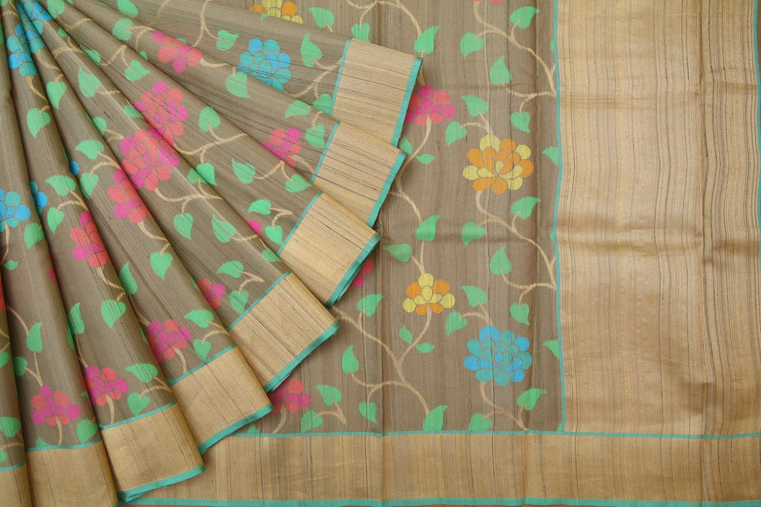
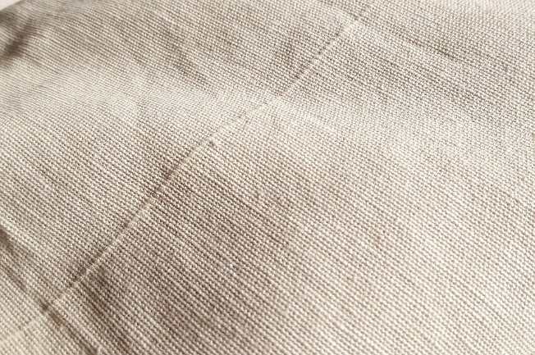
Handloom Weaving Survived
Many people still liked Indian handloom fabrics.
Among rich and middle class people:
Cloth with traditional designs or saris with intricate borders used by them could not be made by machines.
Among poor people:
Coarse cloth used by them were not produced by machines.
New weaving centres emerged at places like Sholapur and Madurai in the late 19th century.
Notes:
Notes for Teacher - < Information for further reference or explanation >
Suggestions: <Ideas/ Images/ Animations / Others – To make better representation of the content > Source of Multimedia Objects (Image/audio/ Video/Animation) used in this slide -
Sari: https://www.pexels.com/photo/online-sarees-online-womens-wear-online-saris-online-party-wear-1426874/
Khadi: https://pixabay.com/photos/woven-fabric-texture-cloth-fiber-2607340/

Slide 8
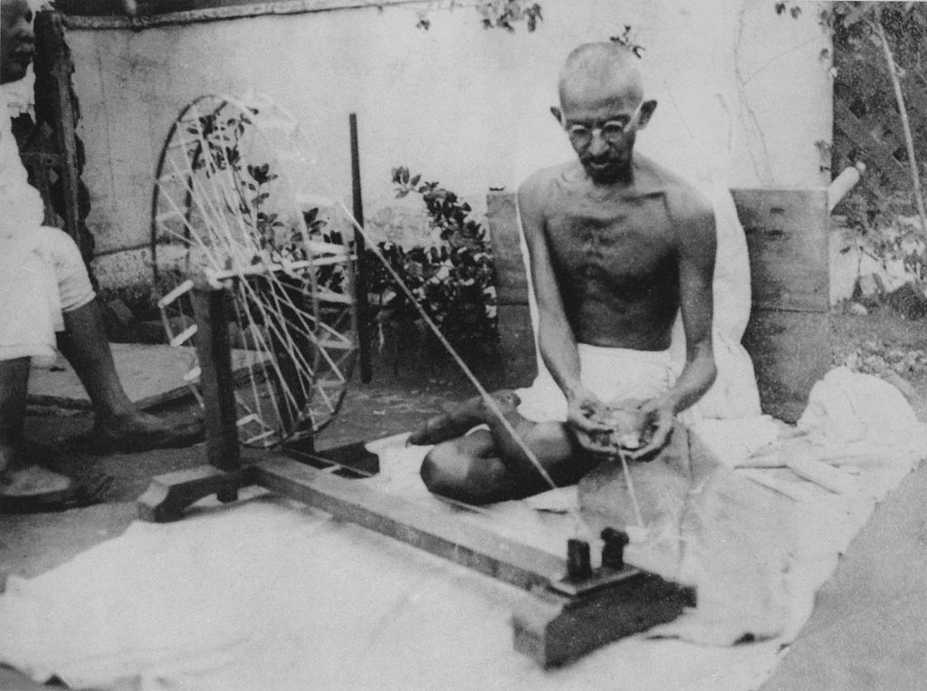
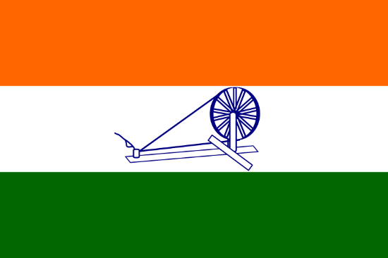
Khadi and National Movement
Efforts to revive the handloom weaving played an important role in the early 20th century during the freedom struggle.
Mahatma Gandhi encouraged
boycott of imported textiles.
use of locally produced cloth, Khadi.
In 1931 Indian National Congress adopted the symbol of charkha in the tricolour flag.
Notes:
Notes for Teacher - < Information for further reference or explanation >
Suggestions: <Ideas/ Images/ Animations / Others – To make better representation of the content > Source of Multimedia Objects (Image/audio/ Video/Animation) used in this slide -
Mahatma: https://commons.wikimedia.org/wiki/File:Gandhi_spinning.jpg#/media/File:Gandhi_spinning.jpg; Public Domain: Unknown author - gandhiserve.org
Flag: https://commons.wikimedia.org/wiki/File:1931_Flag_of_India.svg; Public Domain: Author: Nicholas (Nichalp)

Slide 9
MM Index
Slide# | Thumbnail | Source and Attribution
2 |  | https://pixabay.com/vectors/sailing-ship-ship-sailing-vessel-312417/
2 |  | https://pixabay.com/vectors/currency-dollar-euro-exchange-rate-3727015/
4 |  | https://pixabay.com/vectors/building-map-storage-game-playing-48716/
2 |  | Load: Created using shapes
7 |  | Sari: https://www.pexels.com/photo/online-sarees-online-womens-wear-online-saris-online-party-wear-1426874/
7 |  | Khadi: https://pixabay.com/photos/woven-fabric-texture-cloth-fiber-2607340/
8 |  | Mahatma: https://commons.wikimedia.org/wiki/File:Gandhi_spinning.jpg#/media/File:Gandhi_spinning.jpg; Public Domain: Unknown author - gandhiserve.org
8 |  | Flag: https://commons.wikimedia.org/wiki/File:1931_Flag_of_India.svg; Public Domain: Author: Nicholas (Nichalp)
6 |  | https://pxhere.com/ja/photo/1114339
2 |  | India map:SSSVV Gallery; keyword: India map
6 |  | https://pixabay.com/photos/tea-harvest-tee-tea-plantation-2132767/
6 |  | https://pxhere.com/en/photo/1121730
3 |  | Spinning: https://pxhere.com/en/photo/1293965
3 |  | Weaving: https://pxhere.com/en/photo/768810
Notes:
Notes for Teacher - < Information for further reference or explanation >
Suggestions: <Ideas/ Images/ Animations / Others – To make better representation of the content > Source of Multimedia Objects (Image/audio/ Video/Animation) used in this slide -

