Slide 1
WHAT IS WOOTZ
Notes:
Notes for Teacher - < Information for further reference or explanation >
Suggestions: <Ideas/ Images/ Animations / Others – To make better representation of the content > Source of Multimedia Objects (Image/audio/ Video/Animation) used in this slide -
1. <Short Description> - <SOURCE URL>

Slide 2
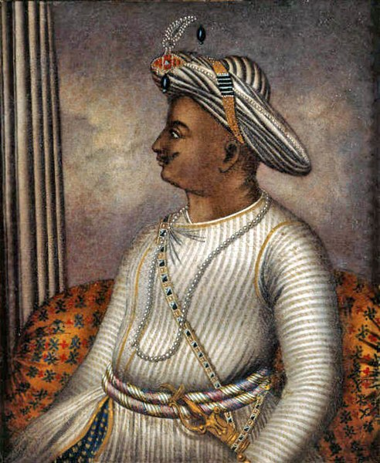
Tipu Sultan and Wootz
Tipu Sultan,the ‘Tiger of Mysore’ ruled the Mysore Kingdom from 1782 to 1799.
He fought four wars with the British and died fighting with his sword in the hand.
Notes:
Notes for Teacher - < Information for further reference or explanation >
Suggestions: <Ideas/ Images/ Animations / Others – To make better representation of the content > Source of Multimedia Objects (Image/audio/ Video/Animation) used in this slide -
https://commons.wikimedia.org/wiki/File:Tipu_Sultan_BL.jpg

Slide 3
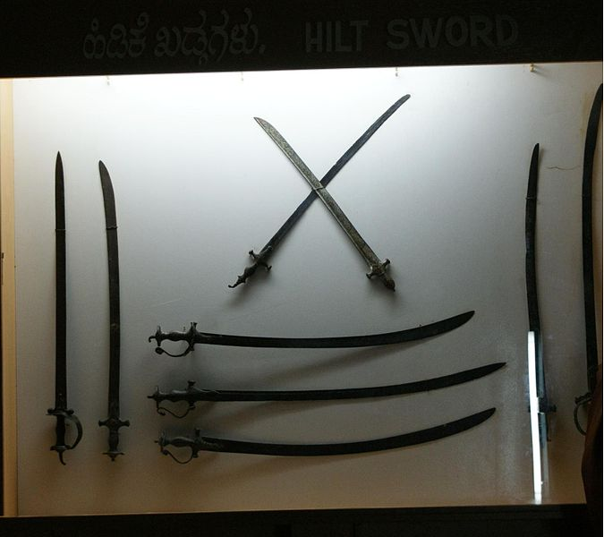
Tipu’s swords made from Wootz steel
Tipu Sultan’s swords were hard and sharp with flowing water patterns.
Tipu’s swords displayed in England museums.
Notes:
Notes for Teacher - < Information for further reference or explanation >
Suggestions: <Ideas/ Images/ Animations / Others – To make better representation of the content > Source of Multimedia Objects (Image/audio/ Video/Animation) used in this slide -
https://commons.wikimedia.org/wiki/File:Tippu_Swords_in_summer_palace.JPG

Slide 4
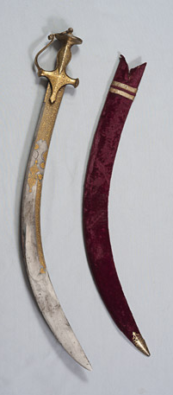
Tipu’s swords made from Wootz steel
had gold on the steel handle
had the tiger head at the bottom of the handle.
had engraved messages on his war victories.
had quotations from the Koran
Notes:
Notes for Teacher - < Information for further reference or explanation >
Suggestions: <Ideas/ Images/ Animations / Others – To make better representation of the content > Source of Multimedia Objects (Image/audio/ Video/Animation) used in this slide - https://commons.wikimedia.org/wiki/File:Inscribed_Sword_of_Tipu_Sultan.jpg
This file is a copyrighted work of the Government of India, licensed under the Government Open Data License - India (GODL).
F

Slide 5
Wootz steel made in India
Wootz steel is produced by the process of smelting.
Carbon crystals
Wootz Steel Ingots
Iron chunks
Smelting small carbon crystals with iron gave the characteristic water flowing pattern to the steel sword.
Notes:
Notes for Teacher - < Information for further reference or explanation >
Suggestions: <Ideas/ Images/ Animations / Others – To make better representation of the content > Source of Multimedia Objects (Image/audio/ Video/Animation) used in this slide -
https://openclipart.org/detail/36883/sword
Iron ore, coal, furnace, steel block created using shapes:

Slide 6
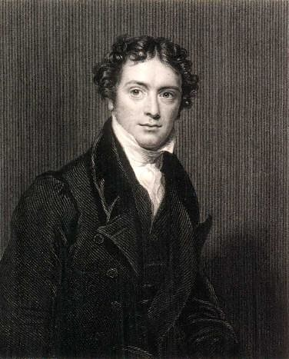
Famous Wootz
Francis Buchanan, a famous surveyor, travelled around Mysore in 1800 and recorded the process of making swords from wootz steel.
Hukku
in Telugu
The wootz steel was exported from India to many European countries for making armoury.
Ukku in
kannada
Wootz
Urukku
in Tamil
Urukku in
Malayalam
Michael Faraday, famous English scientist researched Indian wootz for 4 years (1818-22).
Notes:
Notes for Teacher - < Information for further reference or explanation >
Suggestions: <Ideas/ Images/ Animations / Others – To make better representation of the content > Source of Multimedia Objects (Image/audio/ Video/Animation) used in this slide -
- https://www.flickr.com/photos/29528454@N04/4108204909 (Attribution- ROBERT HUFFSTUTTER)

Slide 7
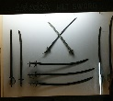
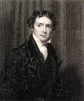
MM Index
Slide# | Thumbnail | Source and Attribution
2 |  | https://commons.wikimedia.org/wiki/File:Tipu_Sultan_BL.jpg
3 |  | https://commons.wikimedia.org/wiki/File:Tippu_Swords_in_summer_palace.JPG
5 |  | Created using Shapes: Anuradha Ramkumar; ramji.anu@gmail.com
5 |  | https://openclipart.org/detail/36883/sword
6 |  | https://www.flickr.com/photos/29528454@N04/4108204909 (Attribution- ROBERT HUFFSTUTTER)
4 |  | https://commons.wikimedia.org/wiki/File:Inscribed_Sword_of_Tipu_Sultan.jpg This file is a copyrighted work of the Government of India, licensed under the Government Open Data License - India (GODL).
Notes:
Notes for Teacher - < Information for further reference or explanation >
Suggestions: <Ideas/ Images/ Animations / Others – To make better representation of the content > Source of Multimedia Objects (Image/audio/ Video/Animation) used in this slide -

