Slide 1
WEAVERS,IRON SMELTERS AND FACTORY OWNERS
-RECAP
Notes:
Notes for Teacher - < 15 minutes>
Objective: The students will be able to assess their learning on the chapter
Suggestions: <Ideas/ Images/ Animations / Others – To make better representation of the content > Source of Multimedia Objects (Image/audio/ Video/Animation) used in this slide -
https://openclipart.org/detail/236432/black-chalkboard

Slide 2
I. Choose the correct answer
1. _______ on the west coast was an important port for trade in India during the early 17th century.
Bombay
Ans
A) Bombay B) Chennai C) Kolkata
2. The Agarias were traditional iron smelters from_____________.
Central India
A) South India B) East India C) Central India
Ans
Britain
3. In 18th century ________ came to be known as
‘Workshop of the World’.
A) France B) Britain C) Portugal
Ans
Click on the Ans icon for answer
Notes:
Notes for Teacher – The teacher can discuss parts I to VII in the class. PPT can be used to display the questions. Sufficient time can be given for every question. The teacher can ensure that all students participate.
Click on the Ans icon for answer
Suggestions: N/A Source of Multimedia Objects (Image/audio/ Video/Animation) used in this slide - N/A

Slide 3
I. Choose the correct answer
India
4. Before the 18th century ______was the largest producer of cotton textiles in the world.
Ans
A) India B) Britain C) China
Wootz steel
5. Tipu’s sword was made of___________.
A) Pure Gold B)Wootz steel C) Copper
Ans
Click on the Ans icon for answer
Notes:
Notes for Teacher – The teacher can discuss parts I to VII of the asset doc in the class. PPT can be used to display the questions. Sufficient time can be given for every question. The teacher can ensure that all students participate.
Click on the Ans icon for answer
Suggestions: N/A
Source of Multimedia Objects (Image/audio/ Video/Animation) used in this slide - N/A

Slide 4
II. TRUE OR FALSE
a. Indian Swaraj Party adopted the symbol of charkha on our national flag in 1931.
False
Indian National Congress adopted the symbol of charkha on our national our national flag in 1931
b. TISCO came up in the city of Jamshedpur.
True
c. Spinning jenny was invented by Richard Arkwright in 1764.
False
Spinning jenny was invented by John Kaye in 1764.
Click on the question for answer
Notes:
Notes for Teacher – Click on the question for answer
Suggestions: <Ideas/ Images/ Animations / Others – To make better representation of the content > Source of Multimedia Objects (Image/audio/ Video/Animation) used in this slide -

Slide 5
II. TRUE OR FALSE
d. Industrialization in India was rapid during the British rule.
False
Industrialization in India was not rapid during the British rule.
e. The smelting furnaces were built with clay and sun-dried bricks.
True
Click on the question for answer
Notes:
Notes for Teacher – Click on the question for answer
Suggestions: <Ideas/ Images/ Animations / Others – To make better representation of the content > Source of Multimedia Objects (Image/audio/ Video/Animation) used in this slide -

Slide 6
III. GIVE ONE TERM
1. The specialist traditional block printers-
2. Means warehouse in Persian-
3. Also called as ‘Ukku’ in Kannada-
4. Traditional cloth dyers-
5. An equipment used to pump air into the smelting furnaces-
→ Answer: Chhipigars
→ Answer: Aurang
→ Answer: Wootz steel
Answer: Rangrez
→ Answer: Bellow
Notes:
Notes for Teacher – Use ‘onclick’ to display each question and corresponding answer.
Suggestions: <Ideas/ Images/ Animations / Others – To make better representation of the content > Source of Multimedia Objects (Image/audio/ Video/Animation) used in this slide -

Slide 7
IV. MATCH THE FOLLOWING
Type of fabric | Characteristics
1. Chintz
A) Mosul, Iraq
2. Jamdani
B) Cotton with small floral prints
3. Muslin
C) Tie and Dye
4. Bandhana
D) Gold embroidery on fine muslin
E) Printed wool
Notes:
Notes for Teacher – Give the students chances in rotation to respond before revealing the answer by “on click”.
Suggestions: <Ideas/ Images/ Animations / Others – To make better representation of the content > Source of Multimedia Objects (Image/audio/ Video/Animation) used in this slide -

Slide 8
V. Mention the year for the following events
Events | Year
British enacted Calico act
1720
First cotton mill set up in Bombay
1854
Tata Iron and Steel Company began producing steel
1912
First world war
1914
Notes:
Notes for Teacher – Give the students chances in rotation to respond before revealing the answer by “on click”.
Suggestions: <Ideas/ Images/ Animations / Others – To make better representation of the content > Source of Multimedia Objects (Image/audio/ Video/Animation) used in this slide -

Slide 9
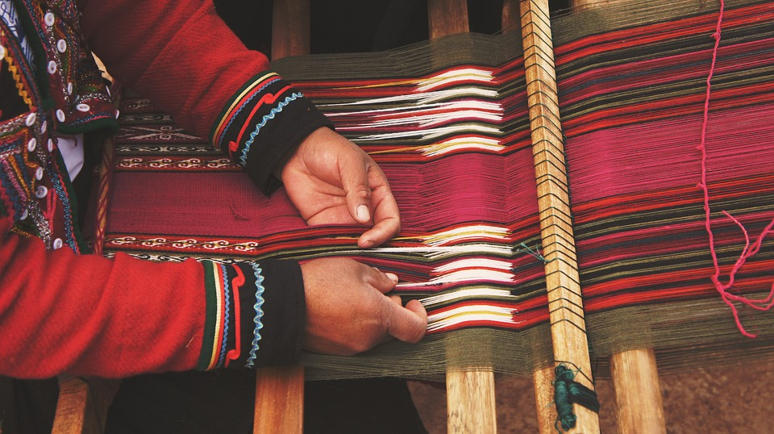
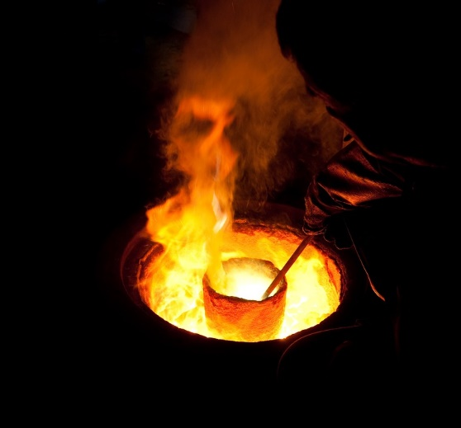
VI. Give Two Reasons
1. Traditional weaving and smelting in India declined during the British rule.
Britain began promoting their goods in India.
The lack of protection for traditional weaving and smelting by the British government.
Notes:
Notes for Teacher – Give the students chances in rotation to respond before revealing the answer by “on click”.
Suggestions: <Ideas/ Images/ Animations / Others – To make better representation of the content > Source of Multimedia Objects (Image/audio/ Video/Animation) used in this slide -
https://pixabay.com/photos/craftsman-loom-craftsmanship-hands-1839920/
https://pixabay.com/photos/molten-metal-crucible-melting-571823/

Slide 10
VI. Give Two Reasons
2. Textiles and steel industries in India developed during the first world war.
The imports of textiles and steel from Britain declined.
Indian industries were given orders to produce supplies for first world war.
Notes:
Notes for Teacher – Give the students chances in rotation to respond before revealing the answer by “on click”.
Suggestions: <Ideas/ Images/ Animations / Others – To make better representation of the content > Source of Multimedia Objects (Image/audio/ Video/Animation) used in this slide -

Slide 11
VI. Give Two Reasons
3. Handloom weaving did not completely vanish in India.
Some fabrics with traditional designs and intricate borders could not be produced by machines. These fabrics had a demand among both rich and middle class people.
Textile manufacturers in Britain did not produce the coarse cloth used by the poor people in India.
Notes:
Notes for Teacher – Give the students chances in rotation to respond before revealing the answer by “on click”.
Suggestions: <Ideas/ Images/ Animations / Others – To make better representation of the content > Source of Multimedia Objects (Image/audio/ Video/Animation) used in this slide -

Slide 12
VII. Think And Answer
1. What would you do if you were a traditional weaver/iron smelter during the 19th century suffering from the decline of traditional occupations?
I would have changed my occupation.
I would have left the country for better prospects.
I would have protested against the British rule.
Notes:
Notes for Teacher – Give the students chances in rotation to respond before revealing the answer by “on click”.
Suggestions: <Ideas/ Images/ Animations / Others – To make better representation of the content > Source of Multimedia Objects (Image/audio/ Video/Animation) used in this slide -

Slide 13
VII. Think And Answer
2. How different might the industrial development in India be if there was no British rule?
India might have continued to be the world's largest textile producers in the world.
India might have experienced a speedy industrialization.
India might have become a richer country during the early industrialization.
Industrialization might have also led to unemployment.
Notes:
Notes for Teacher – Give the students chances in rotation to respond before revealing the answer by “on click”.
Suggestions: <Ideas/ Images/ Animations / Others – To make better representation of the content > Source of Multimedia Objects (Image/audio/ Video/Animation) used in this slide -

Slide 14
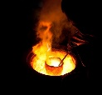
MM Index
Slide# | Thumbnail | Source and Attribution
1 |  | https://openclipart.org/detail/236432/black-chalkboard
9 |  | https://pixabay.com/photos/craftsman-loom-craftsmanship-hands-1839920/
9 |  | https://pixabay.com/photos/molten-metal-crucible-melting-571823/
Notes:
Notes for Teacher –
Suggestions: <Ideas/ Images/ Animations / Others – To make better representation of the content > Source of Multimedia Objects (Image/audio/ Video/Animation) used in this slide -

