Slide 1
Fun with Fabrics
Notes:
Notes for Teacher - < Information for further reference or explanation >
Suggestions: <Ideas/ Images/ Animations / Others – To make better representation of the content > Source of Multimedia Objects (Image/audio/ Video/Animation) used in this slide -

Slide 2
LET US PLAY A GAME
AIM OF THE PROJECT:
To identify the fabrics with the given hints.
MATERIALS REQUIRED:
Notebooks
Pens
Notes:
Notes for Teacher - < Information for further reference or explanation >
Suggestions: <Ideas/ Images/ Animations / Others – To make better representation of the content > Source of Multimedia Objects (Image/audio/ Video/Animation) used in this slide -

Slide 3
Indian Fabrics
Muslin
Calico
Chintz
Indian textiles were very popular in the world.
Bandhana
Jamdani
Kalamkari
The East India Company ordered clothes that originated from many parts of India
Paithani
Pashmina
Phulkari
Patola
Muga
Notes:
Notes for Teacher – The teacher can use this slide for introducing the activity
Suggestions: <Ideas/ Images/ Animations / Others – To make better representation of the content > Source of Multimedia Objects (Image/audio/ Video/Animation) used in this slide -

Slide 4
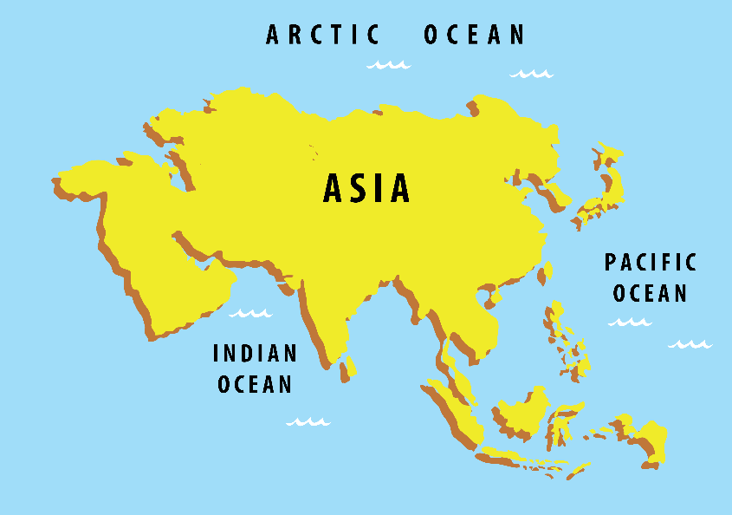
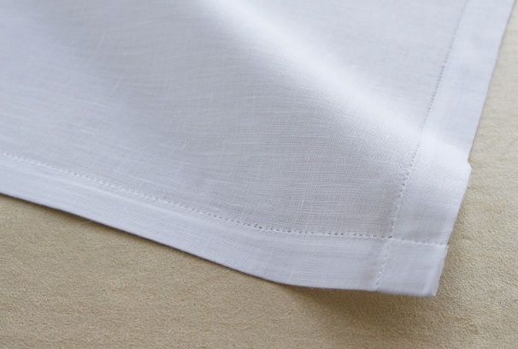
Know the Fabrics
Muslin was mostly produced in Kolkata and Dhaka.
Mosul (Iraq)
India
Mosul
Muslin
Notes:
Notes for Teacher - < Information for further reference or explanation >
Suggestions: <Ideas/ Images/ Animations / Others – To make better representation of the content > Source of Multimedia Objects (Image/audio/ Video/Animation) used in this slide -
Muslin: https://pixabay.com/photos/handkerchief-textile-fashion-white-5425158/
Asia map: SSSVV gallery; Keyword: Asia map

Slide 5
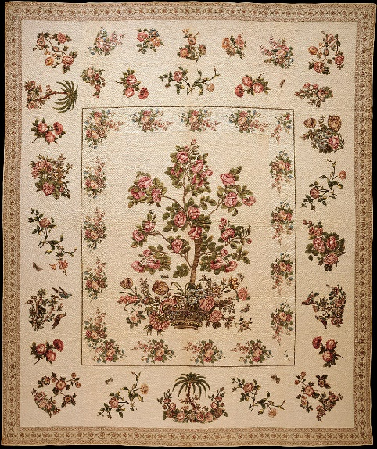
Know the Fabrics
Chintz are small and colourful floral printed cotton clothes produced in Masulipatnam, Andhra Pradesh.
Chint (small)
Chintz
Notes:
Notes for Teacher - < Information for further reference or explanation >
Suggestions: <Ideas/ Images/ Animations / Others – To make better representation of the content > Source of Multimedia Objects (Image/audio/ Video/Animation) used in this slide -
Chintz: https://commons.wikimedia.org/wiki/File:Chintz_appliqu%C3%A9d_quilt_MET_DT1815.jpg

Slide 6
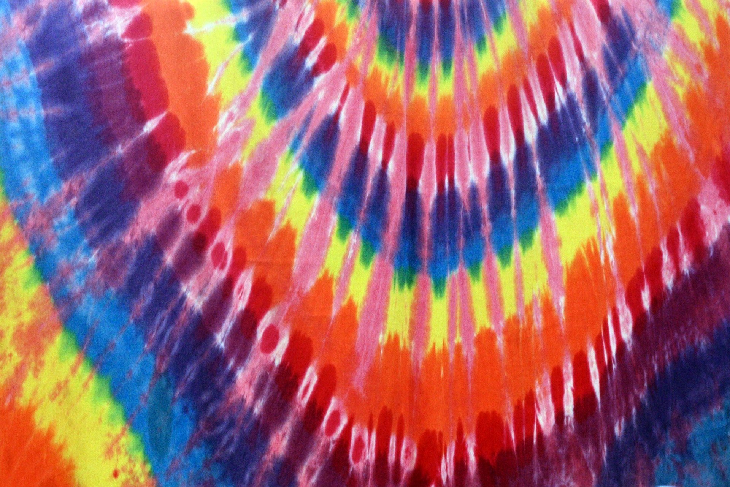
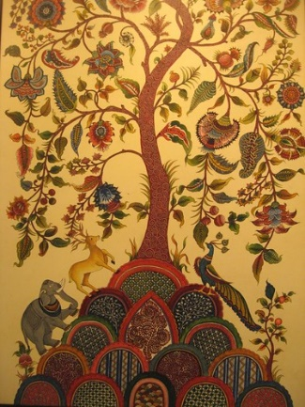
Know the Fabrics
Bandhana were produced in Rajasthan and Gujarat using tie and dye method.
Baandhna (tie)
Bandhana
Kalamkari originated about 3000 years ago
Kalam (pen)
Kalamkari
Notes:
Notes for Teacher - < Information for further reference or explanation >
Suggestions: <Ideas/ Images/ Animations / Others – To make better representation of the content > Source of Multimedia Objects (Image/audio/ Video/Animation) used in this slide -
Bandhana: https://www.publicdomainpictures.net/en/view-image.php?image=101539&picture=tie-dye-background
Kalamkari: https://search.creativecommons.org/photos/aa7a3932-8d57-4450-9a2f-e45885ae3379
"A handmade painting at a kalamkari exhibition" by Anuradha Sengupta is licensed under CC BY 2.0

Slide 7
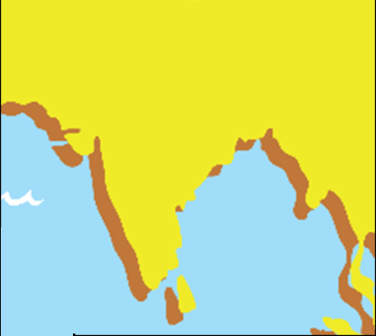
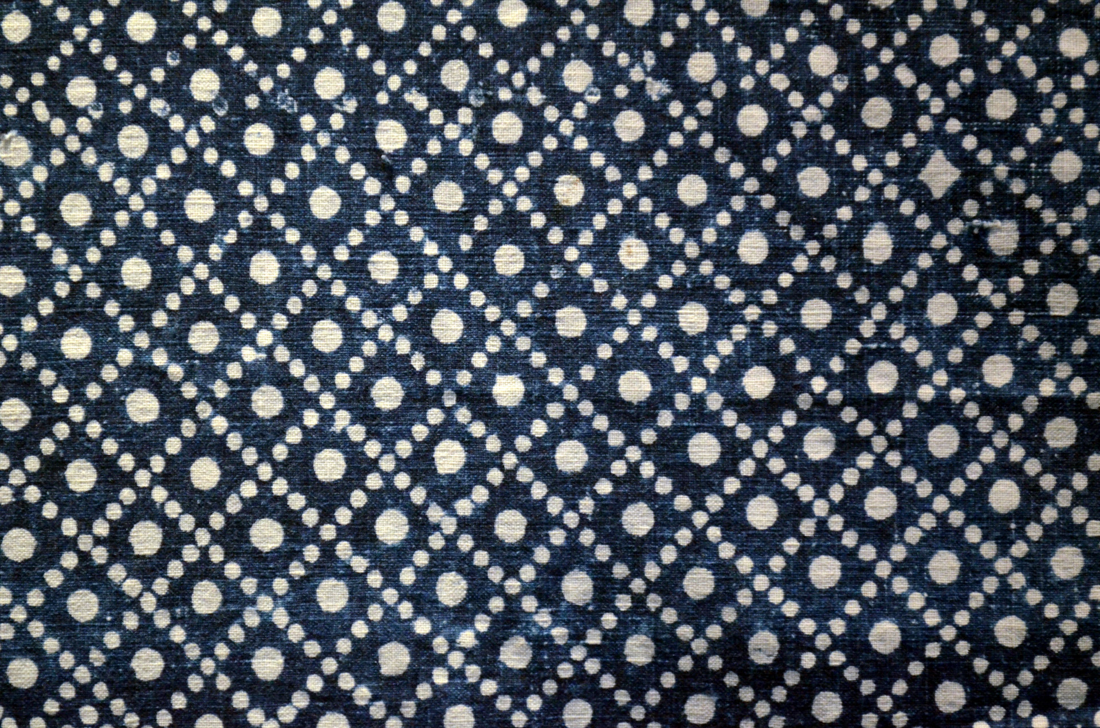
Know the Fabrics
Calico: Portuguese traded this type of fine cotton fabric from Calicut, Kerala and hence gave the name Calico.
Calicut
Calicut
Calico
Notes:
Notes for Teacher - < Information for further reference or explanation >
Suggestions: <Ideas/ Images/ Animations / Others – To make better representation of the content > Source of Multimedia Objects (Image/audio/ Video/Animation) used in this slide -
Calico: https://www.publicdomainpictures.net/en/view-image.php?image=32000&picture=nantong-blue-calico
Asia map: SSSVV gallery; Keyword: Asia map

Slide 8
Know the Fabrics
Jam-Flower
Dhani-Jar
Jamdani
Jamdani fabric has floral motifs on fine muslin woven with a mixture of cotton and gold thread.
They were woven in Dacca, Kolkata and Lucknow.
Notes:
Notes for Teacher - < Information for further reference or explanation >
Suggestions: <Ideas/ Images/ Animations / Others – To make better representation of the content > Source of Multimedia Objects (Image/audio/ Video/Animation) used in this slide -
Jamdani: https://pixabay.com/photos/saree-indian-ethnic-clothing-734917/

Slide 9
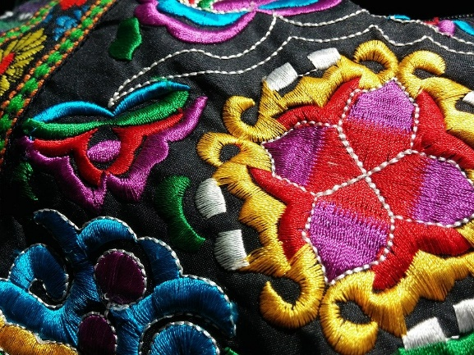
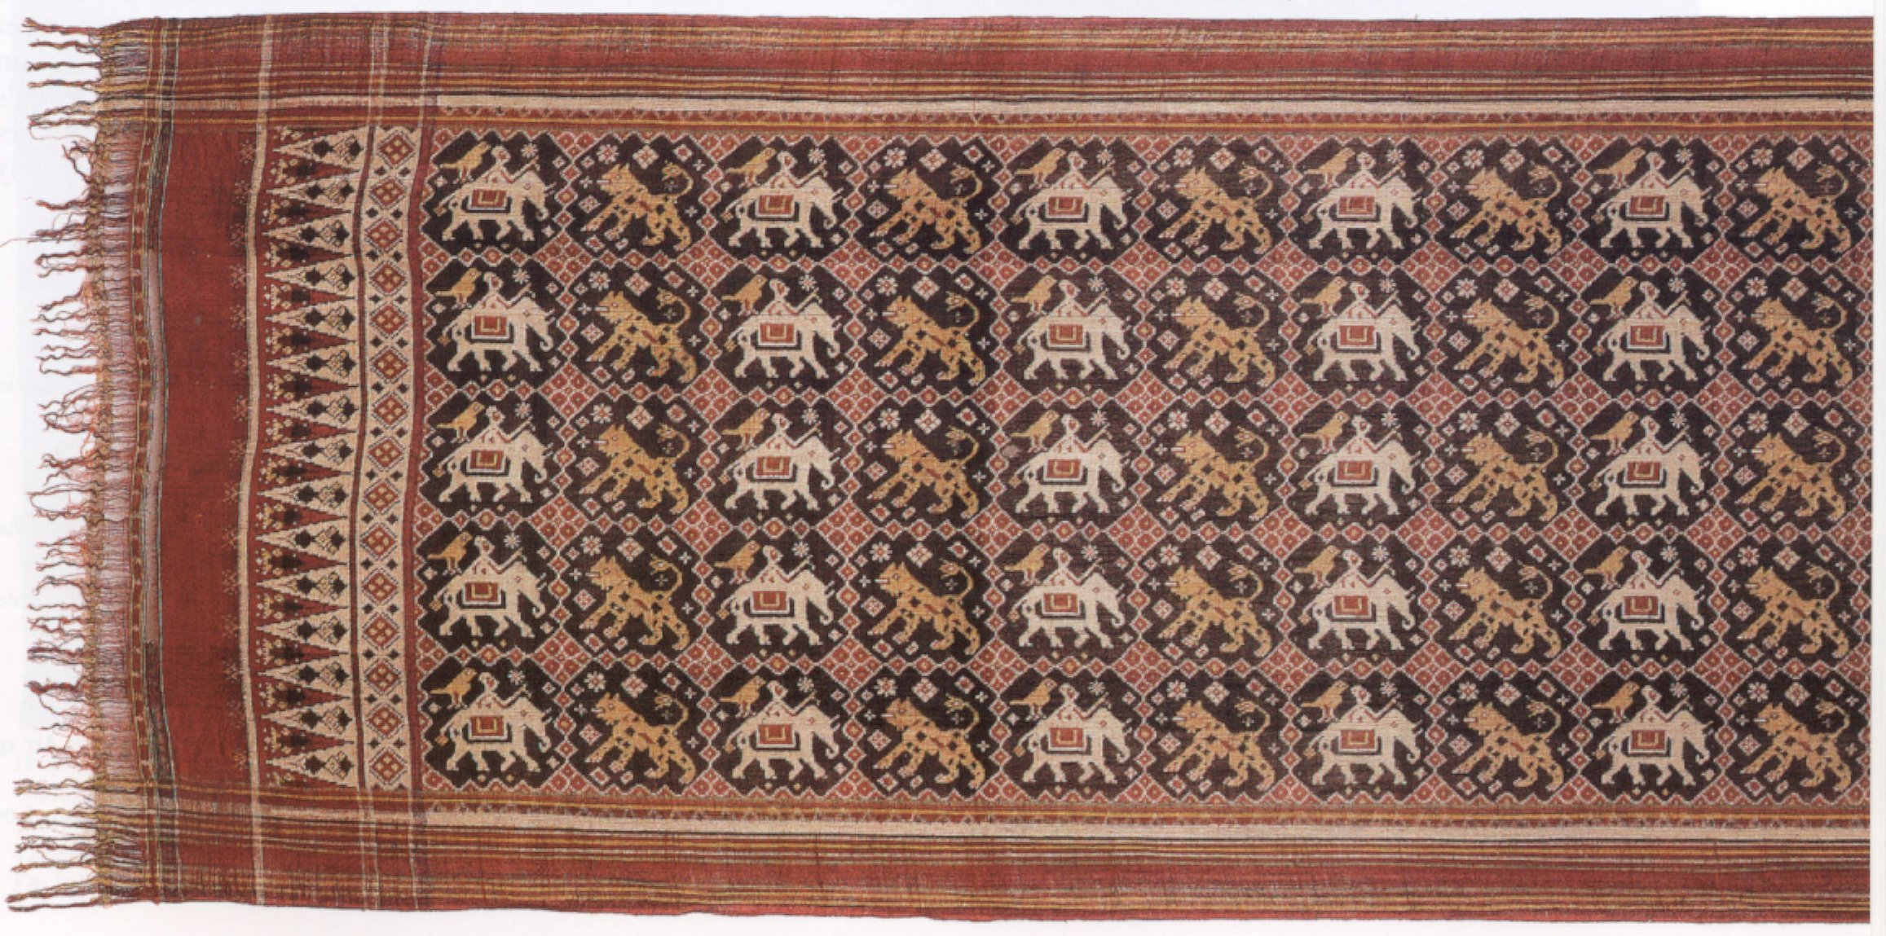
Know the Fabrics
Phulkari originated from Punjab.
Phul-Flower
Kari-Work
Phulkari
Patola is hand-woven silk fabric that originated in Patan, Gujarat.
Pattakulla
Patola
Notes:
Notes for Teacher - < Information for further reference or explanation >
Suggestions: <Ideas/ Images/ Animations / Others – To make better representation of the content > Source of Multimedia Objects (Image/audio/ Video/Animation) used in this slide -
Phulkari: https://pixabay.com/photos/fabric-ethnic-embroidery-textile-1280136/
Patola: https://commons.wikimedia.org/wiki/File:%27Patola%27_(ritual_heirloom_cloth)_from_Gujarat,_India,_late_18th_or_early_19th_century.jpg

Slide 10
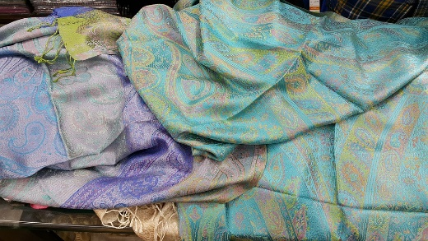
Know the Fabrics
Pashmina is also known as ‘Cashmere' as they are woven in Kashmir.
Pashmina
Made from Wool
Notes:
Notes for Teacher - < Information for further reference or explanation >
Suggestions: <Ideas/ Images/ Animations / Others – To make better representation of the content > Source of Multimedia Objects (Image/audio/ Video/Animation) used in this slide -
Pashmina: https://pixabay.com/photos/india-cashmere-wool-textile-1584302/

Slide 11
Know the Fabrics
Paithan
Paithani
Pratishthana
Notes:
Notes for Teacher - < Information for further reference or explanation >
Suggestions: <Ideas/ Images/ Animations / Others – To make better representation of the content > Source of Multimedia Objects (Image/audio/ Video/Animation) used in this slide -
Paithani: https://pixabay.com/photos/wedding-saree-collection-1050936/
Asia map: SSSVV gallery; Keyword: Asia map

Slide 12
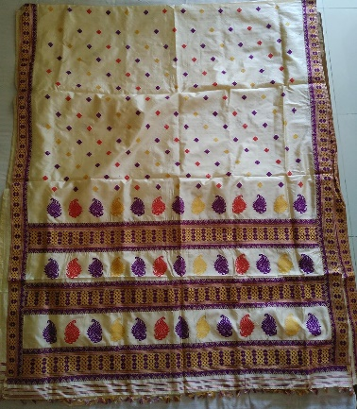
Know the Fabrics
Muga silk is one of the rarest silks in the world from Assam.
It is organic and has the strongest natural fiber.
Muga
Yellowish
Notes:
Notes for Teacher - < Information for further reference or explanation >
Suggestions: <Ideas/ Images/ Animations / Others – To make better representation of the content > Source of Multimedia Objects (Image/audio/ Video/Animation) used in this slide -
Muga silk: Original Contribution: Anuradha Ramkumar; ramji.anu@gmail.com

Slide 13
Procedure
IDENTIFY THE FABRIC WITH THE GIVEN HINTS
Notes:
Notes for Teacher –
Make teams of 2 or 3 students each.
Each of them will be given details of one fabric.
Each team will come in front of the class and give hints on the origin of the fabric without revealing the name of the Fabric.
The rest of the students will be the audience and guess what the fabric is with the given hints.
Suggestions: <Ideas/ Images/ Animations / Others – To make better representation of the content > Source of Multimedia Objects (Image/audio/ Video/Animation) used in this slide -

Slide 14
Example – Muga Silk
HINTS
It is one of the rarest silk fabrics in the world.
Origin: Assam.
Meaning: Yellowish in Assamese.
It is organic and has the strongest natural fiber.
Notes:
Notes for Teacher –
Help the students to form teams of two to three students.
Provide suggestions whenever they need.
The students from the audience can be selected in turns to give the correct answer.
If none can identify, the team may give the answer themselves.
Suggestions: <Ideas/ Images/ Animations / Others – To make better representation of the content > Source of Multimedia Objects (Image/audio/ Video/Animation) used in this slide -
Muga silk: Original Contribution: Anuradha Ramkumar; ramji.anu@gmail.com

Slide 15
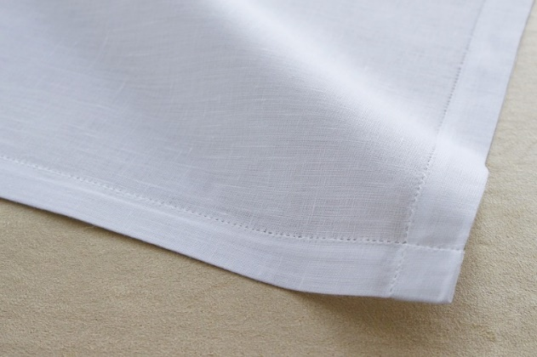
Indian Fabrics
Notes:
Notes for Teacher – Please display the slide when the students give hints for Muslin
Suggestions: <Ideas/ Images/ Animations / Others – To make better representation of the content > Source of Multimedia Objects (Image/audio/ Video/Animation) used in this slide -
Muslin: https://pixabay.com/photos/handkerchief-textile-fashion-white-5425158/

Slide 16
Indian Fabrics
Notes:
Notes for Teacher – Please display the slide when the students give hints for Chintz
Suggestions: <Ideas/ Images/ Animations / Others – To make better representation of the content > Source of Multimedia Objects (Image/audio/ Video/Animation) used in this slide -
Chintz: https://commons.wikimedia.org/wiki/File:Chintz_appliqu%C3%A9d_quilt_MET_DT1815.jpg

Slide 17
Indian Fabrics
Notes:
Notes for Teacher – Please display the slide when the students give hints for Bandhana
Suggestions: <Ideas/ Images/ Animations / Others – To make better representation of the content > Source of Multimedia Objects (Image/audio/ Video/Animation) used in this slide -
Bandhana: https://www.publicdomainpictures.net/en/view-image.php?image=101539&picture=tie-dye-background

Slide 18
Indian Fabrics
Notes:
Notes for Teacher – Please display the slide when the students give hints for kalamkari
Suggestions: <Ideas/ Images/ Animations / Others – To make better representation of the content > Source of Multimedia Objects (Image/audio/ Video/Animation) used in this slide -
Kalamkari: https://search.creativecommons.org/photos/aa7a3932-8d57-4450-9a2f-e45885ae3379
"A handmade painting at a kalamkari exhibition" by Anuradha Sengupta is licensed under CC BY 2.0

Slide 19
Indian Fabrics
Notes:
Notes for Teacher – Please display the slide when the students give hints for Calico
Suggestions: <Ideas/ Images/ Animations / Others – To make better representation of the content > Source of Multimedia Objects (Image/audio/ Video/Animation) used in this slide -
Calico: https://www.publicdomainpictures.net/en/view-image.php?image=32000&picture=nantong-blue-calico

Slide 20
Indian Fabrics
Notes:
Notes for Teacher – Please display the slide when the students give hints for Jamdani
Suggestions: <Ideas/ Images/ Animations / Others – To make better representation of the content > Source of Multimedia Objects (Image/audio/ Video/Animation) used in this slide -
Jamdani: https://pixabay.com/photos/saree-indian-ethnic-clothing-734917/

Slide 21
Indian Fabrics
Notes:
Notes for Teacher – Please display the slide when the students give hints for Phulkari
Suggestions: <Ideas/ Images/ Animations / Others – To make better representation of the content > Source of Multimedia Objects (Image/audio/ Video/Animation) used in this slide -
Phulkari: https://pixabay.com/photos/fabric-ethnic-embroidery-textile-1280136/

Slide 22
Indian Fabrics
Notes:
Notes for Teacher – Please display the slide when the students give hints for Patola
Suggestions: <Ideas/ Images/ Animations / Others – To make better representation of the content > Source of Multimedia Objects (Image/audio/ Video/Animation) used in this slide -
Patola: https://commons.wikimedia.org/wiki/File:%27Patola%27_(ritual_heirloom_cloth)_from_Gujarat,_India,_late_18th_or_early_19th_century.jpg

Slide 23
Indian Fabrics
Notes:
Notes for Teacher – Please display the slide when the students give hints for Pashmina
Suggestions: <Ideas/ Images/ Animations / Others – To make better representation of the content > Source of Multimedia Objects (Image/audio/ Video/Animation) used in this slide -
Pashmina: https://pixabay.com/photos/india-cashmere-wool-textile-1584302/

Slide 24
Indian Fabrics
Notes:
Notes for Teacher – Please display the slide when the students give hints for Paithani
Suggestions: <Ideas/ Images/ Animations / Others – To make better representation of the content > Source of Multimedia Objects (Image/audio/ Video/Animation) used in this slide -
Paithani: https://pixabay.com/photos/wedding-saree-collection-1050936/

Slide 25
Observation and Conclusion
Observation: Each fabric has a specific origin.
Conclusion:
India has rich heritage in Textile Industry.
Notes:
Notes for Teacher –
Help the students to form teams of two to three students.
Provide suggestions whenever they need.
The students from the audience can be selected in turns to give the correct answer.
If none can identify, the team may give the answer themselves.
Suggestions: <Ideas/ Images/ Animations / Others – To make better representation of the content > Source of Multimedia Objects (Image/audio/ Video/Animation) used in this slide -

Slide 26
MM Index
Slide# | Thumbnail | Source and Attribution
10,23 |  | Pashmina: https://pixabay.com/photos/india-cashmere-wool-textile-1584302/
9,21 |  | Phulkari: https://pixabay.com/photos/fabric-ethnic-embroidery-textile-1280136/
11,24 |  | Paithani: https://pixabay.com/photos/wedding-saree-collection-1050936/
8,20 |  | Jamdani: https://pixabay.com/photos/saree-indian-ethnic-clothing-734917/
6,18 |  | Kalamkari: https://search.creativecommons.org/photos/aa7a3932-8d57-4450-9a2f-e45885ae3379 "A handmade painting at a kalamkari exhibition" by Anuradha Sengupta is licensed under CC BY 2.0
9,22 |  | Patola: https://commons.wikimedia.org/wiki/File:%27Patola%27_(ritual_heirloom_cloth)_from_Gujarat,_India,_late_18th_or_early_19th_century.jpg
4,15 |  | Muslin: https://pixabay.com/photos/handkerchief-textile-fashion-white-5425158/
7,19 |  | Calico: https://www.publicdomainpictures.net/en/view-image.php?image=32000&picture=nantong-blue-calico
5,16 |  | Chintz: https://commons.wikimedia.org/wiki/File:Chintz_appliqu%C3%A9d_quilt_MET_DT1815.jpg
6,17 |  | Bandhana: https://www.publicdomainpictures.net/en/view-image.php?image=101539&picture=tie-dye-background
12,14 |  | Muga silk: Original Contribution: Anuradha Ramkumar; ramji.anu@gmail.com
4,7,11 |  | Asia map: SSSVV gallery; keyword: Asia map
Notes:
Notes for Teacher - < Information for further reference or explanation >
Suggestions: <Ideas/ Images/ Animations / Others – To make better representation of the content > Source of Multimedia Objects (Image/audio/ Video/Animation) used in this slide -

