Slide 1
Industrialization of Iron and Steel in India
Notes:
Notes for Teacher – N/A
Suggestions: N/A Source of Multimedia Objects (Image/audio/ Video/Animation) used in this slide -

Slide 2
Role Play – Industrialization of Iron and Steel in India
Aim: To enact the role-play on industrialization of iron and steel in India.
No. of students:
10
Setting:
School Campus Classroom
Time Required:
10 Min.
Notes:
Notes for Teacher -
Suggestions: N/A Source of Multimedia Objects (Image/audio/ Video/Animation) used in this slide -

Slide 3
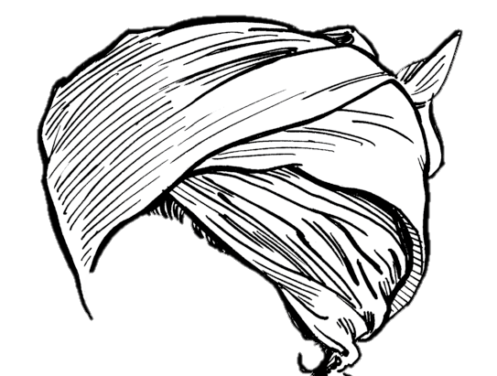
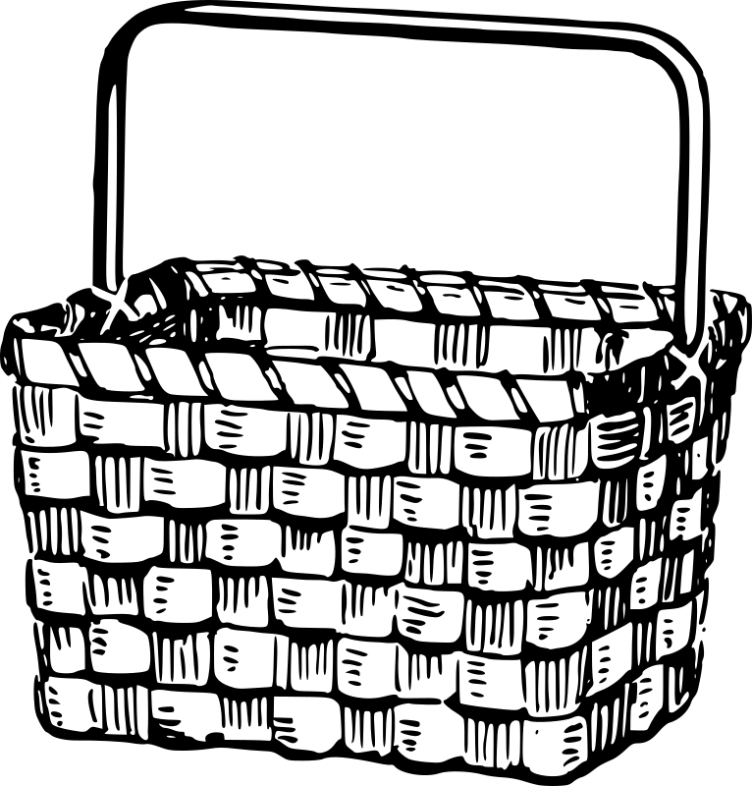
Materials Required
Role play Script
Industrialization of
Iron and Steel
in India
Load
Turban
OR
Basket
British Hat
Notes:
Notes for Teacher -
Suggestions: N/A Source of Multimedia Objects (Image/audio/ Video/Animation) used in this slide -
<paper pad> - https://openclipart.org/detail/289290/clipboard-empty
Turban: https://commons.wikimedia.org/wiki/File:Turban_2_(PSF).png
https://openclipart.org/detail/181579/top-hat
https://openclipart.org/detail/285744/little-red-in-Africa
https://openclipart.org/detail/92467/basket

Slide 4
Role-play Characters
Narrators(3)
Charles Weld
Dorabji Tata
Agarias(3)
Let us watch this role play
British(2)
Notes:
Notes for Teacher –
Teacher may announce a day for the role-play a week ahead.
Teacher can take permission to present it in the assembly or ground or conduct the role-play in the class.
Teacher can give the dialogues to the selected students a week ahead and help them arrange for their props..
Teacher may explain every student his or her role and asks them to learn the dialogues given.
Teacher makes all the students sit according to the roles given.
Teacher asks the narrator to begin the role-play.
Teacher guides the other students to follow the dialogues and the play.
Suggestions: N/A
Source of Multimedia Objects (Image/audio/ Video/Animation) used in this slide -
1. <GD> - https://openclipart.org/detail/271246/diverse-student-group

Slide 5
Conclusion
Students will be able to:
Present the role-play well.
Have a better understanding of industrialization of iron and steel in India
Notes:
Notes for Teacher - Troubleshoot:
Teacher should be ready with a substitute student for the roles in case of absentees.
Teacher should have the dialogues handy to guide the students.
Suggestions: N/A Source of Multimedia Objects (Image/audio/ Video/Animation) used in this slide - N/A

Slide 6
MM Index
Slide # | Thumbnail | Source and Attribution
3 |  | https://openclipart.org/detail/289290/clipboard-empty
4 |  | https://openclipart.org/detail/271246/diverse-student-group
3 |  | Turban: https://commons.wikimedia.org/wiki/File:Turban_2_(PSF).png
3 |  | https://openclipart.org/detail/181579/top-hat
3 |  | https://openclipart.org/detail/285744/little-red-in-Africa
3 |  | https://openclipart.org/detail/92467/basket

