Slide 1
Weaving in India during 18th Century
Notes:
Notes for Teacher - < Information for further reference or explanation >
Suggestions: <Ideas/ Images/ Animations / Others – To make better representation of the content >
Source of Multimedia Objects (Image/audio/ Video/Animation) used in this slide -
1. <Short Description> - <SOURCE URL>

Slide 2
Indian Textiles during 18th Century
Aim:
Region-wise mark on the map, the places and types of fabrics woven in India during 18th Century.
Resources required for Each Team:
India map-Outline map
Sketch pens, Colour pencils, Pencils
Atlas
Notes:
Notes for Teacher – The teacher can introduce the activity as follows:
During the 18th century traders transported their goods via roads as railways had not developed. The goods were brought to the major cities and sold to the European Traders.The Indian textile production was divided into four regions namely East, West, North and South.
Bengal and Dacca (now in Bangladesh) were one of the major trade centres for the East India Company in the eighteenth century. It was famous for its mulmul and jamdani weaving.
Gujarat had many important weaving centres in the west coast.
North India had weaving centres in Punjab and Lahore( now Pakistan).
South India was considered as the next major region with many cotton weaving centres along the Coromandel coast that stretches from north of Andhra Pradesh to Madras( now Chennai).
Let us now explore the places and fabrics of these four regions.
Suggestions: <Ideas/ Images/ Animations / Others – To make better representation of the content > Source of Multimedia Objects (Image/audio/ Video/Animation) used in this slide -

Slide 3
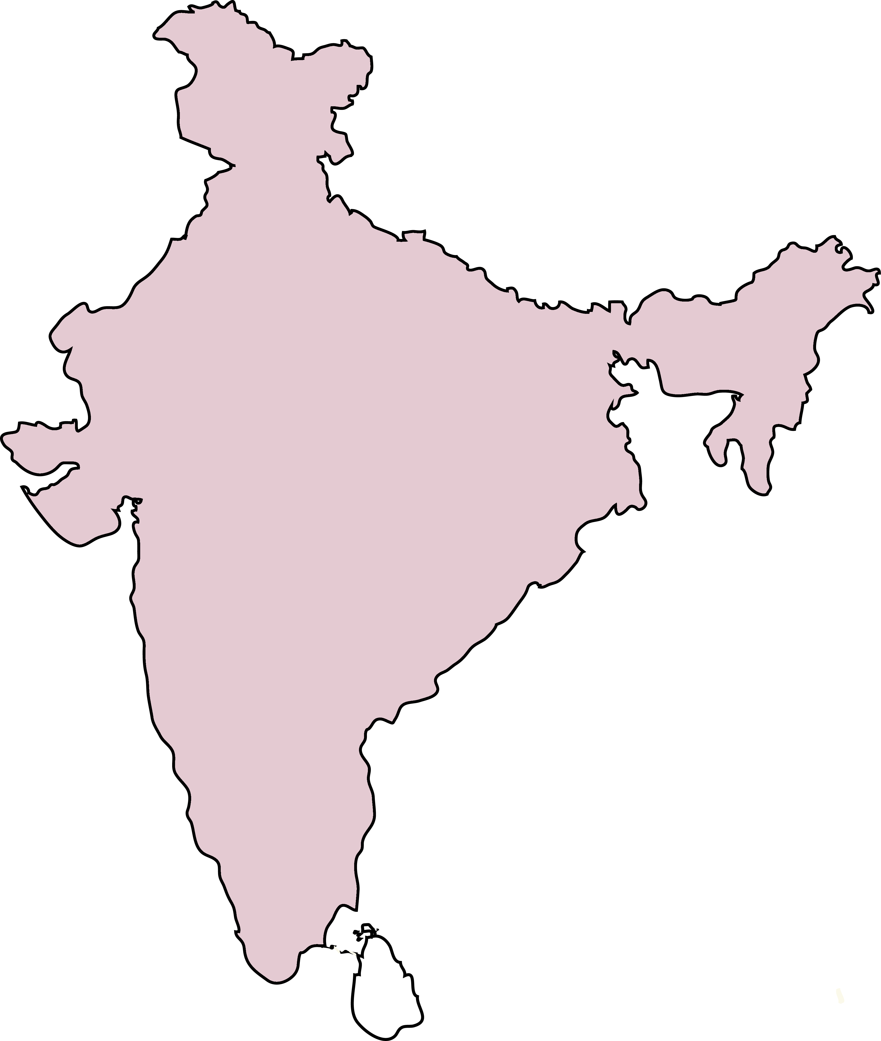
Indian Weaving Centres in 18th Century
Lahore
Sirhind
Samana
N
Ahmedabad
Surat
Birhanpur
Patan
Calcutta
Dhaka
Benaras
Patna
W
E
S
Madras
Petaboli
Pondicherry
Notes:
Notes for Teacher –
Make 4 teams. Assign one region to each team- East, West, North, South.
Each team will note down the places and fabrics produced in their assigned region as shown in the slide.
The teacher can check whether each team has correctly noted the important places for that region before marking on the map.
Suggestions: <Ideas/ Images/ Animations / Others – To make better representation of the content > Source of Multimedia Objects (Image/audio/ Video/Animation) used in this slide -
India map: SSSVV gallery Keyword: India Map

Slide 4
Procedure
Region wise mark the places and mention the fabrics produced using symbols
Notes:
Notes for Teacher –
Make 4 teams. Assign one region to each team- East, West, North, South.
Each team will note down the places and fabrics produced in their assigned region as shown in the slide.
The teacher can check whether each team has correctly noted the important places for that region before marking on the map.
Suggestions: <Ideas/ Images/ Animations / Others – To make better representation of the content > Source of Multimedia Objects (Image/audio/ Video/Animation) used in this slide -

Slide 5
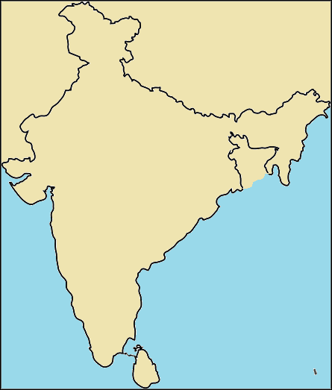
Indian Textiles during 18th Century
Plain Cotton
Lahore
Sirhind
Stripes And Checks
Samana
Chintz
Benaras
Patna
Patan
Silk
Calcutta
Ahmedabad
Burhanpur
Dhaka
Surat
Petaboli
Madras
Click on the fabric type.
Pondicherry
Notes:
Notes for Teacher –
‘Click on’ the Relevant mineral to show the places where they are found on the map.
Eg: Click on ‘Plain cotton’ to display the places where plain cotton fabric is available on the map.
Please display the map before the activity for a better understanding.
The teacher can check if the students are marking on the map using correct symbols.
Teacher will organise, supervise and guide the activity.
Suggestions: <Ideas/ Images/ Animations / Others – To make better representation of the content > Source of Multimedia Objects (Image/audio/ Video/Animation) used in this slide -
SSSVV Gallery Key word: India Map

Slide 6
Observation and Conclusion
Observation
There were many varieties of fabrics traded around four major
regions during 18th century in India.
Conclusion
Thus the map shows the important centres and the fabrics woven
in there during the 18th century in India.
Notes:
Notes for Teacher –
The teacher can conclude the activity by mounting the completed maps on the bulletin board for students' reference.
A follow-up assignment can be given to all the students to make a table of places and fabric region wise. This can be done in the notebooks.
The teacher can give a short recall session the next day to locate/show a place on the wall-mounted map and mention the fabrics weaved there.
Suggestions: <Ideas/ Images/ Animations / Others – To make better representation of the content > Source of Multimedia Objects (Image/audio/ Video/Animation) used in this slide -

Slide 7
Follow-up Assignment
Make a table of distribution of fabrics in India region wise
Notes:
Notes for Teacher - < Information for further reference or explanation >
Suggestions: <Ideas/ Images/ Animations / Others – To make better representation of the content >
Source of Multimedia Objects (Image/audio/ Video/Animation) used in this slide -
1. <Short Description> - <SOURCE URL>

Slide 8
Distribution Of Types Of Fabrics In India Region-wise
Sample Table
Region | Place | Type of Fabrics
North | Lahore | Plain cotton, stripes and checks
South
West
East
Notes:
Notes for Teacher –The teacher can display this slide to give an example for the follow-up assignment
Suggestions: <Ideas/ Images/ Animations / Others – To make better representation of the content > Source of Multimedia Objects (Image/audio/ Video/Animation) used in this slide -
1. <Short Description> - <SOURCE URL>

Slide 9
DISTRIBUTION OF TYPES OF FABRICS IN INDIA REGION-WISE
ANSWER
Region | Place | Type of Fabrics
North | Lahore | Plain cotton, stripes and checks
 | Sirhind | Plain cotton, stripes and checks
 | Samana | Plain cotton, stripes and checks, chintz
South | Madras (Chennai) | Plain cotton, stripes and checks, chintz
 | Petaboli | Plain cotton,chintz
 | Pondicherry (Puducherry) | Plain cotton, stripes and checks
Notes:
Notes for Teacher –The teacher can display this slide to give the answer after the follow-up assignment.
Suggestions: <Ideas/ Images/ Animations / Others – To make better representation of the content > Source of Multimedia Objects (Image/audio/ Video/Animation) used in this slide -
1. <Short Description> - <SOURCE URL>

Slide 10
DISTRIBUTION OF TYPES OF FABRICS IN INDIA REGION-WISE
ANSWER
Region | Place | Type of Fabrics
West | Ahmedabad | Plain cotton, chintz
 | Surat | Plain cotton, stripes and checks
 | Birhanpur | Plain cotton, stripes and checks
 | Patan | Chintz, silk
East | Calcutta(Kolkata) | Plain cotton, stripes and checks, chintz
 | Dhaka | Plain cotton, chintz
 | Benaras | Silk
 | Patna | Plain cotton, chintz
Notes:
Notes for Teacher –The teacher can display this slide to give the answer after the follow-up assignment.
Suggestions: <Ideas/ Images/ Animations / Others – To make better representation of the content > Source of Multimedia Objects (Image/audio/ Video/Animation) used in this slide -
1. <Short Description> - <SOURCE URL>

Slide 11
MM Index
Slide# | Thumbnail | Source and Attribution
3 |  | India Map: SSSVV gallery key word: India
5 |  | India Map: SSSVV gallery key word: India
Notes:
Notes for Teacher - < Information for further reference or explanation >
Suggestions: <Ideas/ Images/ Animations / Others – To make better representation of the content > Source of Multimedia Objects (Image/audio/ Video/Animation) used in this slide -

