Slide 1
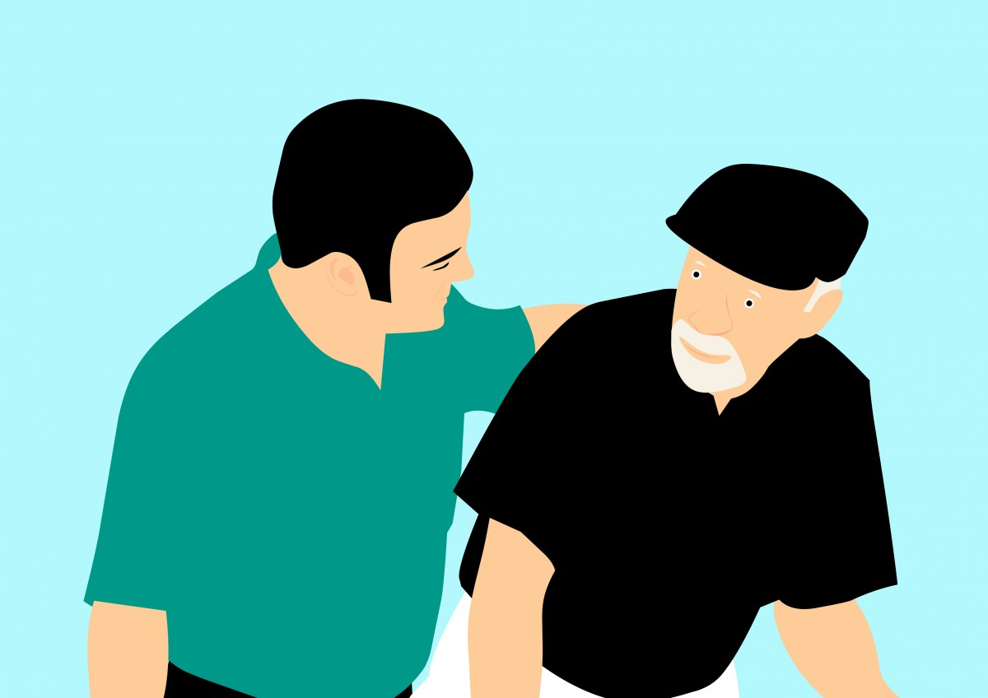
BEING EMPATHETIC
Notes:
Notes for Teacher – N/A
Suggestions: N/A
Source of Multimedia Objects (Image/audio/ Video/Animation) used in this slide –
Oldman: https://pxhere.com/en/photo/1456085

Slide 2
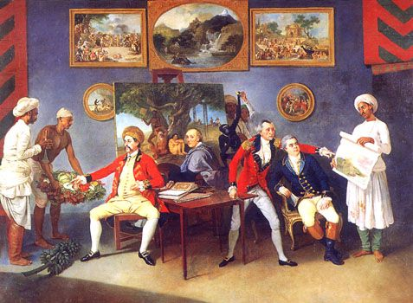
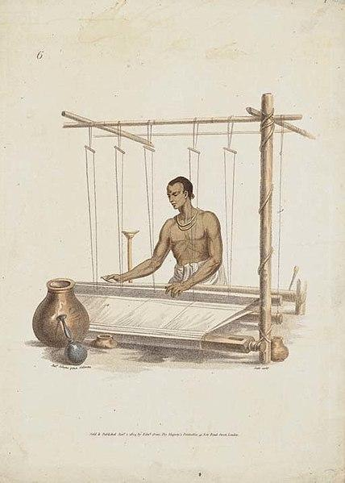
Empathy
By the beginning of the 19ᵗʰͭ century, English ousted Indian goods from their markets which left thousands of Indian weavers unemployed.
If only British had some empathy for weavers, this could’ve been averted.
Notes:
Notes for Teacher – N/A
Suggestions: N/A
Source of Multimedia Objects (Image/audio/ Video/Animation) used in this slide –
Weaver: https://commons.wikimedia.org/wiki/File:Weaver_an_engraving_by_Edmond_Scott.jpg
British: https://commons.wikimedia.org/wiki/File:PolierMartinWombwellZoffany.jpg

Slide 3
Empathy
What do you understand by empathy?
Empathy is feeling someone’s pain and taking action to help
Notes:
Notes for Teacher – The teacher can begin a brainstorming session with the students:
(let students come out with their definitions)
Suggestions: N/A
Source of Multimedia Objects (Image/audio/ Video/Animation) used in this slide –
Old Woman: https://pixabay.com/illustrations/senior-citizens-senior-man-4167547/

Slide 4
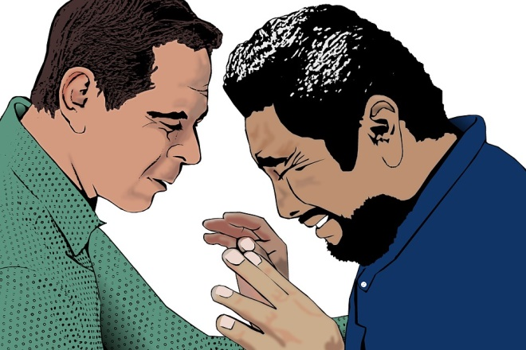
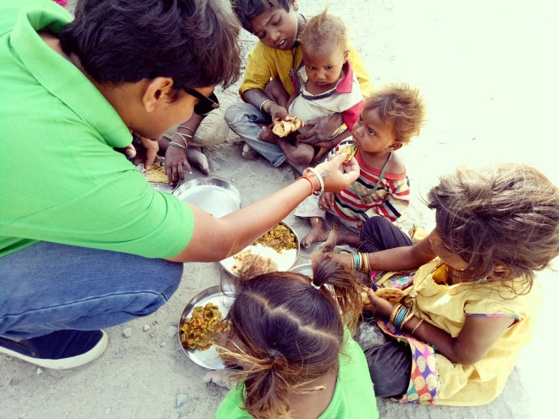
Empathy
Are empathy and sympathy same? What is the difference?
Sympathy is understanding others’ feelings and being compassionate
Empathy is the ability to step into someone else’s shoes and help them
Notes:
Notes for Teacher – N/A
Suggestions: N/A
Source of Multimedia Objects (Image/audio/ Video/Animation) used in this slide –
Sympathy: https://pixabay.com/es/illustrations/pastor-hombre-consolador-la-oraci%C3%B3n-4079182/
Empathy: https://pixabay.com/es/photos/trabajo-social-hambre-2356009/

Slide 5
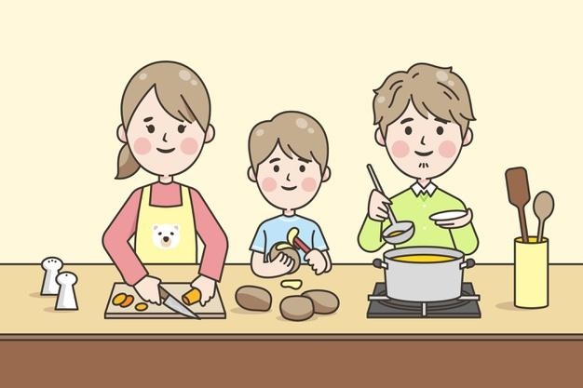
What is it to be empathetic? –
Story Time
Elizabeth, mother of Stephen
Stephen, a hardworking boy
Notes:
Notes for Teacher – N/A
Suggestions: N/A
Source of Multimedia Objects (Image/audio/ Video/Animation) used in this slide –
Mom and son: https://www.freepik.com/free-vector/linear-style-japanese-family-cooking_9979196.htm#query=asian-mom-and-son&position=4 Attribution: <a href="https://www.freepik.com/vectors/family">Family vector created by pikisuperstar - www.freepik.com</a>

Slide 6
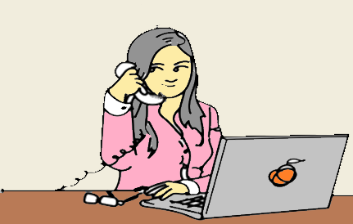
What is it to be empathetic? –
Story Time
Mom, It’s Stephen. I need a pair of gloves for Cricket League in school. Can you please buy me?
The manager overheard the phone call
of Stephen’s mother
Notes:
Notes for Teacher – N/A
Suggestions: N/A
Source of Multimedia Objects (Image/audio/ Video/Animation) used in this slide –
Manager: https://pixabay.com/vectors/man-business-cartoon-businessman-1351317/
Clerk: https://pixabay.com/vectors/women-receptionist-phone-2835113/

Slide 7
What is it to be empathetic? –
Story Time
The manager presented a gift to Stephen’s mother
Notes:
Notes for Teacher – N/A
Suggestions: N/A
Source of Multimedia Objects (Image/audio/ Video/Animation) used in this slide –
Manager and Clerk: https://pixabay.com/vectors/silhouette-couple-valentine-s-gift-3119210/

Slide 8
Let Us Discuss…
1. Do you agree that the store manager was empathetic? If yes, why?
Suggested Answer
The manager stepped into Elizabeth’s shoes by understanding her predicament and helped her by gifting a pair of gloves for her son.
The smallest act of empathy had the potential to turn her life around.
Click on the ‘Suggested Answer’
Notes:
Notes for Teacher – The teacher can continue the discussion by asking these questions and let children come out with their views
Suggestions: N/A
Source of Multimedia Objects (Image/audio/ Video/Animation) used in this slide – N/A

Slide 9
Let Us Discuss…
2. Who do you think is benefited by the acts of empathy?
Receiver or Giver?
Suggested Answer
Acts of empathy not only benefit receivers, but the giver too gets a sense of satisfaction and happiness.
Click on the ‘Suggested Answer’
Notes:
Notes for Teacher – The teacher can continue the discussion by asking these questions and let children come out with their views
Suggestions: N/A
Source of Multimedia Objects (Image/audio/ Video/Animation) used in this slide – N/A

Slide 10
MM Index
Slide# | Thumbnail | Source and Attribution
1, 9 |  | https://pxhere.com/en/photo/1456085
2 |  | https://commons.wikimedia.org/wiki/File:Weaver_an_engraving_by_Edmond_Scott.jpg
2 |  | https://commons.wikimedia.org/wiki/File:PolierMartinWombwellZoffany.jpg
3 |  | https://pixabay.com/illustrations/senior-citizens-senior-man-4167547/
4 |  | Sympathy: https://pixabay.com/es/illustrations/pastor-hombre-consolador-la-oraci%C3%B3n-4079182/
4 |  | Empathy: https://pixabay.com/es/photos/trabajo-social-hambre-2356009/
6 |  | https://pixabay.com/vectors/man-business-cartoon-businessman-1351317/
6 |  | https://pixabay.com/vectors/women-receptionist-phone-2835113/
7, 8 |  | https://pixabay.com/vectors/silhouette-couple-valentine-s-gift-3119210/
5 |  | https://www.freepik.com/free-vector/linear-style-japanese-family-cooking_9979196.htm#query=asian-mom-and-son&position=4 Attribution: <a href="https://www.freepik.com/vectors/family">Family vector created by pikisuperstar - www.freepik.com</a>

