Slide 1
Knowing Compound Words
Light
Flash
Notes:
Notes for Teacher - < Information for further reference or explanation >
Suggestions: <Ideas/ Images/ Animations / Others – To make better representation of the content >
Source of Multimedia used in this slide - <Please provide source URL where we find the image and the license agreement>
https://pixabay.com/fr/photos/se-connecter-connexion-collaboration-2777620/

Slide 2
Words
note
house
sun
+
+
+
book
fly
light
=
=
=
notebook
housefly
sunlight
Compound words
Notes:
Notes for Teacher - < Information for further reference or explanation >
Suggestions: <Ideas/ Images/ Animations / Others – To make better representation of the content >
Source of Multimedia used in this slide - <Please provide source URL where we find the image and the license agreement>
<black board> <https://pixabay.com/photos/black-board-traces-of-chalk-school-1072366/>

Slide 3
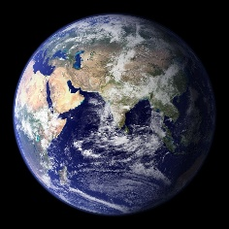
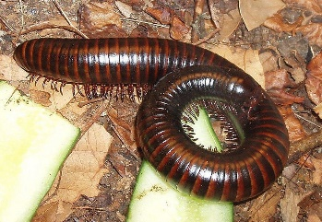
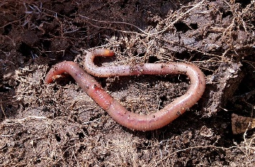
Compound Words
Two small words combine Compound words
Note
+
=
Note + Book =
Notebook
+
=
Earth + Worm =
Earthworm
+
=
Tooth + Brush =
Toothbrush
Notes:
Notes for Teacher - < Information for further reference or explanation >
Suggestions: <Ideas/ Images/ Animations / Others – To make better representation of the content >
Source of Multimedia used in this slide - <Please provide source URL where we find the image and the license agreement>
<note> https://pixabay.com/photos/blank-board-business-cork-board-89184/
Book - https://pixabay.com/photos/a-book-embossing-leather-empty-3040862/
Notebook - https://pixabay.com/photos/notebook-page-open-notepad-5978603/
Earth - https://pixabay.com/photos/earth-planet-space-world-11008/
Worm - https://pixabay.com/photos/millipede-myriapoda-centipede-11116/
Earthworm - https://pixabay.com/photos/worm-vermiculture-humus-earth-soil-1140767/
Tooth - https://pixabay.com/vectors/dentist-teeth-tooth-happy-smiling-158225/
Brush - https://pixabay.com/vectors/brush-construction-jims-card-paint-1297095/
<toothbrush> https://pixabay.com/vectors/toothbrush-green-dental-hygiene-311373/

Slide 4
Types Of Compound Words
Compound words
Closed form
There is no space or hyphen between the words
Open form
There is a space between the words
Hyphenated
A hyphen separates the words
Notes:
Notes for Teacher - < Information for further reference or explanation >
Suggestions: <Ideas/ Images/ Animations / Others – To make better representation of the content >
Source of Multimedia used in this slide - <Please provide source URL where we find the image and the license agreement>

Slide 5
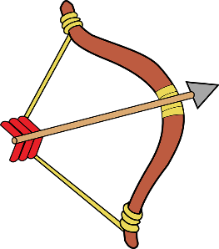
Closed Compounds
+
=
Earth
Worm
Earthworm
+
=
Butter
Fly
Butterfly
+
=
Rain
Bow
Rainbow
Notes:
Notes for Teacher - < Information for further reference or explanation >
Suggestions: <Ideas/ Images/ Animations / Others – To make better representation of the content >
Source of Multimedia used in this slide - <Please provide source URL where we find the image and the license agreement>
Earth - https://pixabay.com/vectors/globe-world-green-blue-earth-1579177/
Worm - https://pixabay.com/vectors/insect-caterpillar-worm-entomology-6595117/
<earthworm> <https://pixabay.com/vectors/alphabet-word-images-animal-worm-1295265/>
Butter - https://pixabay.com/vectors/butter-magerine-knife-pound-spread-25232/
Fly - https://pixabay.com/vectors/house-fly-fly-insect-flies-pest-24629/
<butterfly> <https://pixabay.com/vectors/animal-butterfly-chromatic-flying-2027356/>
Rain - https://pixabay.com/vectors/cloud-drawing-rain-raindrops-6664918/
Bow - https://pixabay.com/vectors/arrow-bow-indian-weapon-sports-160075/
<rainbow> <https://pixabay.com/illustrations/rainbow-cute-arts-kids-clipart-5112211/>

Slide 6
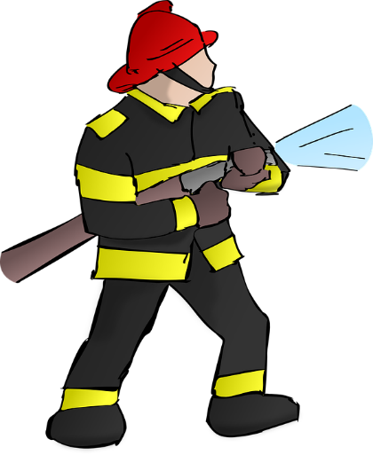
Closed Compounds
+
=
Fire
Man
Fireman
+
=
Pop
Corn
Popcorn
Notes:
Notes for Teacher - < Information for further reference or explanation >
Suggestions: <Ideas/ Images/ Animations / Others – To make better representation of the content >
Source of Multimedia used in this slide - <Please provide source URL where we find the image and the license agreement>
Fire - https://pixabay.com/vectors/fire-camp-bonfire-wood-heat-30231/
Man - https://pixabay.com/vectors/comic-characters-hello-man-smile-2023311/
Fireman - https://pixabay.com/vectors/firefighter-fire-fireman-hose-151712/
Pop - https://openclipart.org/detail/311059/pop
Corn - https://pixabay.com/vectors/corn-food-maize-plant-agriculture-296956/
Popcorn - https://pixabay.com/vectors/popcorn-box-snack-movie-cinema-4788367/

Slide 7
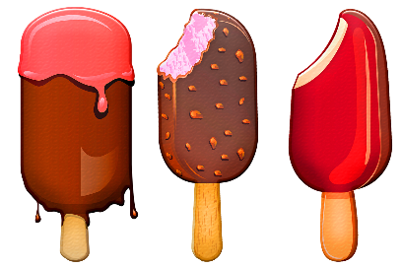
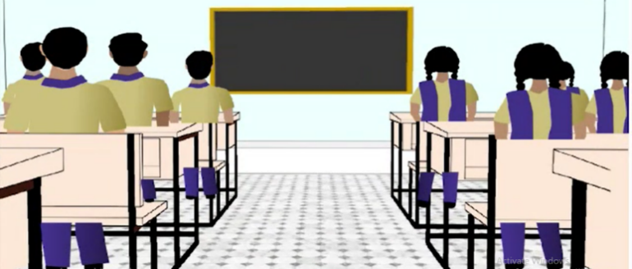
Open Compounds
+
=
Ice
Cream
Ice cream
+
=
Full
Moon
Full moon
+
=
High
School
High
School
High school
Notes:
Notes for Teacher - < Information for further reference or explanation >
Suggestions: <Ideas/ Images/ Animations / Others – To make better representation of the content >
Source of Multimedia used in this slide - <Please provide source URL where we find the image and the license agreement>
Ice - https://pixabay.com/vectors/ice-cube-transparent-water-cold-576352/
Cream - https://pixabay.com/illustrations/cream-whipped-cream-bowl-dairy-6600553/
Ice cream - https://pixabay.com/illustrations/ice-cream-on-stick-ice-cream-4898244/
Full - https://pixabay.com/vectors/water-glass-full-drink-beverage-308595/
Cresent Moon - https://pixabay.com/vectors/moon-stars-sky-night-nature-blue-310151/
Full moon – https://pixabay.com/vectors/full-moon-moon-lunar-night-planet-151379/
High - https://pixabay.com/vectors/leadership-motivational-business-153250/
School – https://pixabay.com/vectors/school-building-education-property-295210/
High School - SSSVV

Slide 8
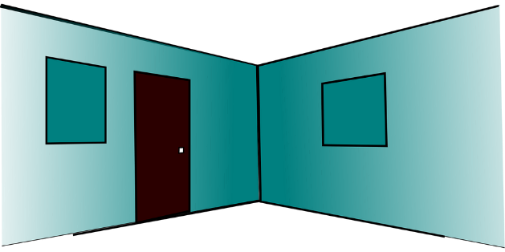
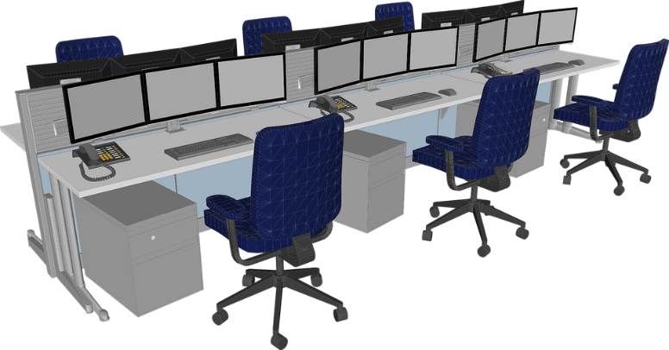
Open Compounds
+
=
Living
Room
Living Room
High
School
+
=
Post
Office
Post Office
Notes:
Notes for Teacher - < Information for further reference or explanation >
Suggestions: <Ideas/ Images/ Animations / Others – To make better representation of the content >
Source of Multimedia used in this slide - <Please provide source URL where we find the image and the license agreement>
Family – https://pixabay.com/vectors/cheering-happy-jumping-people-297419/
Room – https://pixabay.com/vectors/room-interior-door-empty-307048/
Living room - https://pixabay.com/vectors/living-room-home-room-furniture-3749761/
Letter - https://pixabay.com/vectors/envelope-mail-postage-post-office-3172770/
Office - https://pixabay.com/vectors/office-desks-chairs-workplace-6354296/
Post Office - https://openclipart.org/detail/327170/post-office

Slide 9
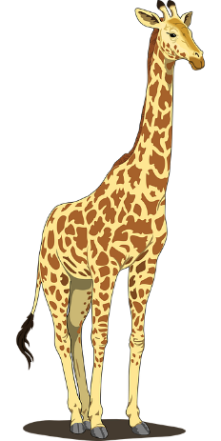
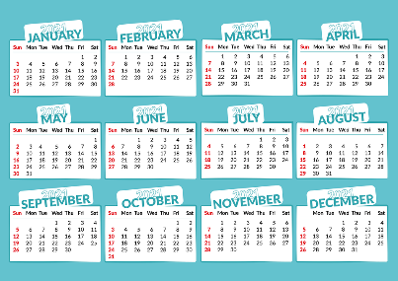
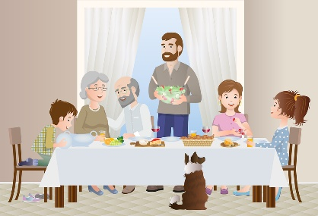
Hyphenated Compounds
+
=
Long
Term
Long-term
+
=
One
Half
One-half
High
School
+
=
Get
Together
Get-together
Notes:
Notes for Teacher - < Information for further reference or explanation >
Suggestions: <Ideas/ Images/ Animations / Others – To make better representation of the content >
Source of Multimedia used in this slide - <Please provide source URL where we find the image and the license agreement>
Giraffe - https://pixabay.com/vectors/giraffe-tall-long-neck-long-legged-48393/
Term - https://pixabay.com/vectors/calendar-2021-year-date-months-5620762/
long term - https://pixabay.com/vectors/growth-man-boy-avatar-boy-avatar-5674053/
One - https://pixabay.com/vectors/birthday-candle-number-one-2024492/
Half - https://pixabay.com/vectors/glass-tumbler-liquid-blue-310750/
Lemon - https://pixabay.com/vectors/lime-fruit-food-lemon-citrus-25314/
Girl - https://pixabay.com/vectors/girl-child-kids-towel-1613946/
Bear hug - https://pixabay.com/vectors/bears-couple-love-hug-heart-6200535/
Get-together - https://pixabay.com/vectors/family-parents-grandparents-6351117/

Slide 10
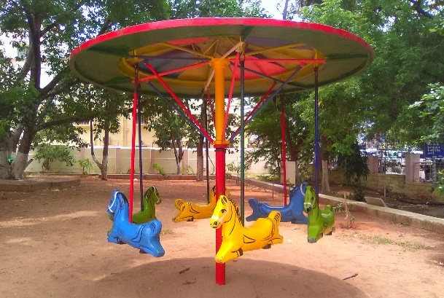
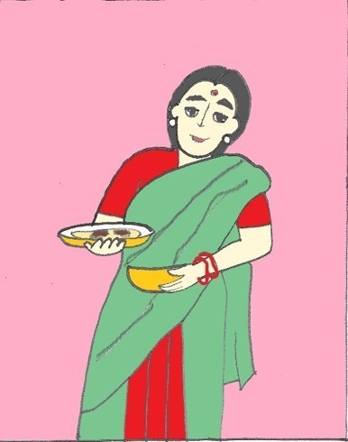
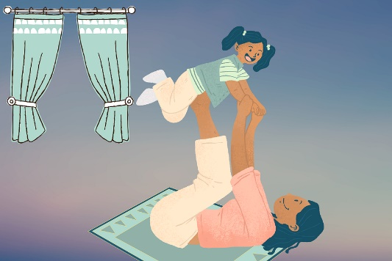
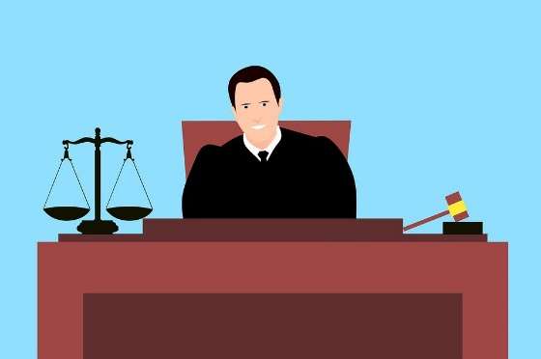
Hyphenated Compounds
+
Go
+
=
Merry
Round
Merry-go-round
High
School
+
In
+
=
Mother
Law
Mother-in-law
Notes:
Notes for Teacher - < Information for further reference or explanation >
Suggestions: <Ideas/ Images/ Animations / Others – To make better representation of the content >
Source of Multimedia used in this slide - <Please provide source URL where we find the image and the license agreement>
Merry - https://pixabay.com/vectors/kids-drawing-scribble-lines-girl-3171905/
Round – https://pixabay.com/vectors/arrows-direction-round-right-4838655/
Merry-go-round – SSSVV
Mother - https://pixabay.com/illustrations/mother-daughter-play-family-love-6680895/
Law - https://pixabay.com/illustrations/judge-court-gavel-administration-5313542/

Slide 11
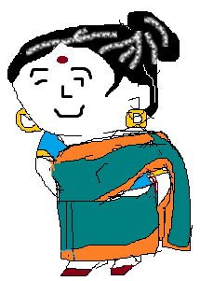
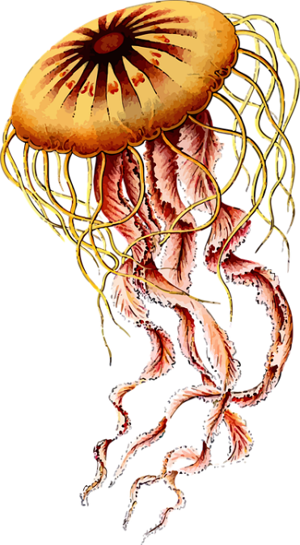
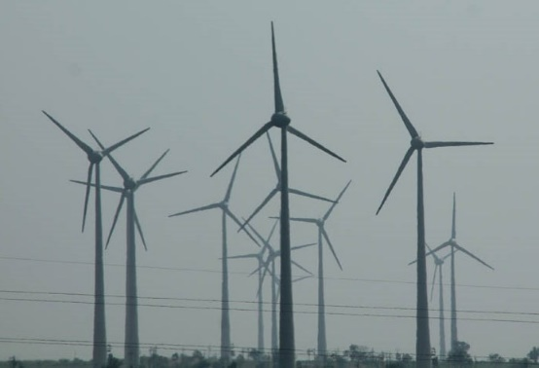
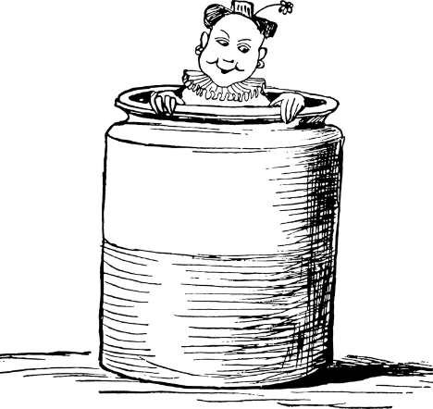
Some more closed form compound words
mail + box = mailbox
grand + mother = grandmother
jelly + fish = jellyfish
wind + mill = windmill
in + side = inside
Notes:
Notes for Teacher - < Information for further reference or explanation >
Suggestions: <Ideas/ Images/ Animations / Others – To make better representation of the content >
Source of Multimedia used in this slide - <Please provide source URL where we find the image and the license agreement>
Postbox - https://pixabay.com/vectors/mail-post-letter-envelope-mailbox-6551666/
<grandmother> <SSSVV>
Jellyfish - https://pixabay.com/vectors/animal-art-forms-in-nature-jellyfish-1298203/
<windmill> <SSSVV>
Inside - https://pixabay.com/vectors/edward-lear-sketch-vintage-1823632/

Slide 12
Some more closed form compound words
grass + hopper = grasshopper
Sun + flower = sunflower
moon + light = moonlight
basket + ball = basketball
Notes:
Notes for Teacher - < Information for further reference or explanation >
Suggestions: <Ideas/ Images/ Animations / Others – To make better representation of the content >
Source of Multimedia used in this slide - <Please provide source URL where we find the image and the license agreement>
Grasshopper - https://pixabay.com/vectors/animal-grasshopper-insect-nature-1296187/
Sunflower - https://pixabay.com/vectors/sunflower-summer-plant-garden-1563432/
Moonlight - https://pixabay.com/vectors/moon-sea-ocean-night-moonlight-4563611/
<basketball> <https://pixabay.com/vectors/basketball-ball-sports-orange-157925/>

Slide 13
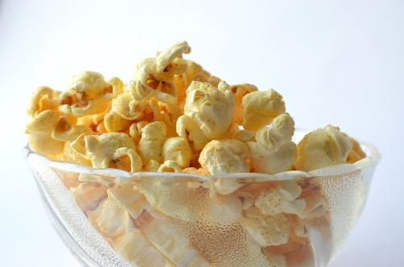
Compound words in sentences
My grandmother is coming home for the holidays.
2. The earthworm is a friend of the farmer.
3. I like to watch butterflies fly.
4. Vikram is eating popcorn.
5. Renu is playing basketball.
Notes:
Notes for Teacher - < Information for further reference or explanation >
Suggestions: <Ideas/ Images/ Animations / Others – To make better representation of the content >
Source of Multimedia used in this slide - <Please provide source URL where we find the image and the license agreement>
<earthworm> <https://pixabay.com/vectors/alphabet-word-images-animal-worm-1295265/>
<butterfly> <https://pixabay.com/vectors/animal-butterfly-chromatic-flying-2027356/>
<popcorn> <https://pixabay.com/photos/popcorn-food-snack-bowl-yellow-166839/>
<sunflower> <SSSVV>
<grandmother> <SSSVV>

Slide 14
MM INDEX
Slide # | Thumbnail | Source link and Attribution
1 |  | https://pixabay.com/fr/photos/se-connecter-connexion-collaboration-2777620/
2 |  | Black board: https://pixabay.com/photos/black-board-traces-of-chalk-school-1072366/
3 |  | Note - https://pixabay.com/photos/blank-board-business-cork-board-89184/ Book - https://pixabay.com/photos/a-book-embossing-leather-empty-3040862/ Notebook - https://pixabay.com/photos/notebook-page-open-notepad-5978603/ Earth - https://pixabay.com/photos/earth-planet-space-world-11008/ Worm - https://pixabay.com/photos/millipede-myriapoda-centipede-11116/ Earthworm - https://pixabay.com/photos/worm-vermiculture-humus-earth-soil-1140767/ Tooth - https://pixabay.com/vectors/dentist-teeth-tooth-happy-smiling-158225/ Brush - https://pixabay.com/vectors/brush-construction-jims-card-paint-1297095/ Toothbrush: https://pixabay.com/vectors/toothbrush-green-dental-hygiene-311373/
5 |  | Earth - https://pixabay.com/vectors/globe-world-green-blue-earth-1579177/ Worm - https://pixabay.com/vectors/insect-caterpillar-worm-entomology-6595117/ Earthworm - https://pixabay.com/vectors/alphabet-word-images-animal-worm-1295265/ Butter - https://pixabay.com/vectors/butter-magerine-knife-pound-spread-25232/ Fly - https://pixabay.com/vectors/house-fly-fly-insect-flies-pest-24629/ Butterfly- https://pixabay.com/vectors/animal-butterfly-chromatic-flying-2027356/ Rain - https://pixabay.com/vectors/cloud-drawing-rain-raindrops-6664918/ Bow - https://pixabay.com/vectors/arrow-bow-indian-weapon-sports-160075/ Rainbow - https://pixabay.com/illustrations/rainbow-cute-arts-kids-clipart-5112211/
6 |  | Fire - https://pixabay.com/vectors/fire-camp-bonfire-wood-heat-30231/ Man - https://pixabay.com/vectors/comic-characters-hello-man-smile-2023311/ Fireman - https://pixabay.com/vectors/firefighter-fire-fireman-hose-151712/ Pop - https://openclipart.org/detail/311059/pop Corn - https://pixabay.com/vectors/corn-food-maize-plant-agriculture-296956/ Popcorn - https://pixabay.com/vectors/popcorn-box-snack-movie-cinema-4788367/
7 |  | Ice - https://pixabay.com/vectors/ice-cube-transparent-water-cold-576352/ Cream - https://pixabay.com/illustrations/cream-whipped-cream-bowl-dairy-6600553/ Ice cream - https://pixabay.com/illustrations/ice-cream-on-stick-ice-cream-4898244/ Full - https://pixabay.com/vectors/water-glass-full-drink-beverage-308595/ Crescent Moon - https://pixabay.com/vectors/moon-stars-sky-night-nature-blue-310151/ Full moon - https://pixabay.com/vectors/full-moon-moon-lunar-night-planet-151379/ High - https://pixabay.com/vectors/leadership-motivational-business-153250/ School - https://pixabay.com/vectors/school-building-education-property-295210/ High School - SSSVV Image Gallery: Search keyword “school”
Notes:
Notes for Teacher - < Information for further reference or explanation >
Suggestions: <Ideas/ Images/ Animations / Others – To make better representation of the content >
Source of Multimedia used in this slide - <Please provide source URL where we find the image and the license agreement>

Slide 15
MM INDEX
Slide # | Thumbnail | Source link and Attribution
8 |  | Family - https://pixabay.com/vectors/cheering-happy-jumping-people-297419/ Room - https://pixabay.com/vectors/room-interior-door-empty-307048/ Living room - https://pixabay.com/vectors/living-room-home-room-furniture-3749761/ Letter - https://pixabay.com/vectors/envelope-mail-postage-post-office-3172770/ Office - https://pixabay.com/vectors/office-desks-chairs-workplace-6354296/ Post Office - https://openclipart.org/detail/327170/post-office
9 |  | Giraffe - https://pixabay.com/vectors/giraffe-tall-long-neck-long-legged-48393/ Term - https://pixabay.com/vectors/calendar-2021-year-date-months-5620762/ long term - https://pixabay.com/vectors/growth-man-boy-avatar-boy-avatar-5674053/ One - https://pixabay.com/vectors/birthday-candle-number-one-2024492/ Half - https://pixabay.com/vectors/glass-tumbler-liquid-blue-310750/ Lemon - https://pixabay.com/vectors/lime-fruit-food-lemon-citrus-25314/ Girl - https://pixabay.com/vectors/girl-child-kids-towel-1613946/ Bear hug - https://pixabay.com/vectors/bears-couple-love-hug-heart-6200535/ Get-together - https://pixabay.com/vectors/family-parents-grandparents-6351117/
10 |  | Merry - https://pixabay.com/vectors/kids-drawing-scribble-lines-girl-3171905/ Round - https://pixabay.com/vectors/arrows-direction-round-right-4838655/ Merry-go-round - SSSVV Image Gallery: Search keyword “merry” Mother - https://pixabay.com/illustrations/mother-daughter-play-family-love-6680895/ Law - https://pixabay.com/illustrations/judge-court-gavel-administration-5313542/ Mother-in-law - SSSVV Image Gallery: Search keyword “mother”
11 |  | Postbox - https://pixabay.com/vectors/mail-post-letter-envelope-mailbox-6551666/ Grandmother - SSSVV Image Gallery: Search keyword “grandmother” Jellyfish - https://pixabay.com/vectors/animal-art-forms-in-nature-jellyfish-1298203/ Windmill - SSSVV Image Gallery: Search keyword “windmill” Inside - https://pixabay.com/vectors/edward-lear-sketch-vintage-1823632/
12 |  | Grasshopper - https://pixabay.com/vectors/animal-grasshopper-insect-nature-1296187/ Sunflower - https://pixabay.com/vectors/sunflower-summer-plant-garden-1563432/ Moonlight - https://pixabay.com/vectors/moon-sea-ocean-night-moonlight-4563611/ Basketball - https://pixabay.com/vectors/basketball-ball-sports-orange-157925/
13 |  | Earthworm - https://pixabay.com/vectors/alphabet-word-images-animal-worm-1295265/ Butterfly - https://pixabay.com/vectors/animal-butterfly-chromatic-flying-2027356/ Popcorn - https://pixabay.com/photos/popcorn-food-snack-bowl-yellow-166839/ Grandmother - SSSVV Image Gallery: Search keyword “grandmother” Basketball - https://pixabay.com/vectors/basketball-ball-sports-orange-157925/
Notes:
Notes for Teacher - < Information for further reference or explanation >
Suggestions: <Ideas/ Images/ Animations / Others – To make better representation of the content >
Source of Multimedia used in this slide - <Please provide source URL where we find the image and the license agreement>

