Slide 1
Magic with Compound Words
Notes:
Notes for Teacher - < Information for further reference or explanation >
Suggestions: <Ideas/ Images/ Animations / Others – To make better representation of the content >
Source of Multimedia used in this slide - <Please provide source URL where we find the image and the license agreement>
<magic> <https://pixabay.com/illustrations/magician-magic-illusionist-tricks-4860002/>

Slide 2
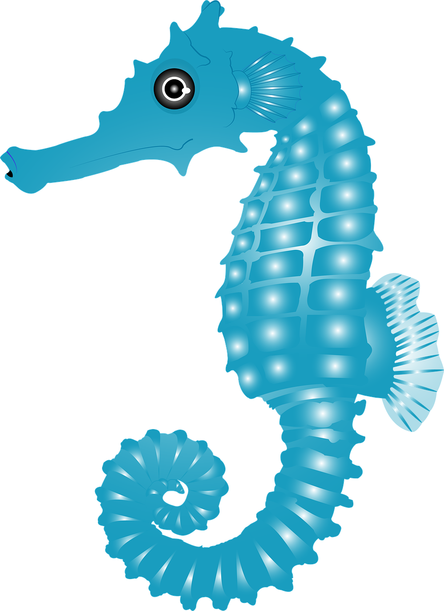
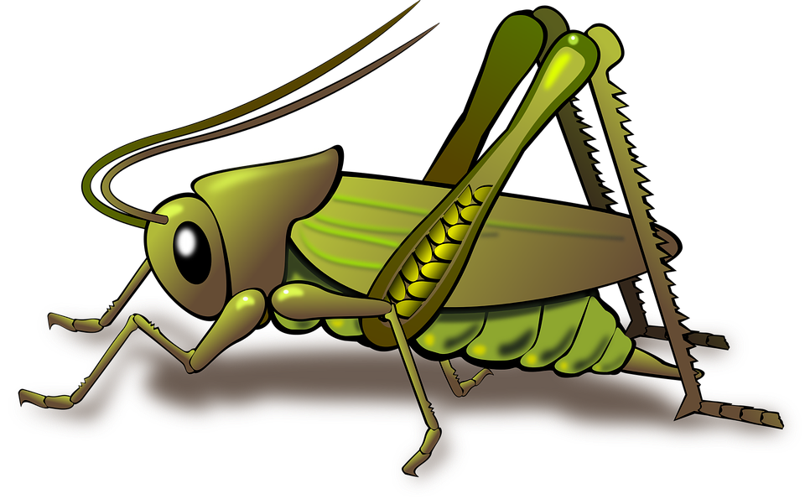
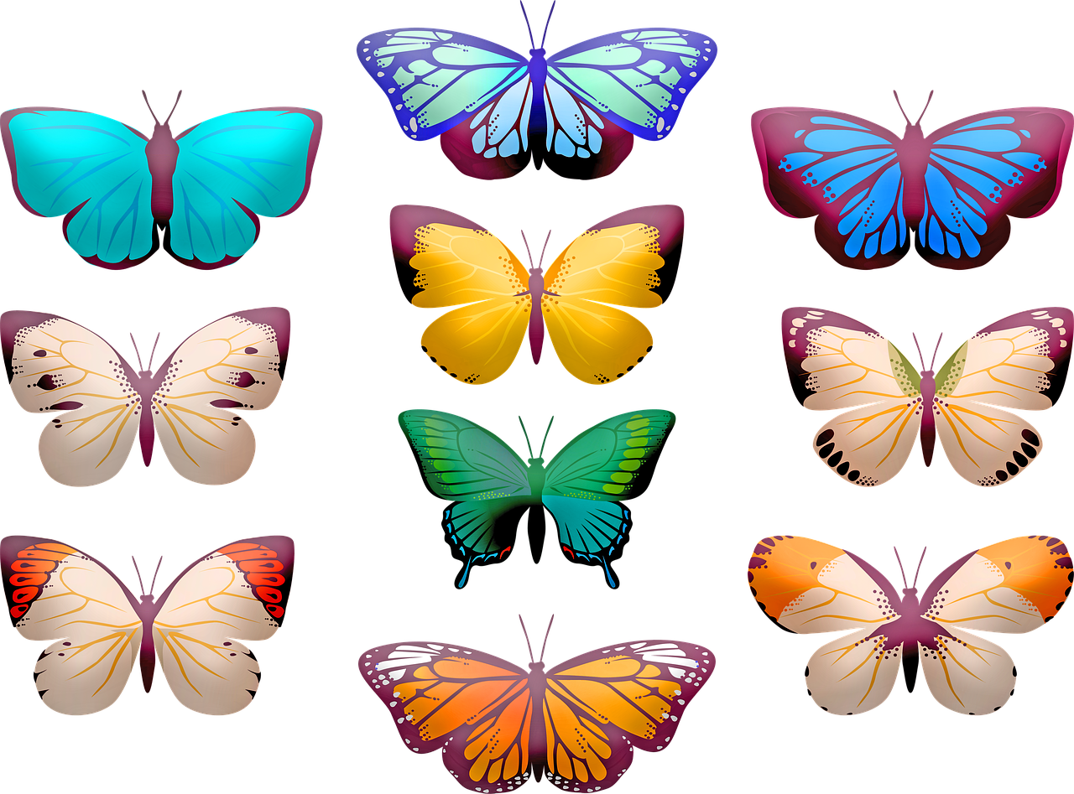
Make compound words with the following
ant | hopper | paste | fall
tooth | water | note | rays
butter | hill | grass | rain
book | ball | foot | Sun
toe | nail | fly | sea
lady | horse | bird | bow
Notes:
Notes for Teacher - < Information for further reference or explanation >
Suggestions: <Ideas/ Images/ Animations / Others – To make better representation of the content >
Source of Multimedia used in this slide - <Please provide source URL where we find the image and the license agreement>
<blackboard> <https://pixabay.com/photos/black-board-traces-of-chalk-school-1072366/>

Slide 3
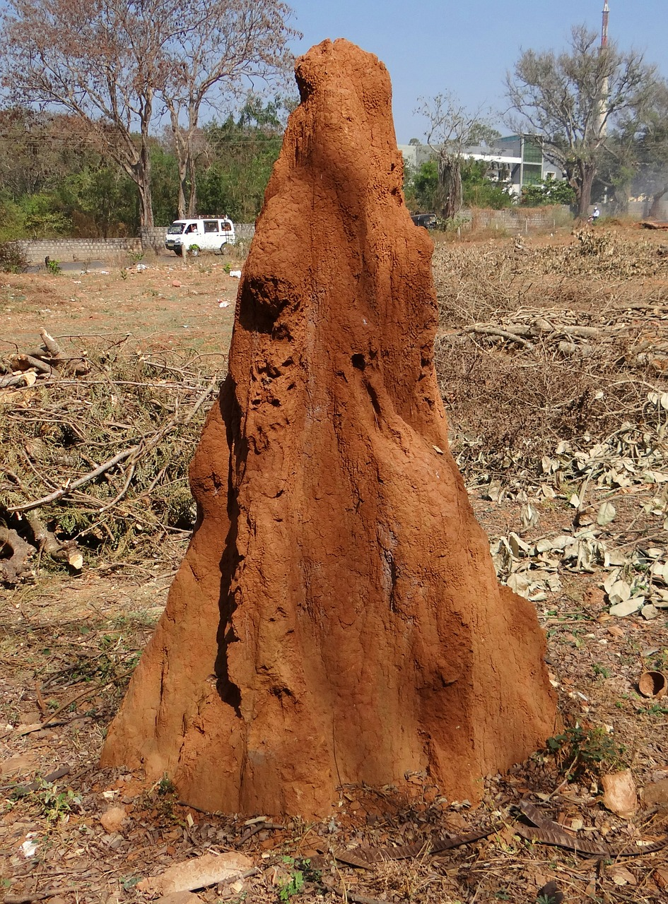
Make compound words with the following
ant | hopper | paste | fall
tooth | water | note | rays
butter | hill | grass | rain
book | ball | foot | Sun
toe | nail | fly | sea
lady | horse | bird | bow
2. ant + hill = anthill
1. sea + horse = seahorse
3. grass + hopper = grasshopper
Notes:
Notes for Teacher - < Information for further reference or explanation >
Suggestions: <Ideas/ Images/ Animations / Others – To make better representation of the content >
Source of Multimedia used in this slide - <Please provide source URL where we find the image and the license agreement>
<seahorse> <https://pixabay.com/illustrations/seahorse-fish-animal-blue-water-5435384/>
<termitehill> <https://pixabay.com/photos/termite-hill-termites-mound-dharwad-238384/>
Grasshopper – https://pixabay.com/vectors/animal-grasshopper-insect-nature-1296187/
<toothpaste> <https://pixabay.com/photos/toothbrush-toothpaste-dental-care-571741/>
waterfall - https://pixabay.com/vectors/waterfall-water-nature-landscape-310140/
<notebook> <https://pixabay.com/photos/notebook-page-open-notepad-5978603/>
<sunrays> https://pixabay.com/vectors/plant-photosynthesis-sunlight-leaf-3759893/

Slide 4
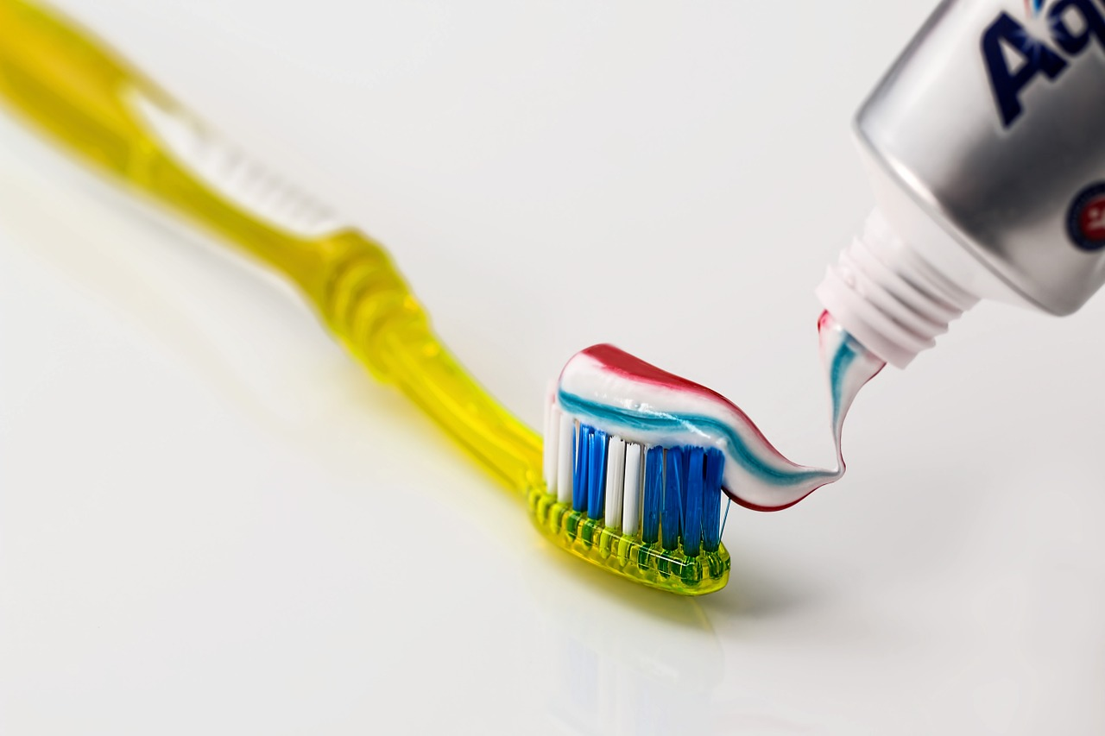
Make compound words with the following
ant | hopper | paste | fall
tooth | water | note | rays
butter | hill | grass | rain
book | ball | foot | Sun
toe | nail | fly | sea
lady | horse | bird | bow
4. tooth + paste = toothpaste
5. water + fall = waterfall
Notes:
Notes for Teacher - < Information for further reference or explanation >
Suggestions: <Ideas/ Images/ Animations / Others – To make better representation of the content >
Source of Multimedia used in this slide - <Please provide source URL where we find the image and the license agreement>
<seahorse> <https://pixabay.com/illustrations/seahorse-fish-animal-blue-water-5435384/>
<termitehill> <https://pixabay.com/photos/termite-hill-termites-mound-dharwad-238384/>
Grasshopper – https://pixabay.com/vectors/animal-grasshopper-insect-nature-1296187/
<toothpaste> <https://pixabay.com/photos/toothbrush-toothpaste-dental-care-571741/>
waterfall - https://pixabay.com/vectors/waterfall-water-nature-landscape-310140/
<notebook> <https://pixabay.com/photos/notebook-page-open-notepad-5978603/>
<sunrays> https://pixabay.com/vectors/plant-photosynthesis-sunlight-leaf-3759893/

Slide 5
Make compound words with the following
ant | hopper | paste | fall
tooth | water | note | rays
butter | hill | grass | rain
book | ball | foot | Sun
toe | nail | fly | sea
lady | horse | bird | bow
6. note + book = notebook
7. Sun + rays = Sunrays
Notes:
Notes for Teacher - < Information for further reference or explanation >
Suggestions: <Ideas/ Images/ Animations / Others – To make better representation of the content >
Source of Multimedia used in this slide - <Please provide source URL where we find the image and the license agreement>
<seahorse> <https://pixabay.com/illustrations/seahorse-fish-animal-blue-water-5435384/>
<termitehill> <https://pixabay.com/photos/termite-hill-termites-mound-dharwad-238384/>
Grasshopper – https://pixabay.com/vectors/animal-grasshopper-insect-nature-1296187/
<toothpaste> <https://pixabay.com/photos/toothbrush-toothpaste-dental-care-571741/>
waterfall - https://pixabay.com/vectors/waterfall-water-nature-landscape-310140/
<notebook> <https://pixabay.com/photos/notebook-page-open-notepad-5978603/>
<sunrays> https://pixabay.com/vectors/plant-photosynthesis-sunlight-leaf-3759893/

Slide 6
Make compound words with the following
ant | hopper | paste | Fall
tooth | water | note | rays
butter | hill | grass | rain
book | ball | foot | sun
toe | nail | fly | sea
lady | horse | bird | bow
9. rain + bow = rainbow
10. foot + ball = football
8. butter + fly = butterfly
Notes:
Notes for Teacher - < Information for further reference or explanation >
Suggestions: <Ideas/ Images/ Animations / Others – To make better representation of the content >
Source of Multimedia used in this slide - <Please provide source URL where we find the image and the license agreement>
<seahorse> <https://pixabay.com/illustrations/seahorse-fish-animal-blue-water-5435384/>
<termitehill> <https://pixabay.com/photos/termite-hill-termites-mound-dharwad-238384/>
Grasshopper – https://pixabay.com/vectors/animal-grasshopper-insect-nature-1296187/
<toothpaste> <https://pixabay.com/photos/toothbrush-toothpaste-dental-care-571741/>
waterfall - https://pixabay.com/vectors/waterfall-water-nature-landscape-310140/
<notebook> <https://pixabay.com/photos/notebook-page-open-notepad-5978603/>
<sunrays> https://pixabay.com/vectors/plant-photosynthesis-sunlight-leaf-3759893/

Slide 7
Make compound words with the following
ant | hopper | paste | Fall
tooth | water | note | rays
butter | hill | grass | rain
book | ball | foot | sun
toe | nail | fly | sea
lady | horse | bird | bow
11. toe + nail = toenail
12. lady + bird = ladybird
Notes:
Notes for Teacher - < Information for further reference or explanation >
Suggestions: <Ideas/ Images/ Animations / Others – To make better representation of the content >
Source of Multimedia used in this slide - <Please provide source URL where we find the image and the license agreement>
<seahorse> <https://pixabay.com/illustrations/seahorse-fish-animal-blue-water-5435384/>
<termitehill> <https://pixabay.com/photos/termite-hill-termites-mound-dharwad-238384/>
Grasshopper – https://pixabay.com/vectors/animal-grasshopper-insect-nature-1296187/
<toothpaste> <https://pixabay.com/photos/toothbrush-toothpaste-dental-care-571741/>
waterfall - https://pixabay.com/vectors/waterfall-water-nature-landscape-310140/
<notebook> <https://pixabay.com/photos/notebook-page-open-notepad-5978603/>
<sunrays> https://pixabay.com/vectors/plant-photosynthesis-sunlight-leaf-3759893/

Slide 8
MM INDEX
Slide # | Thumbnail | Source link and Attribution
1 |  | <magic> https://pixabay.com/illustrations/magician-magic-illusionist-tricks-4860002/
2, 3 |  | <seahorse> https://pixabay.com/illustrations/seahorse-fish-animal-blue-water-5435384 Grasshopper – https://pixabay.com/vectors/animal-grasshopper-insect-nature-1296187/
3 |  | <termitehill> https://pixabay.com/photos/termite-hill-termites-mound-dharwad-238384/
2, 4 |  | <toothpaste> https://pixabay.com/photos/toothbrush-toothpaste-dental-care-571741/ waterfall - https://pixabay.com/vectors/waterfall-water-nature-landscape-310140/
2, 5 |  | <notebook> https://pixabay.com/photos/notebook-page-open-notepad-5978603/ <sunrays> https://pixabay.com/vectors/plant-photosynthesis-sunlight-leaf-3759893/
2, 6 |  | <butterfly> https://pixabay.com/illustrations/butterfly-clip-art-butterflies-4117065/ <rainbow> https://pixabay.com/illustrations/rainbow-cute-arts-kids-clipart-5112211/ <football> https://pixabay.com/vectors/football-soccer-ball-sport-147854/
7 |  | <feet> https://pixabay.com/photos/feet-barefoot-outside-wet-1176612/ <ladybird> https://pixabay.com/photos/ladybug-seven-spot-ladybird-beetle-5279651/
Notes:
Notes for Teacher - < Information for further reference or explanation >
Suggestions: <Ideas/ Images/ Animations / Others – To make better representation of the content >
Source of Multimedia used in this slide - <Please provide source URL where we find the image and the license agreement>

