Slide 1
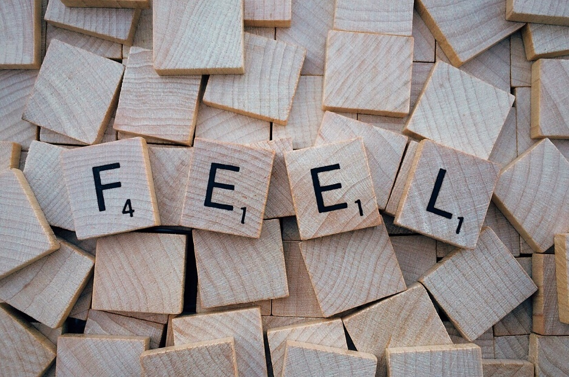
Fun Forming Compound Words
Notes:
Notes for Teacher - < Information for further reference or explanation >
Suggestions: <Ideas/ Images/ Animations / Others – To make better representation of the content >
Source of Multimedia used in this slide - <Please provide source URL where we find the image and the license agreement>
<words> <https://pixabay.com/photos/feel-word-letters-scrabble-1804600/>

Slide 2
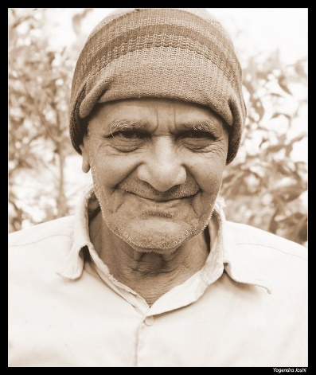
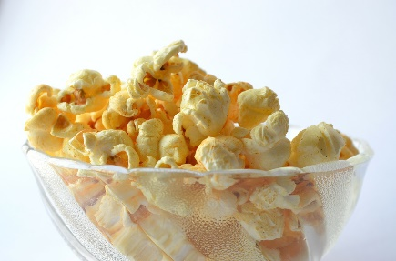
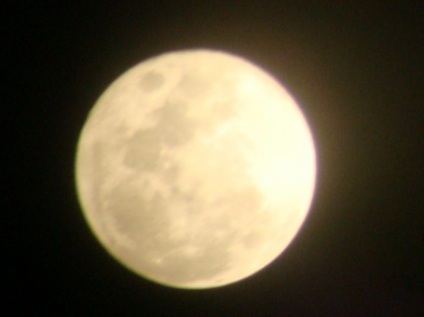
I. Write the compound words
doormat
door + mat = ________
grand + father = ___________
pop + corn = ________
after + noon = _________
moon + light = _________
grandfather
popcorn
afternoon
moonlight
Notes:
Notes for Teacher - < Information for further reference or explanation >
Suggestions: <Ideas/ Images/ Animations / Others – To make better representation of the content >
Source of Multimedia used in this slide - <Please provide source URL where we find the image and the license agreement>
<doormat> <https://pixabay.com/vectors/rug-carpet-brown-white-oval-round-576081/>
<grandfather> <https://www.flickr.com/photos/39072595@N03/4280710509> by Yogendra Joshi
<popcorn> <https://pixabay.com/photos/popcorn-food-snack-bowl-yellow-166839/>
<sun> <SSSVV Image Gallery: Search Keyword “sun”>
<moon> <SSSVV Image Gallery: Search Keyword “moon”>

Slide 3
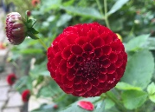
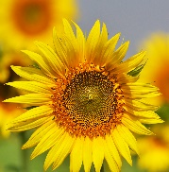
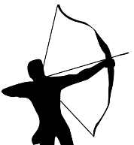
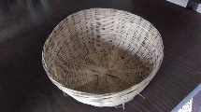
Write the compound words using the pictures as clues and draw the compound word formed.
II. Write the compound words
Words
sun + flower
rain + bow
basket + ball
Compound Word
sunflower
rainbow
basketball
Notes:
Notes for Teacher - < Information for further reference or explanation >
Suggestions: <Ideas/ Images/ Animations / Others – To make better representation of the content >
Source of Multimedia used in this slide - <Please provide source URL where we find the image and the license agreement>
<sun><SSSVV Image Gallery: Search Keyword “sun”>
<flower> <SSSVV Image Gallery: Search Keyword “flower”>
<sunflower> <SSSVVImage Gallery: Search Keyword “sunflower”>
<rain> <SSSVV Image Gallery: Search Keyword “rain”>
<bow> <SSSVV Image Gallery: Search Keyword “bow”>
<rainbow> <https://pixabay.com/illustrations/rainbow-cute-arts-kids-clipart-5112211/>
<basket> <SSSVV Image Gallery: Search Keyword “basket”>
<ball> <https://pixabay.com/vectors/ball-gold-round-shiny-gloss-149922/>
<basketball> <https://pixabay.com/vectors/basketball-ball-sports-orange-157927/>

Slide 4
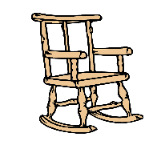
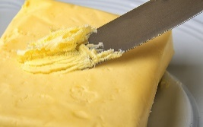
Write the compound words using the pictures as clues and draw the compound word formed.
II. Write the compound words
Words
arm + chair
butter + fly
star + fish
Compound Word
armchair
butterfly
starfish
Notes:
Notes for Teacher - < Information for further reference or explanation >
Suggestions: <Ideas/ Images/ Animations / Others – To make better representation of the content >
Source of Multimedia used in this slide - <Please provide source URL where we find the image and the license agreement>
<arm> <https://pixabay.com/vectors/arm-friend-friendship-gesture-2025687/>
<chair> <https://pixabay.com/illustrations/chair-wooden-hard-seat-seating-316889/>
<armchair> <https://pixabay.com/illustrations/furniture-chair-back-seats-vector-2315966/>
<butter> <https://pixabay.com/photos/butter-knife-ingredient-food-4872620/>
<fly> <https://pixabay.com/vectors/animal-bug-fly-insect-1295160/>
<butterfly> <https://pixabay.com/vectors/animal-butterfly-chromatic-flying-2027356/>
<star> <https://pixabay.com/illustrations/star-black-silhouette-shape-design-937527/>
<fish> <https://pixabay.com/illustrations/clipart-fish-sea-water-swim-3418189/>
<starfish> <https://pixabay.com/vectors/starfish-purple-pink-sea-tropical-303554/>

Slide 5
III. Circle the compound words
pancake | people | please | panda
poster | fireworks | computer | teapot
sunlight | student | football | strawberry
ending | bamboo | snowfall | children
Notes:
Notes for Teacher - < Information for further reference or explanation >
Suggestions: <Ideas/ Images/ Animations / Others – To make better representation of the content >
Source of Multimedia used in this slide - <Please provide source URL where we find the image and the license agreement>

Slide 6
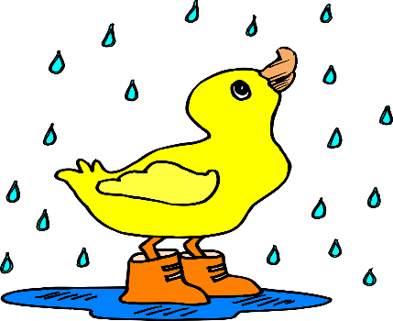
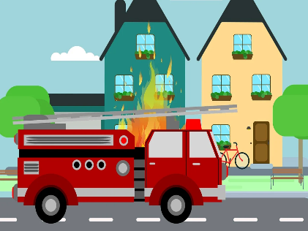
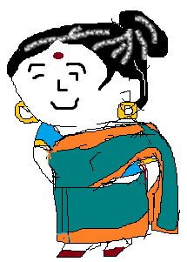
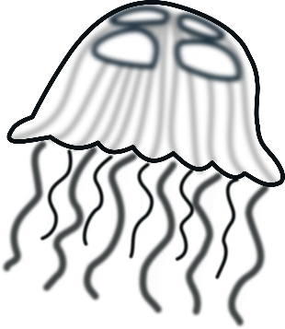
Fill in the blanks with compound words. Use the help box.
IV. Fill in the Blanks
firefighter
bluebird
jellyfish
grandmother
fireflies
raindrops
The __________ look beautiful in the dark.
The __________ formed a puddle.
We watched as the __________ climbed the ladder.
Each morning a ________sings a song to me.
My ____________is a good cook.
The ____________are very harmful.
fireflies
raindrops
firefighter
bluebird
grandmother
jellyfish
Notes:
Notes for Teacher - < Information for further reference or explanation >
Suggestions: <Ideas/ Images/ Animations / Others – To make better representation of the content >
Source of Multimedia used in this slide - <Please provide source URL where we find the image and the license agreement>
<fireflies> <https://pixabay.com/photos/lights-fireflies-glow-glowworms-5310589/>
<raindrop> <https://pixabay.com/vectors/rain-duck-puddle-boots-water-bird-312098/>
<firetruck> <https://pixabay.com/illustrations/fire-truck-fighting-extinguishing-4088850/>
<bluebird> <https://pixabay.com/vectors/mascot-blue-bird-twitter-tweet-48563/>
<grandmother> <SSSVV Image Gallery: Search Keyword “grandmother”>
<jellyfish><https://pixabay.com/vectors/jellyfish-black-white-water-animal-305392/>

Slide 7
V. Make Sentences
I use a toothbrush to clean my teeth.
toothbrush: ______________________________________
airport: ______________________________________
We can see a lot of aeroplanes at the airport.
Notes:
Notes for Teacher - < Information for further reference or explanation >
Suggestions: <Ideas/ Images/ Animations / Others – To make better representation of the content >
Source of Multimedia used in this slide - <Please provide source URL where we find the image and the license agreement>
<toothpaste> <https://pixabay.com/illustrations/tooth-toothbrush-toothpaste-dental-5453270>
<airport> <SSSVV Image Gallery: Search Keyword “airport”>

Slide 8
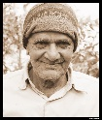
MM INDEX
Slide # | Thumbnail | Source link and Attribution
1 |  | <words> https://pixabay.com/photos/feel-word-letters-scrabble-1804600/
2 |  | <doormat> https://pixabay.com/vectors/rug-carpet-brown-white-oval-round-576081/ <grandfather> https://www.flickr.com/photos/39072595@N03/4280710509 by Yogendra Joshi <popcorn> https://pixabay.com/photos/popcorn-food-snack-bowl-yellow-166839/ <sun> <SSSVV Image Gallery: Search Keyword “sun”> <moon> <SSSVV Image Gallery: Search Keyword “moon”>
3 |  | <sun><SSSVV Image Gallery: Search Keyword “sun”> <flower> <SSSVV Image Gallery: Search Keyword “flower”> <sunflower> <SSSVVImage Gallery: Search Keyword “sunflower”> <rain> <SSSVV Image Gallery: Search Keyword “rain”> <bow> <SSSVV Image Gallery: Search Keyword “bow”> <rainbow> https://pixabay.com/illustrations/rainbow-cute-arts-kids-clipart-5112211/ <basket> <SSSVV Image Gallery: Search Keyword “basket”> <ball> https://pixabay.com/vectors/ball-gold-round-shiny-gloss-149922/ <basketball> https://pixabay.com/vectors/basketball-ball-sports-orange-157927/
4 |  | <arm> https://pixabay.com/vectors/arm-friend-friendship-gesture-2025687/ <chair> https://pixabay.com/illustrations/chair-wooden-hard-seat-seating-316889/ <armchair> https://pixabay.com/illustrations/furniture-chair-back-seats-vector-2315966/ <butter> https://pixabay.com/photos/butter-knife-ingredient-food-4872620/ <fly> https://pixabay.com/vectors/animal-bug-fly-insect-1295160/ <butterfly> https://pixabay.com/vectors/animal-butterfly-chromatic-flying-2027356/ <star> https://pixabay.com/illustrations/star-black-silhouette-shape-design-937527/ <fish> https://pixabay.com/illustrations/clipart-fish-sea-water-swim-3418189/ <starfish> https://pixabay.com/vectors/starfish-purple-pink-sea-tropical-303554
6 |  | <fireflies> https://pixabay.com/photos/lights-fireflies-glow-glowworms-5310589/ <raindrop> https://pixabay.com/vectors/rain-duck-puddle-boots-water-bird-312098/ <firetruck> https://pixabay.com/illustrations/fire-truck-fighting-extinguishing-4088850/ <bluebird> https://pixabay.com/vectors/mascot-blue-bird-twitter-tweet-48563/ <grandmother> <SSSVV Image Gallery: Search Keyword “grandmother”> <jellyfish> https://pixabay.com/vectors/jellyfish-black-white-water-animal-305392/
7 |  | <toothpaste> https://pixabay.com/illustrations/tooth-toothbrush-toothpaste-dental-5453270 <airport> <SSSVV Image Gallery: Search Keyword “airport”>
Notes:
Notes for Teacher - < Information for further reference or explanation >
Suggestions: <Ideas/ Images/ Animations / Others – To make better representation of the content >
Source of Multimedia used in this slide - <Please provide source URL where we find the image and the license agreement>

