Slide 1
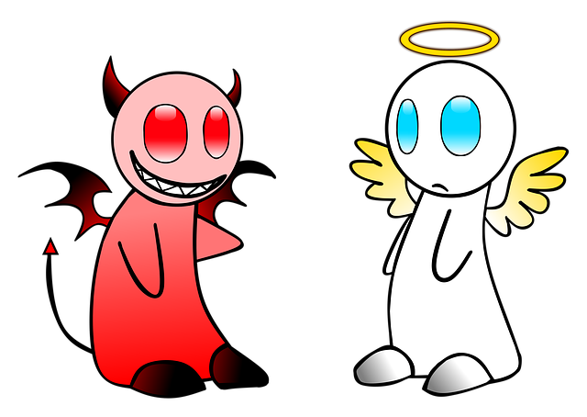
All About Opposites
Notes:
Notes for Teacher - < Information for further reference or explanation >
Suggestions: <Ideas/ Images/ Animations / Others – To make better representation of the content >
Source of Multimedia used in this slide - <Please provide source URL where we find the image and the license agreement>
<angel and devil> <https://pixabay.com/illustrations/angel-devil-good-evil-heaven-1939761/>

Slide 2
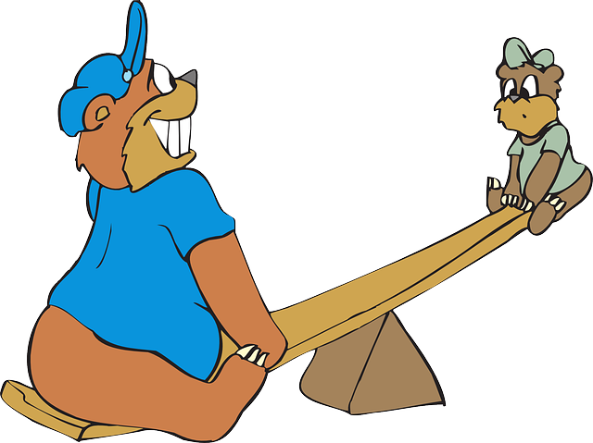
What are Opposites?
Opposites are pairs of words that have different meanings/or contrasting words.
Examples
big/small
fast/slow
happy/sad
Notes:
Notes for Teacher - < Information for further reference or explanation >
Suggestions: <Ideas/ Images/ Animations / Others – To make better representation of the content >
Source of Multimedia used in this slide - <Please provide source URL where we find the image and the license agreement>
<big/small> <https://pixabay.com/vectors/small-see-saw-big-bears-playing-46188/>
<fast/slow> <https://pixabay.com/vectors/alphabet-word-images-fast-icon-1298865/>
<happy/sad> <https://pixabay.com/illustrations/mask-happy-sad-costume-smile-face-3682206/>

Slide 3
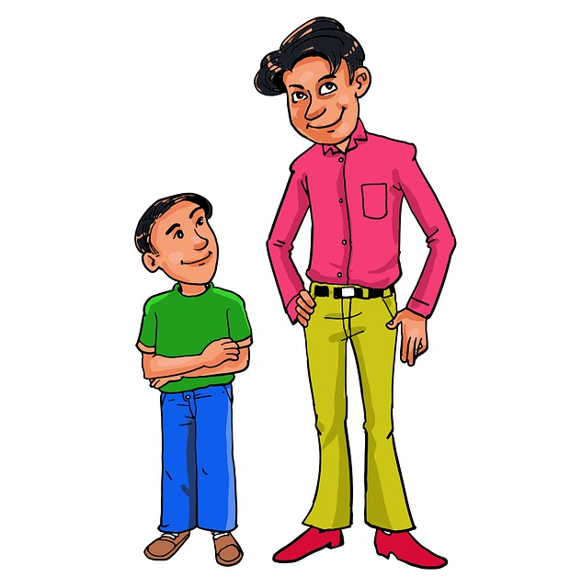
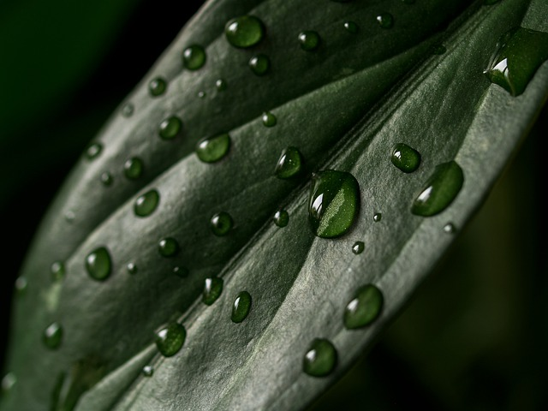
Examples of Opposites (Adjectives)
happy/sad
(emotion)
round/flat
(shape)
wet/dry
(condition)
tall/short
(height)
Notes:
Notes for Teacher - < Information for further reference or explanation >
Explain the adjectives with each pair of opposites.
Suggestions: <Ideas/ Images/ Animations / Others – To make better representation of the content >
Source of Multimedia used in this slide - <Please provide source URL where we find the image and the license agreement>
<round> <https://pixabay.com/vectors/red-button-circle-round-icon-41378/>
<happy/sad> <https://pixabay.com/illustrations/mask-happy-sad-costume-smile-face-3682206/>
<wet/dry> <https://pixabay.com/photos/leaf-plant-texture-drops-water-5533218/>
<tall/short> <https://pixabay.com/illustrations/height-and-short-man-short-tall-man-5740589/>

Slide 4
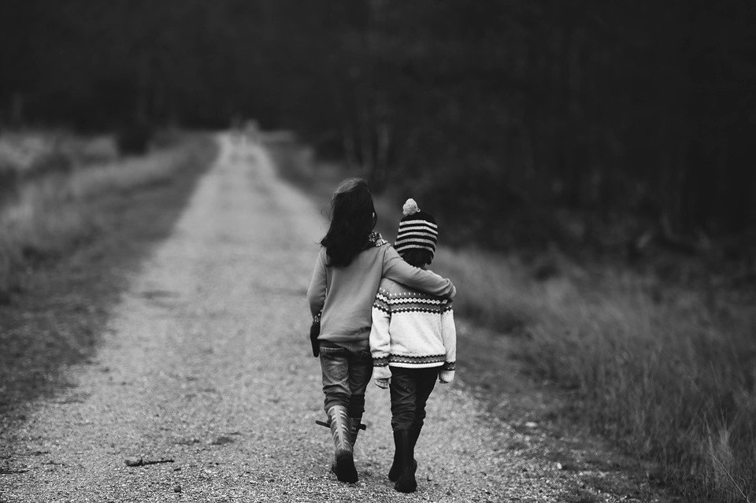
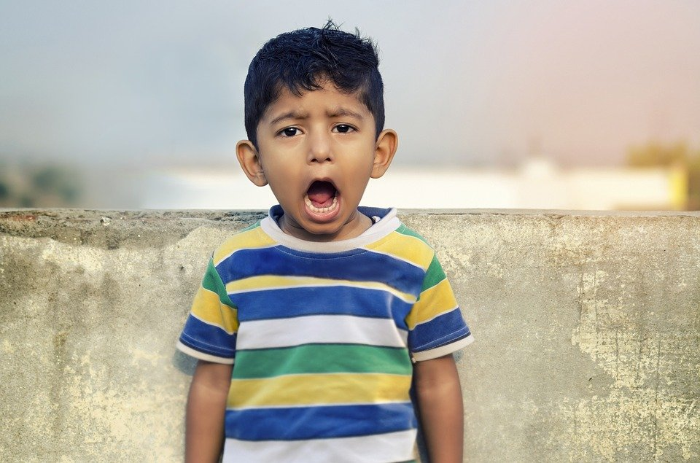
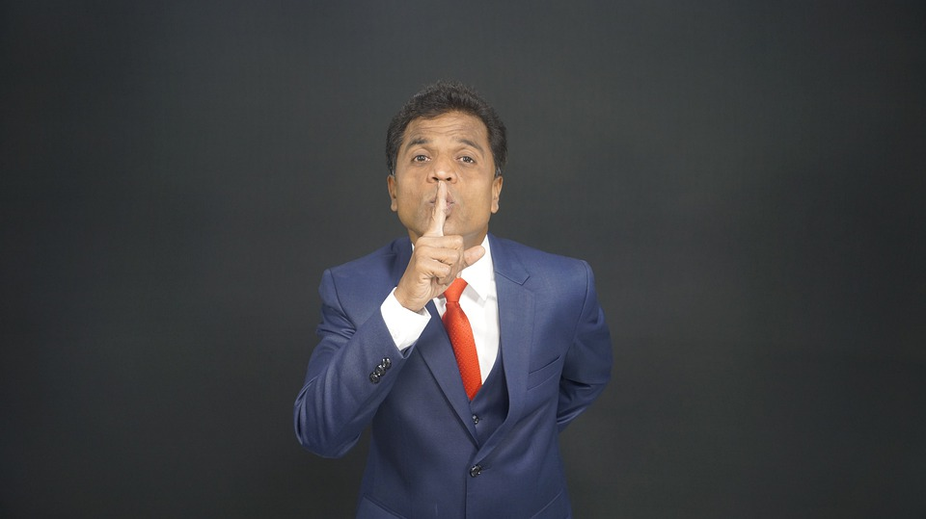
Examples of Opposites
Take a big step and a small step.
First turn right and then left.
Colour the black and white picture!
Be quiet and don’t be noisy!
Notes:
Notes for Teacher - < Information for further reference or explanation >
The teacher can ask the students to do a few actions in the classroom to have a better understanding of the concept.
Suggestions: <Ideas/ Images/ Animations / Others – To make better representation of the content >
Source of Multimedia used in this slide - <Please provide source URL where we find the image and the license agreement>
<Big Step> <https://media.radiosai.org/journals/vol_14/01MAY16/SUMMER-SHOWERS-ILLUSTRATED-1990-DISCOURSE-17.htm> Edited Image
<Small Step> <https://media.radiosai.org/journals/vol_14/01MAY16/SUMMER-SHOWERS-ILLUSTRATED-1990-DISCOURSE-17.htm> Edited Image
<Turn> <https://pixabay.com/photos/sign-traffic-right-left-turn-road-2020917/>
<Picture> <https://pixabay.com/photos/children-road-supportive-support-1149671/>
<Shout> <https://pixabay.com/photos/boy-child-shouting-shout-loud-2380079/>
<Quiet> <https://pixabay.com/photos/silent-shut-up-no-comment-5744384/>

Slide 5
Adjectives and Opposites
beautiful
new
polite
poor
safe
strong
true
hardworking
ugly
old
impolite
rich
dangerous
weak
false
lazy
early
right
interesting
fat
light
difficult
cheap
bitter
late
wrong
boring
thin
heavy
easy
expensive
sweet
Notes:
Notes for Teacher - < Information for further reference or explanation >
Suggestions: <Ideas/ Images/ Animations / Others – To make better representation of the content >
Source of Multimedia used in this slide - <Please provide source URL where we find the image and the license agreement>

Slide 6
Adjectives and Opposites
careful
empty
deep
calm
wide
young
private
friend
careless
full
shallow
excited
narrow
old
public
enemy
sharp
rough
fresh
temporary
blunt
smooth
stale
permanent
Notes:
Notes for Teacher - < Information for further reference or explanation >
Suggestions: <Ideas/ Images/ Animations / Others – To make better representation of the content >
Source of Multimedia used in this slide - <Please provide source URL where we find the image and the license agreement>
<classroom> <https://pixabay.com/vectors/blackboard-boys-chalkboard-children-1299841/>

Slide 7
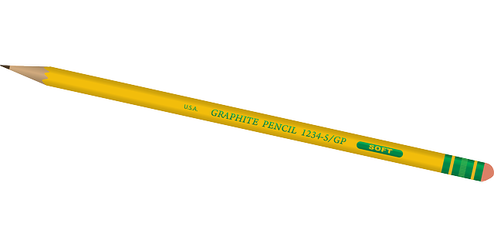
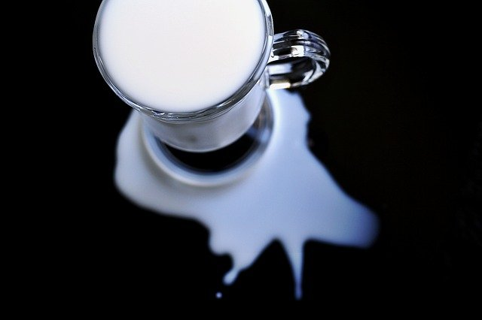
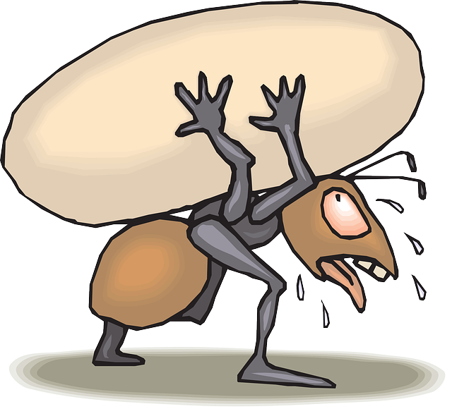
Examples of opposites with sentences
We should eat fresh fruits and vegetables and not stale ones.
Use a sharp pencil to draw and not a blunt pencil.
If you are careful, then you can avoid making careless mistakes.
The most difficult task can become easy if we work hard.
Notes:
Notes for Teacher - < Information for further reference or explanation >
The teacher may help the students in framing sentences with as many opposites as possible so that they can learn new words. A few are given below. Suggestions: <Ideas/ Images/ Animations / Others – To make better representation of the content >
Source of Multimedia used in this slide - <Please provide source URL where we find the image and the license agreement>
<fresh fruit> <https://pixabay.com/vectors/fruit-bowl-fruits-food-fresh-diet-2411828/>
<pencil> <https://pixabay.com/vectors/pencil-yellow-writing-write-tool-33449/>
<spilt milk> <https://pixabay.com/photos/milk-spilt-white-glass-spill-1543193/>
<hard work> <https://pixabay.com/vectors/ant-brown-carrying-egg-white-44588/>

Slide 8
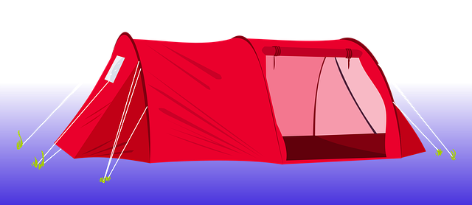
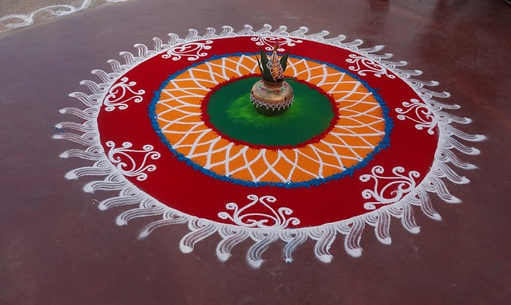
Examples of opposites with sentences
A tent is a temporary house but a house made of bricks and cement is permanent.
Expensive things are not always the best, cheap things can be the best too.
Festivals are celebrated by the young and old in our country.
Notes:
Notes for Teacher - < Information for further reference or explanation >
The teacher may help the students in framing sentences with as many opposites as possible so that they can learn new words. A few are given below. Suggestions: <Ideas/ Images/ Animations / Others – To make better representation of the content >
Source of Multimedia used in this slide - <Please provide source URL where we find the image and the license agreement>
<tent> <https://pixabay.com/illustrations/tent-camping-red-clip-art-1139376/>
<gift> <https://pixabay.com/vectors/gift-present-wrapped-bow-ribbon-575653/>
<festival> <https://pixabay.com/photos/rangoli-colorful-indian-festival-231339/>

Slide 9
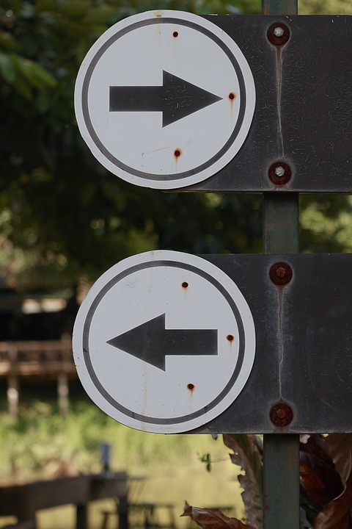
MM INDEX
Slide # | Thumbnail | Source link and Attribution
1 |  | <angel and devil> https://pixabay.com/illustrations/angel-devil-good-evil-heaven-1939761/
2 |  | <big/small> https://pixabay.com/vectors/small-see-saw-big-bears-playing-46188/ <fast/slow> https://pixabay.com/vectors/alphabet-word-images-fast-icon-1298865/
2, 3 |  | <happy/sad> https://pixabay.com/illustrations/mask-happy-sad-costume-smile-face-3682206/
3 |  | <wet/dry> https://pixabay.com/photos/leaf-plant-texture-drops-water-5533218/ <round> https://pixabay.com/vectors/red-button-circle-round-icon-41378/ <tall/short> https://pixabay.com/illustrations/height-and-short-man-short-tall-man-5740589/
4 |  | <Big Step> https://media.radiosai.org/journals/vol_14/01MAY16/SUMMER-SHOWERS-ILLUSTRATED-1990-DISCOURSE-17.htm Edited Image <Small Step> https://media.radiosai.org/journals/vol_14/01MAY16/SUMMER-SHOWERS-ILLUSTRATED-1990-DISCOURSE-17.htm Edited Image <Turn> https://pixabay.com/photos/sign-traffic-right-left-turn-road-2020917/ <Picture> https://pixabay.com/photos/children-road-supportive-support-1149671/ <Shout> https://pixabay.com/photos/boy-child-shouting-shout-loud-2380079/ <Quiet> https://pixabay.com/photos/silent-shut-up-no-comment-5744384/
7 |  | <fresh fruit> https://pixabay.com/vectors/fruit-bowl-fruits-food-fresh-diet-2411828/ <pencil> https://pixabay.com/vectors/pencil-yellow-writing-write-tool-33449/ <spilt milk> https://pixabay.com/photos/milk-spilt-white-glass-spill-1543193/ <hard work> https://pixabay.com/vectors/ant-brown-carrying-egg-white-44588/
8 |  | <tent> https://pixabay.com/illustrations/tent-camping-red-clip-art-1139376/ <gift> https://pixabay.com/vectors/gift-present-wrapped-bow-ribbon-575653/ <festival> https://pixabay.com/photos/rangoli-colorful-indian-festival-231339/
Notes:
Notes for Teacher - < Information for further reference or explanation >
Suggestions: <Ideas/ Images/ Animations / Others – To make better representation of the content >
Source of Multimedia used in this slide - <Please provide source URL where we find the image and the license agreement>

