Slide 1
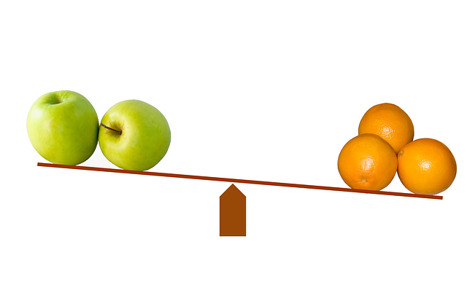
Gaining more Knowledge on Degrees of Comparison of Adjectives
Notes:
Notes for Teacher - < Information for further reference or explanation >
Suggestions: <Ideas/ Images/ Animations / Others – To make better representation of the content >
Source of Multimedia used in this slide - <Please provide source URL where we find the image and the license agreement>
<comparisons> <https://pixabay.com/illustrations/compare-comparison-scale-balance-643305/>

Slide 2
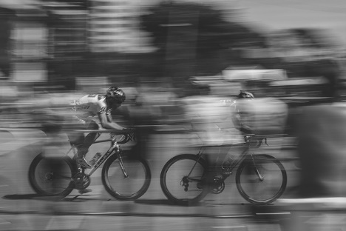
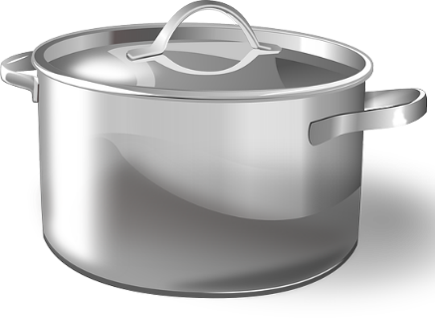
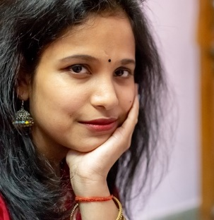
Forms of Comparative Adjectives: Form 1
Form No:1 - One syllable and two syllable adjectives most commonly use ‘er’ form.
Examples:
fast - (fa+st) - faster
heavy - (hea+vy) - heavier
large - (lar+ge) - larger
pretty - (pre+tty ) - prettier
Notes:
Notes for Teacher - < Information for further reference or explanation >
Suggestions: <Ideas/ Images/ Animations / Others – To make better representation of the content >
Source of Multimedia used in this slide - <Please provide source URL where we find the image and the license agreement>
<fast> <https://pixabay.com/photos/bike-riding-fast-moving-bike-motion-1149234/>
<heavy> <https://pixabay.com/photos/heavy-hard-work-hard-work-young-934552/>
<large> <https://pixabay.com/vectors/cooking-pot-sauce-pan-pot-cooking-146459/>
<pretty> <https://pixabay.com/photos/indian-girl-female-fashion-asian-4985302/>

Slide 3
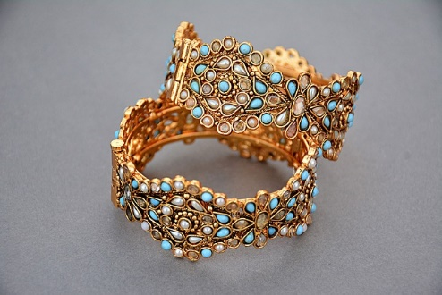
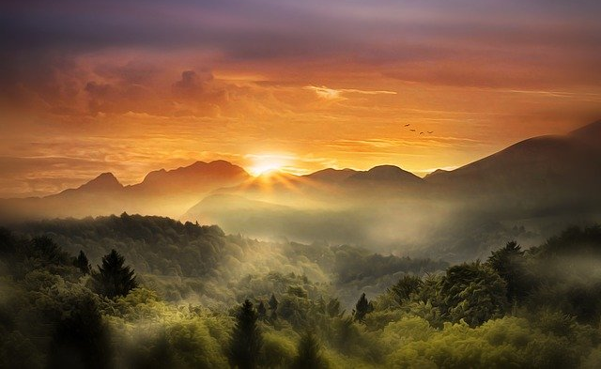
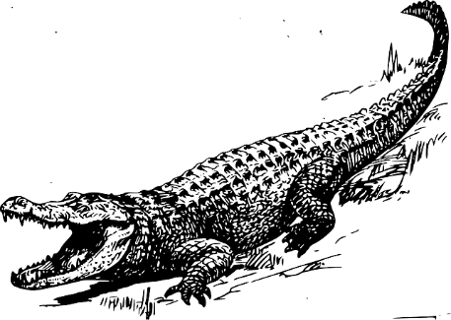
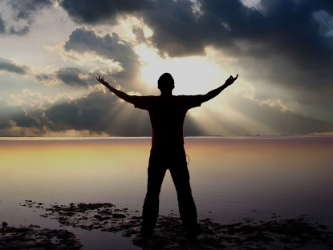
Forms of Comparative Adjectives: Form 2
Form No:2 - The more or less + adjective, is used when there are adjectives with three syllables.
Examples:
expensive(ex+pen+sive)- more or less expensive
beautiful(beau+ti+ful)- more or less beautiful
dangerous-(dan+ger+ous)- more or less dangerous
wonderful(won+der+ful)- more or less wonderful.
Notes:
Notes for Teacher - < Information for further reference or explanation >
Suggestions: <Ideas/ Images/ Animations / Others – To make better representation of the content >
Source of Multimedia used in this slide - <Please provide source URL where we find the image and the license agreement>
<expensive> <https://pixabay.com/photos/jewellery-golden-gold-jewelry-1175533/>
<beautiful> <https://pixabay.com/photos/landscape-sunset-sunrise-beautiful-4013258/>
<dangerous> <https://pixabay.com/vectors/alligators-dangerous-crocodiles-37912/>
<wonderful> <https://pixabay.com/photos/rays-wonder-sun-light-wonderful-2464986/>

Slide 4
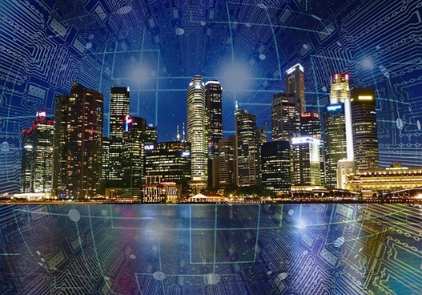
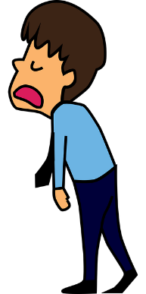
Exception to Form 2
Exception to rule - more or less + adjective words can be used with two syllable words also.
Examples:
modern - more or less modern
polite - more or less polite
tired - more or less tired
Notes:
Notes for Teacher - < Information for further reference or explanation >
Suggestions: <Ideas/ Images/ Animations / Others – To make better representation of the content >
Source of Multimedia used in this slide - <Please provide source URL where we find the image and the license agreement>
<modern> <https://pixabay.com/photos/city-smart-modern-future-connect-4317139/>
<polite> <https://pixabay.com/illustrations/thanks-thank-you-message-grateful-1314692/>
<tired> <https://pixabay.com/vectors/man-employee-exhausted-tired-5754626/>

Slide 5
Forms of Comparative Adjectives: Form 3
Some adjectives are compared irregularly
Form No 3: Irregular forms of comparison
Their comparatives are not formed from their positive forms
A completely new word is formed
Positive | Comparative
Good | Better
Bad | Worse
Much | More
Examples:
Notes:
Notes for Teacher - < Information for further reference or explanation >
Suggestions: <Ideas/ Images/ Animations / Others – To make better representation of the content >
Source of Multimedia used in this slide - <Please provide source URL where we find the image and the license agreement>
<expensive> <https://pixabay.com/photos/jewellery-golden-gold-jewelry-1175533/>
<beautiful> <https://pixabay.com/photos/landscape-sunset-sunrise-beautiful-4013258/>
<dangerous> <https://pixabay.com/vectors/alligators-dangerous-crocodiles-37912/>
<wonderful> <https://pixabay.com/photos/rays-wonder-sun-light-wonderful-2464986/>

Slide 6
Comparative Adjectives and their Forms
Positive | Comparative
angry | angrier
bold | bolder
Brave | braver
bright | brighter
busy | busier
big | bigger
clean | cleaner
dry | drier
early | earlier
grand | grander
calm | calmer
Positive | Comparative
cold | colder
crispy | crispier
coarse | coarser
dark | darker
dirty | dirtier
easy | easier
fat | fatter
fair | fairer
beautiful | more beautiful
dangerous | more dangerous
famous | more famous
Positive | Comparative
perfect | more perfect
comfortable | more comfortable
quick | quicker
close | closer
sweet | sweeter
young | younger
old | older
kind | kinder
cheap | cheaper
Notes:
Notes for Teacher - < Information for further reference or explanation >
Suggestions: <Ideas/ Images/ Animations / Others – To make better representation of the content >
Source of Multimedia used in this slide - <Please provide source URL where we find the image and the license agreement>

Slide 7
Comparative Adjectives and their Forms
Irregular Adjectives. Irregular Positive | Comparative
bad | worse
good | better
much | more
many | more
little | lesser
Notes:
Notes for Teacher - < Information for further reference or explanation >
Suggestions: <Ideas/ Images/ Animations / Others – To make better representation of the content >
Source of Multimedia used in this slide - <Please provide source URL where we find the image and the license agreement>

Slide 8
MM INDEX
Slide # | Thumbnail | Source link and Attribution
1 |  | Comparisons: https://pixabay.com/illustrations/compare-comparison-scale-balance-643305/
2 |  | Fast: https://pixabay.com/photos/bike-riding-fast-moving-bike-motion-1149234/ Heavy: https://pixabay.com/photos/heavy-hard-work-hard-work-young-934552/ Large: https://pixabay.com/vectors/cooking-pot-sauce-pan-pot-cooking-146459/ Pretty: https://pixabay.com/photos/indian-girl-female-fashion-asian-4985302/
3 |  | Expensive: https://pixabay.com/photos/jewellery-golden-gold-jewelry-1175533/ Beautiful: https://pixabay.com/photos/landscape-sunset-sunrise-beautiful-4013258/ Dangerous: https://pixabay.com/vectors/alligators-dangerous-crocodiles-37912/ Wonderful: https://pixabay.com/photos/rays-wonder-sun-light-wonderful-2464986/
4 |  | Polite: https://pixabay.com/illustrations/thanks-thank-you-message-grateful-1314692/ Tired: https://pixabay.com/vectors/man-employee-exhausted-tired-5754626/ Modern: https://pixabay.com/photos/city-smart-modern-future-connect-4317139/
Notes:
Notes for Teacher - < Information for further reference or explanation >
Suggestions: <Ideas/ Images/ Animations / Others – To make better representation of the content >
Source of Multimedia used in this slide - <Please provide source URL where we find the image and the license agreement>

