Slide 1
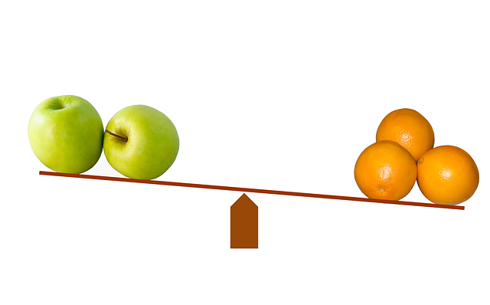
Exploring Degrees of Comparison of Adjectives
Notes:
Notes for Teacher - < Information for further reference or explanation >
Suggestions: <Ideas/ Images/ Animations / Others – To make better representation of the content >
Source of Multimedia used in this slide - <Please provide source URL where we find the image and the license agreement>
<comparisons> <https://pixabay.com/illustrations/compare-comparison-scale-balance-643305/>

Slide 2
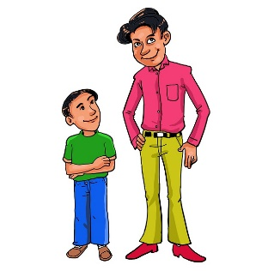
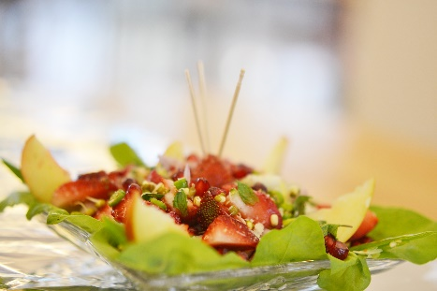
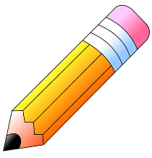
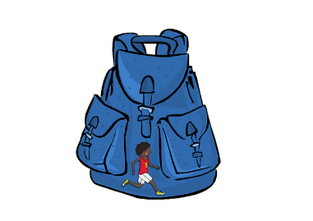
Recapitulation on Adjectives
People and animals - tall, short, kind, fat, thin.
Food items - big, small, sweet, delicious, tasty, juicy.
Pencils - long and short ones, striped.
School bags - blue, big, plastic, cloth.
Notes:
Notes for Teacher - < Information for further reference or explanation >
Suggestions: <Ideas/ Images/ Animations / Others – To make better representation of the content >
Source of Multimedia used in this slide - <Please provide source URL where we find the image and the license agreement>
<tall short> <https://pixabay.com/illustrations/height-and-short-man-short-tall-man-5740589/>
<snacks> <SSSVV Image Gallery: Search Keyword: “snacks”>
<pencil> <https://pixabay.com/illustrations/pencil-school-supplies-5507780/>
<school bags> <https://pixabay.com/illustrations/backpack-bag-school-hike-healthy-924589/>

Slide 3
Degrees of Comparison
When adjectives change in form to show comparison, they are called - degrees of comparison.
Degrees Of Comparison
Positive
Comparative
Superlative
Notes:
Notes for Teacher - < Information for further reference or explanation >
Suggestions: <Ideas/ Images/ Animations / Others – To make better representation of the content >
Source of Multimedia used in this slide - <Please provide source URL where we find the image and the license agreement>

Slide 4
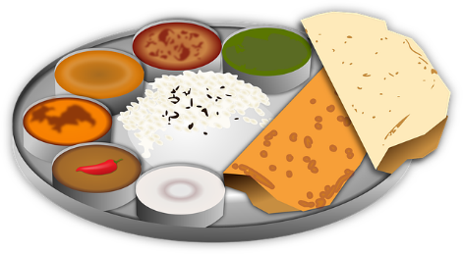
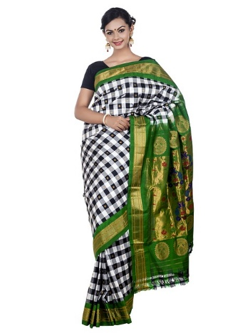
Positive Degree of Comparison
This type of adjective is in its basic form.
1. She is as tall as her father.
2. Iron is a heavy metal.
3. My mother makes tasty food.
4. She is wearing a beautiful saree.
Tall, heavy, tasty, and beautiful are in their original forms.
They are called positive degree of comparison.
Notes:
Notes for Teacher - < Information for further reference or explanation >
Suggestions: <Ideas/ Images/ Animations / Others – To make better representation of the content >
Source of Multimedia used in this slide - <Please provide source URL where we find the image and the license agreement>
<girl> <https://pixabay.com/illustrations/woman-student-book-fashion-girl-5957134/>
<Man> <SSSVV Image Gallery: Search Keyword “man”>
<iron> <https://pixabay.com/vectors/metal-blocks-steel-commodity-iron-36867/>
<food> <https://pixabay.com/vectors/bread-cultural-culture-curry-food-1296280/>
<saree> <https://pixabay.com/photos/wedding-saree-collection-1050933/>

Slide 5
Comparative Degree of Comparison
Comparison of the same quality between two people or things,
we use – ‘er’ form of the adjective to show comparison.
It is called the Comparative degree.
Notes:
Notes for Teacher - < Information for further reference or explanation >
Suggestions: <Ideas/ Images/ Animations / Others – To make better representation of the content >
Source of Multimedia used in this slide - <Please provide source URL where we find the image and the license agreement>
<comparison> <https://pixabay.com/vectors/arrows-left-right-faces-funny-35160/>

Slide 6
Comparative Degree of Comparison
Examples
1. Ajay can run faster than Arun.
2. My brother is taller than my father.
3. Anita looks prettier than her sister.
4. The elephant is heavier than a tiger.
5. Homemade food is tastier than hotel food.
Notes:
Notes for Teacher - < Information for further reference or explanation >
Suggestions: <Ideas/ Images/ Animations / Others – To make better representation of the content >
Source of Multimedia used in this slide - <Please provide source URL where we find the image and the license agreement>

Slide 7
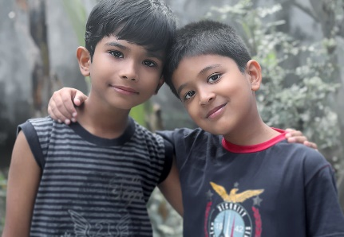
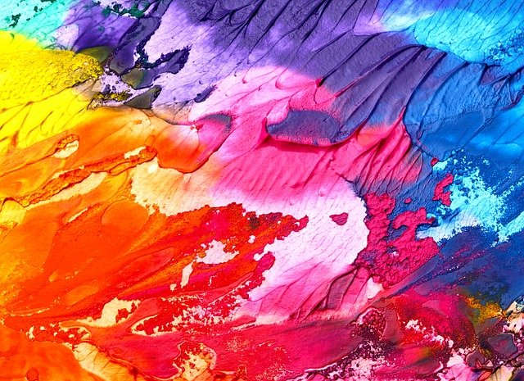
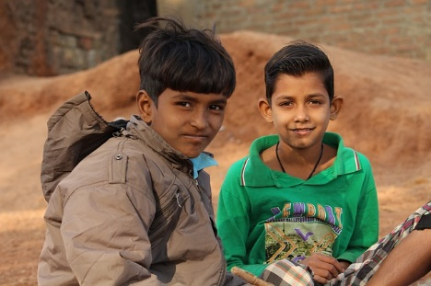
Comparing Two Nouns
Noun (Subject) + verb + comparative adjective + than + noun (object)
Examples: Ameeta’s house is larger than Rita’s.
(Ameeta (Subject) + is (verb) + larger (comparative adjective) + than + Rita’s house(object).
1. Vivek is smarter than Anuj.
2. Her paintings are more beautiful than her sister’s.
3. His behavior is better than his brother’s.
Notes:
Notes for Teacher - < Information for further reference or explanation >
Suggestions: <Ideas/ Images/ Animations / Others – To make better representation of the content >
Source of Multimedia used in this slide - <Please provide source URL where we find the image and the license agreement>
<two boys> <https://www.flickr.com/photos/nithiclicks/16019423039> By Nithi Anand
<painting> <https://pixabay.com/photos/colorful-painting-background-2468874/>
<two brothers> <https://pixabay.com/photos/poor-boy-cute-village-boy-child-4133641/>

Slide 8
MM INDEX
Slide # | Thumbnail | Source link and Attribution
1 |  | Comparisons: https://pixabay.com/illustrations/compare-comparison-scale-balance-643305/
2 |  | Tall short: https://pixabay.com/illustrations/height-and-short-man-short-tall-man-5740589/ Snacks: SSSVV Image Gallery: Search Keyword: “snacks” Pencil: https://pixabay.com/illustrations/pencil-school-supplies-5507780/ School Bags: https://pixabay.com/illustrations/backpack-bag-school-hike-healthy-924589/
4 |  | Girl: https://pixabay.com/illustrations/woman-student-book-fashion-girl-5957134/ Food: https://pixabay.com/vectors/bread-cultural-culture-curry-food-1296280/ Saree: https://pixabay.com/photos/wedding-saree-collection-1050933/ Iron: https://pixabay.com/vectors/metal-blocks-steel-commodity-iron-36867/ Man: SSSVV Image Gallery: Search Keyword “man”
5 |  | Comparison: https://pixabay.com/vectors/arrows-left-right-faces-funny-35160/
7 |  | Two boys: https://www.flickr.com/photos/nithiclicks/16019423039 By Nithi Anand Painting: https://pixabay.com/photos/colorful-painting-background-2468874/ Two brothers: https://pixabay.com/photos/poor-boy-cute-village-boy-child-4133641/
Notes:
Notes for Teacher - < Information for further reference or explanation >
Suggestions: <Ideas/ Images/ Animations / Others – To make better representation of the content >
Source of Multimedia used in this slide - <Please provide source URL where we find the image and the license agreement>

