Slide 1
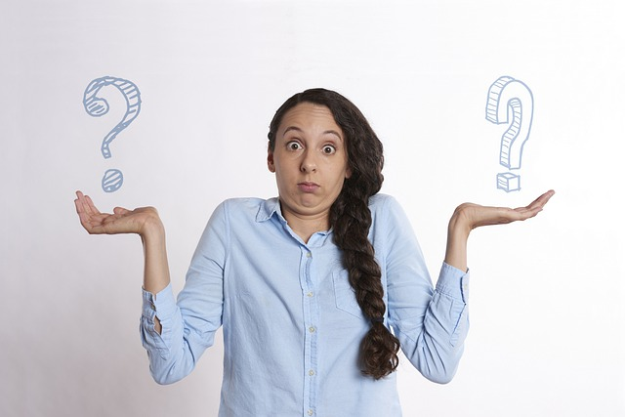
Usage of Comparatives
Notes:
Notes for Teacher - < Information for further reference or explanation >
Suggestions: <Ideas/ Images/ Animations / Others – To make better representation of the content >
Source of Multimedia used in this slide - <Please provide source URL where we find the image and the license agreement>
<comparisons> <https://pixabay.com/photos/compare-comparison-options-choice-5201278/>

Slide 2
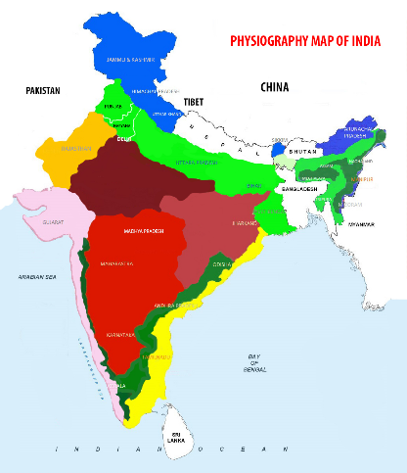
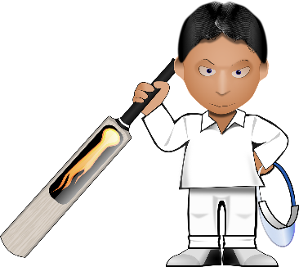
Set A
Fill in the blanks with the correct comparative form of the adjectives given in the brackets.
bigger than
1. India is ___________ Sri Lanka. (big)
2. A snake bite __________________ a bee sting. (danger)
3. Cricket is ________________ football in our country. (popular)
4. She is three years ____________ her sister. (young)
5. Chennai is ___________ Delhi in December. (warm)
more dangerous than
more popular than
younger than
warmer than
Notes:
Notes for Teacher - < Information for further reference or explanation >
Suggestions: <Ideas/ Images/ Animations / Others – To make better representation of the content >
Source of Multimedia used in this slide - <Please provide source URL where we find the image and the license agreement>
<india map> <SSSVV>
<airoplane> <SSSVV>
<cricket> <https://pixabay.com/vectors/cricket-bat-cricketer-player-33064/>

Slide 3
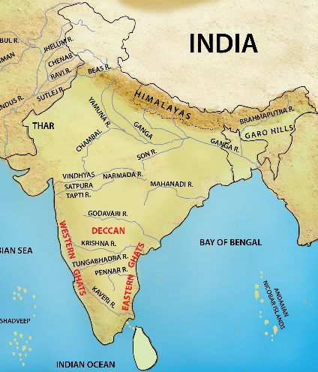
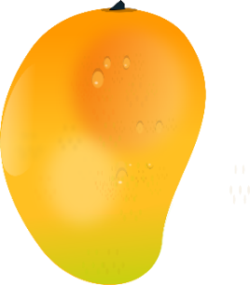
Set A
Fill in the blanks with the correct comparative form of the adjectives given in the brackets.
faster than
A cheetah/leopard runs __________ a lion. (fast )
The river Ganges is ___________ the Cauvery river. (long)
A feather is ___________ a pen. (light)
Ajay is ___________ Anil in Mathematics. (clever)
Mangoes are ___________ pineapples. (sweet)
longer than
lighter than
cleverer than
sweeter than
Notes:
Notes for Teacher - < Information for further reference or explanation >
Suggestions: <Ideas/ Images/ Animations / Others – To make better representation of the content >
Source of Multimedia used in this slide - <Please provide source URL where we find the image and the license agreement>
<cheetah> <https://pixabay.com/vectors/cheetah-running-speed-animal-fast-48433/>
<river map> <SSSVV>
<pen> <https://pixabay.com/vectors/ink-paper-pen-writing-filler-150697/>
<feather> <https://pixabay.com/illustrations/feather-gray-grey-design-light-1093535/>
<pineapple> <https://pixabay.com/vectors/pineapple-fruit-tropical-fresh-25251/>
<mango> <https://pixabay.com/vectors/mango-ripe-food-fruit-fresh-304315/>

Slide 4
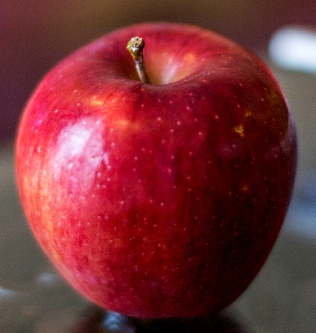
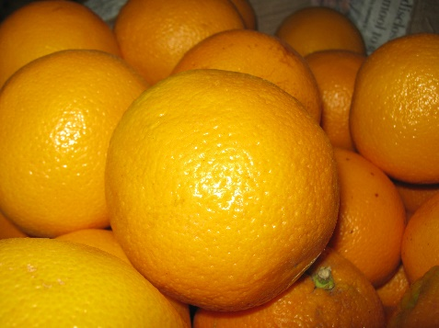
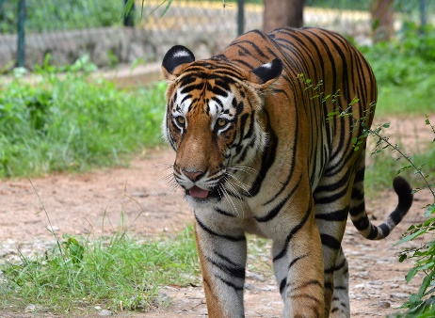
Set B
Fill in the blanks with the correct comparative form of the adjectives given in the brackets.
more expensive than
Apples are _________________ oranges. (expensive)
There is no animal _________________a tiger in the jungle world. (cruel)
The pen is ____________ sword. (strong)
He requires a ____________________ diet to take part in sports activities. (healthy)
My uncle is __________ my father. (rich)
more cruel than
stronger than
more healthy/healthier
richer than
Notes:
Notes for Teacher - < Information for further reference or explanation >
Suggestions: <Ideas/ Images/ Animations / Others – To make better representation of the content >
Source of Multimedia used in this slide - <Please provide source URL where we find the image and the license agreement>
<pen> <https://pixabay.com/vectors/ink-paper-pen-writing-filler-150697/>
<tiger> <SSSVV>
<apple> <SSSVV>
<orange> SSSVV>

Slide 5
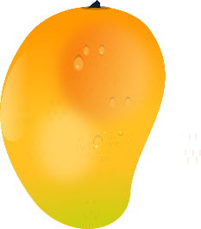
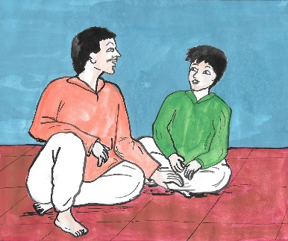
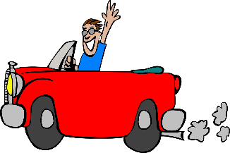
Set B
Fill in the blanks with the correct comparative form of the adjectives given in the brackets.
sweeter than
Mangoes are ___________ pineapples. (sweet)
Dwarfs are very short, they are __________ 5 feet. (little)
Raja is __________________ Ashok. (intelligent)
I am a ______ dancer _____ my sister. (good)
Driving is __________________ flying. (danger)
less than
more intelligent than
better
than
more dangerous than
Notes:
Notes for Teacher - < Information for further reference or explanation >
Suggestions: <Ideas/ Images/ Animations / Others – To make better representation of the content >
Source of Multimedia used in this slide - <Please provide source URL where we find the image and the license agreement>
<pineapple> <https://pixabay.com/vectors/pineapple-fruit-tropical-fresh-25251/>
<mango> <https://pixabay.com/vectors/mango-ripe-food-fruit-fresh-304315/>
<boys> <SSSVV>
<dancer> <SSSVV>
<driver> <https://pixabay.com/vectors/cabriolet-car-guy-wave-grin-310460/>

Slide 6
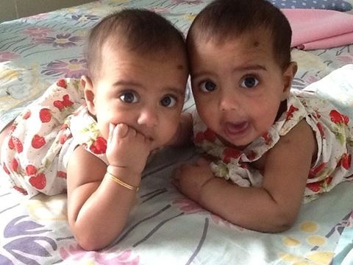
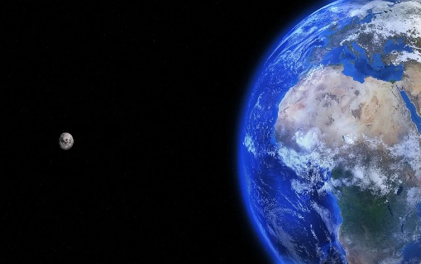
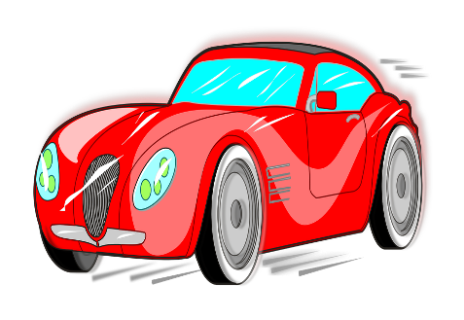
Set C
Fill in the blanks with the correct comparative form of the adjectives given in the brackets.
worse than
His marks are __________ mine. (bad)
Vinita is _________________ Veena. (talkative)
This exercise is __________ the previous one. (easy)
The car is ________________ yours. (modern)
The earth is __________ the moon. (large)
more talkative than
easier than
more modern than
larger than
Notes:
Notes for Teacher - < Information for further reference or explanation >
Suggestions: <Ideas/ Images/ Animations / Others – To make better representation of the content >
Source of Multimedia used in this slide - <Please provide source URL where we find the image and the license agreement>
<yoga> <https://pixabay.com/illustrations/silhouette-woman-yoga-3092140>
<car> <https://pixabay.com/vectors/game-red-speed-car-1300503/>
<earth and moon> <https://pixabay.com/photos/earth-moon-space-planet-world-1365995/>
<two girls> <SSSVV>

Slide 7
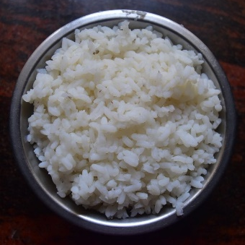
Set C
Fill in the blanks with the correct comparative form of the adjectives given in the brackets.
better than
Prevention is __________ cure.(good)
Steamed food is ____________ fried food. (healthy)
A peacock is _________________ a hare. (beautiful)
The river Ganges is __________ the Cauvery river. (long)
A feather is ___________ a pen. (light)
healthier than
more beautiful than
longer than
lighter than
Notes:
Notes for Teacher - < Information for further reference or explanation >
Suggestions: <Ideas/ Images/ Animations / Others – To make better representation of the content >
Source of Multimedia used in this slide - <Please provide source URL where we find the image and the license agreement>
<pen> <https://pixabay.com/vectors/ink-paper-pen-writing-filler-150697/>
<feather> <https://pixabay.com/illustrations/feather-gray-grey-design-light-1093535/>
<rice> <SSSVV>
<workout> <https://pixabay.com/vectors/gym-weight-lifting-muscle-exercise-307770/>
<cycling> <SSSVV>

Slide 8
MM INDEX
Slide # | Thumbnail | Source link and Attribution
1 |  | <comparisons> https://pixabay.com/photos/compare-comparison-options-choice-5201278/
2 |  | <india map> <SSSVV: Image Gallery: Search Keyword “india map”> <aeroplane> <SSSVV: Image Gallery: Search Keyword “plane”> <cricket> https://pixabay.com/vectors/cricket-bat-cricketer-player-33064/
3 |  | <cheetah> https://pixabay.com/vectors/cheetah-running-speed-animal-fast-48433/ <river map> <SSSVV: Image Gallery: Search Keyword “river map”> <pen> https://pixabay.com/vectors/ink-paper-pen-writing-filler-150697/ <feather> https://pixabay.com/illustrations/feather-gray-grey-design-light-1093535/ <pineapple> https://pixabay.com/vectors/pineapple-fruit-tropical-fresh-25251/ <mango> https://pixabay.com/vectors/mango-ripe-food-fruit-fresh-304315/
4 |  | <pen> https://pixabay.com/vectors/ink-paper-pen-writing-filler-150697/ <tiger> <SSSVV: Image Gallery: Search Keyword “tiger”> <apple> <SSSVV: Image Gallery: Search Keyword “apple”> <orange> SSSVV: Image Gallery: Search Keyword “orange”>
5 |  | <pineapple> https://pixabay.com/vectors/pineapple-fruit-tropical-fresh-25251/ <mango> https://pixabay.com/vectors/mango-ripe-food-fruit-fresh-304315/ <boys> <SSSVV: Image Gallery: Search Keyword “boys”> <dancer> <SSSVV: Image Gallery: Search Keyword “dance”> <driver> https://pixabay.com/vectors/cabriolet-car-guy-wave-grin-310460/
6 |  | <yoga> https://pixabay.com/illustrations/silhouette-woman-yoga-3092140 <car> https://pixabay.com/vectors/game-red-speed-car-1300503/ <earth and moon> https://pixabay.com/photos/earth-moon-space-planet-world-1365995/ <two girls> <SSSVV: Image Gallery: Search Keyword “baby”>
7 |  | <pen> https://pixabay.com/vectors/ink-paper-pen-writing-filler-150697/ <feather> https://pixabay.com/illustrations/feather-gray-grey-design-light-1093535/ <rice> <SSSVV: Image Gallery: Search Keyword “rice”> <workout> https://pixabay.com/vectors/gym-weight-lifting-muscle-exercise-307770/ <cycling> <SSSVV: Image Gallery: Search Keyword “cycling”>
Notes:
Notes for Teacher - < Information for further reference or explanation >
Suggestions: <Ideas/ Images/ Animations / Others – To make better representation of the content >
Source of Multimedia used in this slide - <Please provide source URL where we find the image and the license agreement>

