Slide 1
I can Recognise Degrees of Comparisons
Notes:
Notes for Teacher - Aim is for students to identify and apply the concept of comparative adjectives in the given exercises.
Suggestions: <Ideas/ Images/ Animations / Others – To make better representation of the content >
Source of Multimedia used in this slide - <Please provide source URL where we find the image and the license agreement>
Degree of comparison: https://pixabay.com/vectors/justice-scales-orange-libra-311699/

Slide 2
Exercise 1
Complete the following sentence using the right adjective
She is ___________ her classmates.(brighter than/ bright/ the brightest)
Ashok is ____________ his brother.(the smartest/ smarter than/ smart)
Supriya is __________________ all the girls in the class.(intelligent/ more intelligent than/ the most intelligent)
Santosh speaks English__________ his friends.(well/ better than/ the best)
Bed is____________________ a sofa. (comfortable/ the most comfortable/ more comfortable than)
He woke up ______________ all his cousins and made arrangements for the picnic.(earlier than/ the earliest/ early)
brighter than
smarter than
more intelligent than
better than
more comfortable than
earlier than
Notes:
Notes for Teacher - < Information for further reference or explanation >
Suggestions: <Ideas/ Images/ Animations / Others – To make better representation of the content >
Source of Multimedia used in this slide - <Please provide source URL where we find the image and the license agreement>

Slide 3
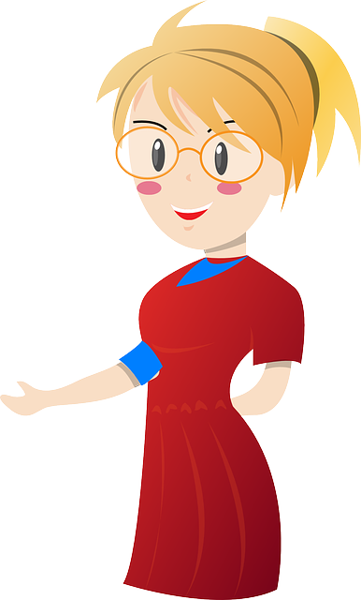
Exercise 2
Complete the table
Positive | Comparative
 | Easier
Dirty
Good
Beautiful
Positive | Comparative
Bad
Little
 | Farther
 | More
Easy
Worse
Dirtier
Less
Better
Far
More Beautiful
Much
Notes:
Notes for Teacher - < Information for further reference or explanation >
Suggestions: <Ideas/ Images/ Animations / Others – To make better representation of the content >
Source of Multimedia used in this slide - <Please provide source URL where we find the image and the license agreement>
<teacher> <https://pixabay.com/vectors/blonde-teacher-woman-female-school-160653/>

Slide 4
Exercise 3
Make sentences of your own with the correct form of comparatives of the adjectives.
Example : Cold - Srinagar is colder than Delhi.
Hot ___________________________________________
Good ___________________________________________
Bright ___________________________________________
Sweet ___________________________________________
Clean ___________________________________________
Jaipur is hotter than Mumbai in the month of June.
Anil is better than his brother in Science.
The stars are shining brighter than the moon.
This green mango is sweeter than that yellow mango.
Your house is cleaner than mine.
Notes:
Notes for Teacher - < Information for further reference or explanation >
Suggestions: <Ideas/ Images/ Animations / Others – To make better representation of the content >
Source of Multimedia used in this slide - <Please provide source URL where we find the image and the license agreement>

Slide 5
MM INDEX
Slide # | Thumbnail | Source link and Attribution
1 |  | Degree of comparison: https://pixabay.com/vectors/justice-scales-orange-libra-311699/
3 |  | Teacher: https://pixabay.com/vectors/blonde-teacher-woman-female-school-160653/
Notes:
Notes for Teacher - < Information for further reference or explanation >
Suggestions: <Ideas/ Images/ Animations / Others – To make better representation of the content >
Source of Multimedia used in this slide - <Please provide source URL where we find the image and the license agreement>

