Slide 1
Rules for changing Singular Nouns to Plural Nouns
Notes:
Notes for Teacher - < Information for further reference or explanation >
Suggestions: <Ideas/ Images/ Animations / Others – To make better representation of the content >
Source of Multimedia used in this slide - <Please provide source URL where we find the image and the license agreement>

Slide 2
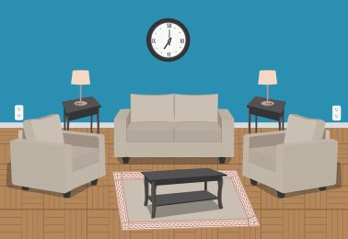
Nouns
Nouns are names of
A Person - Doctor
A Place - Living room
An Animal - Lion
A Thing - Chair
Notes:
Notes for Teacher - The teacher can begin the class by recapitulating nouns.
Suggestions: <Ideas/ Images/ Animations / Others – To make better representation of the content >
Source of Multimedia used in this slide -
Doctor: https://pixabay.com/vectors/boy-cartoon-checkup-clinic-comic-2027768/
Living Room: https://pixabay.com/vectors/living-room-home-room-furniture-3749761/
Lion: https://pixabay.com/vectors/africa-animal-cat-lion-1300564/
Chair: https://pixabay.com/vectors/chair-furniture-wood-wooden-157788/

Slide 3
Forms of Nouns
Different forms of Nouns
Singular Nouns
Plural Nouns
Irregular Plural Nouns
Notes:
Notes for Teacher - < Information for further reference or explanation >
Suggestions: <Ideas/ Images/ Animations / Others – To make better representation of the content >
Source of Multimedia used in this slide - <Please provide source URL where we find the image and the license agreement>

Slide 4
Singular Nouns
Means one
1
Refers to only one
2
Person - Doctor
Place - School
Animal - Lion
Thing - Balloon
Notes:
Notes for Teacher - < Information for further reference or explanation >
Suggestions: <Ideas/ Images/ Animations / Others – To make better representation of the content >
Source of Multimedia used in this slide -
School: https://pixabay.com/vectors/school-building-education-property-295210/
Balloon: https://pixabay.com/vectors/balloon-birthday-balloon-25734/

Slide 5
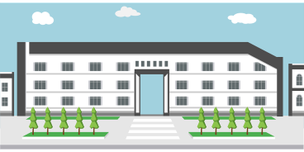
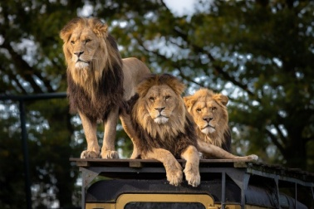
Plural Nouns
Means two or more than two
1
Refers to more than one
2
Persons - Doctors
Places - Schools
Animals - Lions
Things - Balloons
Notes:
Notes for Teacher - < Information for further reference or explanation >
Suggestions: <Ideas/ Images/ Animations / Others – To make better representation of the content >
Source of Multimedia used in this slide -
Doctors: https://pixabay.com/vectors/man-couple-men-s-and-women-s-doctor-1957067/
Schools: https://pixabay.com/vectors/school-design-building-architecture-1727572/
Lions: https://pixabay.com/photos/lion-zoo-africa-predator-animal-4581841/
Balloons: https://pixabay.com/vectors/balloons-decoration-party-decor-25737/

Slide 6
Singular Nouns to Plural Nouns
Rule 1 – By Adding ‘s’
Doctor - Doctors
Lamp - Lamps
Lion - Lions
Chair - Chairs
Notes:
Notes for Teacher - < Information for further reference or explanation >
Suggestions: <Ideas/ Images/ Animations / Others – To make better representation of the content >
Source of Multimedia used in this slide - <Please provide source URL where we find the image and the license agreement>

Slide 7
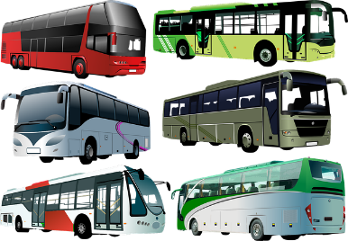
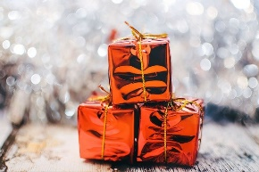
Singular Nouns to Plural Nouns
Rule 2 – By adding ‘es’
If a noun ends in s, ss, x, sh or ch add ‘es’ to make them plural
1
It is difficult to pronounce an s after these letters
2
Bus - Buses
Box - Boxes
Bunch - Bunches
Class - Classes
Brush - Brushes
Notes:
Notes for Teacher - < Information for further reference or explanation >
Suggestions: <Ideas/ Images/ Animations / Others – To make better representation of the content >
Source of Multimedia used in this slide - <Please provide source URL where we find the image and the license agreement>
Bus: https://pixabay.com/vectors/bus-public-transport-transport-304845/
Buses: https://pixabay.com/vectors/city-bus-tourist-bus-transport-4677487/
Box: https://pixabay.com/illustrations/present-gift-wrapped-green-1417611/
Boxes: https://pixabay.com/photos/gifts-presents-shiny-christmas-2178635/

Slide 8
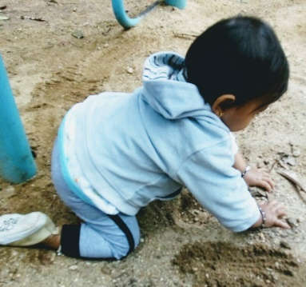
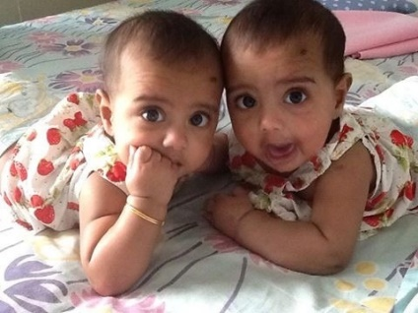
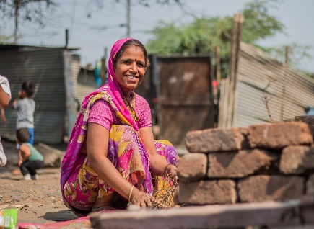
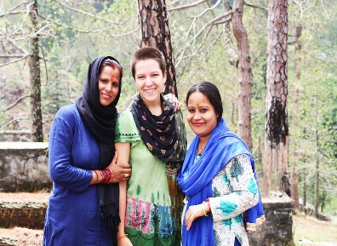
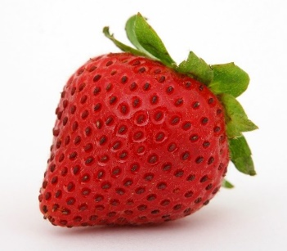
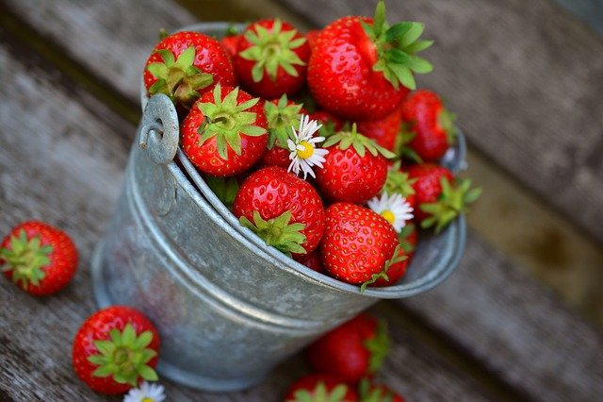
Singular Nouns to Plural Nouns
Rule 3 – By Adding ‘ies’
If a Noun ends in a consonant followed by y – remove the ‘y’ and add ‘ies’
Baby - Babies
Lady - Ladies
Strawberry - Strawberries
Notes:
Notes for Teacher - < Information for further reference or explanation >
Suggestions: <Ideas/ Images/ Animations / Others – To make better representation of the content >
Source of Multimedia used in this slide - <Please provide source URL where we find the image and the license agreement>
Baby: SSSVV: Search Keyword “baby”
Babies: SSSVV: Search Keyword “baby”
Strawberries: https://pixabay.com/photos/strawberries-fruits-berries-bucket-3431122/
Strawberry: https://pixabay.com/photos/strawberry-berry-fruit-food-fresh-1238295/
Lady: https://pixabay.com/photos/lady-street-photography-woman-2408609/
Ladies: https://pixabay.com/photos/indian-woman-lady-rural-3681655/

Slide 9
Summary
A noun names a person, place, animal or thing.
1
A singular noun refers to only one person, place, animal or thing.
2
A plural noun refers to two or more than two people, places, animals or things.
3
Notes:
Notes for Teacher - < Information for further reference or explanation >
Suggestions: <Ideas/ Images/ Animations / Others – To make better representation of the content >
Source of Multimedia used in this slide - <Please provide source URL where we find the image and the license agreement>

Slide 10
Summary
The rules to form regular plural nouns
Rule | Singular Noun | Plural Noun
For most nouns just add - s | Car | Cars
If a noun ends in s, ss, x, sh, ch add - es | Bus Class | Buses Classes
If a noun ends in y and has a consonant before it then remove the y and add - ies | Cherry Fly | Cherries Flies
Notes:
Notes for Teacher - < Information for further reference or explanation >
Suggestions: <Ideas/ Images/ Animations / Others – To make better representation of the content >
Source of Multimedia used in this slide - <Please provide source URL where we find the image and the license agreement>

Slide 11
List of some Plural Nouns
Adding - s | Adding - es | Adding - ies
Girls | Buses | Babies
Schools | Gases | Fairies
Beds | Classes | Berries
Apples | Glasses | Cherries
Flowers | Boxes | Cities
Books | Foxes | Countries
Pens | Branches | Strawberries
Plants | Churches | Flies
Elephants | Brushes | Butterflies
Notes:
Notes for Teacher - < Information for further reference or explanation >
Suggestions: <Ideas/ Images/ Animations / Others – To make better representation of the content >
Source of Multimedia used in this slide - <Please provide source URL where we find the image and the license agreement>

Slide 12
MM INDEX
Slide # | Thumbnail | Source link and Attribution
2,4 |  | Doctor: https://pixabay.com/vectors/boy-cartoon-checkup-clinic-comic-2027768/ Living Room: https://pixabay.com/vectors/living-room-home-room-furniture-3749761/ Lion: https://pixabay.com/vectors/africa-animal-cat-lion-1300564/ Chair: https://pixabay.com/vectors/chair-furniture-wood-wooden-157788/
4, 5 |  | School: https://pixabay.com/vectors/school-building-education-property-295210/ Balloon: https://pixabay.com/vectors/balloon-birthday-balloon-25734/
5 |  | Doctors: https://pixabay.com/vectors/man-couple-men-s-and-women-s-doctor-1957067/ Schools: https://pixabay.com/vectors/school-design-building-architecture-1727572/ Lions: https://pixabay.com/photos/lion-zoo-africa-predator-animal-4581841/ Balloons: https://pixabay.com/vectors/balloons-decoration-party-decor-25737/
7 |  | Bus: https://pixabay.com/vectors/bus-public-transport-transport-304845/ Buses: https://pixabay.com/vectors/city-bus-tourist-bus-transport-4677487/ Box: https://pixabay.com/illustrations/present-gift-wrapped-green-1417611/ Boxes: https://pixabay.com/photos/gifts-presents-shiny-christmas-2178635/
8 |  | Baby: SSSVV: Search Keyword “baby” Babies: SSSVV: Search Keyword “baby” Strawberries: https://pixabay.com/photos/strawberries-fruits-berries-bucket-3431122/ Strawberry: https://pixabay.com/photos/strawberry-berry-fruit-food-fresh-1238295/ Lady: https://pixabay.com/photos/lady-street-photography-woman-2408609/ Ladies: https://pixabay.com/photos/indian-woman-lady-rural-3681655/
Notes:
Notes for Teacher - < Information for further reference or explanation >
Suggestions: <Ideas/ Images/ Animations / Others – To make better representation of the content >
Source of Multimedia used in this slide - <Please provide source URL where we find the image and the license agreement>

