Slide 1
RULES FOR CHANGING SINGULAR AND PLURAL NOUNS
Notes:
Notes for Teacher - < Information for further reference or explanation >
Suggestions: <Ideas/ Images/ Animations / Others – To make better representation of the content >
Source of Multimedia used in this slide - <Please provide source URL where we find the image and the license agreement>

Slide 2
Singular and Plural Nouns
Singular Nouns
Plural Nouns
Book
Books
Ball
Balls
Star
Stars
Notes:
Notes for Teacher - < Information for further reference or explanation >
Suggestions: <Ideas/ Images/ Animations / Others – To make better representation of the content >
Source of Multimedia used in this slide - <Please provide source URL where we find the image and the license agreement>
All images are taken from MS power point icons

Slide 3
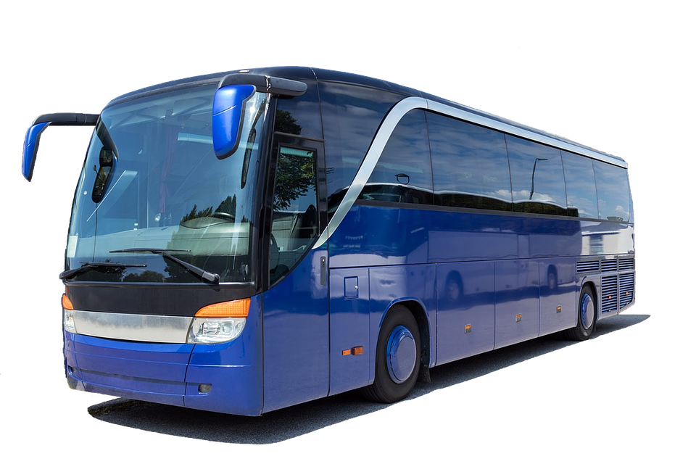
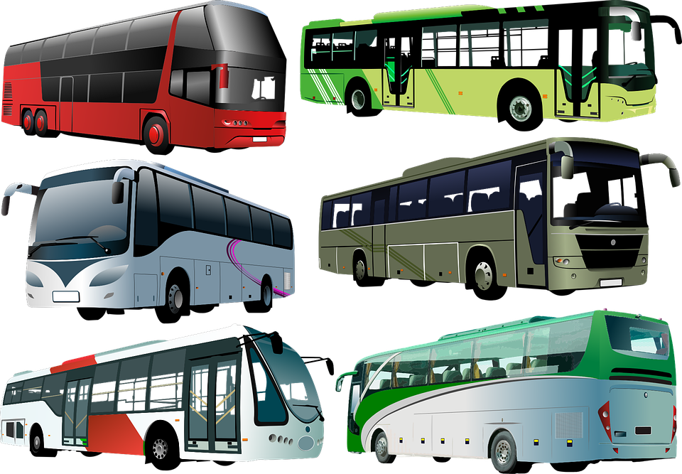
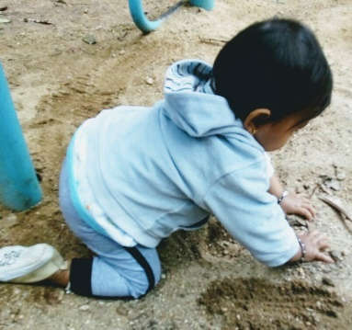
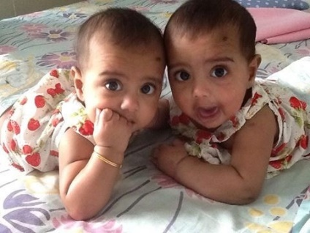
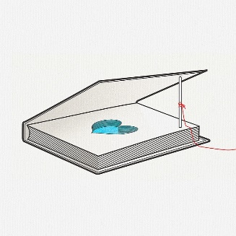
Irregular Plural Nouns
Singular Nouns
Plural Nouns
Bus
Buses
Baby
Babies
Story
Stories
Notes:
Notes for Teacher - < Information for further reference or explanation >
Suggestions: <Ideas/ Images/ Animations / Others – To make better representation of the content >
Source of Multimedia used in this slide - <Please provide source URL where we find the image and the license agreement>
Bus - https://pixabay.com/photos/coach-bus-holiday-modern-bus-3206326/
Buses - https://pixabay.com/vectors/city-bus-tourist-bus-transport-4677487/
Baby: SSSVV: Search Keyword “baby”
Babies: SSSVV: Search Keyword “baby”
Book - https://pixabay.com/illustrations/fantasies-books-traps-love-stories-4063346/
Books - https://pixabay.com/vectors/book-books-library-books-reading-2022464/

Slide 4
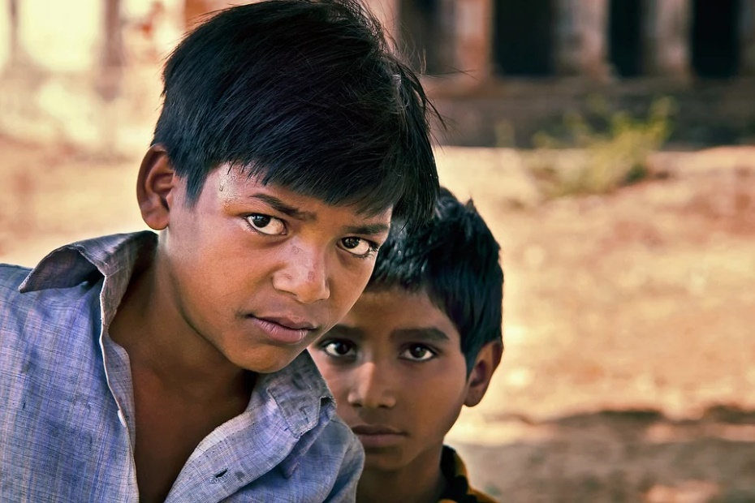
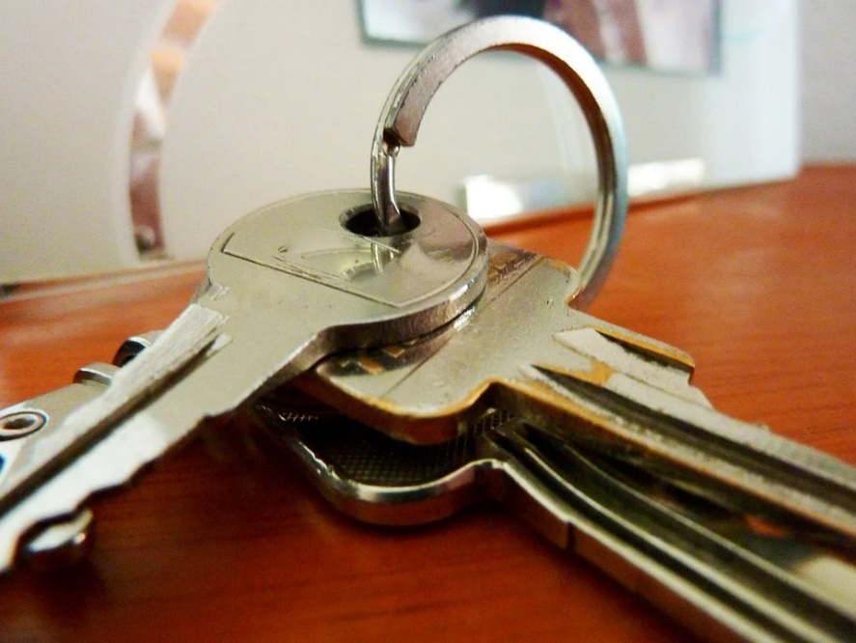
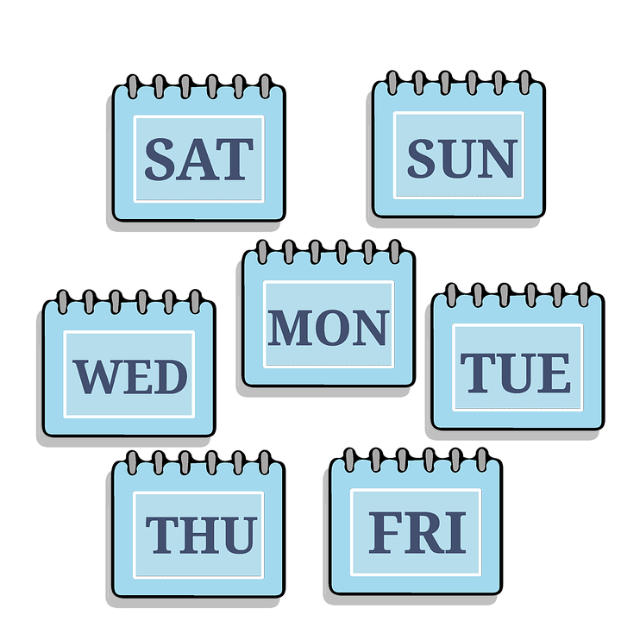
Irregular Plural Nouns - Rule No 4
If a noun ends in a VOWEL followed by ‘y’, add ‘s’ to make it Plural.
Boy - Boys
Key - Keys
Day - Days
Notes:
Notes for Teacher - < Information for further reference or explanation >
Suggestions: <Ideas/ Images/ Animations / Others – To make better representation of the content >
Source of Multimedia used in this slide - <Please provide source URL where we find the image and the license agreement>
Boys - https://pixabay.com/photos/boys-indian-portrait-children-kids-1158803/
Keys - https://pixabay.com/photos/key-house-key-beard-key-castle-979593/
Days - https://pixabay.com/illustrations/time-management-week-calendar-days-2323612/

Slide 5
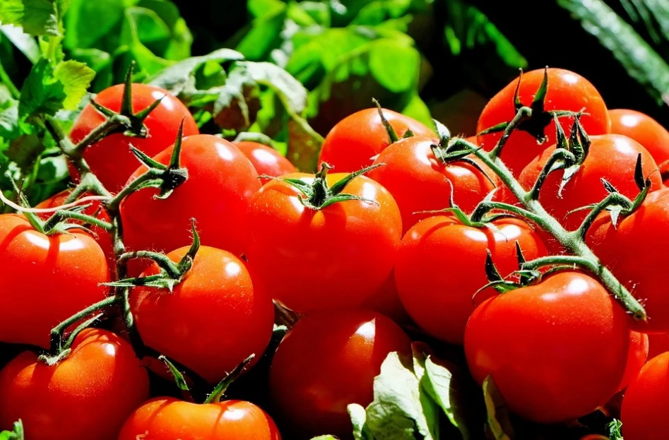
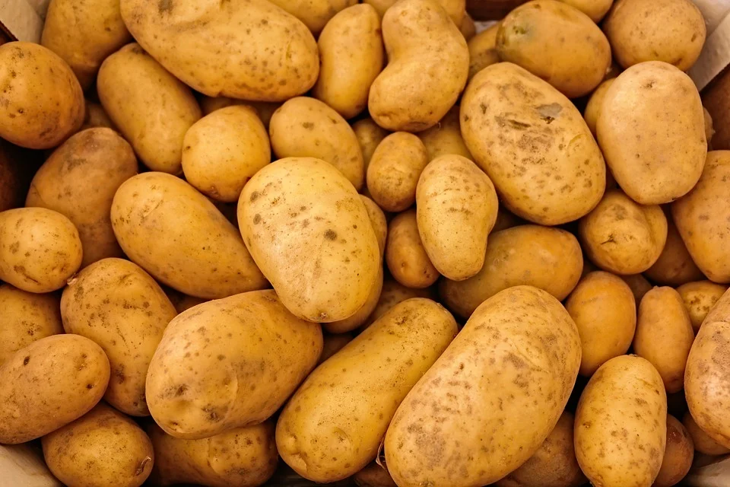
Irregular Plural Nouns - Rule No 5
If a noun ends in a CONSONANT followed by ‘o’, add ‘es’ to make it Plural.
Tomato - Tomatoes
Potato - Potatoes
Hero - Heroes
Notes:
Notes for Teacher - < Information for further reference or explanation >
Suggestions: <Ideas/ Images/ Animations / Others – To make better representation of the content >
Source of Multimedia used in this slide - <Please provide source URL where we find the image and the license agreement>
Tomatoes - https://pixabay.com/photos/tomatoes-fruit-food-harvest-1280859/
Potatoes - https://pixabay.com/photos/potatoes-vegetables-food-raw-411975/
Hero - https://pixabay.com/illustrations/superman-kid-hero-superhero-hero-2478978/

Slide 6
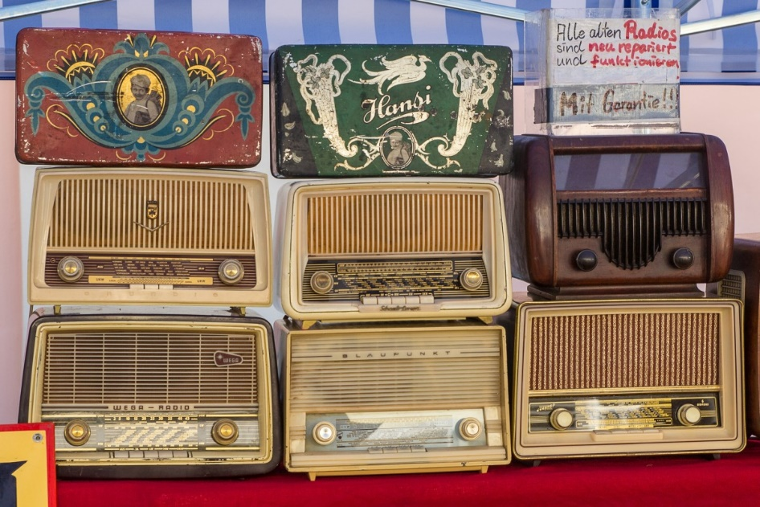
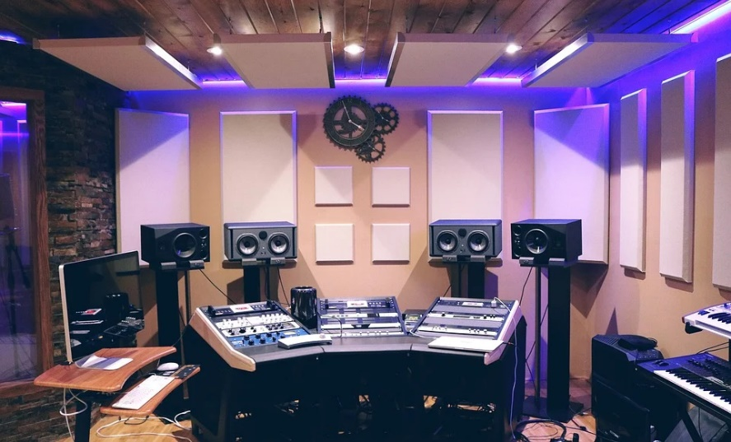
Irregular Plural Nouns - Rule No 6
If a noun ends in a VOWEL followed by ‘o’, add ‘s’ to make it Plural.
Radio - Radios
Studio - Studios
Notes:
Notes for Teacher - < Information for further reference or explanation >
Suggestions: <Ideas/ Images/ Animations / Others – To make better representation of the content >
Source of Multimedia used in this slide - <Please provide source URL where we find the image and the license agreement>
Radios - https://pxhere.com/en/photo/486262
Studio - https://pixabay.com/photos/music-studio-music-studio-sound-1290087/

Slide 7
Summary
A noun names a person, place, animal or thing.
A singular noun refers to only one person, place, animal or thing.
A plural noun refers to two or more than two people, places, animals or things.

Slide 8
Summary
Rule | Singular Noun | Plural Noun | Exceptions
If a noun ends in ‘y’ and has a vowel before it - just add ‘s’ | Boy | Boys | -
If a noun ends in ‘o’ and has a consonant before it - add ‘es’ | Tomato | Tomatoes | There are some exceptions to this rule: piano - pianos halo - halos
If a noun ends in ‘o’ and has a vowel before it - add ‘s’ | Studio Radio | Studios Radios

Slide 9
List of some Plural Nouns
Adding ‘s’ | Adding ‘es’
days | tomatoes
boys | potatoes
toys | heroes
monkeys | mosquitoes
studios | buffaloes
pianos | echoes
radios | volcanoes
zoos
kangaroos

Slide 10
MM INDEX
Slide # | Thumbnail | Source link and Attribution
3 |  | Bus - https://pixabay.com/photos/coach-bus-holiday-modern-bus-3206326/ Buses - https://pixabay.com/vectors/city-bus-tourist-bus-transport-4677487/
3 |  | Baby: SSSVV: Search Keyword “baby” Babies: SSSVV: Search Keyword “baby” Book - https://pixabay.com/illustrations/fantasies-books-traps-love-stories-4063346/ Books - https://pixabay.com/vectors/book-books-library-books-reading-2022464/
4 |  | Boys - https://pixabay.com/photos/boys-indian-portrait-children-kids-1158803/ Keys - https://pixabay.com/photos/key-house-key-beard-key-castle-979593/ Days - https://pixabay.com/illustrations/time-management-week-calendar-days-2323612/
5 |  | Tomatoes - https://pixabay.com/photos/tomatoes-fruit-food-harvest-1280859/ Potatoes - https://pixabay.com/photos/potatoes-vegetables-food-raw-411975/ Hero - https://pixabay.com/illustrations/superman-kid-hero-superhero-hero-2478978/
6 |  | Radios - https://pxhere.com/en/photo/486262 Studio - https://pixabay.com/photos/music-studio-music-studio-sound-1290087/
Notes:
Notes for Teacher - < Information for further reference or explanation >
Suggestions: <Ideas/ Images/ Animations / Others – To make better representation of the content >
Source of Multimedia used in this slide - <Please provide source URL where we find the image and the license agreement>

