Slide 1
Game BINGO with Plural Nouns
1
95
55
68
71
80
76
4
16
19
26
36
Notes:
Notes for Teacher - < Information for further reference or explanation >
Suggestions: <Ideas/ Images/ Animations / Others – To make better representation of the content >
Source of Multimedia used in this slide - <Please provide source URL where we find the image and the license agreement>

Slide 2
Draw the Following Grid
Notes:
Notes for Teacher –
Suggestions: <Ideas/ Images/ Animations / Others – To make better representation of the content >
Source of Multimedia used in this slide - <Please provide source URL where we find the image and the license agreement>

Slide 3
List of Nouns
Pick any nine nouns from the following. Write their plural form in the grid in any order
watch | fish
toy | dress
potato | cherry
car | brush
fox | tooth
leaf | child
Notes:
Notes for Teacher –
Suggestions: <Ideas/ Images/ Animations / Others – To make better representation of the content >
Source of Multimedia used in this slide - <Please provide source URL where we find the image and the license agreement>

Slide 4
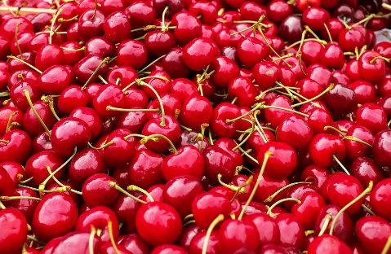
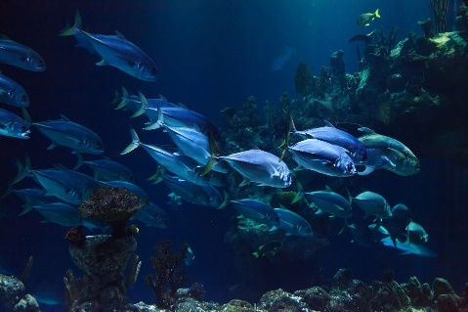
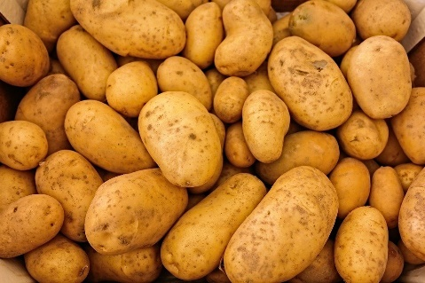
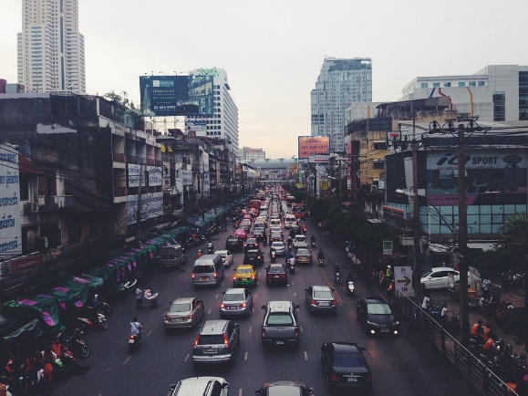
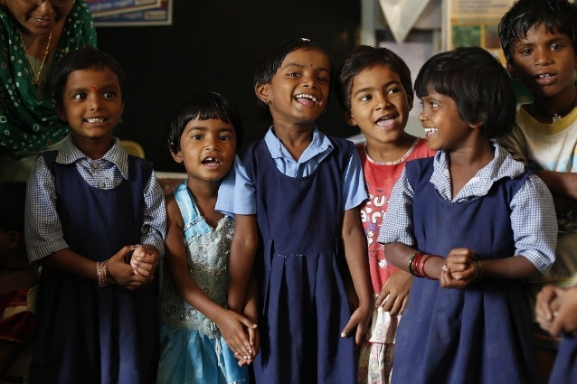
Cross the Nouns called out
cherries | cars | teeth
foxes | children | potatoes
fish | toys | watches
Notes:
Notes for Teacher –
Suggestions: <Ideas/ Images/ Animations / Others – To make better representation of the content >
Source of Multimedia used in this slide –
Cherries: https://pixabay.com/photos/cherries-sweet-cherries-1465801/
Fish: https://pixabay.com/photos/animal-aquarium-aquatic-blue-coral-21668/
Potatoes: https://pixabay.com/photos/potatoes-vegetables-food-raw-411975/
Teeth: https://pixabay.com/photos/teeth-dental-smile-white-teeth-977208/
Cars: https://pixabay.com/photos/traffic-jam-traffic-india-street-388924/
Children: https://pixabay.com/photos/children-india-education-classroom-876543/

Slide 5
BINGO – Singular and Plural Nouns
WATCHES
WATCH
TOY
TOYS
POTATOES
POTATO
FISH
FISH
LEAF
LEAVES
FOXES
FOX
Click on each noun to see answer
CHERRIES
CHERRY
BRUSH
BRUSHES
CARS
CAR
TEETH
TOOTH
DRESS
DRESSES
CHILDREN
CHILD
Notes:
Notes for Teacher –Answer is revealed only on the click on the noun. For example: click on car to get the plural cars. Click on dress to get the plural dresses etc. If you click outside, the slide ends.
Suggestions: <Ideas/ Images/ Animations / Others – To make better representation of the content >
Source of Multimedia used in this slide - <Please provide source URL where we find the image and the license agreement>

Slide 6
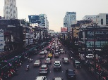
MM INDEX
Slide # | Thumbnail | Source link and Attribution
4 |  | Cherries: https://pixabay.com/photos/cherries-sweet-cherries-1465801/ Fish: https://pixabay.com/photos/animal-aquarium-aquatic-blue-coral-21668/ Potatoes: https://pixabay.com/photos/potatoes-vegetables-food-raw-411975/ Teeth: https://pixabay.com/photos/teeth-dental-smile-white-teeth-977208/ Cars: https://pixabay.com/photos/traffic-jam-traffic-india-street-388924/ Children: https://pixabay.com/photos/children-india-education-classroom-876543/
Notes:
Notes for Teacher - < Information for further reference or explanation >
Suggestions: <Ideas/ Images/ Animations / Others – To make better representation of the content >
Source of Multimedia used in this slide - <Please provide source URL where we find the image and the license agreement>

