Slide 1
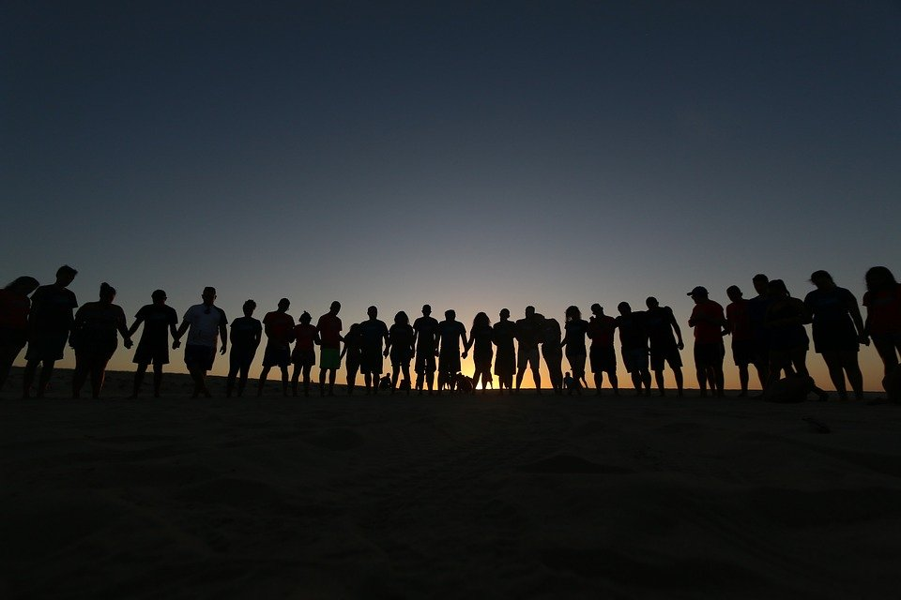
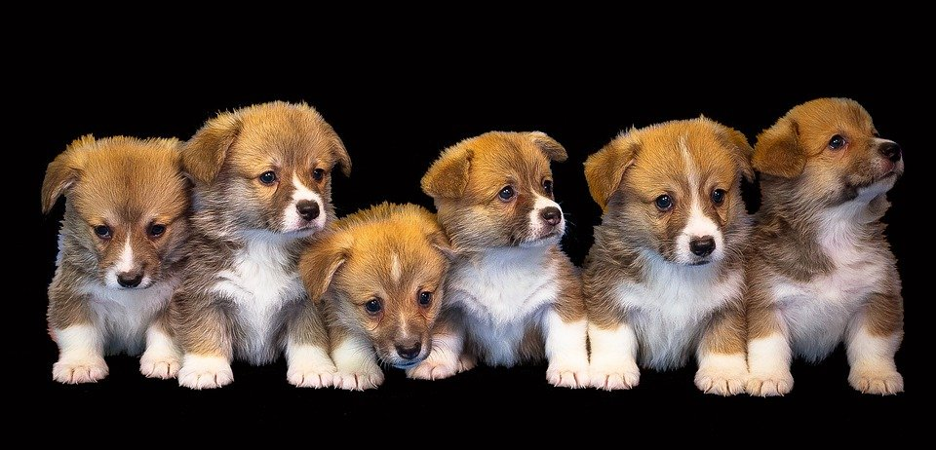
Joy of Getting the Right number
Notes:
Notes for Teacher - < Information for further reference or explanation >
Suggestions: <Ideas/ Images/ Animations / Others – To make better representation of the content >
Source of Multimedia used in this slide - <Please provide source URL where we find the image and the license agreement>
Men: https://pixabay.com/photos/people-friends-together-happy-kid-4050698/
Puppies: https://pixabay.com/photos/dog-animal-isolated-cute-puppy-3128192/

Slide 2
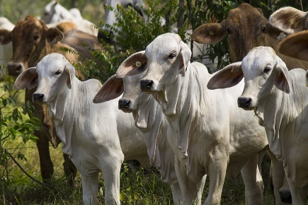
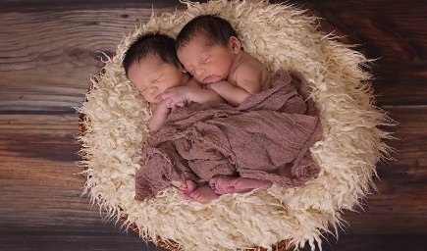
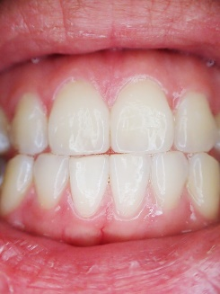
Answer the Following Questions
Write the plural nouns for the following. Put them in the correct column
puppy | pen | branch | deer | woman | child
sheep | party | brush | calf | bat | tooth
fox | house | baby | knife | leaf | fish
Click here
-s | -es | -ies | -ves | Change in spelling | No change
pens
branches
puppies
calves
women
deer
bats
brushes
parties
knives
children
sheep
houses
foxes
babies
leaves
teeth
fish
Notes:
Notes for Teacher - < Information for further reference or explanation >
Suggestions: <Ideas/ Images/ Animations / Others – To make better representation of the content >
Source of Multimedia used in this slide - <Please provide source URL where we find the image and the license agreement>
Calves: https://pixabay.com/photos/calves-livestock-calves-white-3212880/
Babies: https://pixabay.com/photos/twins-babies-newborn-boys-1628843/
Teeth: https://pixabay.com/photos/teeth-mouth-dental-dentist-tooth-887338/

Slide 3
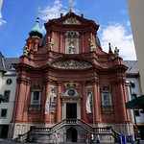
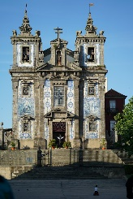
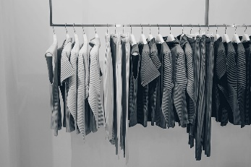
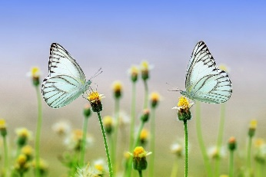
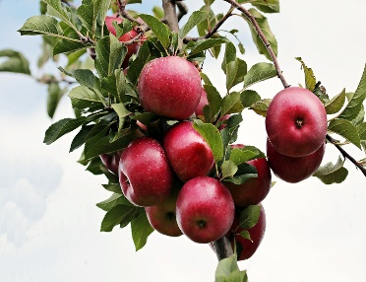
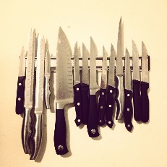
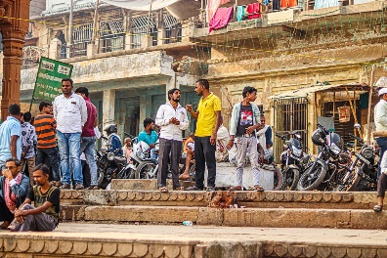
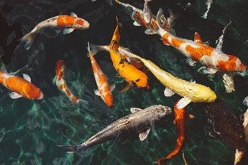
Answer the Following Questions
Name the noun and write their singular form
Noun | Plural Noun | Singular Noun
Noun | Plural Noun | Singular Noun
churches
church
dresses
dress
butterflies
butterfly
apples
apple
knives
knife
men
man
fish
fish
Click on image for answers
Notes:
Notes for Teacher - < Information for further reference or explanation >
Suggestions: <Ideas/ Images/ Animations / Others – To make better representation of the content >
Source of Multimedia used in this slide - <Please provide source URL where we find the image and the license agreement>
Church: https://www.flickr.com/photos/75487768@N04/15083005650 by barnyz
Church: https://pixabay.com/photos/porto-portugal-saint-ildefonso-2444570/
Apples: https://pixabay.com/photos/apples-red-apple-ripe-apple-orchard-2788599/
Men: https://pixabay.com/photos/varanasi-india-people-men-hinduism-6748058/
Dresses: https://pixabay.com/photos/blouse-clothing-dress-fashion-2597205/
Butterflies: https://pixabay.com/photos/butterflies-flowers-pollinate-1127666/
Knife: https://pixabay.com/photos/knives-knife-magnetic-sharp-687081/
Fish: https://pixabay.com/photos/koi-fish-animals-fish-swimming-1868779/

Slide 4
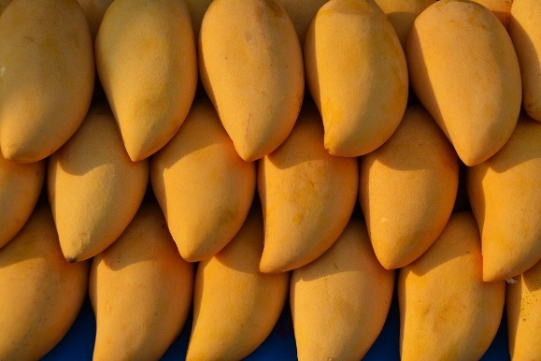
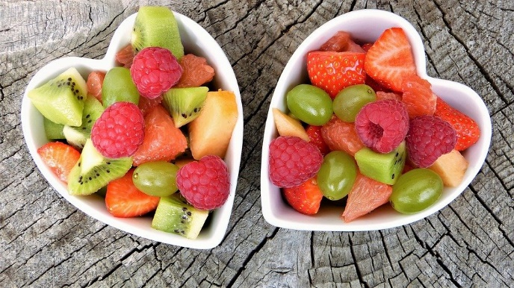
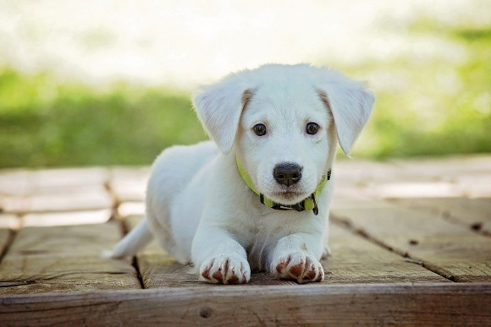
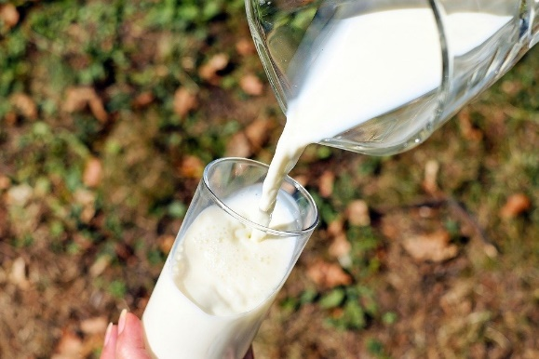
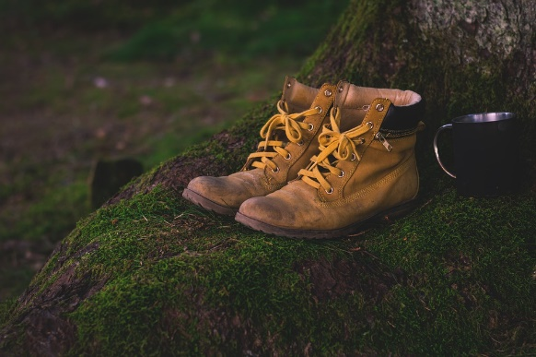
Answer the Following Questions
Pick the correct nouns to complete the sentences.
I like to eat _______ . (mango, mangoes)
We use baskets to carry _____. (fruit, fruits)
One ____ barked last night. (dog, dogs)
He drinks ____ in the morning. (milk, milks)
Those are new _____ . (shoe, shoes)
mangoes
fruits
dog
milk
shoes
Click on image for answers
Notes:
Notes for Teacher - < Information for further reference or explanation >
Suggestions: <Ideas/ Images/ Animations / Others – To make better representation of the content >
Source of Multimedia used in this slide -
Mango: https://pixabay.com/photos/mangoes-fruit-mango-food-tropical-1320111/
Fruits: https://pixabay.com/photos/fresh-fruits-bowls-fruit-bowls-2305192/
Dog: https://pixabay.com/photos/puppy-dog-pet-collar-dog-collar-1903313/
Milk: https://pixabay.com/photos/glass-milk-pour-pouring-1587258/
Shoes: https://pixabay.com/photos/boots-shoes-moss-hiking-shoes-worn-1638873/

Slide 5
Answer the Following Questions
Make sentences with the following nouns
boxes : ____________________________
mice : _____________________________
Notes:
Notes for Teacher - < Information for further reference or explanation >
Suggestions: <Ideas/ Images/ Animations / Others – To make better representation of the content >
Source of Multimedia used in this slide - <Please provide source URL where we find the image and the license agreement>

Slide 6
Answer the Following Questions
Draw the following and label it
A Singular Noun | A Plural Noun

Slide 7
MM INDEX
Slide # | Thumbnail | Source link and Attribution
1 |  | Men: https://pixabay.com/photos/people-friends-together-happy-kid-4050698/ Puppies: https://pixabay.com/photos/dog-animal-isolated-cute-puppy-3128192/
2 |  | Calves: https://pixabay.com/photos/calves-livestock-calves-white-3212880/ Babies: https://pixabay.com/photos/twins-babies-newborn-boys-1628843/ Teeth: https://pixabay.com/photos/teeth-mouth-dental-dentist-tooth-887338/
3 |  | Church: https://www.flickr.com/photos/75487768@N04/15083005650 by barnyz Church: https://pixabay.com/photos/porto-portugal-saint-ildefonso-2444570/ Apples: https://pixabay.com/photos/apples-red-apple-ripe-apple-orchard-2788599/ Men: https://pixabay.com/photos/varanasi-india-people-men-hinduism-6748058/ Dresses: https://pixabay.com/photos/blouse-clothing-dress-fashion-2597205/ Butterflies: https://pixabay.com/photos/butterflies-flowers-pollinate-1127666/ Knife: https://pixabay.com/photos/knives-knife-magnetic-sharp-687081/ Fish: https://pixabay.com/photos/koi-fish-animals-fish-swimming-1868779/
4 |  | Mango: https://pixabay.com/photos/mangoes-fruit-mango-food-tropical-1320111/ Fruits: https://pixabay.com/photos/fresh-fruits-bowls-fruit-bowls-2305192/ Dog: https://pixabay.com/photos/puppy-dog-pet-collar-dog-collar-1903313/ Milk: https://pixabay.com/photos/glass-milk-pour-pouring-1587258/ Shoes: https://pixabay.com/photos/boots-shoes-moss-hiking-shoes-worn-1638873/
Notes:
Notes for Teacher - < Information for further reference or explanation >
Suggestions: <Ideas/ Images/ Animations / Others – To make better representation of the content >
Source of Multimedia used in this slide - <Please provide source URL where we find the image and the license agreement>

