Slide 1
FUN WITH NUMBERS
Notes:
Notes for Teacher - < Information for further reference or explanation >
Suggestions: <Ideas/ Images/ Animations / Others – To make better representation of the content >
Source of Multimedia used in this slide - <Please provide source URL where we find the image and the license agreement>
https://publicdomainvectors.org/en/free-clipart/Female-student-asking-a-question-vector-illustration/33142.html

Slide 2
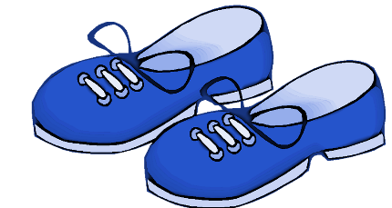
Answer the Following Questions
Write the following nouns under the right heading:
Click here
shoes | door | chairs | glass
bus | berries | foot | churches
Singular Noun | Plural Noun
door
shoes
glass
chairs
bus
churches
foot
berries
Notes:
Notes for Teacher - < Information for further reference or explanation >
Suggestions: <Ideas/ Images/ Animations / Others – To make better representation of the content >
Source of Multimedia used in this slide - <Please provide source URL where we find the image and the license agreement>
Shoes : https://pixabay.com/illustrations/blue-shoes-kids-footwear-fashion-927282/

Slide 3
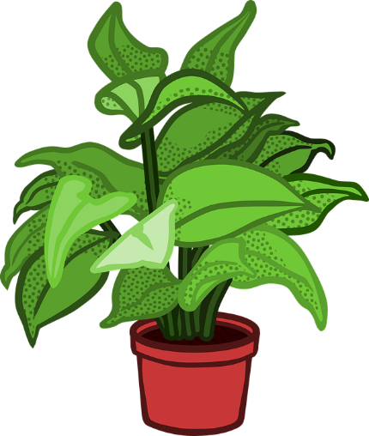
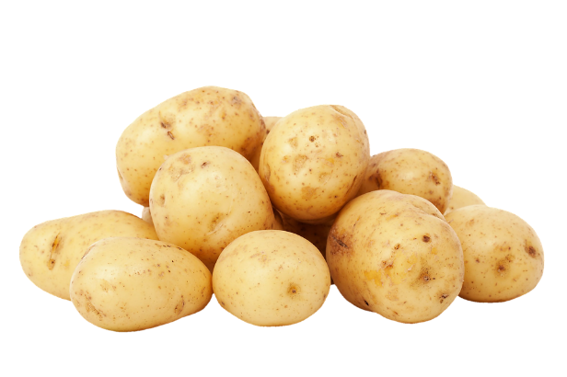
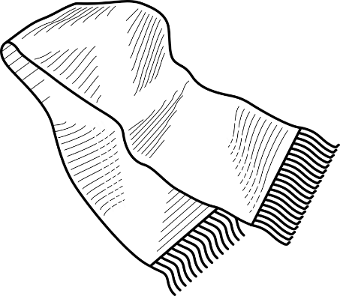
Answer the Following Questions
Write the plural of the following nouns:
plant : ________
plants
fox : ________
foxes
tooth : ________
teeth
baby : ________
babies
potatoes
potato : ________
scarf : _____________
scarfs/ scarves
Click the questions for answers
Notes:
Notes for Teacher - < Information for further reference or explanation >
Suggestions: <Ideas/ Images/ Animations / Others – To make better representation of the content >
Source of Multimedia used in this slide - <Please provide source URL where we find the image and the license agreement>
Plants : https://pixabay.com/vectors/plant-pot-potted-verbs-2027989/
Potatoes : https://pixabay.com/photos/potatoes-unpeeled-carbohydrates-2829118/
Tooth: https://pixabay.com/vectors/tooth-bite-dentist-practitioner-146674/
Scarf: https://pixabay.com/vectors/scarf-clothing-shawl-winter-warm-145586/

Slide 4
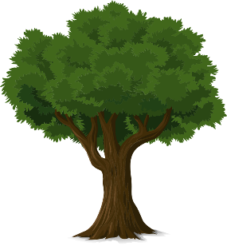
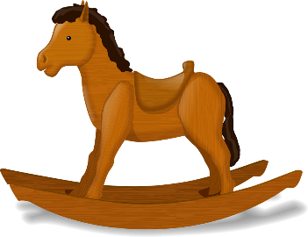
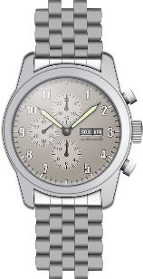
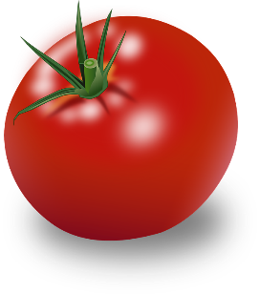
Answer the Following Questions
Name the noun and write its plural:
Noun | Singular Noun | Plural Noun
Noun | Singular Noun | Plural Noun
tree
trees
toy
toys
brush
brushes
watch
watches
tomato
tomatoes
leaf
leaves
Click on image for answers
Notes:
Notes for Teacher - < Information for further reference or explanation >
Suggestions: <Ideas/ Images/ Animations / Others – To make better representation of the content >
Source of Multimedia used in this slide - <Please provide source URL where we find the image and the license agreement>
Tree: https://pixabay.com/vectors/tree-trunk-leaves-branches-nature-576847/
Brush: https://pixabay.com/vectors/paint-brush-paint-brush-color-1266212/
Tomato: https://pixabay.com/vectors/tomato-vegetable-food-nature-plant-153272/
Toy: https://pixabay.com/vectors/rocking-horse-child-s-toy-horse-33719/
Watch: https://pixabay.com/vectors/wristwatch-watch-wrist-watch-ticker-161854/
Leaf: https://pixabay.com/vectors/leaf-blue-green-stylized-gradients-1821763/

Slide 5
Answer the Following Questions
Fill in the blanks choosing the correct answers:
mice | hands and feet | men | children | teeth
There were three ________ playing in the park.
children
I lost two _______ yesterday.
teeth
The _______ made holes in the wall.
mice
We wash our ____________ when we come back home.
hands and feet
The ______ were working in the field.
men
Click the questions for answers
Notes:
Notes for Teacher - < Information for further reference or explanation >
Suggestions: <Ideas/ Images/ Animations / Others – To make better representation of the content >
Source of Multimedia used in this slide - <Please provide source URL where we find the image and the license agreement>

Slide 6
Answer the Following Questions
Make sentences with the given nouns:
books : ____________________________
fish : _____________________________
Notes:
Notes for Teacher - < Information for further reference or explanation >
Suggestions: <Ideas/ Images/ Animations / Others – To make better representation of the content >
Source of Multimedia used in this slide - <Please provide source URL where we find the image and the license agreement>

Slide 7
MM INDEX
Slide # | Thumbnail | Source link and Attribution
1 |  | https://publicdomainvectors.org/en/free-clipart/Female-student-asking-a-question-vector-illustration/33142.html
2 |  | Shoes: https://pixabay.com/illustrations/blue-shoes-kids-footwear-fashion-927282/
3 |  | Plants: https://pixabay.com/vectors/plant-pot-potted-verbs-2027989/ Potatoes: https://pixabay.com/photos/potatoes-unpeeled-carbohydrates-2829118/ Tooth: https://pixabay.com/vectors/tooth-bite-dentist-practitioner-146674/ Scarf: https://pixabay.com/vectors/scarf-clothing-shawl-winter-warm-145586/
4 |  | Tree: https://pixabay.com/vectors/tree-trunk-leaves-branches-nature-576847/ Brush: https://pixabay.com/vectors/paint-brush-paint-brush-color-1266212/ Tomato: https://pixabay.com/vectors/tomato-vegetable-food-nature-plant-153272/ Toy: https://pixabay.com/vectors/rocking-horse-child-s-toy-horse-33719/ Watch: https://pixabay.com/vectors/wristwatch-watch-wrist-watch-ticker-161854/ Leaf: https://pixabay.com/vectors/leaf-blue-green-stylized-gradients-1821763/
Notes:
Notes for Teacher - < Information for further reference or explanation >
Suggestions: <Ideas/ Images/ Animations / Others – To make better representation of the content >
Source of Multimedia used in this slide - <Please provide source URL where we find the image and the license agreement>

