Slide 1
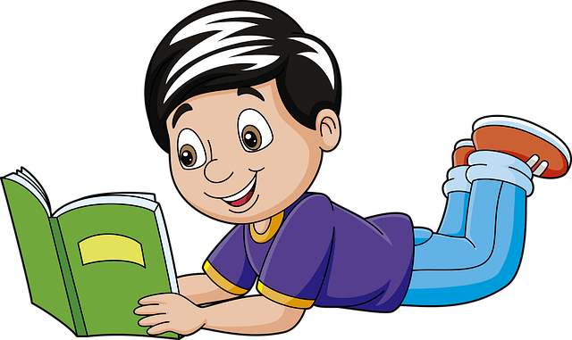
Reading is Fun
Notes:
Notes for Teacher - < Information for further reference or explanation >
Suggestions: <Ideas/ Images/ Animations / Others – To make better representation of the content >
Source of Multimedia used in this slide - <Please provide source URL where we find the image and the license agreement>
<reading> <https://pixabay.com/illustrations/student-boy-reading-book-studying-5730767/>

Slide 2
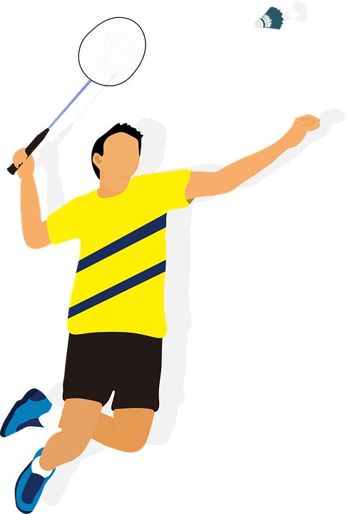
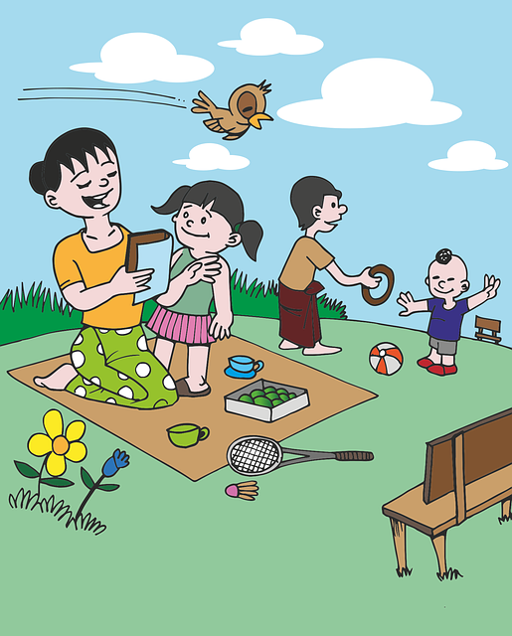
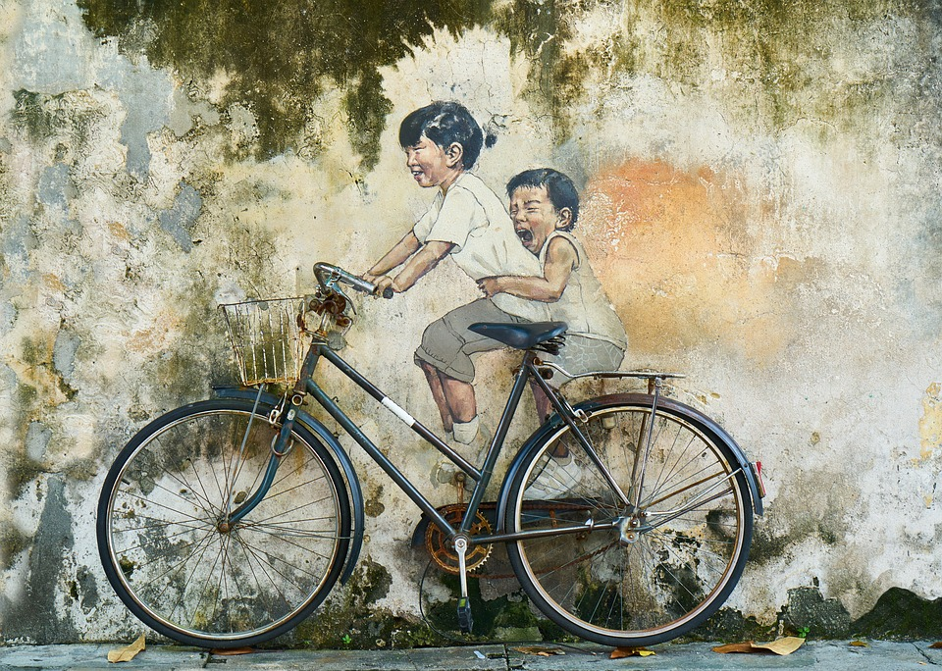
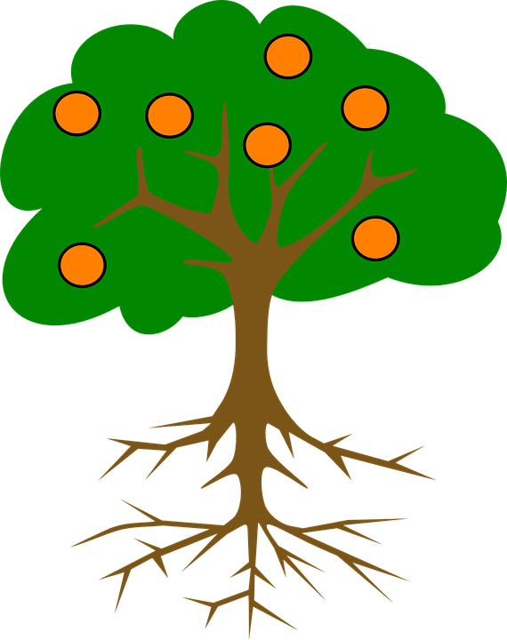
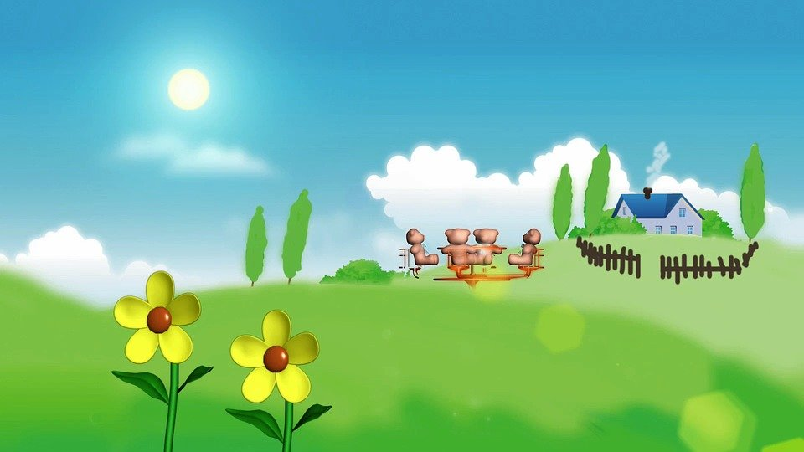
Passage
Playing in the park on a sunny day
It is a sunny day with clear skies.
The weather is pleasant.
Colourful flowers are blooming everywhere.
Many children are playing in the park.
The boys are playing badminton.
Girls are riding bicycles.
There are two orange trees in the park.
Everyone is happy and enjoying the bright sunshine on a winter afternoon.
Notes:
Notes for Teacher - < Information for further reference or explanation >
Suggestions: <Ideas/ Images/ Animations / Others – To make better representation of the content >
Source of Multimedia used in this slide -
<playing in a park> <https://pixabay.com/vectors/games-park-child-children-grass-1459575/>
<orange tree> <https://pixabay.com/vectors/tree-oranges-roots-plant-fruit-309106/>
<badminton> <https://pixabay.com/illustrations/badminton-sport-athlete-racket-5542285/>
<bicycle> <https://pixabay.com/photos/bicycle-children-graffiti-art-3045580/>

Slide 3
Exercise 1
Read the passage carefully and say whether the following statements are True or False
It is a rainy day today. ________
The weather is pleasant. _______
There are no flowers in the park. _________
Two girls are riding bicycles. ______
There are three orange trees in the park. _______
Everyone is happy. ________
False
True
False
True
False
True
Notes:
Notes for Teacher - < Information for further reference or explanation >
Suggestions: <Ideas/ Images/ Animations / Others – To make better representation of the content >
Source of Multimedia used in this slide - <Please provide source URL where we find the image and the license agreement>
<playing in a park> <https://pixabay.com/vectors/games-park-child-children-grass-1459575/>

Slide 4
Exercise 2
Answer the questions given below based on the reading of the passage
Why did the children go to play in the park?
The children went to play in the park because the weather was pleasant / it was a sunny day.
What are the boys playing?
The boys are playing badminton in the park.
Where do you go out to play? Give two describing words about the place where you go out to play.
We go out to play in our uncle’s playground which is big and beautiful.
Notes:
Notes for Teacher - The teacher can accept any answer for the above question. It is an open ended question.
Suggestions: <Ideas/ Images/ Animations / Others – To make better representation of the content >
Source of Multimedia used in this slide - <Please provide source URL where we find the image and the license agreement>

Slide 5
MM INDEX
Slide # | Thumbnail | Source link and Attribution
1 |  | <reading> https://pixabay.com/illustrations/student-boy-reading-book-studying-5730767/
2 |  | <orange tree> https://pixabay.com/vectors/tree-oranges-roots-plant-fruit-309106/ <badminton> https://pixabay.com/illustrations/badminton-sport-athlete-racket-5542285/ <bicycle> https://pixabay.com/photos/bicycle-children-graffiti-art-3045580/
2,3 |  | <playing in a park> https://pixabay.com/vectors/games-park-child-children-grass-1459575/
Notes:
Notes for Teacher - < Information for further reference or explanation >
Suggestions: <Ideas/ Images/ Animations / Others – To make better representation of the content >
Source of Multimedia used in this slide - <Please provide source URL where we find the image and the license agreement>

