Slide 1
Yes! I Can Do It.
Notes:
Notes for Teacher - < Information for further reference or explanation >
Suggestions: <Ideas/ Images/ Animations / Others – To make better representation of the content >
Source of Multimedia used in this slide - <Please provide source URL where we find the image and the license agreement>
<reading> <https://pixabay.com/illustrations/boy-reading-book-sun-relaxation-2181154/>

Slide 2
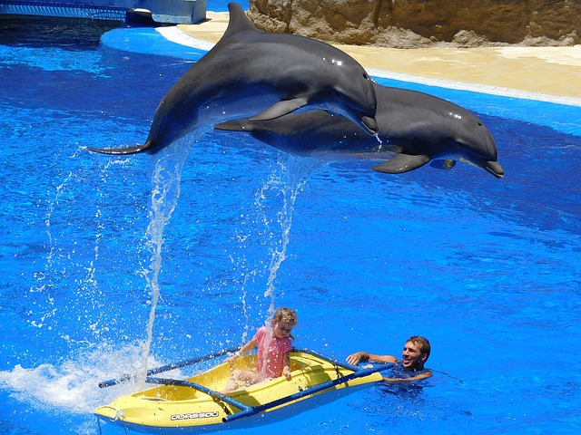
Comprehension
Read the passage carefully at least thrice and then answer the questions
A dolphin seems to be smiling at us, when it lifts its face from the water. Dolphins look happy when they jump out of the water. They look very beautiful too. Their smooth bodies shine in the Sun.
Dolphins are playful. They play with people and they also play with each other. They can blow bubble rings. Then they push the rings with their noses!
Some dolphins live in water parks. They learn how to do many tricks. They can carry big balls on the tips of their noses. They can move on top of the water using their strong tails. People smile and clap when they see them.
Dolphins also help people. They push swimmers to the shore or keep them safe from sharks. They have warned ships of impending dangers.
We should help dolphins too. We should try not to hurt dolphins with our boats. We should keep their home - the ocean, safe and clean.
Notes:
Notes for Teacher - < Information for further reference or explanation >
Suggestions: <Ideas/ Images/ Animations / Others – To make better representation of the content >
Source of Multimedia used in this slide - <Please provide source URL where we find the image and the license agreement>
<dolphin> <https://pixabay.com/photos/dolphins-water-jump-water-park-1170342/>

Slide 3
Exercise
Q1.
How do dolphins look?
Dolphins look very beautiful. Their smooth bodies shine in the Sun.
Q2.
How do we know that dolphins are playful? (Write 2 sentences for this question)
Dolphins are playful; they play with people and they also play with each other.
As part of the game they can blow bubble rings and push the bubble rings with their noses.
Q3.
What are the tricks that dolphins have learnt to do?
The tricks they have learnt to do are to carry big balls on the tips of their noses and move on top of the water using their strong tails.
Notes:
Notes for Teacher - < Information for further reference or explanation >
Suggestions: <Ideas/ Images/ Animations / Others – To make better representation of the content >
Source of Multimedia used in this slide - <Please provide source URL where we find the image and the license agreement>

Slide 4
Exercise
Q4.
Why should we protect the dolphins from any harm?
We should protect dolphins from any harm because they are very helpful to people. They have pushed swimmers to the shore or have kept them safe from sharks. They have warned ships of impending dangers.
Q5.
Do you think dolphins are intelligent animals?
Yes, dolphins are intelligent animals because they easily learn to perform tricks that are taught to them.
Q6.
Find the opposites of the following words from the passage
a) sad ___________ b) dangerous ______
c) ugly _________ d) few ______
happy
safe
beautiful
many
Notes:
Notes for Teacher - < Information for further reference or explanation >
Suggestions: <Ideas/ Images/ Animations / Others – To make better representation of the content >
Source of Multimedia used in this slide - <Please provide source URL where we find the image and the license agreement>

Slide 5
MM INDEX
Slide # | Thumbnail | Source link and Attribution
1 |  | <reading> https://pixabay.com/illustrations/boy-reading-book-sun-relaxation-2181154/
2, 3, 4 |  | <dolphin> https://pixabay.com/photos/dolphins-water-jump-water-park-1170342/
Notes:
Notes for Teacher - < Information for further reference or explanation >
Suggestions: <Ideas/ Images/ Animations / Others – To make better representation of the content >
Source of Multimedia used in this slide - <Please provide source URL where we find the image and the license agreement>

