Slide 1
Guess The Punctuation Marks
. , ! ? ABC
Notes:
Notes for Teacher - < Information for further reference or explanation >
Suggestions: <Ideas/ Images/ Animations / Others – To make better representation of the content >
Source of Multimedia used in this slide - <Please provide source URL where we find the image and the license agreement>

Slide 2
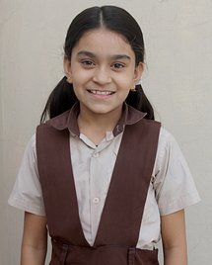
Punctuate the Sentences
Capital letters
Full stop (.)
Question Mark (?)
Exclamation (!)
Comma (,)
Use the help box given above
1
my name is reena
My name is Reena.
2
how do you go to school
How do you go to school?
3
how cute the puppy is
How cute the puppy is!
Notes:
Notes for Teacher – Click for the answers.
The teacher may begin the class by writing the sample sentences on the board or using the PPT provided. Elicit from them to punctuate the sentences given. The stress should be on allowing the students to come up with as many answers as possible, rather than on the right answers.
Suggestions: <Ideas/ Images/ Animations / Others – To make better representation of the content >
Source of Multimedia used in this slide -
Girl: https://pixabay.com/photos/child-girl-indian-clapping-hands-237705/
School : https://pixabay.com/photos/school-indian-school-school-dress-3760342/
Puppy: https://pixabay.com/photos/puppy-dog-pet-collar-dog-collar-1903313/

Slide 3
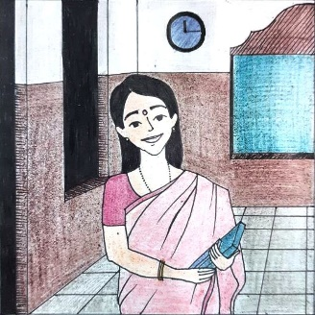
Punctuate the Sentences
Capital letters
Full stop (.)
Question Mark (?)
Exclamation (!)
Comma (,)
Use the help box given above
4
anil ranbir javid and rishan are in the library
Anil, Ranbir, Javid and Rishan are in the library.
5
we didn’t notice the teacher coming
We didn’t notice the teacher coming.
6
bharat’s pet dog is hurt
Bharat’s pet dog is hurt.
Notes:
Notes for Teacher – Click for the answers.
The teacher could then draw the attention to sentences 5 and 6 and ask why the commas in both the sentences are floating(up in the air) and not next to the word as in sentence 4. After the students have given their answers, the teacher could take a cue and say that the punctuation mark is not a comma but an Apostrophe and they can learn more about it.
Suggestions: <Ideas/ Images/ Animations / Others – To make better representation of the content >
Source of Multimedia used in this slide -
Boys: https://pixabay.com/photos/school-children-classroom-school-7047131/
Dog: https://pixabay.com/photos/pet-dog-puppy-sad-eyes-animal-1284307/
Teacher – original creation

Slide 4
MM Index
2 |  | Girl: https://pixabay.com/photos/child-girl-indian-clapping-hands-237705/ School : https://pixabay.com/photos/school-indian-school-school-dress-3760342/ Puppy: https://pixabay.com/photos/puppy-dog-pet-collar-dog-collar-1903313/
3 |  | Boys: https://pixabay.com/photos/school-children-classroom-school-7047131/ Dog: https://pixabay.com/photos/pet-dog-puppy-sad-eyes-animal-1284307/ 3. Teacher – original creation
Notes:
Notes for Teacher - < Information for further reference or explanation >
Suggestions: <Ideas/ Images/ Animations / Others – To make better representation of the content >
Source of Multimedia used in this slide - <Please provide source URL where we find the image and the license agreement>

