Slide 1
Learning the Apostrophe
Notes:
Notes for Teacher - < Information for further reference or explanation >
Suggestions: <Ideas/ Images/ Animations / Others – To make better representation of the content >
Source of Multimedia used in this slide - <Please provide source URL where we find the image and the license agreement>

Slide 2
Apostrophe – What is it?
Apostrophe (’)
- Punctuation mark
- Looks like a floating comma
Can you pick out the apostrophe in this picture?
$$A$$
$$B$$
$$C$$
$$D$$
$$E$$
$$F$$
?
.
’
!
,
“
Answer
Notes:
Notes for Teacher - < Contents appear on each click
Suggestions: <Ideas/ Images/ Animations / Others – To make better representation of the content >
Source of Multimedia used in this slide - <Please provide source URL where we find the image and the license agreement>
Finger point- PPT icon

Slide 3
Why are Apostrophes used?
Who owns something (belonging / possession)
To show
That a letter/some letters have been omitted (contractions)
Notes:
Notes for Teacher –Contents appear on each click
Suggestions: <Ideas/ Images/ Animations / Others – To make better representation of the content >
Source of Multimedia used in this slide - <Please provide source URL where we find the image and the license agreement>

Slide 4
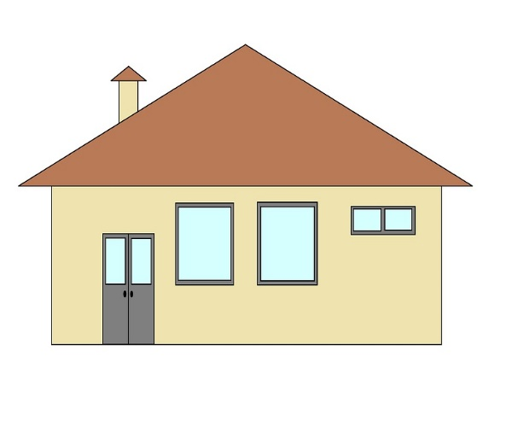
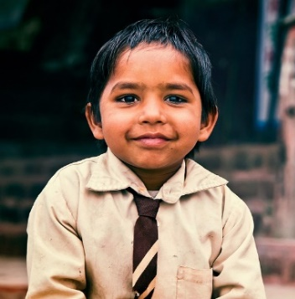
How are Apostrophes used?
Belonging or Possession
Add ’s after singular nouns and names.
Tail
Ali
House
Cow
This is Ali’s house.
The cow’s tail is very long.
Notes:
Notes for Teacher - < Information for further reference or explanation >
Suggestions: <Ideas/ Images/ Animations / Others – To make better representation of the content >
Source of Multimedia used in this slide - <Please provide source URL where we find the image and the license agreement>
Boy - https://pixabay.com/photos/indian-boy-child-male-asian-1119236/
House - https://pixabay.com/illustrations/home-little-house-construction-4503982/
Cow - https://pixabay.com/vectors/cow-livestock-cattle-farm-animal-44695/

Slide 5
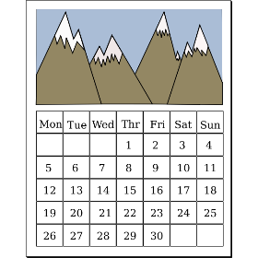
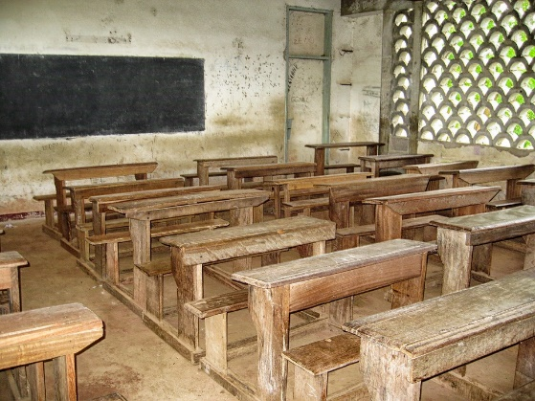
How are Apostrophes used?
Belonging or Possession
Add ’ after plural nouns that end with s.
3 months
House
The students’ benches are arranged in rows.
It will take three months’ work to complete the house.
Notes:
Notes for Teacher - < Information for further reference or explanation >
Suggestions: <Ideas/ Images/ Animations / Others – To make better representation of the content >
Source of Multimedia used in this slide - <Please provide source URL where we find the image and the license agreement>
Desk - https://pixabay.com/photos/cameroon-school-classroom-desks-104485/
House - https://pixabay.com/illustrations/home-little-house-construction-4503982/
Students - https://pixabay.com/photos/school-nursery-children-india-298681/
Calendar - https://freesvg.org/aqeeliz-calendar

Slide 6
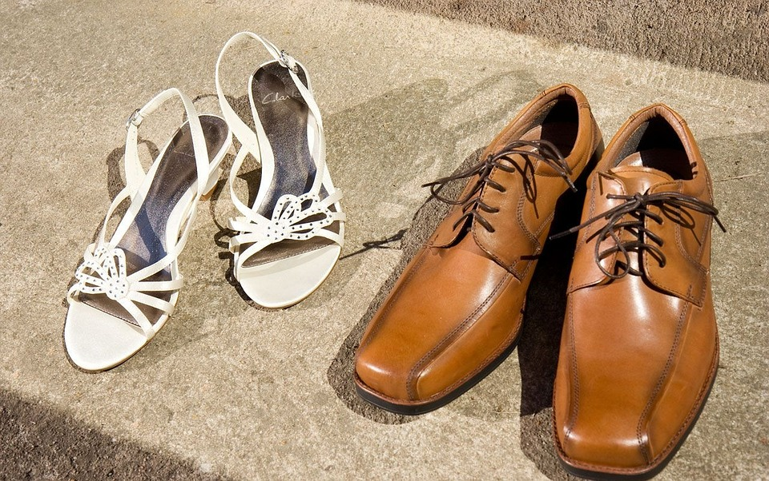
How are Apostrophes used?
Belonging or Possession
Add ’ s after plural nouns that don’t end in s.
Women’s shoes
Men’s shoes
The children’s books are on the table.
Men’s shoes are usually larger than women’s shoes.
Notes:
Notes for Teacher - < Information for further reference or explanation >
Suggestions: <Ideas/ Images/ Animations / Others – To make better representation of the content >
Source of Multimedia used in this slide - <Please provide source URL where we find the image and the license agreement>
Shoes - https://pixabay.com/photos/shoes-men-women-boots-sandals-89037/
Table - https://pixabay.com/vectors/table-furniture-wooden-1300555/
Students - https://pixabay.com/photos/school-nursery-children-india-298681/
Books – PPT icon

Slide 7
How are Apostrophes used?
Contractions
A letter or some letters in a word have been left out/omitted.
I could not attend school as
I was unwell.
I am a student of Bal Vihar School.
I’m a student of Bal Vihar School.
I couldn’t attend school as
I was unwell.
Notes:
Notes for Teacher - < Information for further reference or explanation >
Suggestions: <Ideas/ Images/ Animations / Others – To make better representation of the content >
Source of Multimedia used in this slide - <Please provide source URL where we find the image and the license agreement>
Poster images
Parliament- https://pixabay.com/vectors/parliament-india-government-2028311/
Notepad- PPT icon

Slide 8
Commonly used Contractions
Full Form
Contraction
Full Form
Contraction
I am
I’m
We have
We’ve
I have
I’ve
We will
We’ll
I will
I’ll
Has not
Hasn’t
It is
It’s
We had
We’d
I had
I’d
Is not
Isn’t
Please click on each full form for the respective contraction.
Notes:
Notes for Teacher - < . Contraction boxes appear on the click of the respective Full Form boxes.
Suggestions: <Ideas/ Images/ Animations / Others – To make better representation of the content >
Source of Multimedia used in this slide - <Please provide source URL where we find the image and the license agreement>

Slide 9
MM INDEX
Slide # | Thumbnail | Source link and Attribution
4 |  | Boy - https://pixabay.com/photos/indian-boy-child-male-asian-1119236/ Cow - https://pixabay.com/vectors/cow-livestock-cattle-farm-animal-44695/
4,5 |  | House - https://pixabay.com/illustrations/home-little-house-construction-4503982/
5,6 |  | Students - https://pixabay.com/photos/school-nursery-children-india-298681/
5 |  | Desk - https://pixabay.com/photos/cameroon-school-classroom-desks-104485/ Calendar - https://freesvg.org/aqeeliz-calendar
6 |  | Shoes - https://pixabay.com/photos/shoes-men-women-boots-sandals-89037/ Table - https://pixabay.com/vectors/table-furniture-wooden-1300555/
Notes:
Notes for Teacher - < Information for further reference or explanation >
Suggestions: <Ideas/ Images/ Animations / Others – To make better representation of the content >
Source of Multimedia used in this slide - <Please provide source URL where we find the image and the license agreement>

