Slide 1
Apostrophe Speech Bubbles
Notes:
Notes for Teacher - NA
The teacher may use the PPT provided to reinforce the usage of apostrophes in their daily lives in different environments.There is no need for any explanation. the students could view the slides and enjoy it at the same time.
Suggestions: NA
Source of Multimedia used in this slide -
https://commons.wikimedia.org/wiki/File:Apostrophe.svg Attribution to Andreas 06

Slide 2
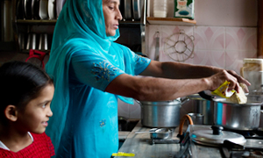
Apostrophe Usage - House
This isn’t my brother’s room.
My mother’s favourite pastime is cooking.
Notes:
Notes for Teacher - NA
Suggestions: NA
Source of Multimedia used in this slide -
https://publicdomainvectors.org/en/free-clipart/Bedroom-interior-clip-art/85002.html
https://openclipart.org/detail/217102/kids-facesm
https://www.flickr.com/photos/28056346@N06/5552880728 "Mother and daughter cooking noodles" by Nestlé is licensed under CC BY-NC-ND 2.0.

Slide 3
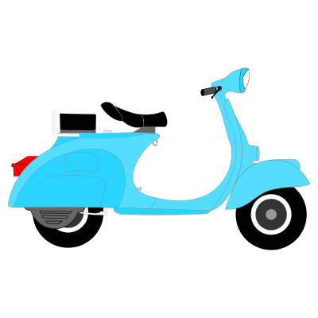
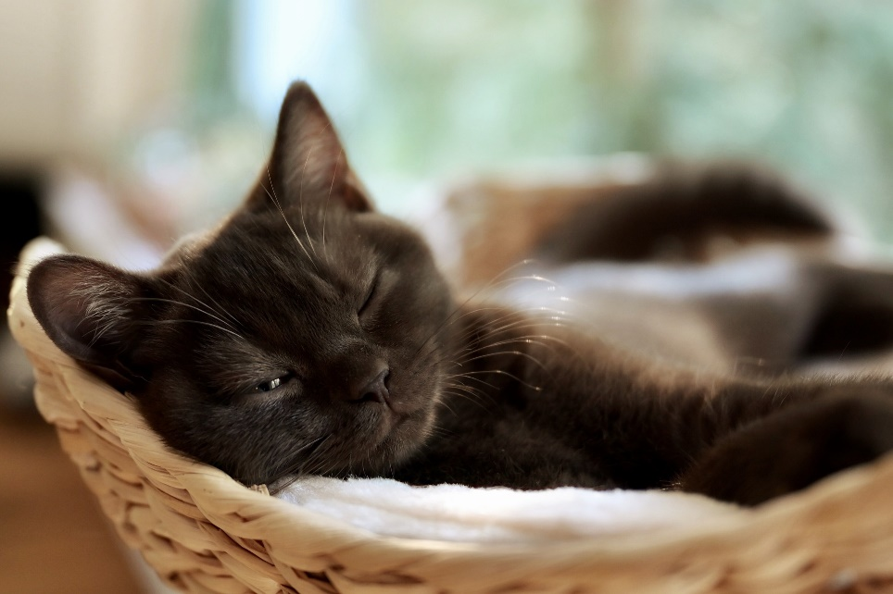
Apostrophe Usage - House
This is my father’s scooter.
My pet cat Rani doesn’t allow anyone in her cozy corner.
Notes:
Notes for Teacher - NA
Suggestions: NA
Source of Multimedia used in this slide -
https://openclipart.org/detail/162301/vespa-1957
https://openclipart.org/detail/217102/kids-facesm
https://pixabay.com/photos/cat-kitten-eyes-domestic-cat-purr-5345498/

Slide 4
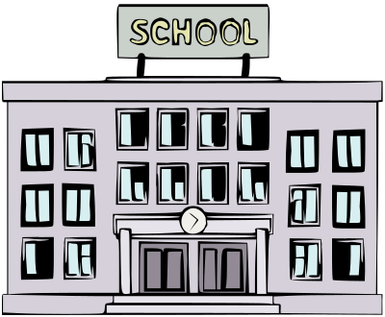
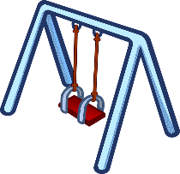
Apostrophe Usage - School
Teachers’ Room
The children’s playground is behind the school.
The teachers’ rooms are on the first floor.
Notes:
Notes for Teacher - NA
Suggestions: NA
Source of Multimedia used in this slide -
https://openclipart.org/detail/298870/school-colour
https://openclipart.org/detail/217102/kids-facesm
See saw - https://pixabay.com/vectors/playground-seesaw-teeter-toys-1295285/
Swing - https://pixabay.com/vectors/children-play-kinder-playground-1295470/

Slide 5
Apostrophe Usage - School
The school library isn’t open on Sundays.
The students’ books are neatly arranged in the classrooms.
Notes:
Notes for Teacher - NA
Suggestions: NA
Source of Multimedia used in this slide -
https://openclipart.org/detail/298280/college-library
https://openclipart.org/detail/217102/kids-facesm
https://openclipart.org/detail/191463/wooden-bookcase

Slide 6
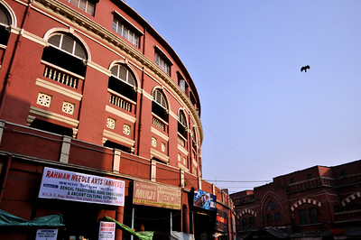
Apostrophe Usage - Market
The green grocers’ stalls aren’t open on Sundays.
Notes:
Notes for Teacher - NA
Suggestions: NA
Source of Multimedia used in this slide -
https://openclipart.org/detail/217102/kids-facesm
https://commons.wikimedia.org/wiki/File:New_market_(Esplanade)_Old_hogg_market,_Kolkata_(5376329266).jpg by offbit2010 is licensed under CC BY 2.0.

Slide 7
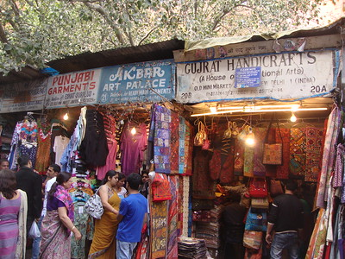
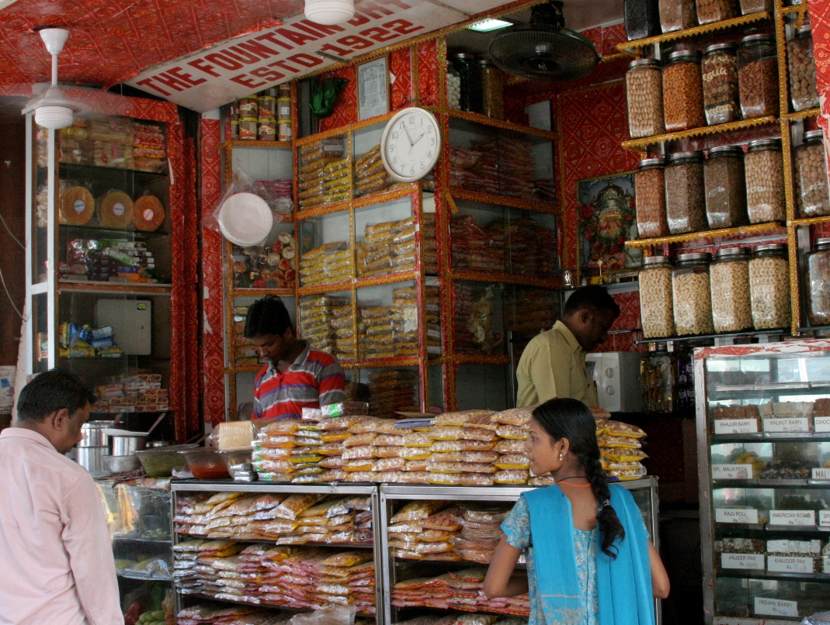
Apostrophe Usage - Market
The second stall to the left belongs to my friend’s father.
My uncle’s store is also in this market.
Notes:
Notes for Teacher - NA
Suggestions: NA
Source of Multimedia used in this slide -
https://openclipart.org/detail/217102/kids-facesm
//www.flickr.com/photos/vasenka/7026348373 by VasenkaPhotography is licensed under CC BY 2.0.
https://www.flickr.com/photos/62719770@N00/3081809045/ by Kate Boydell is licensed under CC BY 2.0.

Slide 8
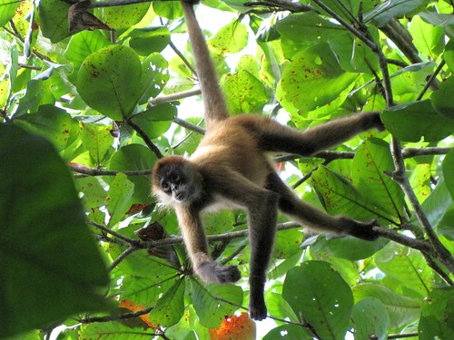
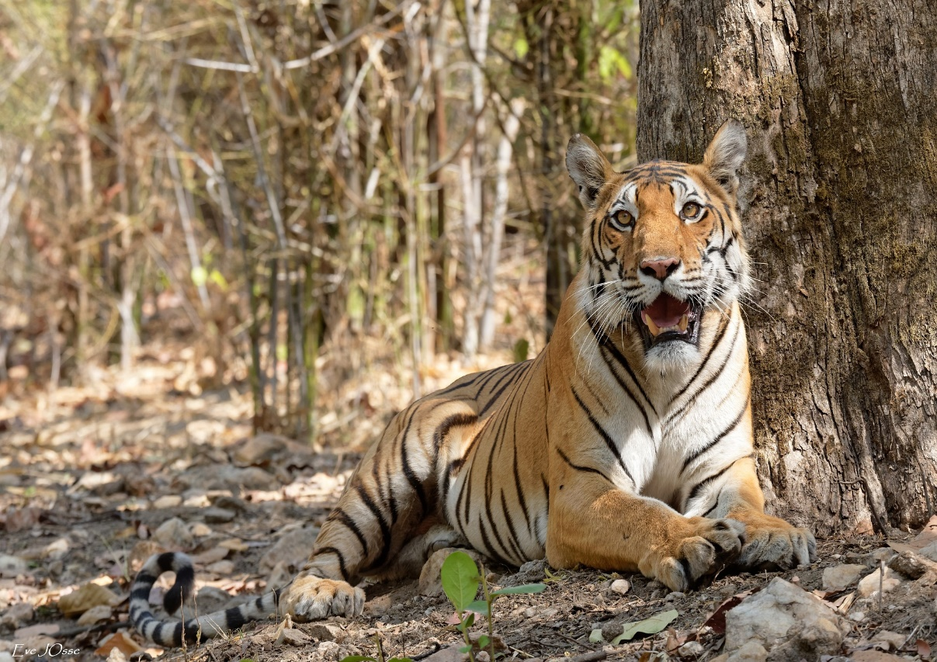
Apostrophe Usage - Jungle
The monkey’s tail helps it to hang from trees.
The tiger’s stripes help it to stay camouflaged in the jungle.
Notes:
Notes for Teacher - NA
Suggestions: NA
Source of Multimedia used in this slide -
https://openclipart.org/detail/217102/kids-facesm
https://www.flickr.com/photos/sdbeazley/5355861188 by sdbeazley is licensed under CC BY 2.0.
https://pixabay.com/photos/tiger-animal-forest-mammal-big-cat-5838947/

Slide 9
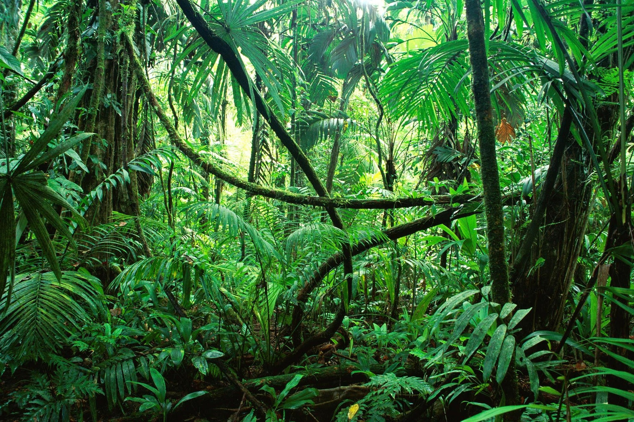
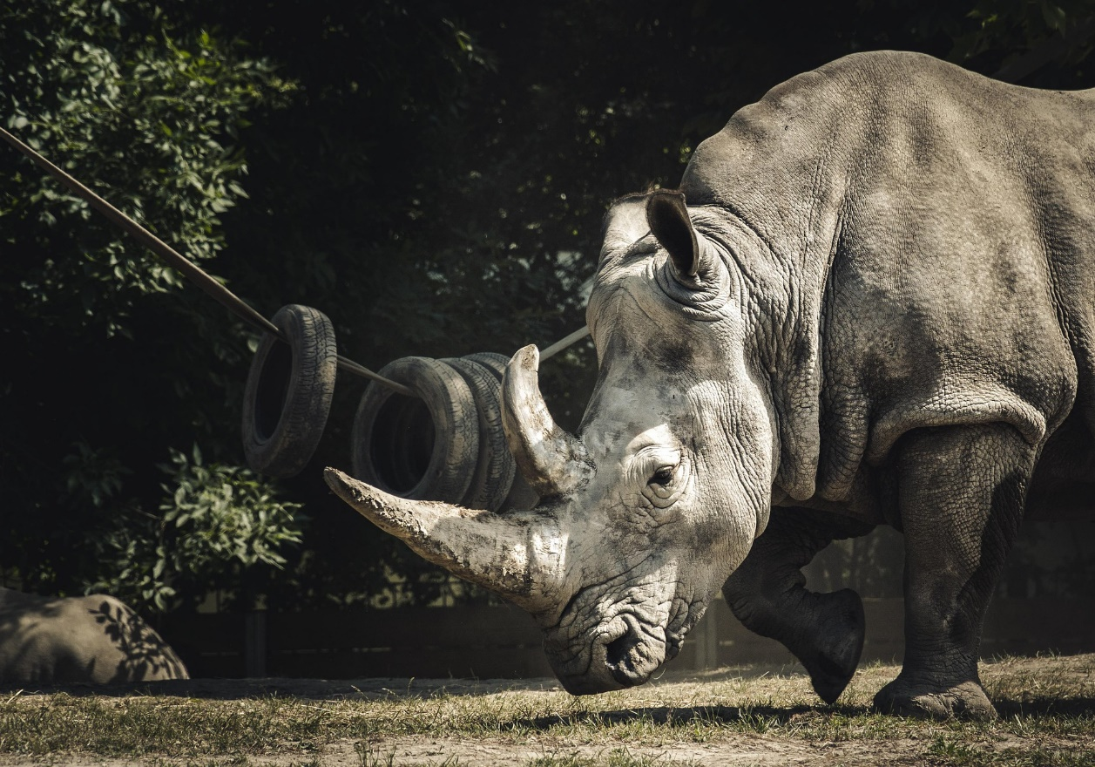
Apostrophe Usage - Jungle
The jungle isn’t a safe place for human beings to live in.
The rhinocerous’ horns are used for self defence.
Notes:
Notes for Teacher - NA
Suggestions: NA
Source of Multimedia used in this slide –
https://openclipart.org/detail/217102/kids-facesm
https://pixabay.com/photos/the-jungle-of-chiapas-1865639/
https://pixabay.com/photos/animal-rhinoceros-mammal-horn-zoo-4451152/

Slide 10
MM Index
Slide # | Thumbnail | Source link and Attribution
1 |  | https://commons.wikimedia.org/wiki/File:Apostrophe.svg
2 ,4,6,8 |  | https://openclipart.org/detail/175972/classic-art-roo
2 |  | https://publicdomainvectors.org/en/free-clipart/Bedroom-interior-clip-art/85002.html https://www.flickr.com/photos/28056346@N06/5552880728 "Mother and daughter cooking noodles" by Nestlé is licensed under CC BY-NC-ND 2.0.
3 |  | https://openclipart.org/detail/162301/vespa-1957 https://pixabay.com/photos/cat-kitten-eyes-domestic-cat-purr-5345498/
4 |  | https://openclipart.org/detail/298870/school-colour See saw - https://pixabay.com/vectors/playground-seesaw-teeter-toys-1295285/ Swing - https://pixabay.com/vectors/children-play-kinder-playground-1295470/
5 |  | https://openclipart.org/detail/298280/college-library https://openclipart.org/detail/191463/wooden-bookcase
6 |  | https://www.flickr.com/photos/mckaysavage/3059483658/ by mckaysavage is licensed under CC BY 2.0. https://commons.wikimedia.org/wiki/File:New_market_(Esplanade)_Old_hogg_market,_Kolkata_(5376329266).jpg by offbit2010 is licensed under CC BY 2.0.
7 |  | https://www.flickr.com/photos/vasenka/7026348373 by VasenkaPhotography is licensed under CC BY 2.0. https://www.flickr.com/photos/62719770@N00/3081809045/ by Kate Boydell is licensed under CC BY 2.0.
8 |  | https://www.flickr.com/photos/sdbeazley/5355861188 by sdbeazley is licensed under CC BY 2.0. https://pixabay.com/photos/tiger-animal-forest-mammal-big-cat-5838947/
9 |  | https://pixabay.com/photos/the-jungle-of-chiapas-1865639/ https://pixabay.com/photos/animal-rhinoceros-mammal-horn-zoo-4451152/
3,5,7,9 |  | https://openclipart.org/detail/175972/classic-art-roo
Notes:
Notes for Teacher - < Information for further reference or explanation >
Suggestions: <Ideas/ Images/ Animations / Others – To make better representation of the content >
Source of Multimedia used in this slide - <Please provide source URL where we find the image and the license agreement>

