Slide 1
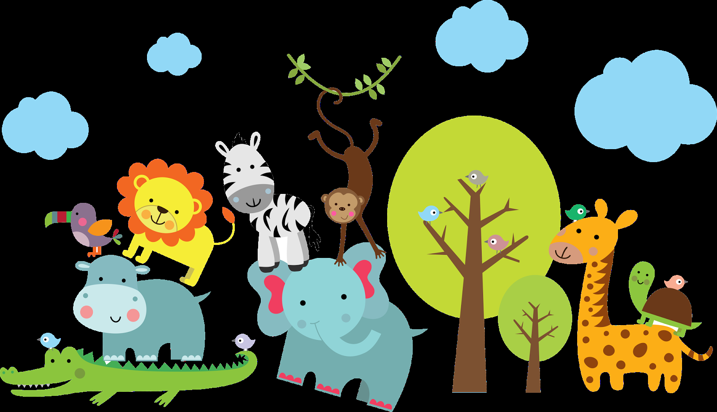
Each one is Unique
Notes:
Notes for Teacher - < Information for further reference or explanation >
Suggestions: <Ideas/ Images/ Animations / Others – To make better representation of the content >
Source of Multimedia used in this slide -
1. https://www.hiclipart.com/free-transparent-background-png-clipart-dyidw

Slide 2
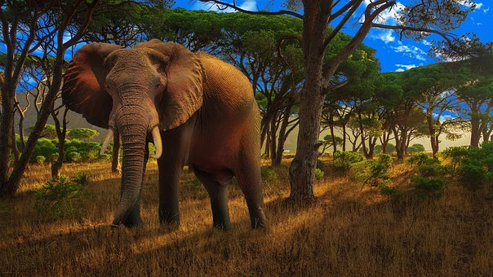
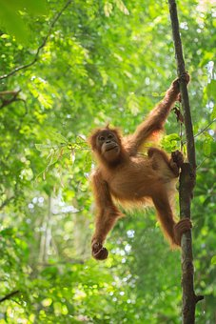
Searching for Friendship
The Elephant was searching for a friend...
You are too big and cannot swing on trees.
Will you be my friend?
Will you be my friend?
You are too big to fit inside my burrow.
Notes:
Notes for Teacher –
Punctuations are different marks and symbols that add clarity and precision to sentences. (example) Apostrophes
are used in place of missing letters, show possession etc.
So too each one of us is different in many ways, but together we make the world. Suggestions: <Ideas/ Images/ Animations / Others – To make better representation of the content >
Source of Multimedia used in this slide -
Elephant: https://pixabay.com/photos/elephant-forest-trees-woods-sky-7138065/
Monkey: https://pixabay.com/photos/green-plants-nature-forest-trees-2600479/
Rabbit: https://pixabay.com/photos/rabbits-cute-infant-rabbit-3716254/

Slide 3
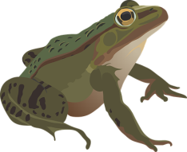
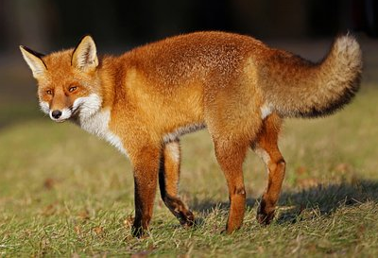
Searching for Friendship
Will you be my friend?
You are too big and heavy. You cannot jump like me.
Will you be my friend?
You are too big.
Notes:
Notes for Teacher - < Information for further reference or explanation >
Suggestions: <Ideas/ Images/ Animations / Others – To make better representation of the content >
Source of Multimedia used in this slide -
Frog: https://pixabay.com/vectors/frog-green-amphibian-animal-nature-2457343/
Fox: https://pixabay.com/photos/fox-red-fox-nature-animals-wild-4388014/
Elephant: https://pixabay.com/photos/elephant-forest-trees-woods-sky-7138065/

Slide 4
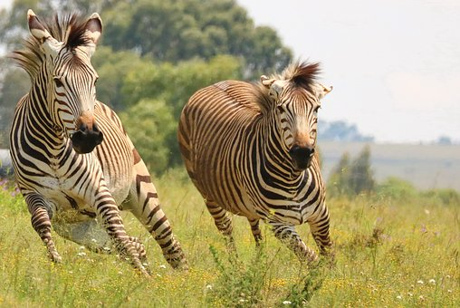
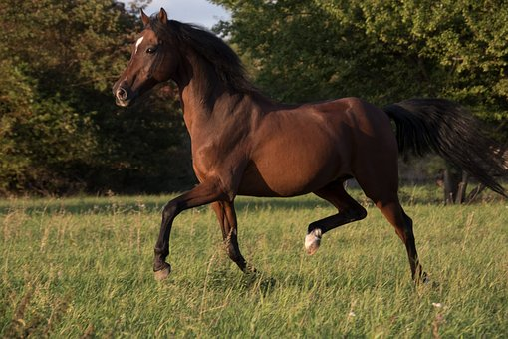
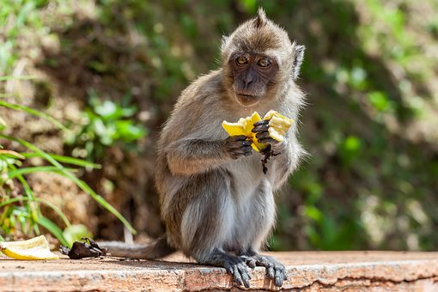
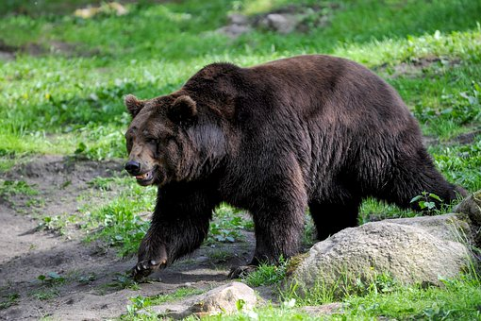
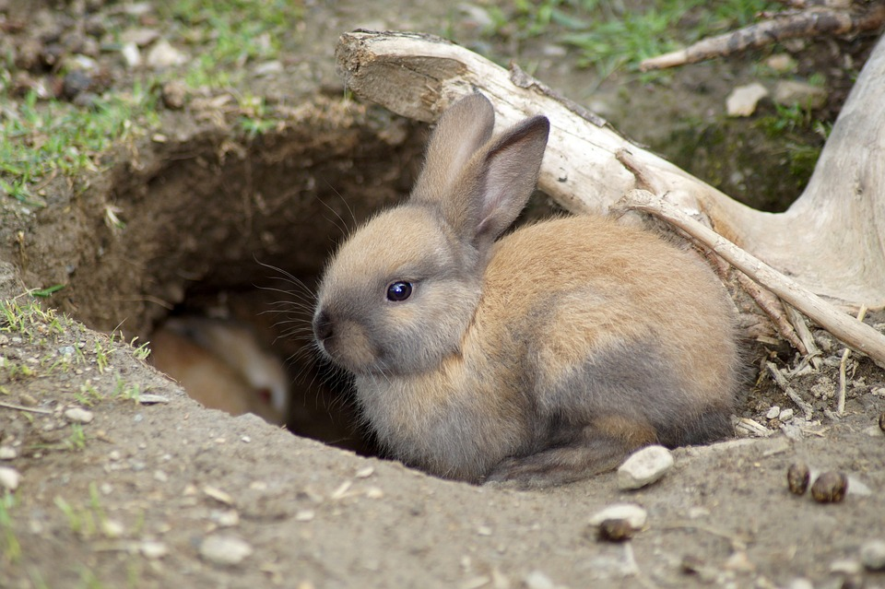
The Fear
What is happening?
Has been
attacking all
animals.
Notes:
Notes for Teacher - The next day, all the animals in the forest were running in fear. The elephant stopped a bear and asked what was happening and was told that a tiger had been attacking all the animals. Suggestions: <Ideas/ Images/ Animations / Others – To make better representation of the content >
Source of Multimedia used in this slide -
Zebra: https://pixabay.com/photos/hartmann-s-zebra-hartmann-s-zebra-4823240/
Bear: https://pixabay.com/photos/brown-bear-bear-wild-animal-4859243/
Horse: https://pixabay.com/photos/horse-running-galloping-5576651/
Rabbit: https://pixabay.com/photos/rabbits-cute-infant-rabbit-3716254/
Monkey: https://pixabay.com/photos/long-tailed-macaque-4493895/
Tiger: https://pixabay.com/photos/tiger-swamp-big-cat-wild-cat-2535888/

Slide 5
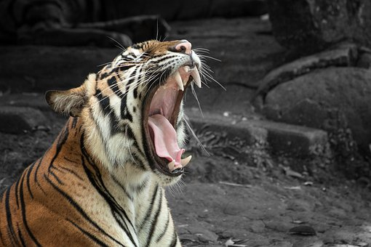
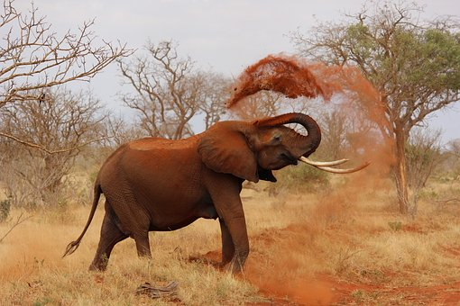
Show of Strength
Notes:
Notes for Teacher - The elephant wanted to save the other weak animals and went to the tiger and said, “Please sir, leave my friends alone. Do not eat them." The tiger didn’t listen and asked the elephant to mind his own business. Seeing no other way to solve the problem, the elephant, with all his power, scared the tiger away.
Suggestions: <Ideas/ Images/ Animations / Others – To make better representation of the content >
Source of Multimedia used in this slide -
Tiger: https://pixabay.com/photos/tiger-roar-animal-predator-fangs-3969118/
Elephant: https://pixabay.com/photos/elephant-animal-zoo-111695/

Slide 6
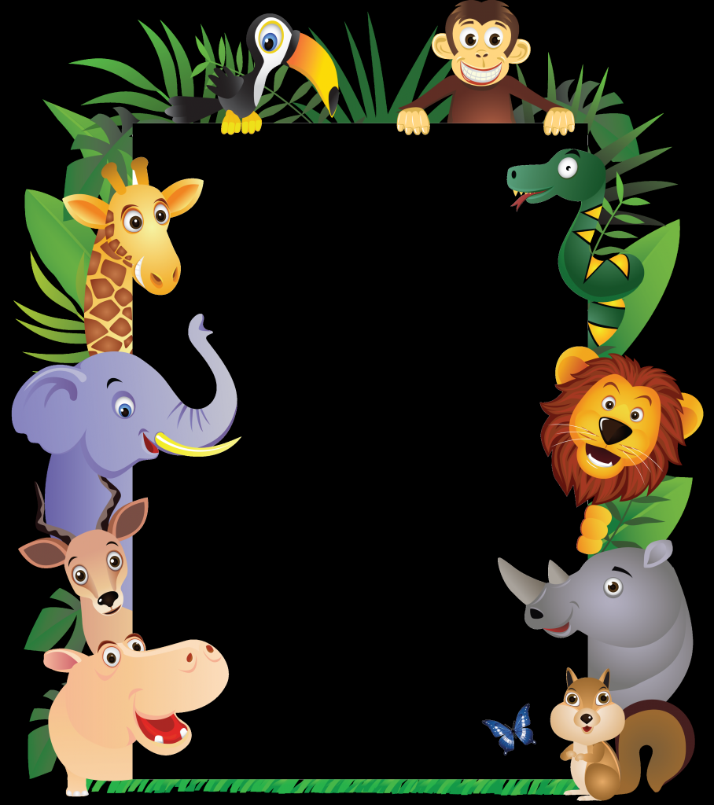
The HERO
YOU are
the right
size for
US
Notes:
Notes for Teacher - Hearing how the elephant saved their lives, the animals understood that each one comes in different shapes, sizes, abilities and skills, and that should not stop one from living and being together. The animals together agreed and said to the elephant, “You are just the right size to be our friend”.
Suggestions: <Ideas/ Images/ Animations / Others – To make better representation of the content >
Source of Multimedia used in this slide -
1. Animals: https://www.hiclipart.com/free-transparent-background-png-clipart-dgquw

Slide 7
Points to reflect upon:
Respect each other.
Be kind, loving and caring to all.
Avoid hurting anyone.
Live in harmony with everyone.
Notes:
Notes for Teacher - < Information for further reference or explanation >
Suggestions: <Ideas/ Images/ Animations / Others – To make better representation of the content >
Source of Multimedia used in this slide - <Please provide source URL where we find the image and the license agreement>

Slide 8
MM INDEX
Slide # | Thumbnail | Source link and Attribution
1 |  | 1 . https://www.hiclipart.com/free-transparent-background-png-clipart-dyidw
2 |  | Elephant: https://pixabay.com/photos/elephant-forest-trees-woods-sky-7138065/ Monkey: https://pixabay.com/photos/green-plants-nature-forest-trees-2600479/ Rabbit: https://pixabay.com/photos/rabbits-cute-infant-rabbit-3716254/
3 |  | Frog: https://pixabay.com/vectors/frog-green-amphibian-animal-nature-2457343/ Fox: https://pixabay.com/photos/fox-red-fox-nature-animals-wild-4388014/ Elephant: https://pixabay.com/photos/elephant-forest-trees-woods-sky-7138065
4 |  | Zebra: https://pixabay.com/photos/hartmann-s-zebra-hartmann-s-zebra-4823240/ Bear: https://pixabay.com/photos/brown-bear-bear-wild-animal-4859243/ Horse: https://pixabay.com/photos/horse-running-galloping-5576651/ Rabbit: https://pixabay.com/photos/rabbits-cute-infant-rabbit-3716254/ Monkey: https://pixabay.com/photos/long-tailed-macaque-4493895/ Tiger: https://pixabay.com/photos/tiger-swamp-big-cat-wild-cat-2535888/
5 |  | Tiger: https://pixabay.com/photos/tiger-roar-animal-predator-fangs-3969118/ Elephant: https://pixabay.com/photos/elephant-animal-zoo-111695/
6 |  | 1. Animals: https://www.hiclipart.com/free-transparent-background-png-clipart-dgquw
Notes:
Notes for Teacher - < Information for further reference or explanation >
Suggestions: <Ideas/ Images/ Animations / Others – To make better representation of the content >
Source of Multimedia used in this slide - <Please provide source URL where we find the image and the license agreement>

