Slide 1
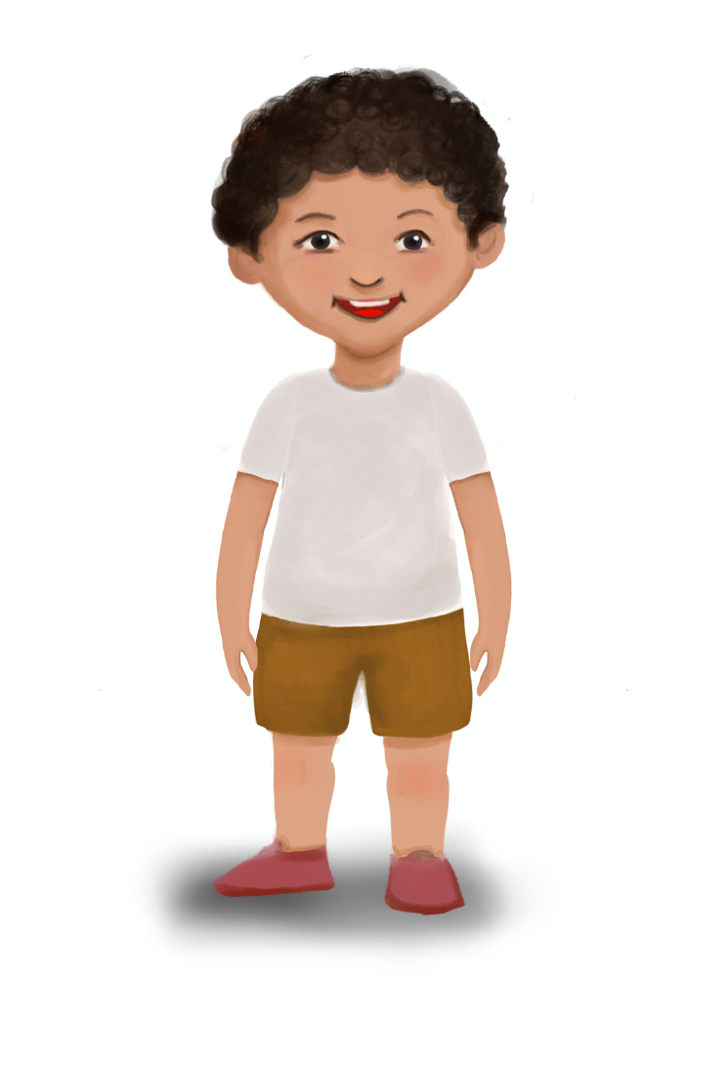
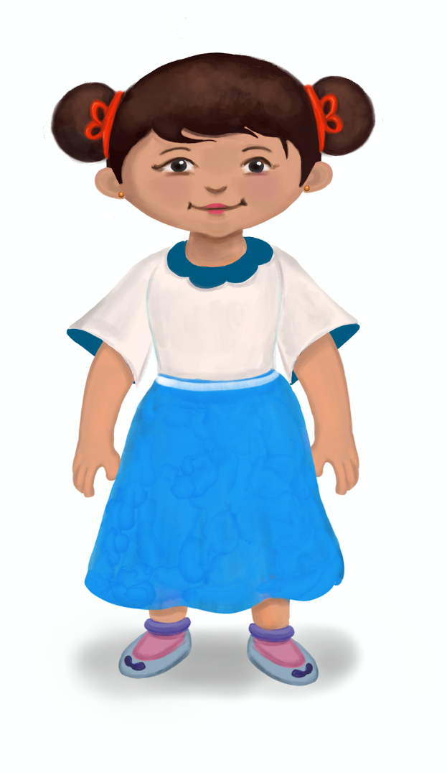
Who am I?
Notes:
Notes for Teacher - The teacher may first ask the students to identify the positive comparative and superlative adjectives in the given sentences as a revision exercise and the clues may be read out to elicit the answers for the riddles. The students will enjoy the riddles and at the same time apply what they have learnt.
Suggestions: <Ideas/ Images/ Animations / Others – To make better representation of the content >
Source of Multimedia used in this slide -
Boy: SSSVV Image Gallery: Search Keyword "<Prem>“
Girl: SSSVV Image Gallery: Search Keyword "<Shanti>"

Slide 2
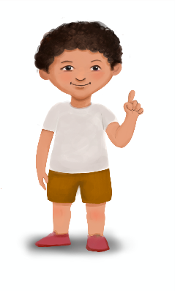
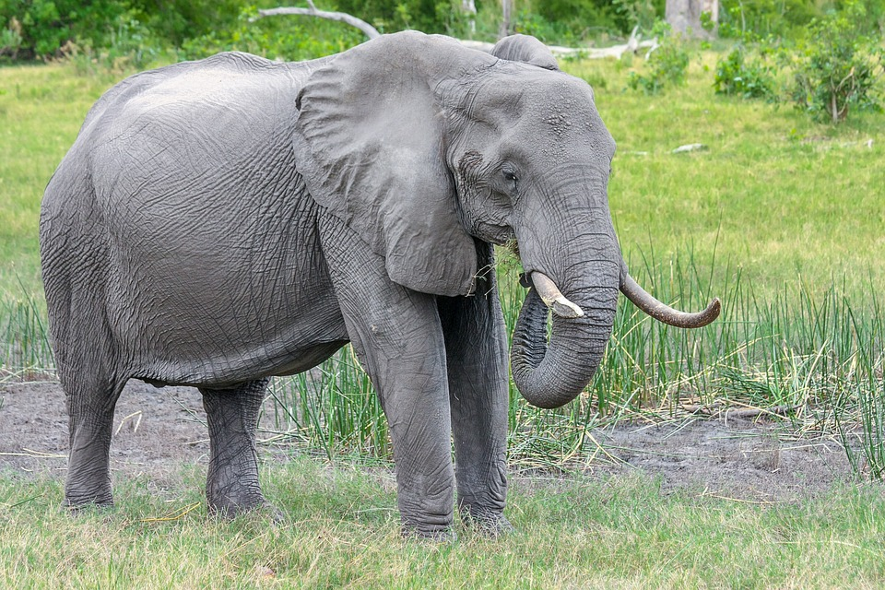
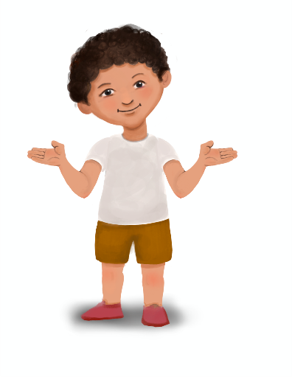
Who am I ?
CHECK
I am bigger than a lion.
I am grey in colour.
I have the biggest ears in the world.
I am an ELEPHANT
Notes:
Notes for Teacher – < Information for further reference or explanation >
Suggestions: <Ideas/ Images/ Animations / Others – To make better representation of the content >
Source of Multimedia used in this slide - <Elephant - https://pixabay.com/images/id-2923912/ By designerpoint
Boy: SSSVV Image Gallery: Search Keyword "<Prem>“
>

Slide 3
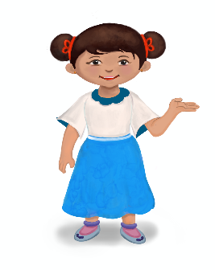
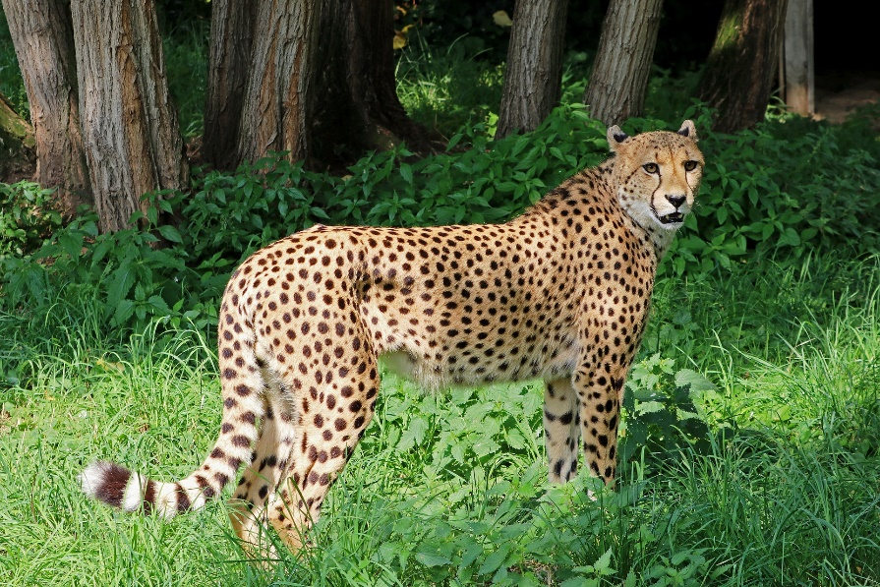
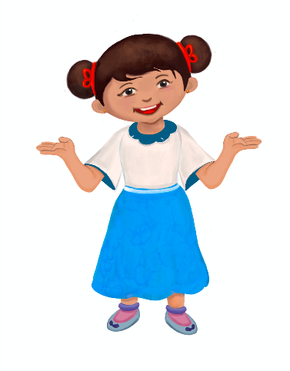
Who am I ?
I have yellow fur with black spots.
CHECK
I am bigger than a cat.
I am a CHEETAH
I am the fastest animal in the world.
Notes:
Notes for Teacher – < Information for further reference or explanation >
Suggestions: <Ideas/ Images/ Animations / Others – To make better representation of the content >
Source of Multimedia used in this slide - <https://pixabay.com/images/id-2477275/ By herbert2512
Girl: SSSVV Image Gallery: Search Keyword "<Shanti>">

Slide 4
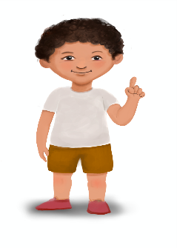
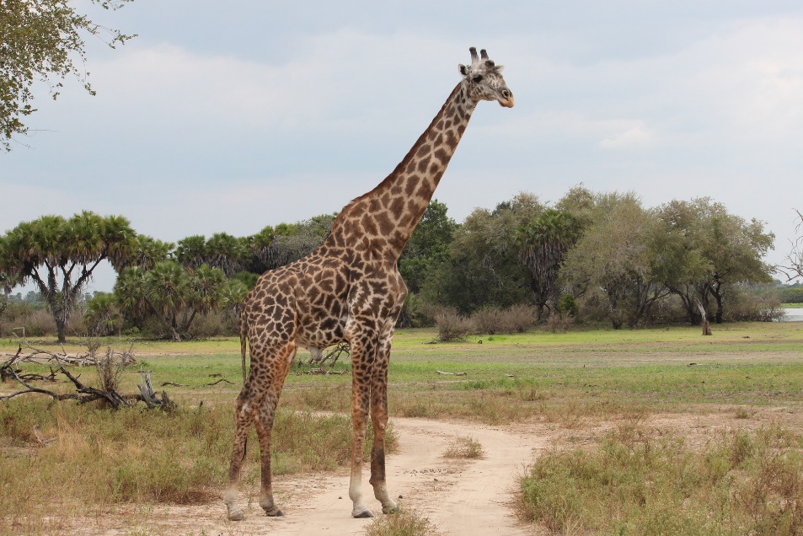
Who am I?
CHECK
I have a very long neck.
I have large brown eyes with black lashes.
I am a GIRAFFE
I am the tallest animal in the animal kingdom.
Notes:
Notes for Teacher – < Information for further reference or explanation >
Suggestions: <Ideas/ Images/ Animations / Others – To make better representation of the content >
Source of Multimedia used in this slide - <https://pixabay.com/images/id-1029795/ By gekkodigitalmedia
Boy: SSSVV Image Gallery: Search Keyword "<Prem>">

Slide 5
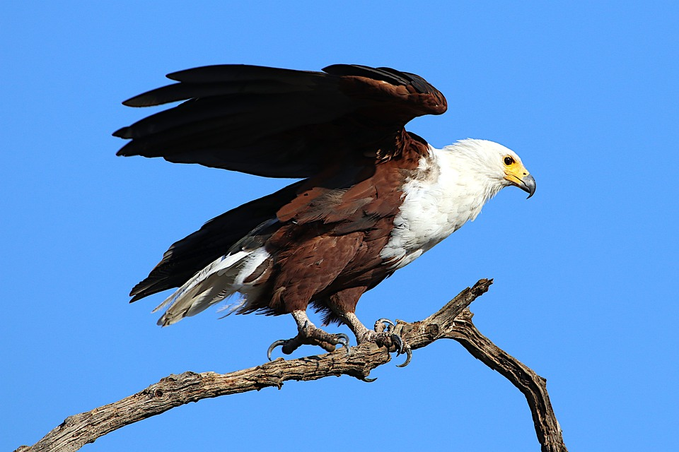
Who am I ?
CHECK
I am a fearless bird.
I have better leadership qualities that other birds.
My vision is the sharpest in the animal kingdom.
I am an EAGLE
Notes:
Notes for Teacher – < Information for further reference or explanation >
Suggestions: <Ideas/ Images/ Animations / Others – To make better representation of the content >
Source of Multimedia used in this slide - <https://pixabay.com/images/id-4694474/ By Like_A_Hartman
Girl: SSSVV Image Gallery: Search Keyword "<Shanti>">

Slide 6
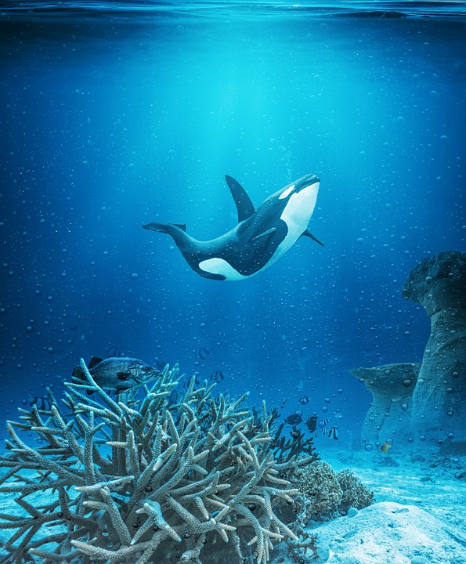
Who am I?
I am large and live in the ocean.
CHECK
I am larger than a dolphin.
I am the largest animal in the world.
I am a WHALE
Notes:
Notes for Teacher – < Information for further reference or explanation >
Suggestions: <Ideas/ Images/ Animations / Others – To make better representation of the content >
Source of Multimedia used in this slide - <https://pixabay.com/images/id-7633370/ By mollyroselee
Boy: SSSVV Image Gallery: Search Keyword "<Prem>">

Slide 7
Attribution / Citation
Slide # | Thumbnail | Source link | Author
2 |  | Elephant - https://pixabay.com/images/id-2923912/ | By designerpoint
3 |  | Cheetah: https://pixabay.com/images/id-2477275/ | By herbert2512
4 |  | Giraffe: https://pixabay.com/images/id-1029795/ | By gekkodigitalmedia
5 |  | Eagle: https://pixabay.com/images/id-4694474/ | By Like_A_Hartman
6 |  | Whale: https://pixabay.com/images/id-7633370/ | By mollyroselee
Notes:
Notes for Teacher - < Information for further reference or explanation >
Suggestions: <Ideas/ Images/ Animations / Others – To make better representation of the content >
Source of Multimedia used in this slide - <Please provide source URL where we find the image and the license agreement>

