Slide 1
Superlatives-Adjectives
Notes:
Notes for Teacher - < Information for further reference or explanation >
Suggestions: <Ideas/ Images/ Animations / Others – To make better representation of the content >
Source of Multimedia used in this slide - <Please provide source URL where we find the image and the license agreement>

Slide 2
Adjectives - Recapitulation
Identify the underlined adjectives and state their forms (Positive or Comparative)
My brother is a very intelligent boy.
Light is more beautiful than darkness.
My sister is kinder than my brother.
My father bought an expensive pen for me.
I like dogs better than rabbits.
Positive form
Comparative form
Comparative form
Positive form
Comparative form
Notes:
Notes for Teacher - < Information for further reference or explanation >
The teacher may begin the class with a review activity by writing a few sentences on the blackboard and then ask the students to identify the underlined adjectives and state their forms (Positive or Comparative) in the sentences given. The teacher may give more examples to explain the degrees of comparison, how two or more things are compared.
(The rules mentioned are for teacher’s reference and not so much for the students to memorise them. The teacher could have an interactive session with the students for them to learn how to use degrees of comparison in written and spoken form.)
Suggestions: N/A
Source of Multimedia used in this slide - N/A

Slide 3
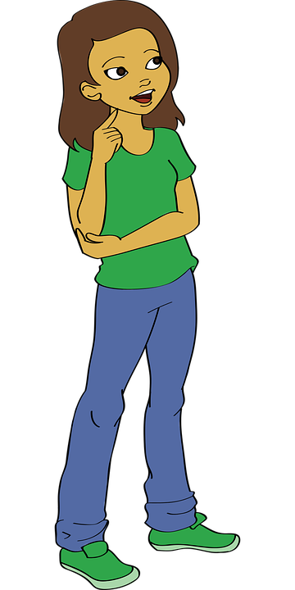
Superlatives-Adjectives
Renu’s hair is long.
Veena’s hair is longer than Renu’s.
Savitha’s hair is the longest among the three girls.
Positive form
Comparative form
Superlative form
Notes:
Notes for Teacher - The teacher may ask three students of different hair lengths to stand in front of the class. Describe the length of their hair using degrees of comparison:
Then the teacher explains that the first sentence simply makes a statement using the adjective long in positive form.
In the second sentence the comparison is between two persons, comparative form longer than is used.
In the third sentence the longest is in the superlative form as the comparison is used for two or more persons.
Suggestions: N/A
Source of Multimedia used in this slide -
Girl1 - https://www.freepik.com/free-vector/happy-diwali-day-logo-design_32670338.htm By brgfx
Girl 2 - https://pixabay.com/illustrations/little-girl-kid-cartoon-girl-child-6400002/
Girl 3 - https://www.freepik.com/free-vector/hand-drawn-teej-festival-illustration_15034819.htm By freepik

Slide 4
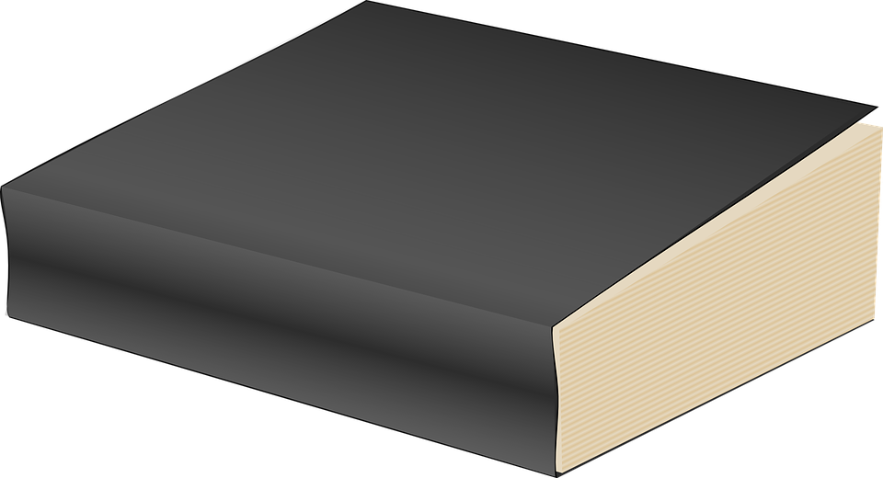
Superlatives-Adjectives
big
bigger than
biggest
Positive form
Comparative form
Superlative form
Notes:
Notes for Teacher - Similarly the teacher could demonstrate with objects like pencils, books and heights of students for better understanding of the concept of ‘Superlatives’. Superlatives are used to compare more than two people or things.
Suggestions: N/A
Source of Multimedia used in this slide -
Biggest book - https://pixabay.com/vectors/book-read-library-reading-2028193/
Bigger book - https://pixabay.com/vectors/book-black-education-paperback-25158/
Big book - https://pixabay.com/vectors/book-blue-closed-literature-297246/

Slide 5
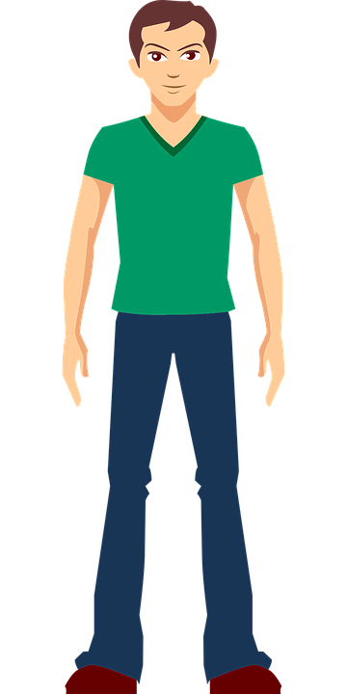
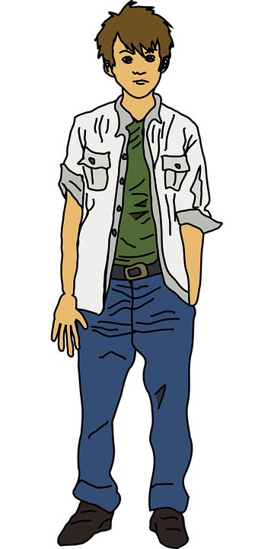
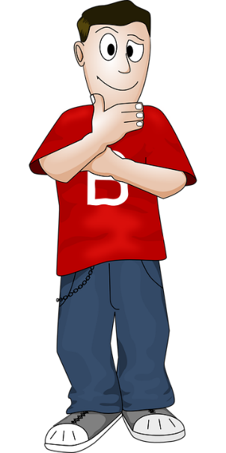
Superlatives-Adjectives
tall
taller than
tallest
Positive form
Comparative form
Superlative form
Notes:
Notes for Teacher – Similarly the teacher could demonstrate with objects like pencils, books and heights of students for better understanding of the concept of ‘Superlatives’. Superlatives are used to compare more than two people or things.
Suggestions: N/A
Source of Multimedia used in this slide -
Boy 1 - https://pixabay.com/vectors/boy-young-man-1456758/
Boy 2 - https://pixabay.com/vectors/boy-man-teen-teenager-young-161793/
Boy 3 - https://pixabay.com/vectors/man-boy-person-male-thinking-157378/

Slide 6
Superlatives-Adjectives Rules
Rule - 1
To form the comparative, we add -er + than after the adjective.
Rule - 2
To form the superlative, we add the -est after the adjective.
ADJECTIVE | COMPARATIVE | SUPERLATIVE
small
smaller than
the smallest
cold
colder than
the coldest
wide
wider than
the widest
Notes:
Notes for Teacher – N/A
Suggestions: N/A
Source of Multimedia used in this slide - N/A

Slide 7
Superlatives-Adjectives Rules
Rule - 3
Two syllable Adjectives ending in ‘y’ - usually form the comparative by adding -er and the superlative by adding -est, the ‘y’ changes to ‘i’ in the comparative / superlative.
ADJECTIVE | COMPARATIVE | SUPERLATIVE
lucky
luckier than
the luckiest
pretty
prettier than
the prettiest
tidy
tidier than
the tidiest
Notes:
Notes for Teacher – N/A
Suggestions: N/A
Source of Multimedia used in this slide - N/A

Slide 8
Superlatives-Adjectives Rules
Rule - 4
If an adjective ends in a vowel and a consonant, we double the consonant.
big
bigger than
the biggest
Notes:
Notes for Teacher – N/A
Suggestions: N/A
Source of Multimedia used in this slide -
Balloon - https://pixabay.com/vectors/balloon-color-birthday-party-2514738/

Slide 9
Superlatives-Adjectives Rules
Rule - 4
If an adjective ends in a vowel and a consonant, we double the consonant.
ADJECTIVE | COMPARATIVE | SUPERLATIVE
big
bigger than
the biggest
fat
fatter than
the fattest
hot
hotter than
the hottest
Notes:
Notes for Teacher - The teacher may then present the Superlative form of adjectives.
The teacher may ask three students of different hair lengths to stand in front of the class. Describe the length of their hair using degrees of comparison:
Suggestions: N/A
Source of Multimedia used in this slide - N/A

Slide 10
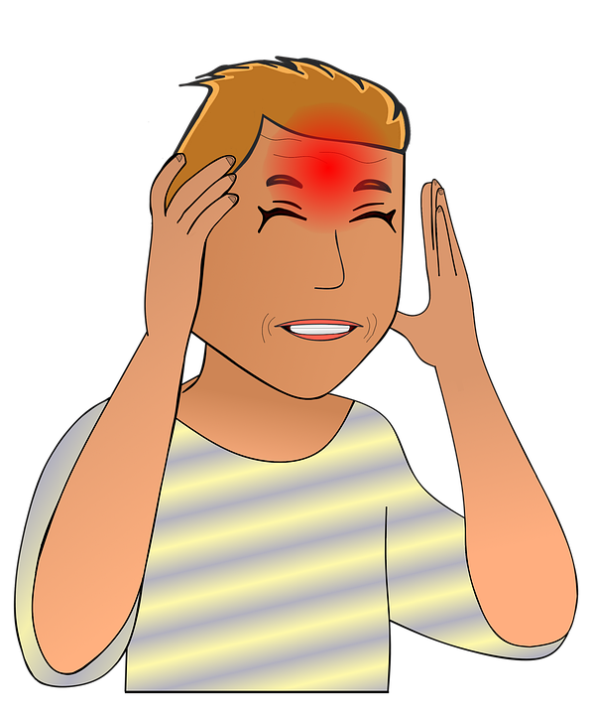
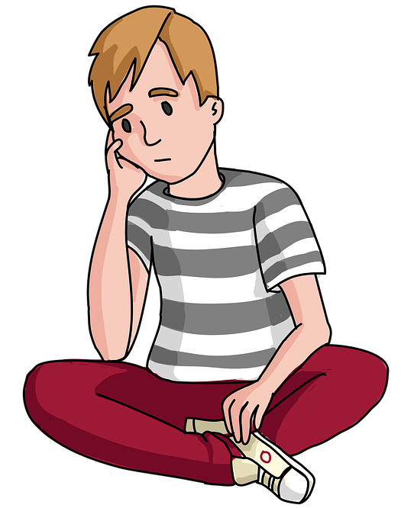
Superlatives-Adjectives Rules
Rule - 5
Two syllable Adjectives ending in ed, ing , ful or less always form the comparative with more and the superlative with most.
worried
more worried
most worried
Notes:
Notes for Teacher – N/A
Suggestions: N/A
Source of Multimedia used in this slide -
Boy 1 - https://pixabay.com/illustrations/boy-thinking-thought-bubble-child-5888240/
Boy 2 - https://pixabay.com/vectors/boy-sad-stress-young-man-young-6204400/
Boy 3 - https://pixabay.com/illustrations/stress-nerve-pain-headache-migraine-4498569/

Slide 11
Superlatives-Adjectives Rules
Rule - 5
Two syllable Adjectives ending in ed, ing, ful or less always form the comparative with more and the superlative with most.
ADJECTIVE | COMPARATIVE | SUPERLATIVE
worried
more worried
most worried
careful
more careful
most careful
useless
more useless
most useless
Notes:
Notes for Teacher - <The teacher may then present the Superlative form of adjectives.
The teacher may ask three students of different hair lengths to stand in front of the class. Describe the length of their hair using degrees of comparison:
Suggestions: N/A
Source of Multimedia used in this slide - N/A

Slide 12
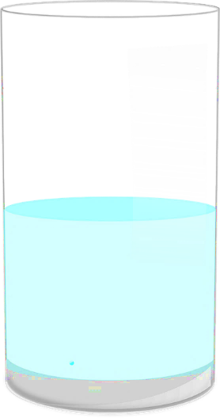
Superlatives-Adjectives Rules
Rule - 6
There are some exceptions where the adjectives change their form completely in comparative and superlative status.
little
less than
the least
Notes:
Notes for Teacher – N/A
Suggestions: N/A
Source of Multimedia used in this slide -
Water- https://pixabay.com/vectors/water-glass-half-full-drink-empty-305658/

Slide 13
Superlatives-Adjectives Rules
Rule - 6
There are some exceptions where the adjectives change their form completely in comparative and superlative status.
ADJECTIVE | COMPARATIVE | SUPERLATIVE
good
better than
the best
bad
worse than
the worst
far
farther / further than
the farthest / furthest
little
less than
the least
Notes:
Notes for Teacher – N/A
Suggestions: N/A
Source of Multimedia used in this slide - N/A

Slide 14
Attribution / Citation
Slide # | Thumbnail | Source link | Author
3 |  | https://www.freepik.com/free-vector/happy-diwali-day-logo-design_32670338.htm | brgfx
3 |  | https://pixabay.com/vectors/cartoon-child-comic-2023899/ | OpenClipart-Vectors
3 |  | https://www.freepik.com/free-vector/hand-drawn-teej-festival-illustration_15034819.htm | freepik
4 |  | https://pixabay.com/vectors/book-blue-closed-literature-297246/ | Clker-Free-Vector-Images
4 |  | https://pixabay.com/vectors/book-black-education-paperback-25158/ | Clker-Free-Vector-Images
4 |  | https://pixabay.com/vectors/book-read-library-reading-2028193/ | OpenClipart-Vectors
5 |  | https://pixabay.com/vectors/man-boy-person-male-thinking-157378/ | OpenClipart-Vectors
5 |  | https://pixabay.com/vectors/boy-man-teen-teenager-young-161793/ | OpenClipart-Vectors
5 |  | https://pixabay.com/vectors/boy-young-man-1456758/ | Harshal07
8 |  | https://pixabay.com/vectors/balloon-color-birthday-party-2514738/ | Josethestoryteller
10 |  | https://pixabay.com/illustrations/boy-thinking-thought-bubble-child-5888240/ | Biistudio21
10 |  | https://pixabay.com/vectors/boy-sad-stress-young-man-young-6204400/ | 17959117
10 |  | https://pixabay.com/illustrations/stress-nerve-pain-headache-migraine-4498569/ | Conmongt
12 |  | https://pixabay.com/vectors/water-glass-half-full-drink-empty-305658/ | Clker-Free-Vector-Images
Notes:
Notes for Teacher - < Information for further reference or explanation >
Suggestions: <Ideas/ Images/ Animations / Others – To make better representation of the content >
Source of Multimedia used in this slide - <Please provide source URL where we find the image and the license agreement>

