Slide 1
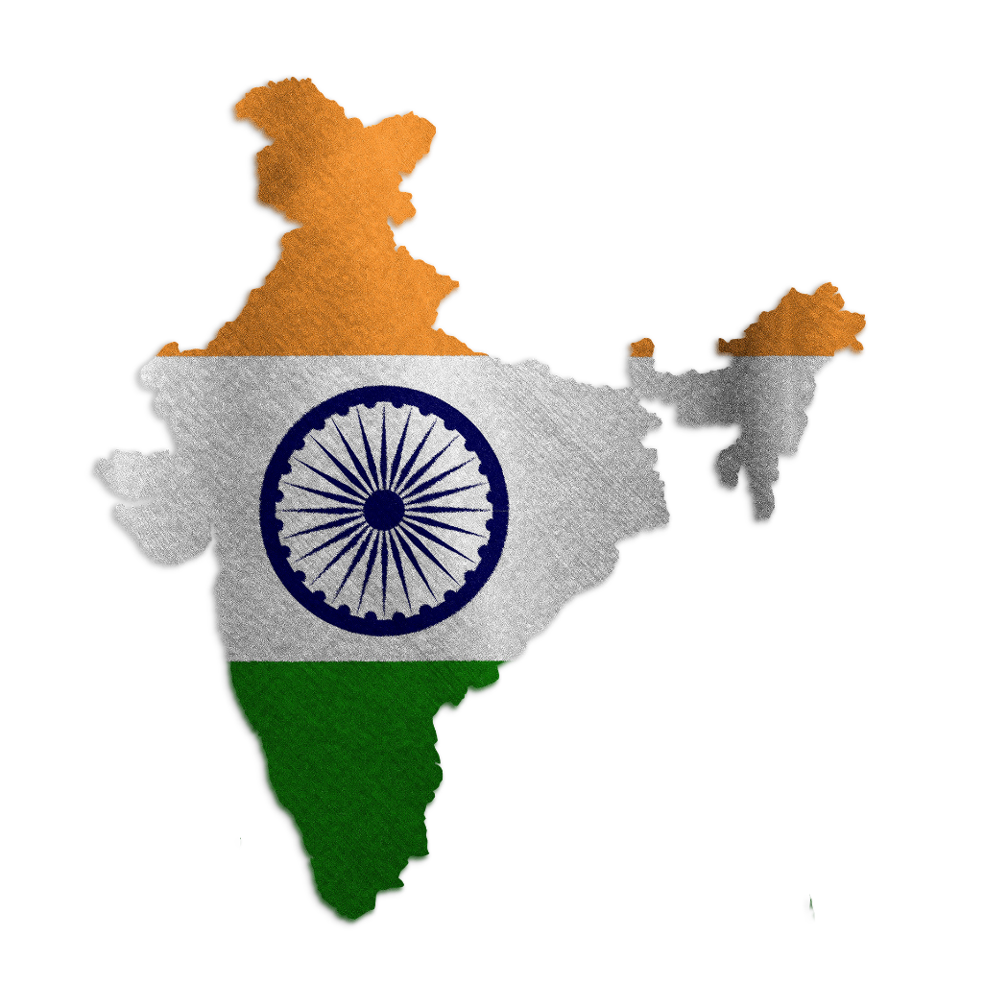
Wow India
Notes:
Notes for Teacher: N/A
Suggestions: N/A
Source of Multimedia used in this slide -
https://pixabay.com/illustrations/india-india-map-flag-country-6487315/

Slide 2
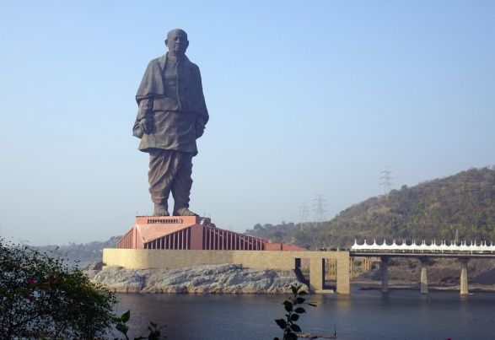
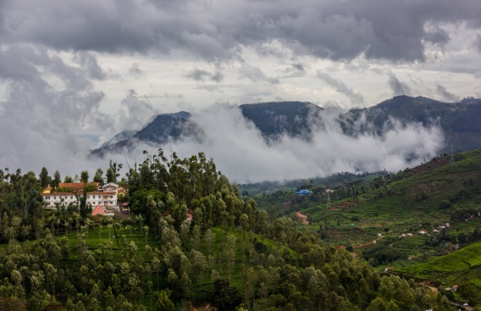
Superlative form of Adjectives
1
The Statue of Unity in Gujarat is the world’s tallest statue with a height of 597 feet.
One of the most beautiful places in India are the Nilgiri Hills in Tamil Nadu. They are part of a larger chain of mountains known as the Western Ghats.
2
Notes:
Notes for Teacher - Notes to the Teacher: The teacher can prepare a print out of the information provided below and read it aloud to the students. The teacher may ask the students to note that the superlative form of adjectives have been used in these sentences.
Suggestions: N/A
Source of Multimedia used in this slide -
Statue: https://pixabay.com/photos/statue-statue-of-unity-india-6678155/
Nilgiri: https://pixabay.com/photos/hills-clouds-nilgiris-tamil-nadu-4688134/

Slide 3
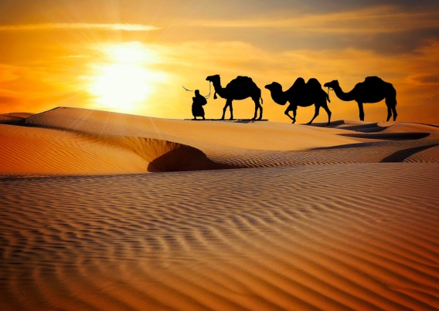
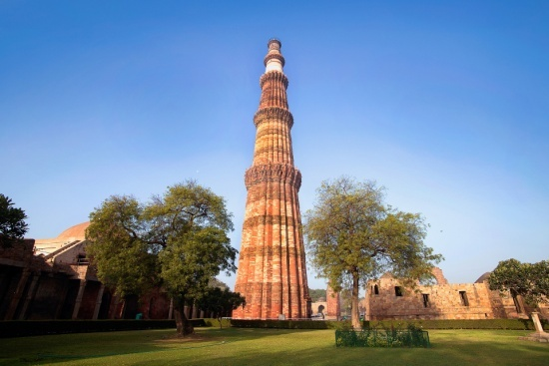
Superlative form of Adjectives
3
Rajasthan is the largest state in India, area wise.
The Qutub Minar in Delhi is one of the most famous monuments in India.
4
Notes:
Notes for Teacher – N/A
Suggestions: N/A
Source of Multimedia used in this slide -
Desert: https://pixabay.com/photos/caravan-desert-safari-dune-camels-3341872/
Minar: https://pixabay.com/photos/qutub-minar-delhi-monument-fort-2155776/

Slide 4
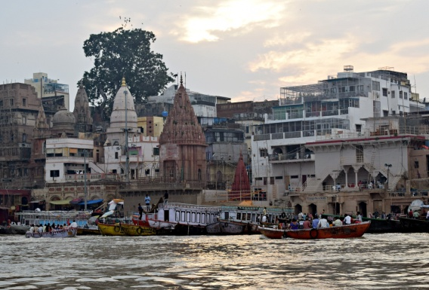
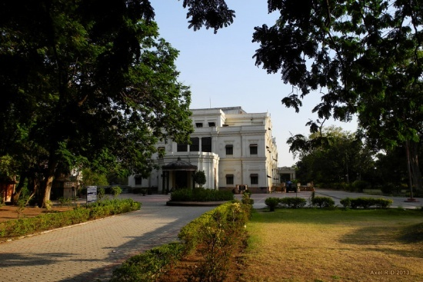
Superlative form of Adjectives
5
One of India’s most ancient cities is Varanasi, also known as Benaras.
Indore in Madhya Pradesh was adjudged the cleanest city in India for the sixth time in a row.
6
Notes:
Notes for Teacher – N/A
Suggestions: N/A
Source of Multimedia used in this slide -
Varanasi: https://pixabay.com/photos/ganga-ghats-varanasi-ganga-river-5268994/
Indore: https://www.flickr.com/photos/axelrd/10372944655

Slide 5
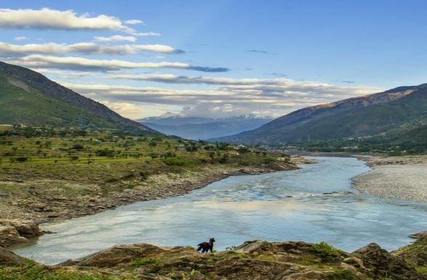
Superlative form of Adjectives
The river Indus is the longest river of India as of 2022.
5
Notes:
Notes for Teacher – N/A
Suggestions: N/A
Source of Multimedia used in this slide -
https://pixabay.com/photos/river-indus-pakistan-goat-4223887/

Slide 6
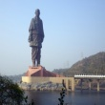
Attribution / Citation
Slide # | Thumbnail | Source link | Author
1 |  | https://pixabay.com/illustrations/india-india-map-flag-country-6487315/ | TheDigitalArtist
2 |  | Statue: https://pixabay.com/photos/statue-statue-of-unity-india-6678155/ Nilgiri: https://pixabay.com/photos/hills-clouds-nilgiris-tamil-nadu-4688134/ | sarangib Balajisrinivasan
3 |  | Desert: https://pixabay.com/photos/caravan-desert-safari-dune-camels-3341872/ Minar: https://pixabay.com/photos/qutub-minar-delhi-monument-fort-2155776/ | mohamed_hassan SuanlianTangpua
4 |  | Varanasi: https://pixabay.com/photos/ganga-ghats-varanasi-ganga-river-5268994/ Indore: https://www.flickr.com/photos/axelrd/10372944655 | balouriarajesh Axel Drainville
5 |  | https://pixabay.com/photos/river-indus-pakistan-goat-4223887/ | faysalkhan101
Notes:
Notes for Teacher – N/A
Suggestions: N/A
Source of Multimedia used in this slide - N/A

