Slide 1
Quiz Time
Notes:
Notes for Teacher - < Information for further reference or explanation >
Suggestions: <Ideas/ Images/ Animations / Others – To make better representation of the content >
Source of Multimedia used in this slide - <Please provide source URL where we find the image and the license agreement>
<quiz> <https://pixabay.com/vectors/question-mark-idea-light-bulb-5976736/>

Slide 2
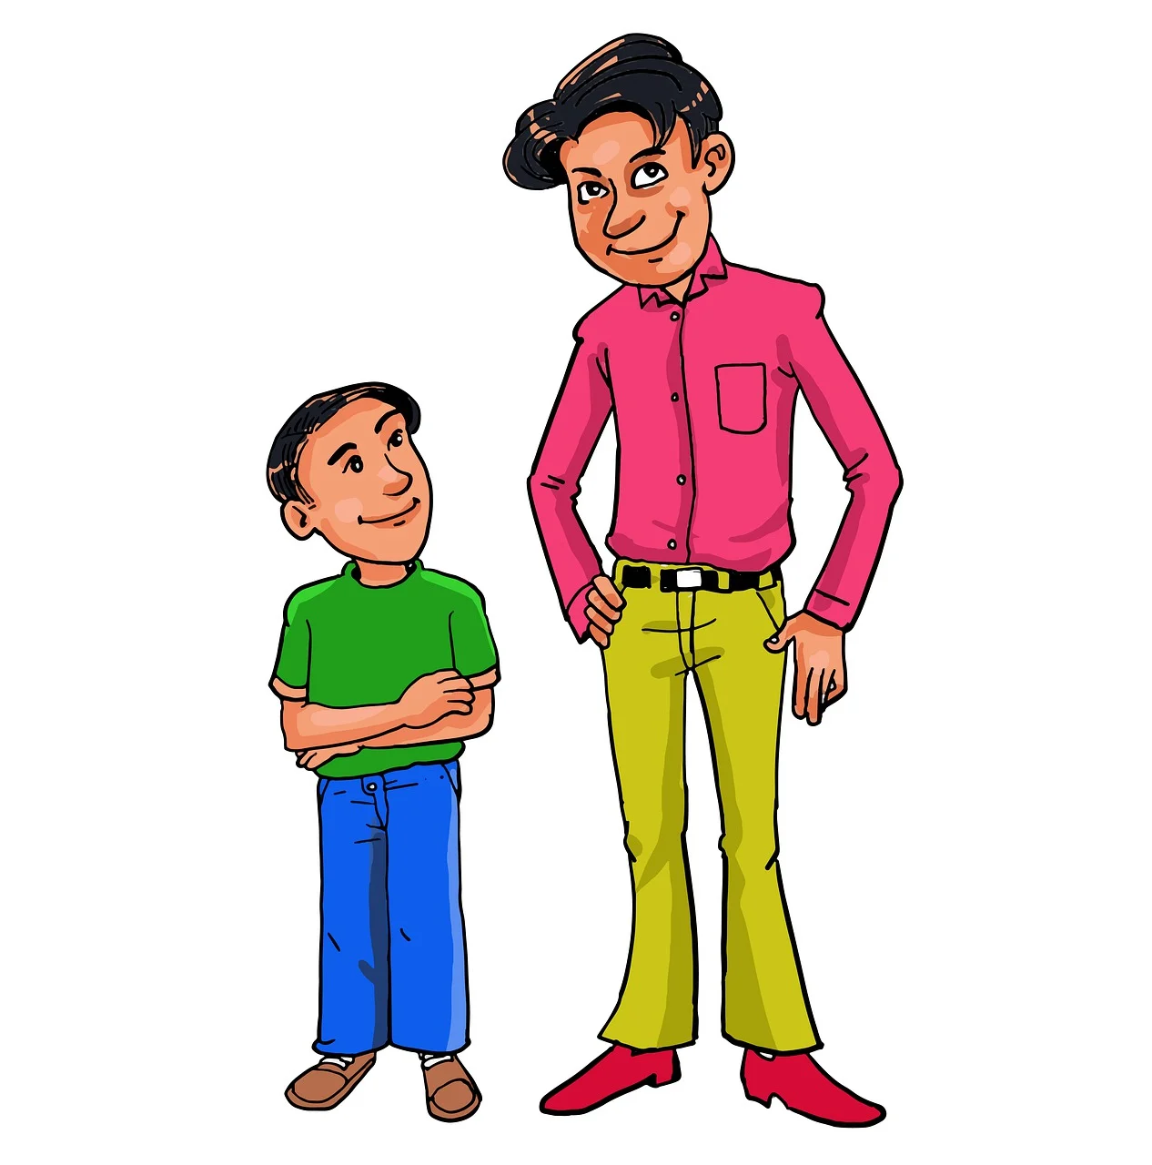
Round 1 - Choose the right answer.
1. Arun is 165 cm tall. Daksh is 167 cm tall. So, Daksh is _________ than Arun.
A. bigger B. shorter
C. More D. taller
2. My father is 45 years old. My mother is 42 years old. So, my mother is _________ than my father.
A. older B. younger
C. stronger D. smarter
Notes:
Notes for Teacher - < Information for further reference or explanation >
Suggestions: <Ideas/ Images/ Animations / Others – To make better representation of the content >
Source of Multimedia used in this slide - <Please provide source URL where we find the image and the license agreement>
<tall and short> <https://pixabay.com/illustrations/height-and-short-man-short-tall-man-5740589/>
<couple> <https://pixabay.com/vectors/indian-couple-traditional-saree-7309884/>
<cow> <https://pixabay.com/vectors/cattle-cow-animal-biology-bovine-153038/>
<elephant> <https://pixabay.com/vectors/elephant-wild-animal-mammal-trunk-24421/>
<girls> <https://www.freepik.com/free-vector/cartoon-stages-baby-girl_14581344.htm By pikisuperstar>

Slide 3
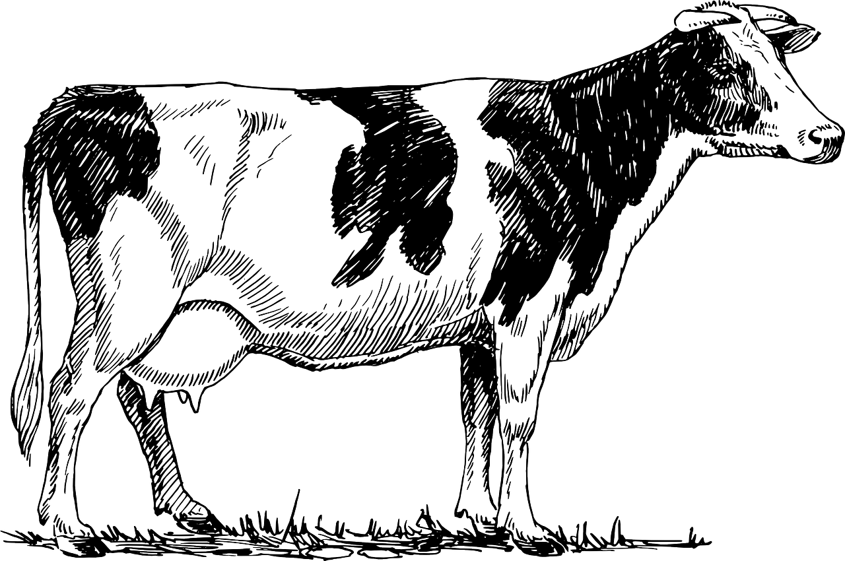
Round 1 - Choose the right answer.
3. A cow is _____ than an elephant.
A. smaller B. bigger
C. thinner D. wilder
5. The minute hand is ____ than the hour hand.
A. smaller B. longer
C. taller D. bigger
4. She is ____ than me.
A. cleanest B. big
C. short D. wiser
Notes:
Notes for Teacher - < Information for further reference or explanation >
Suggestions: <Ideas/ Images/ Animations / Others – To make better representation of the content >
Source of Multimedia used in this slide - <Please provide source URL where we find the image and the license agreement>
<tall and short> <https://pixabay.com/illustrations/height-and-short-man-short-tall-man-5740589/>
<couple> <https://pixabay.com/vectors/indian-couple-traditional-saree-7309884/>
<cow> <https://pixabay.com/vectors/cattle-cow-animal-biology-bovine-153038/>
<elephant> <https://pixabay.com/vectors/elephant-wild-animal-mammal-trunk-24421/>
<girls> <https://www.freepik.com/free-vector/cartoon-stages-baby-girl_14581344.htm By pikisuperstar>
<clock> <https://pixabay.com/vectors/clock-hands-moving-ticking-timer-26094/> By Clker-Free-Vector-Images

Slide 4
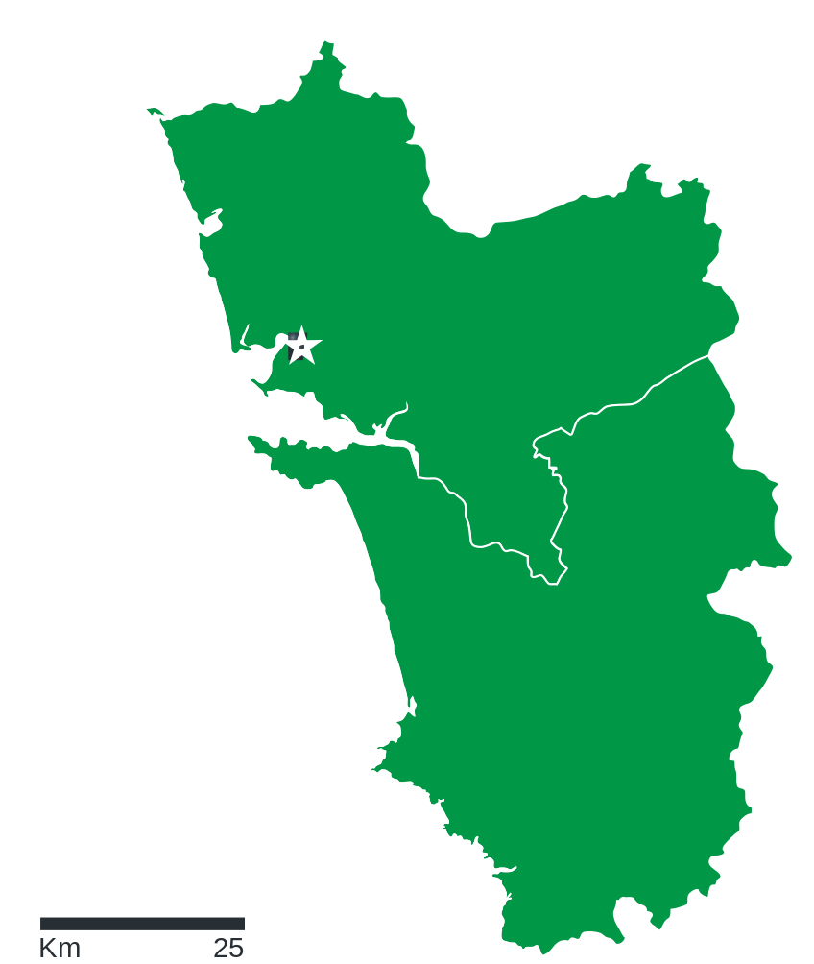
Round 2 - Choose the right option.
1. This painting is __________ than that painting.
A. most interesting B. intresting
C. more interesting D. more investing
2. Goa is_________________ state in India.
A. small B. bigger than
C. beach D. the smallest
Notes:
Notes for Teacher - < Information for further reference or explanation >
Suggestions: <Ideas/ Images/ Animations / Others – To make better representation of the content >
Source of Multimedia used in this slide - <Please provide source URL where we find the image and the license agreement>
<paintings> <https://pixabay.com/vectors/gallery-display-art-frame-boutique-5807858/>
<goa> <https://commons.wikimedia.org/wiki/File:Goa_Comunidades.svg>

Slide 5
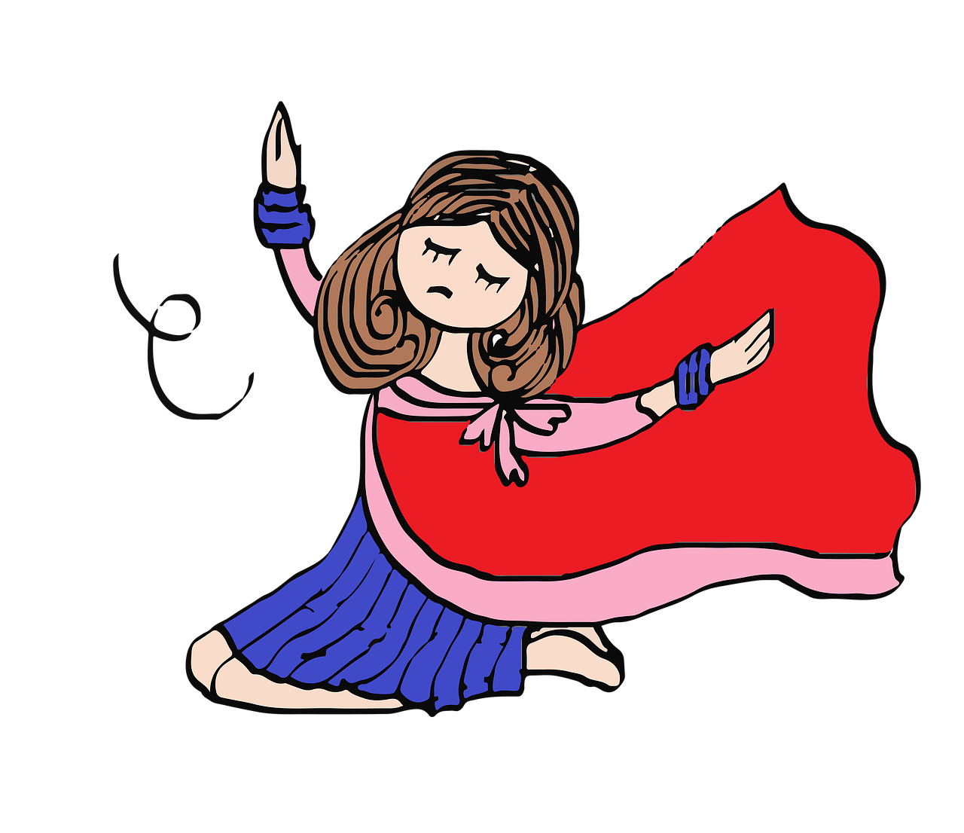
Round 2 - Choose the right option.
3. She is __________ singer in our class.
A. verse B. as good as
C. batter D. the best
4. Apples are ___________ than oranges.
A. Testy B. testier
C. best D. tastier
Notes:
Notes for Teacher - < Information for further reference or explanation >
Suggestions: <Ideas/ Images/ Animations / Others – To make better representation of the content >
Source of Multimedia used in this slide - <Please provide source URL where we find the image and the license agreement>
<girl> <https://pixabay.com/illustrations/girl-character-indian-dance-772413/>
<apples and oranges> <https://pixabay.com/photos/juice-lemon-orange-apple-cap-2902892/>

Slide 6
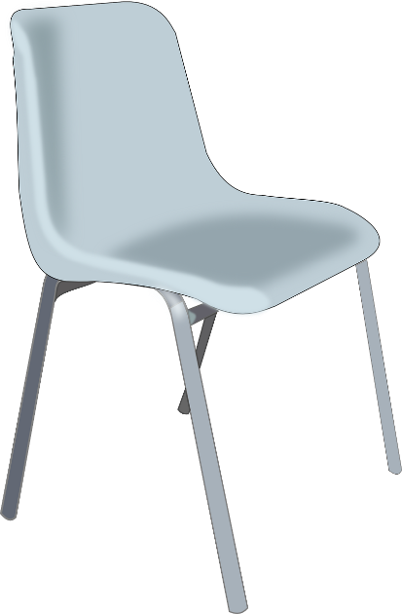
Round 2 - Choose the right option.
5. Those were the __________ comfortable chairs I have ever sat on.
A. lest B. wurst
C. bad D. least
Notes:
Notes for Teacher - < Information for further reference or explanation >
Suggestions: <Ideas/ Images/ Animations / Others – To make better representation of the content >
Source of Multimedia used in this slide - <Please provide source URL where we find the image and the license agreement>
<chair> <https://pixabay.com/vectors/chair-furniture-moulded-plastic-42852/> By Clker-Free-Vector-Images

Slide 7
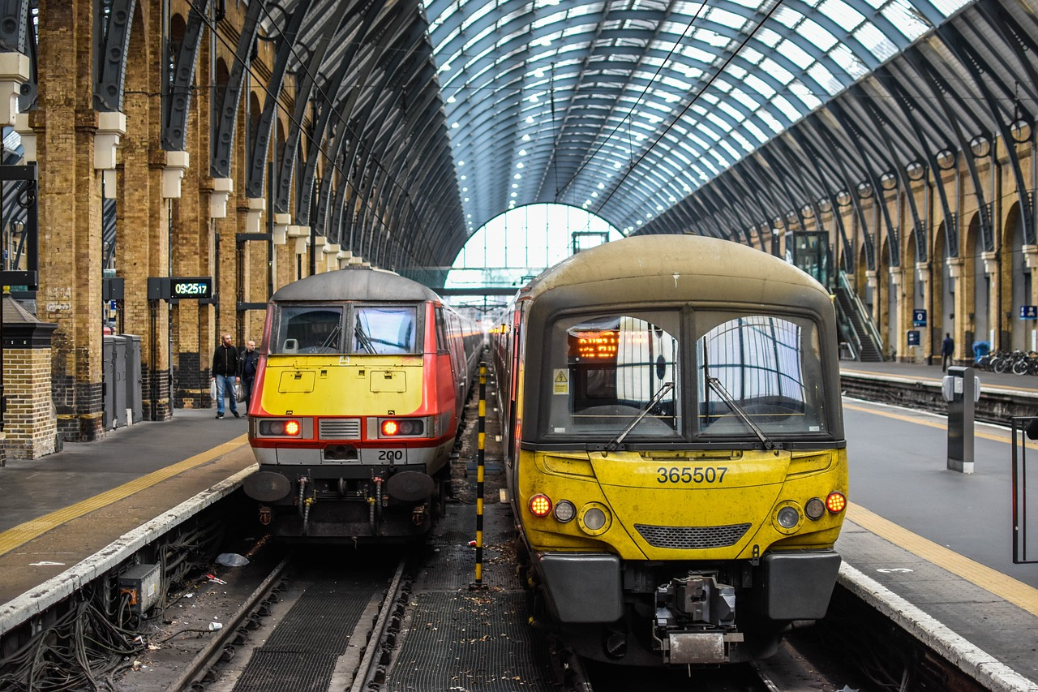
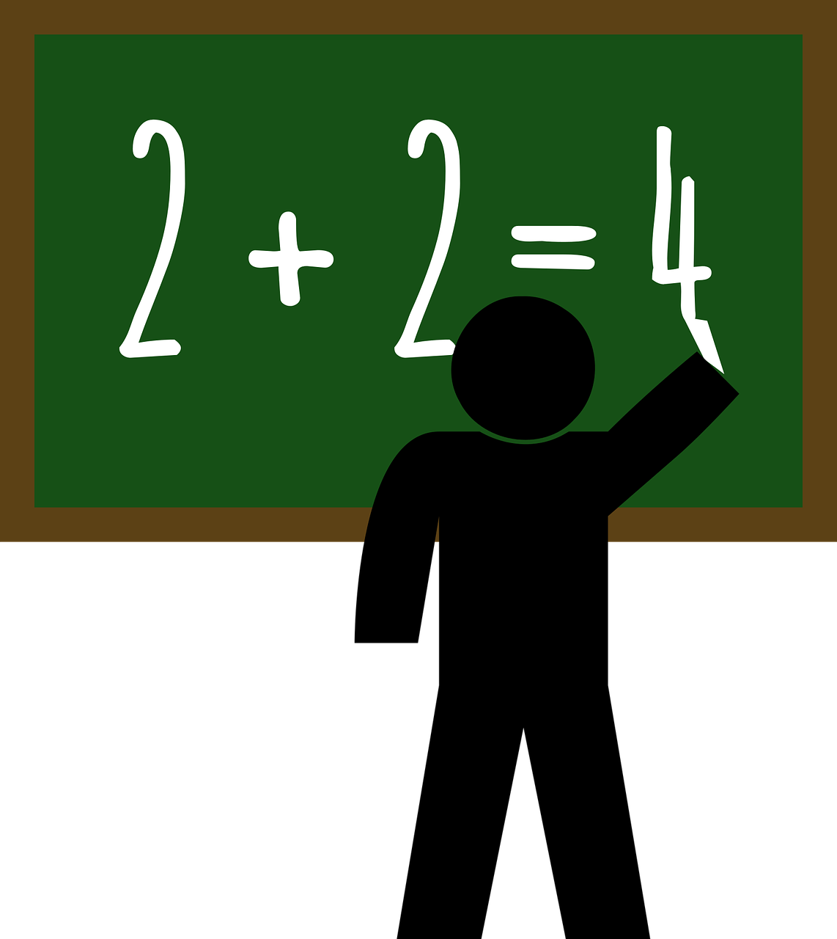
Round 3 - Answer the following
1. The second train is _________ (fast) than the first one.
A. more fast
B. faster
C. the fastest
2. English is very easy! Mathematics is________________(difficult) than English.
A. difficulty
B. difficultest
C. more difficult
3. The first bag is __________(heavy) than the second one.
A. heavier
B. heavyier
C. more heavy
4. An aeroplane is ____________ than a bicycle.
A. slower
B. faster
C. fastest
5kg
2kg
Notes:
Notes for Teacher - < Information for further reference or explanation >
Suggestions: <Ideas/ Images/ Animations / Others – To make better representation of the content >
Source of Multimedia used in this slide - <Please provide source URL where we find the image and the license agreement>
<trains> <https://pixabay.com/photos/the-train-station-train-travel-2030619/>
<mathematics> <https://pixabay.com/vectors/math-teacher-teacher-mathematics-2004081/>
<sacs> <https://pixabay.com/vectors/bag-sack-brown-closed-full-rope-306845/>
<cycle> <https://pixabay.com/vectors/bicycle-bike-black-rider-1296275/>
<aeroplane> <https://pixabay.com/vectors/airplane-jet-silhouette-flight-309386/>

Slide 8
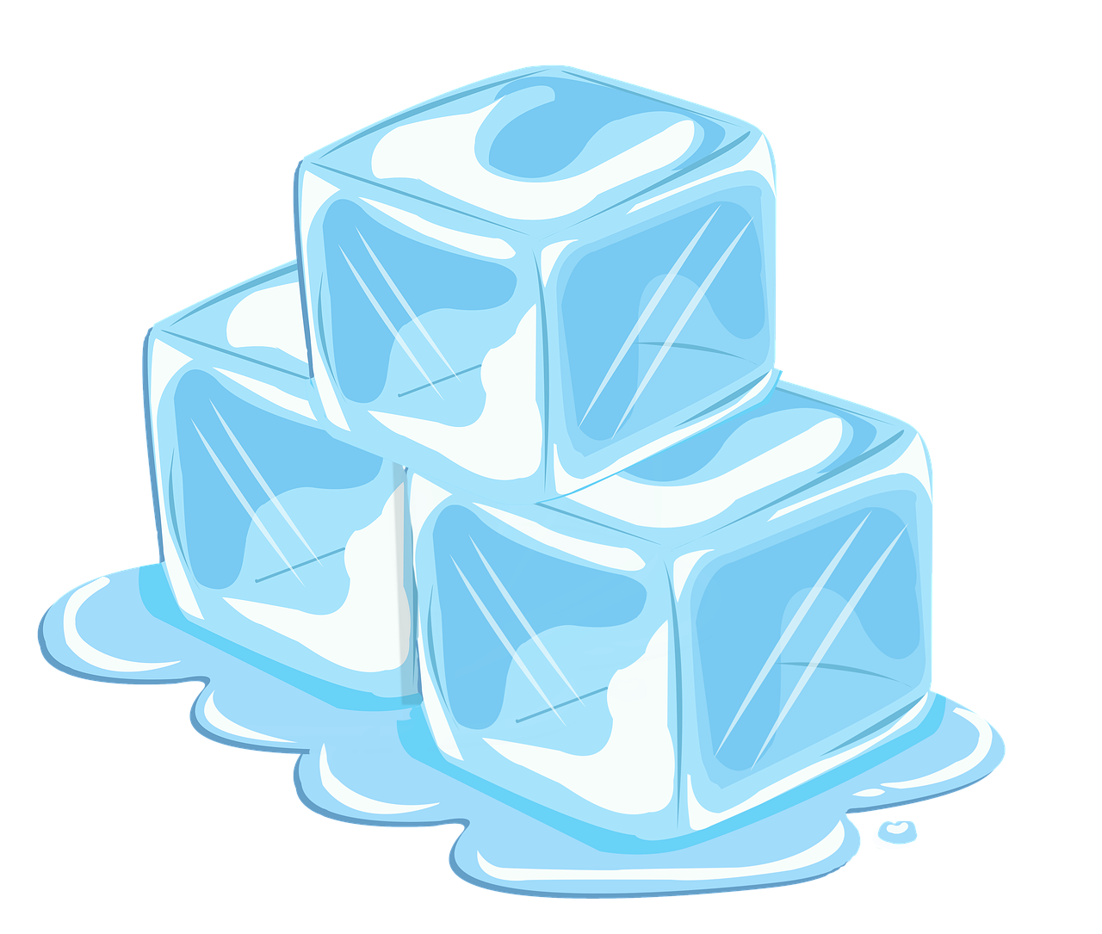
Round 3 - True or false
Ice cubes are lighter than water.
True
Notes:
Notes for Teacher - < Information for further reference or explanation >
Suggestions: <Ideas/ Images/ Animations / Others – To make better representation of the content >
Source of Multimedia used in this slide - <Please provide source URL where we find the image and the license agreement>
<ice cubes> <https://pixabay.com/illustrations/ice-melting-ice-cubes-ice-cubes-7096787/>

Slide 9
Round 4 - Degrees of comparison
Positive | Comparative | Superlative
bad | worse | worst
 |  | least
 | sweeter
 |  | most exciting
 | nicer
happy
fat
 | more expensive
Positive | Comparative | Superlative
 |  | richest
 | hotter
 | prettier
wealthy
 |  | most generous
much
 | more dangerous
famous
rich
richer
little
less
hot
hottest
sweet
sweetest
pretty
prettiest
exciting
more exciting
wealthier
wealthiest
nice
nicest
generous
more generous
happier
happiest
more
most
fatter
fattest
dangerous
most dangerous
expensive
most expensive
more dangerous
most dangerous
Notes:
Notes for Teacher - < Information for further reference or explanation >
Suggestions: <Ideas/ Images/ Animations / Others – To make better representation of the content >
Source of Multimedia used in this slide - <Please provide source URL where we find the image and the license agreement>

Slide 10
Attribution / Citation
Slide # | Thumbnail | Source link | Author
1 |  | <quiz> https://pixabay.com/vectors/question-mark-idea-light-bulb-5976736/ | Shafin_Protic
2 |  | <tall and short> https://pixabay.com/illustrations/height-and-short-man-short-tall-man-5740589/ <couple> https://pixabay.com/vectors/indian-couple-traditional-saree-7309884/ | azmeyart-design mohamed_hassan
3 |  | <cow> https://pixabay.com/vectors/cattle-cow-animal-biology-bovine-153038/ <elephant> https://pixabay.com/vectors/elephant-wild-animal-mammal-trunk-24421/ <girls> https://www.freepik.com/free-vector/cartoon-stages-baby-girl_14581344.htm <clock> https://pixabay.com/vectors/clock-hands-moving-ticking-timer-26094/ | OpenClipart-Vectors Clker-Free-Vector-Images pikisuperstar Clker-Free-Vector-Images
4 |  | <paintings> https://pixabay.com/vectors/gallery-display-art-frame-boutique-5807858/ <goa> https://commons.wikimedia.org/wiki/File:Goa_Comunidades.svg | HollyLynn_art Aldrin Dsouza
5 |  | <girl> https://pixabay.com/illustrations/girl-character-indian-dance-772413/ <apples and oranges> https://pixabay.com/photos/juice-lemon-orange-apple-cap-2902892/ | Yemeomee silviarita
6 |  | <chair> https://pixabay.com/vectors/chair-furniture-moulded-plastic-42852/ | Clker-Free-Vector-Images
7 |  | <trains> https://pixabay.com/photos/the-train-station-train-travel-2030619/ <mathematics> https://pixabay.com/vectors/math-teacher-teacher-mathematics-2004081/ <sacs> https://pixabay.com/vectors/bag-sack-brown-closed-full-rope-306845/ <cycle> https://pixabay.com/vectors/bicycle-bike-black-rider-1296275/ <aeroplane> https://pixabay.com/vectors/airplane-jet-silhouette-flight-309386/ | BondSupanat Padrefilar Clker-Free-Vector-Images OpenClipart-Vectors Clker-Free-Vector-Images
8 |  | <ice cubes> https://pixabay.com/illustrations/ice-melting-ice-cubes-ice-cubes-7096787/ | HUNGQUACH679PNG
Notes:
Notes for Teacher - < Information for further reference or explanation >
Suggestions: <Ideas/ Images/ Animations / Others – To make better representation of the content >
Source of Multimedia used in this slide - <Please provide source URL where we find the image and the license agreement>

