Slide 1
VS
Who is Superior?
Notes:
Notes for Teacher - < Information for further reference or explanation >
Suggestions: <Ideas/ Images/ Animations / Others – To make better representation of the content >
Source of Multimedia used in this slide - <Please provide source URL where we find the image and the license agreement>

Slide 2
Dialogue between Mango and Banana
Hello Mango! It is recess time in school and the kids are waiting to eat me. What about you?
Hello my friend! What are you doing?
Notes:
Notes for Teacher - Role play- The teacher can conduct this activity in the classroom or outside the classroom. After the role play has been conducted the teacher can ask the students to complete table as a follow up activity.
Suggestions: Animation on click
Source of Multimedia used in this slide -
1. Mango - https://pixabay.com/vectors/mango-the-fruit-funny-the-character-1431423/
Image by Alexander Lesnitsky
2. Banana - https://pixabay.com/vectors/banana-character-hands-eyes-mouth-1773796/
GraphicMama-team
3. School lunch - https://www.freepik.com/free-vector/children-having-meal-table_4978332.htm#query=school%20lunch%20animated&position=32&from_view=search&track=ais
Image by brgfx on Freepik

Slide 3
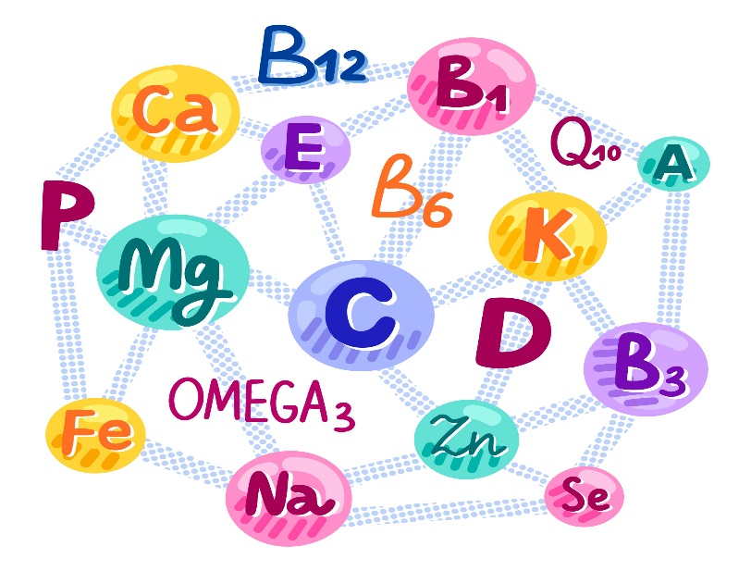
Dialogue between Mango and Banana
People prefer to eat me after lunch or dinner.
Do you know that I am richer than you in minerals and nutrients?
Notes:
Notes for Teacher - Role play- The teacher can conduct this activity in the classroom or outside the classroom. After the role play has been conducted the teacher can ask the students to complete table as a follow up activity.
Suggestions: Animation on click
Source of Multimedia used in this slide -
1. Mango - https://pixabay.com/vectors/mango-the-fruit-funny-the-character-1431423/
Image by Alexander Lesnitsky
2. https://pixabay.com/vectors/banana-smile-the-fruit-good-4289613/
Image by creozavr
3. Nutrients - https://www.freepik.com/free-vector/vitamin-mineral-complex_7408210.htm#query=minerals%20and%20nutrients&position=7&from_view=search&track=sph
By Freepik
4. https://www.freepik.com/free-vector/happy-girl-cartoon-character-holding-mango_16853954.htm#query=Eat%20mango%20animated&position=10&from_view=search&track=ais
Image by brgfx on Freepik

Slide 4
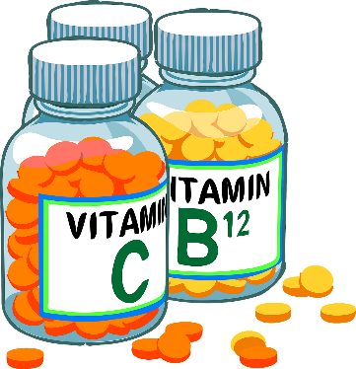
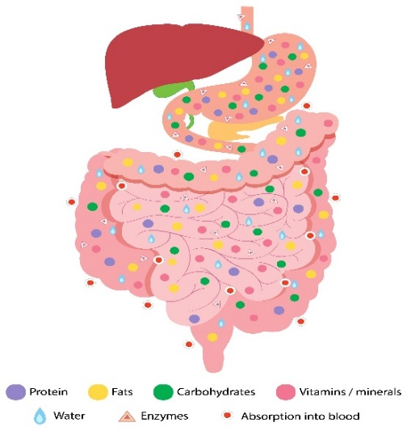
Dialogue between Mango and Banana
But I have more vitamin C than you.
I don’t think that makes you superior. Do you know I keep the heart more healthy and the digestive system more clean?
Notes:
Notes for Teacher - Role play- The teacher can conduct this activity in the classroom or outside the classroom. After the role play has been conducted the teacher can ask the students to complete table as a follow up activity.
Suggestions: Animation on click
Source of Multimedia used in this slide -
1. Mango - https://pixabay.com/vectors/mango-the-fruit-funny-the-character-1431423/
Image by Alexander Lesnitsky
2.Banana - https://openclipart.org/detail/246464/banana-warrior
by jbaldus
3. Vitamin C - https://pixabay.com/vectors/vitamins-tablets-pills-26622/
Image by Clker-Free-Vector-Images
4.Digestive system- https://www.freepik.com/free-vector/diagram-showing-digestive-system_24094522.htm#query=healthydigestive%20system&position=2&from_view=search&track=ais
Image by freepik
5. Heart - https://www.freepik.com/free-vector/red-heartbeat-symbol-graphic-illustration_2631302.htm?query=healthy%20heart#from_view=detail_alsolike
image by rawpixel.com on freepik

Slide 5
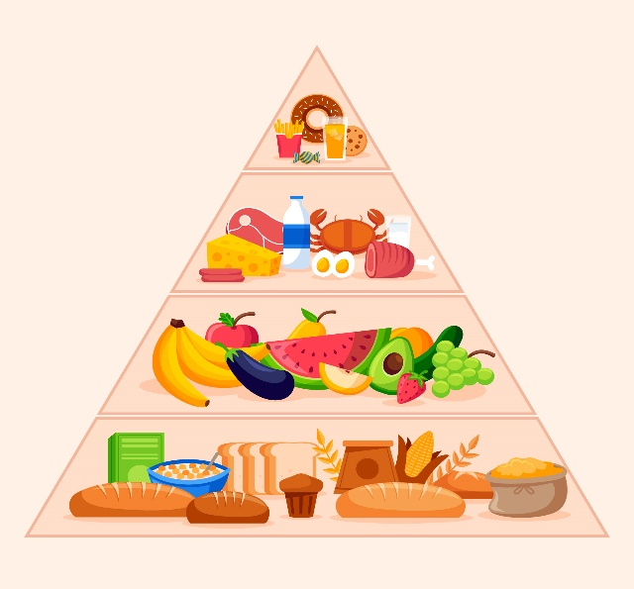
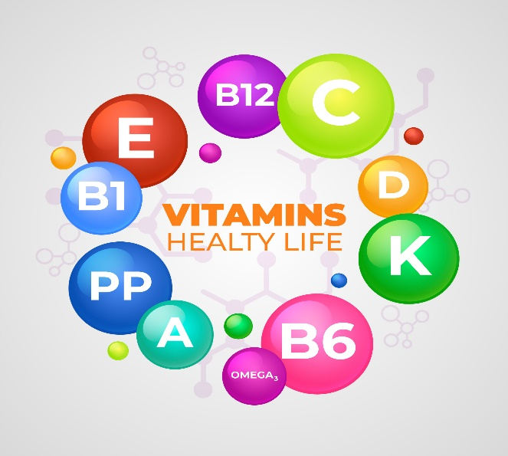
Dialogue between Mango and Banana
Yes, my friend, I agree. Both of us are different, yet both have their own benefits. So let's not fight over, ‘Who is superior’ because both of us are equally valuable and nutritious!
Hmm, my friend I am lower in calories but richer in vitamins.
Notes:
Notes for Teacher - Role play- The teacher can conduct this activity in the classroom or outside the classroom. After the role play has been conducted the teacher can ask the students to complete table as a follow up activity.
Suggestions: Animation on click
Source of Multimedia used in this slide -
1. Mango - https://pixabay.com/vectors/mango-the-fruit-funny-the-character-1431423/
Image by Alexander Lesnitsky
2. https://pixabay.com/vectors/banana-character-hands-eyes-mouth-1773796/
GraphicMama-team
3. Vitamins - https://www.freepik.com/free-vector/essential-vitamin-mineral-complex_7509728.htm#query=vitamins&position=7&from_view=search&track=sph
Image by Freepik
4.Pyramid - https://www.freepik.com/free-vector/food-pyramid-concept_7327894.htm#query=balanced%20diet&position=33&from_view=search&track=sph

Slide 6
Mango VS Banana
COMPARISION | MANGO | BANANA
MINERALS & NUTRIENTS
VITAMIN C
HEART
DIGESTIVE SYSTEM
CALORIES
VITAMINS
HIGHER
MORE
MORE HEALTHY/
HEALTHIER
MORE CLEAN/
CLEANER
LOWER
RICHER
Notes:
Notes for Teacher - Role play- The teacher can conduct this activity in the classroom or outside the classroom. After the role play has been conducted the teacher can ask the students to complete table as a follow up activity.
Suggestions: Animation on click
Source of Multimedia used in this slide - N/A

Slide 7
Attribution / Citation
Slide # | Thumbnail | Source link | Author
1,2,3,4,5 |  | Mango - https://pixabay.com/vectors/mango-the-fruit-funny-the-character-1431423/ | By Alexander Lesnitsky
1,2,5 |  | Banana - https://pixabay.com/vectors/banana-character-hands-eyes-mouth-1773796/ | By GraphicMama-team
2 |  | School lunch - https://www.freepik.com/free-vector/children-having-meal-table_4978332.htm | By brgfx
3 |  | Banana: https://pixabay.com/vectors/banana-smile-the-fruit-good-4289613/ Giri: https://www.freepik.com/free-vector/happy-girl-cartoon-character-holding-mango_16853954.htm | By creozavr By brgfx
3,5 |  | https://www.freepik.com/free-vector/vitamin-mineral-complex_7408210.htm | By Freepik
4 |  | Vitamins: https://pixabay.com/vectors/vitamins-tablets-pills-26622/ Heart: https://www.freepik.com/free-vector/red-heartbeat-symbol-graphic-illustration_2631302.htm Digestive System: https://www.freepik.com/free-vector/diagram-showing-digestive-system_24094522.htm Banana: https://openclipart.org/detail/246464/banana-warrior | By Clker-Free-Vector-Images By rawpixel.com on freepik By freepik by jbaldus
5 |  | Vitamin: https://www.freepik.com/free-vector/essential-vitamin-mineral-complex_7509728.htm Food Pyramid:https://www.freepik.com/free-vector/food-pyramid-concept_7327894.htm | Image by freepik By freepik
Notes:
Notes for Teacher - < Information for further reference or explanation >
Suggestions: <Ideas/ Images/ Animations / Others – To make better representation of the content >
Source of Multimedia used in this slide - <Please provide source URL where we find the image and the license agreement>

