Slide 1
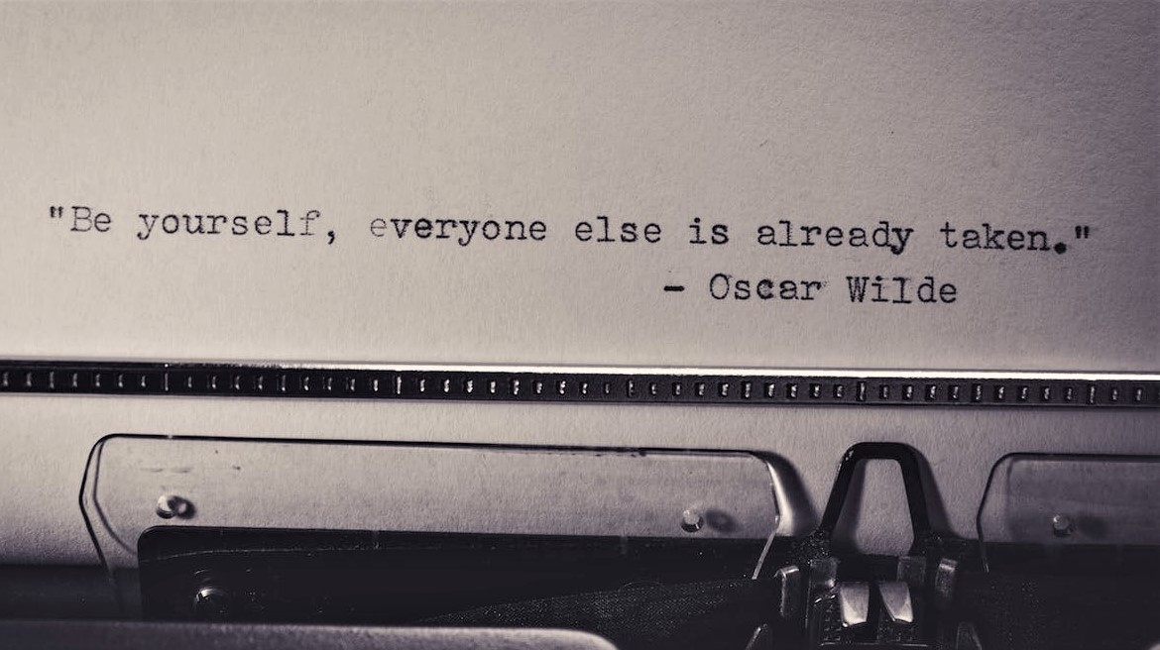
Be Yourself
Notes:
Notes for Teacher – Not applicable
Suggestions: Not applicable
Source of Multimedia used in this slide –
Birds – PPT icons
Quote – https://www.pexels.com/photo/inspirational-qoute-on-a-paper-698324/

Slide 2
Degree of Comparison
A form of adjective used to compare a person or thing possessing the same quality with another.
We tend to compare ourselves with others. But when we do so, we lose our happiness and peace.
Notes:
Notes for Teacher –
Suggestions: Not applicable
Source of Multimedia used in this slide - <Please provide source URL where we find the image and the license agreement>

Slide 3
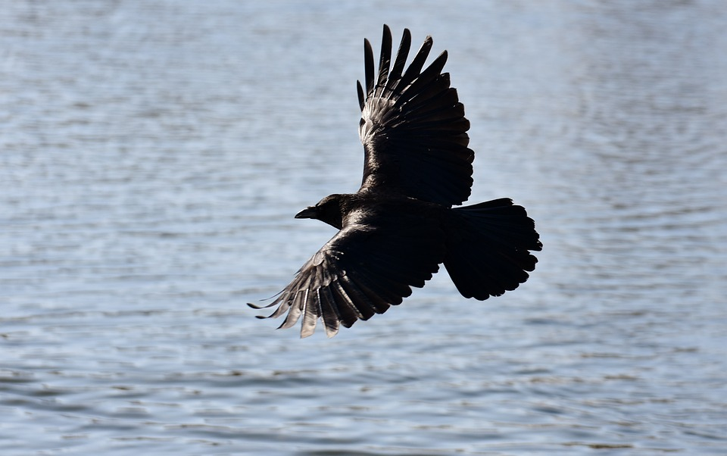
Be Yourself
Watch the story by clicking on the link – https://www.youtube.com/watch?v=4yMImPWTvzU
Notes:
Notes for Teacher – Teacher should click on the link and play the video.
Suggestions: Not applicable
Source of Multimedia used in this slide –
Birds – PPT icons
Crow flying above lake – https://pixabay.com/photos/common-raven-crow-flying-lake-3190864/

Slide 4
Points to Ponder
Unnecessary comparison with others makes us sad.
We should be grateful for what we are and what we have.
A satisfied person is the happiest person.
When we stop comparing ourselves with others, we can focus on developing ourselves.
Notes:
Notes for Teacher – Teacher should click on the link and play the video.
Suggestions: Not applicable
Source of Multimedia used in this slide –
Birds – PPT icons
Crow flying above lake – https://pixabay.com/photos/common-raven-crow-flying-lake-3190864/

Slide 5
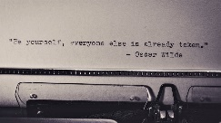
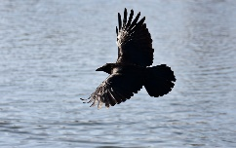
MM INDEX
Slide # | Thumbnail | Source link and Attribution
1 |  | https://www.pexels.com/photo/inspirational-qoute-on-a-paper-698324/
2 |  | https://pixabay.com/photos/common-raven-crow-flying-lake-3190864/
Notes:
Notes for Teacher - < Information for further reference or explanation >
Suggestions: <Ideas/ Images/ Animations / Others – To make better representation of the content >
Source of Multimedia used in this slide - <Please provide source URL where we find the image and the license agreement>

