Slide 1
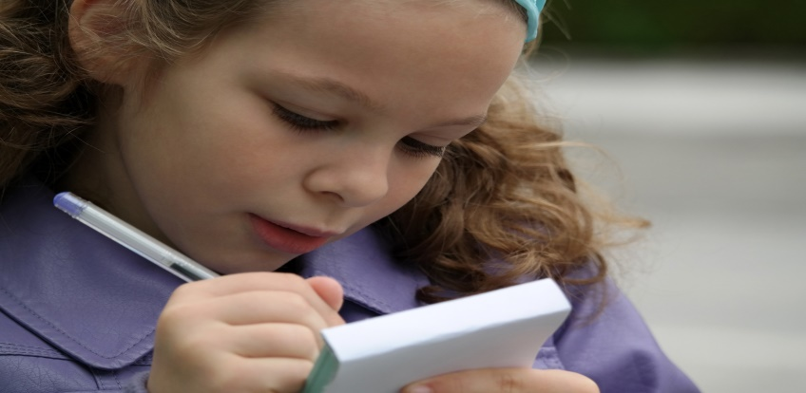
Home Assignment
Tall, Taller, Tallest
Good, Better, Best
Notes:
Notes for Teacher - This asset is a home assignment. The Teacher should get the worksheets as per the strength of the class and distribute them to the students. Give them proper instructions on how to do the exercises in the worksheet and specify the date of submission. The teacher may present the questions and allow the students to write or say the answers before revealing them.
Suggestions: N/A
Source of Multimedia used in this slide -
Writing Girl: https://pixabay.com/photos/girl-little-girl-child-schoolboy-774648/

Slide 2
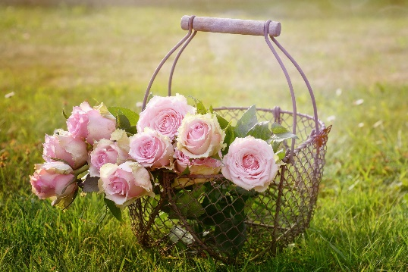
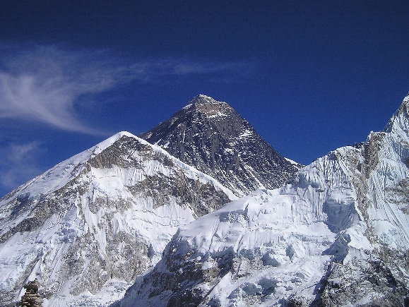
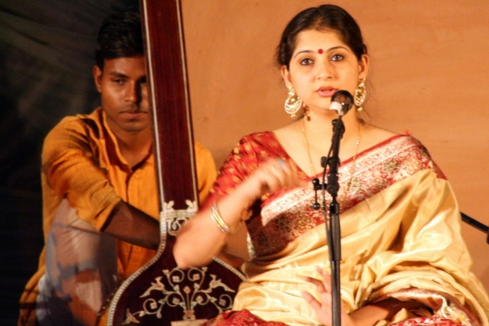
Exercise I
Fill in the blanks with the correct form of the adjectives given in the brackets.
more beautiful
1. A rose is _______________ than a lily. (beautiful)
2. That car is in the _______________ condition. (bad)
3. Mountain Everest is the _______________ mountain in the world. (high)
4. It is a very ____________today. (cold)
5. Sita has the _______________ voice in our house. (sweet)
worst
highest
cold
sweetest
Answer
Notes:
Notes for Teacher : This asset is a home assignment. The Teacher should get the worksheets ready as per the strength of the class and distribute them to the students. Give them proper instructions on how to do the exercises in the worksheet and specify the date of submission. The teacher may present the questions and allow the students to write or say the answers before revealing them.
Suggestions: NA
Source of Multimedia used in this slide -
Rose: https://pixabay.com/photos/roses-flowers-basket-pink-roses-1566792/ By castleguard
Everest: https://pixabay.com/photos/mount-everest-himalaya-nepal-413/ By Simon
Singer: https://www.flickr.com/photos/11398652@N00/8677664655 By Ramesh Lalwani

Slide 3
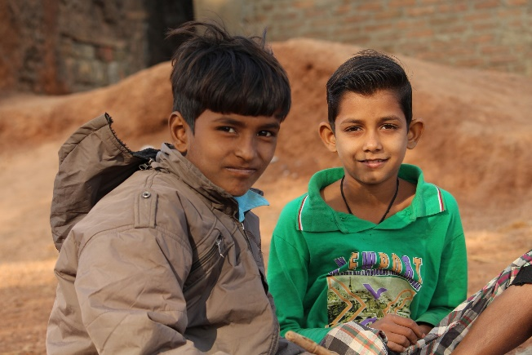
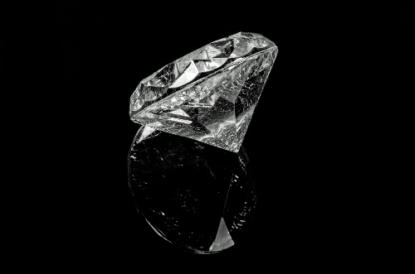
Exercise I
Fill in the blanks with the correct form of the adjectives given in the brackets.
best
Ramesh is my _______________ friend. (good)
My father cooks _______________ than my mother. (good)
This is the _______________ question in the test. (easy)
I am _______________ than my cousin. (young)
Diamonds are _______________ than emeralds. (precious)
better
easiest
Answer
younger
more precious
Notes:
Notes for Teacher : After showing the statements wait for sometime for the students to respond. Then click once on the ‘Answer’ icon. The answers will appear in the sequence. Click outside the ‘Answer’ icon to go to the next slide.
Suggestions: NA
Source of Multimedia used in this slide -
Friends: https://pixabay.com/photos/poor-boy-cute-village-boy-child-4133641/ By sonamabcd
Diamond: https://pixabay.com/photos/diamond-crystal-gem-background-316610/ By PublicDomainPictures

Slide 4
Exercise II
Fill in the missing column with ‘Adjectives’ according to its kind.
S.No. | Positive | Comparative | Superlative
1 | smart |  | smartest
2 |  | more intelligent
3 |  | cleverer | cleverest
4 | good
5 |  | less
6 | tall | taller
7 |  | prettier
8 | brave |  | bravest
smarter
intelligent
most intelligent
clever
better
best
little
least
tallest
Answer
pretty
prettiest
braver
Notes:
Notes for Teacher - After showing the Table wait for sometime for the students to respond. Then click once on the ‘Answer’ icon. The answers will appear in the sequence. Click outside the ‘Answer’ icon to go to the next slide.
Suggestions: NA
Source of Multimedia used in this slide - NA

Slide 5
Exercise III
Compare the objects and complete the sentences with the correct form of adjective given in brackets.
Example 1: Taxi - bus (cheap).
A bus is cheaper than a taxi.
Example 2. Silver - Iron - Gold metal (precious)
Silver is a precious metal, it is more precious than Iron but Gold is the most precious of all metals.
Fruits - sweets (healthy)
A town - city - village (quiet)
My brother - I am - my father (strong)
Fruits are healthier than sweets.
Answer
A town is quieter than a city, and a village is the quietest of the three.
My brother is strong, I am stronger, but my father is the strongest in our family.
Notes:
Notes for Teacher - After showing the example and the statements wait for sometime for the students to respond. Then click once on the ‘Answer’ icon. The answers will appear in the sequence. Click outside the ‘Answer’ icon to go to the next slide.
Suggestions: NA
Source of Multimedia used in this slide - NA

Slide 6
Exercise III
This question is - that question was - than that other, but the third one is - of all (tricky)
Iron - Gold (hard)
Today’s weather - yesterday’s weather (bad)
My brother - me (clever)
North Pole - place on Earth (cold)
This question is tricky, that question was trickier than the other, but the third one is the trickiest of all.
Iron is harder than Gold.
Today’s weather is worse than yesterday.
My brother is cleverer than me.
Answer
North Pole is the coldest place on Earth.
Notes:
Notes for Teacher - After showing the statements wait for sometime for the students to respond. Then click once on the ‘Answer’ icon. The answers will appear in the sequence. Click outside the ‘Answer’ icon to go to the next slide.
Suggestions: NA
Source of Multimedia used in this slide - NA

Slide 7
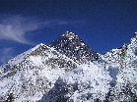
Attribution / Citation
Slide # | Thumbnail | Source link | Author
1 |  | Writing Girl: https://pixabay.com/photos/girl-little-girl-child-schoolboy-774648/ | By RaphaelJeanneret
2 |  | Rose: https://pixabay.com/photos/roses-flowers-basket-pink-roses-1566792/ Everest: https://pixabay.com/photos/mount-everest-himalaya-nepal-413/ Singer: https://www.flickr.com/photos/11398652@N00/8677664655 | By castleguard By Simon By Ramesh Lalwani
3 |  | Friends: https://pixabay.com/photos/poor-boy-cute-village-boy-child-4133641/ Diamond: https://pixabay.com/photos/diamond-crystal-gem-background-316610/ | By sonamabcd By PublicDomainPictures
Notes:
Notes for Teacher – N/A
Suggestions: N/A
Source of Multimedia used in this slide - N/A

