Slide 1
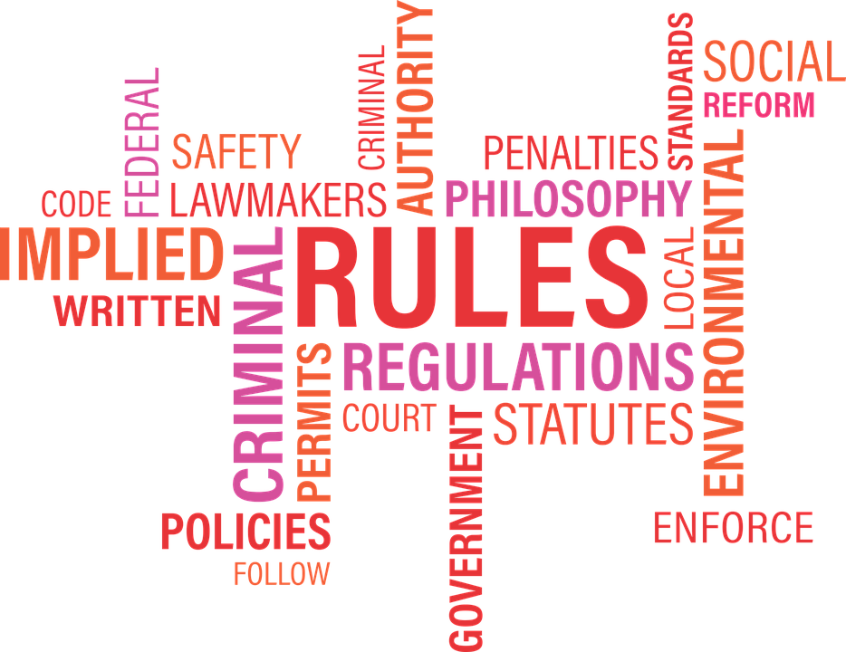
Need for Rules & Regulations
Notes:
Notes for Teacher - Suggestions: <Ideas/ Images/ Animations / Others – To make better representation of the content >
Source of Multimedia used in this slide - <Please provide source URL where we find the image and the license agreement>

Slide 2
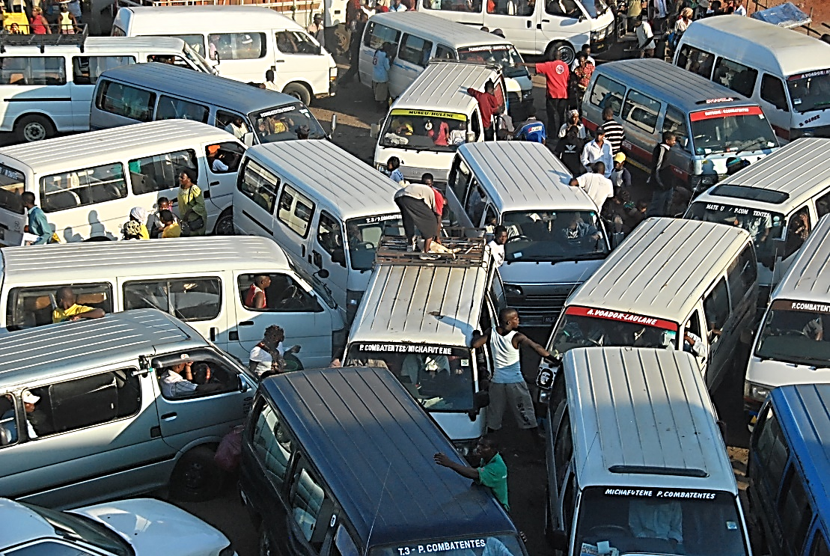
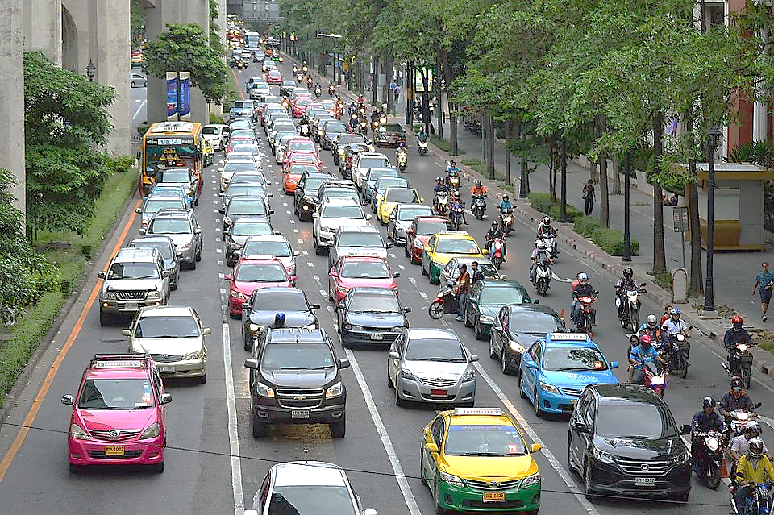
Need for rules and regulations
Q1. What are the broad similarities between the two pictures?
Both the pictures show the traffic on the road
Notes:
Notes for Teacher - The teacher may introduce the chapter by showing the following two pictures side by side. The students may be asked to observe the two pictures and answer the questions that follow.
Suggestions: <Ideas/ Images/ Animations / Others – To make better representation of the content >
Source of Multimedia used in this slide - <Please provide source URL where we find the image and the license agreement>
Traffic - https://www.flickr.com/photos/95731954@N02/9717216968 (A Verdade)
Cars in lanes - https://pixabay.com/photos/traffic-rush-hour-rush-hour-urban-843309/

Slide 3
Need for rules and regulations
Q1. What are the broad differences between the two pictures?
Unruly traffic - no traffic rules
Smooth traffic - traffic rules followed
Notes:
Notes for Teacher - < Information for further reference or explanation >
Suggestions: <Ideas/ Images/ Animations / Others – To make better representation of the content >
Source of Multimedia used in this slide - <Please provide source URL where we find the image and the license agreement>
https://www.flickr.com/photos/95731954@N02/9717216968 (A Verdade)
https://pixabay.com/photos/traffic-rush-hour-rush-hour-urban-843309/

Slide 4
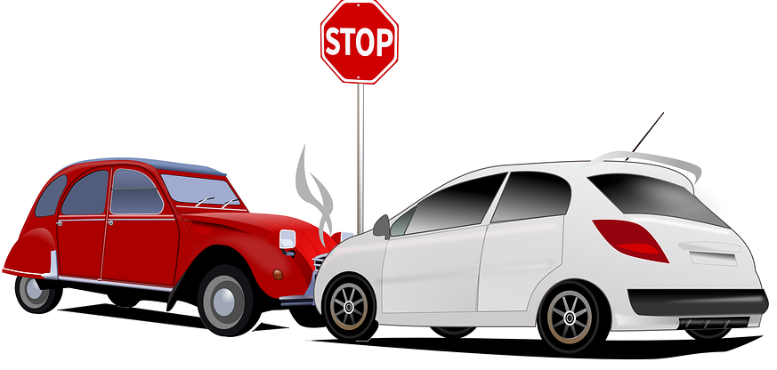
Need for rules and regulations
Q.2
What will happen if the traffic is not regulated?
Ans:
Possibility of accidents resulting in loss of life and property
Notes:
Notes for Teacher - < Information for further reference or explanation >
Suggestions: <Ideas/ Images/ Animations / Others – To make better representation of the content >
Source of Multimedia used in this slide - <Please provide source URL where we find the image and the license agreement>
https://pixabay.com/illustrations/car-accident-car-crash-car-accident-1995852/

Slide 5
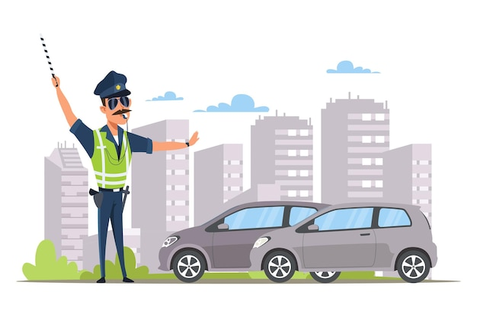
Need for rules and regulations
Q3. How do you think we can regulate the traffic on the public roads?
Traffic police may be deployed on busy roads
Public made aware of rules and regulations
Notes:
Notes for Teacher - The teacher may conclude by saying, “We learn that traffic rules and regulations are required to avoid road accidents.”
Suggestions: <Ideas/ Images/ Animations / Others – To make better representation of the content >
Source of Multimedia used in this slide - <Please provide source URL where we find the image and the license agreement>
https://www.freepik.com/free-vector/car-traffic-control-illustration-young-law-enforcer-patrolman-vest-police-officer-with-striped-rod-whistle-patrolling-street_23591660.htm (studio4rt)

Slide 6
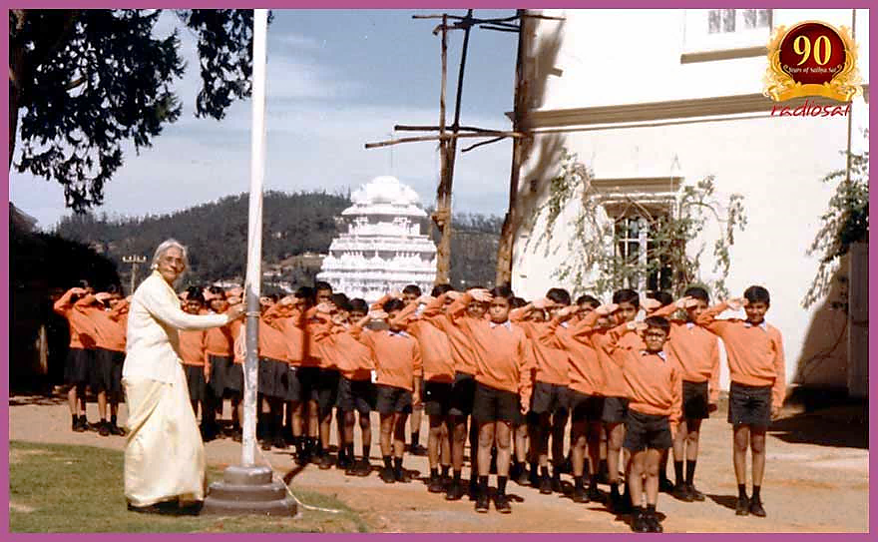
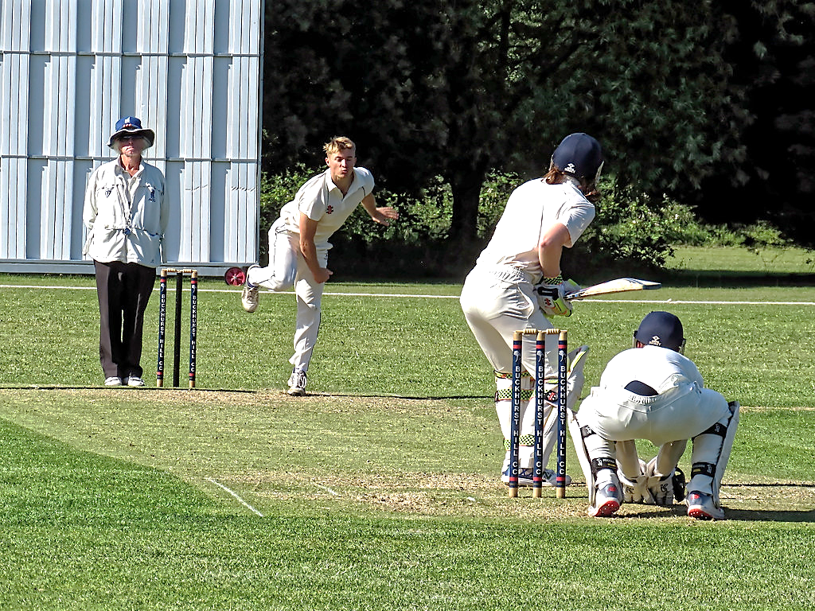
Need for rules and regulations
Q.4 Can you name any other walk of life where rules and regulations are required?
Required in every walk of life
At school
At play
Notes:
Notes for Teacher –
The teacher may conclude by saying that rules are made for our benefit. It helps in the proper functioning of any institution however small or big it may be. If people act on their own without a common understanding there is likely to be chaos. There are rules and regulations for governing a country too which is called the Constitution. We will learn more about it. Suggestions: <Ideas/ Images/ Animations / Others – To make better representation of the content >
Source of Multimedia used in this slide - <Please provide source URL where we find the image and the license agreement>
Rules- - https://pixabay.com/illustrations/rule-hook-check-mark-custom-1752622/
Assembly : https://archive.sssmediacentre.org/journals/vol_13/01SEPT15/images/11_h2h_special/sai-stree-shakti-07/Mrs.-Amar-Kumari-Verma-sathya-sai-school-ooty-04.jpg
Cricket - https://www.flickr.com/photos/150012178@N06/49562372902 (Acabashi)

Slide 7
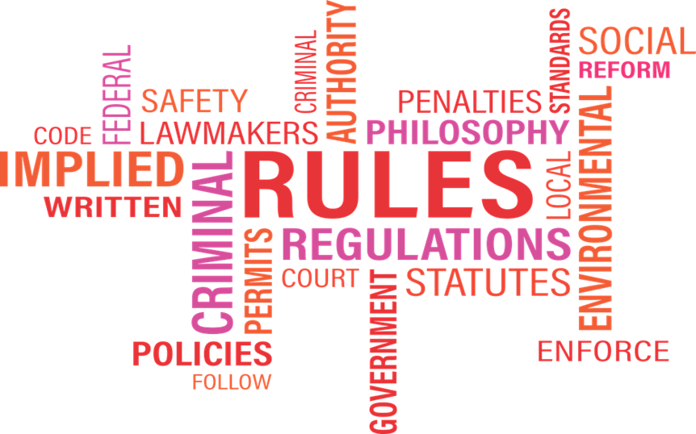
MM Index
Slide # | Thumbnail | Source link and Attribution
1 |  | https://pixabay.com/vectors/rules-word-cloud-word-cloud-agency-1339917/
2, 3 |  | Traffic - https://www.flickr.com/photos/95731954@N02/9717216968 (A Verdade) Cars in lanes - https://pixabay.com/photos/traffic-rush-hour-rush-hour-urban-843309/
4 |  | https://pixabay.com/illustrations/car-accident-car-crash-car-accident-1995852/
5 |  | https://www.freepik.com/free-vector/car-traffic-control-illustration-young-law-enforcer-patrolman-vest-police-officer-with-striped-rod-whistle-patrolling-street_23591660.htm (studio4rt)
6 |  | Rules- - https://pixabay.com/illustrations/rule-hook-check-mark-custom-1752622/ Assembly : https://archive.sssmediacentre.org/journals/vol_13/01SEPT15/images/11_h2h_special/sai-stree-shakti-07/Mrs.-Amar-Kumari-Verma-sathya-sai-school-ooty-04.jpg Cricket - https://www.flickr.com/photos/150012178@N06/49562372902 (Acabashi)
Notes:
Notes for Teacher - < Information for further reference or explanation >
Suggestions: <Ideas/ Images/ Animations / Others – To make better representation of the content >
Source of Multimedia used in this slide - <Please provide source URL where we find the image and the license agreement>

