Slide 1
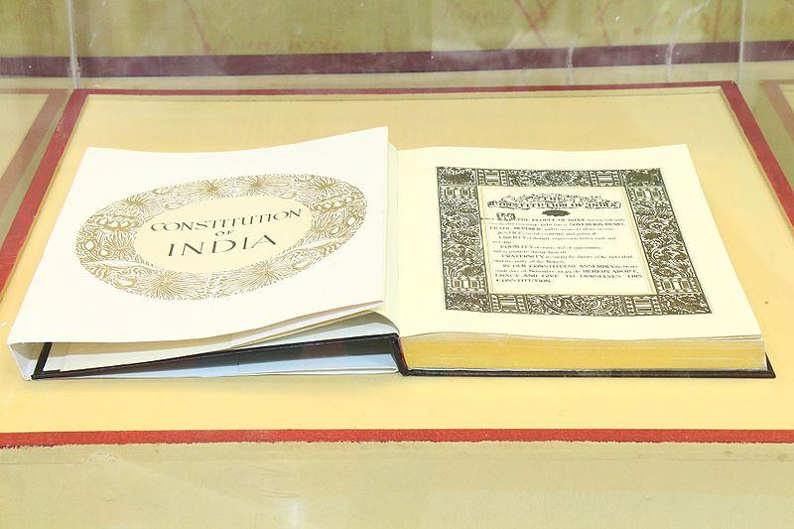
The Meaning of Constitution
Notes:
Notes for Teacher –
The teacher may introduce the topic by stating that, “a nation is also governed by certain rules and regulations known
as the Constitution. Now let us learn what a Constitution is.”
Suggestions: <Ideas/ Images/ Animations / Others – To make better representation of the content >
Source of Multimedia used in this slide - <Please provide source URL where we find the image and the license agreement>
https://commons.wikimedia.org/wiki/File:Constitution_of_India_(31667825533).jpg (Geospatial World)

Slide 2
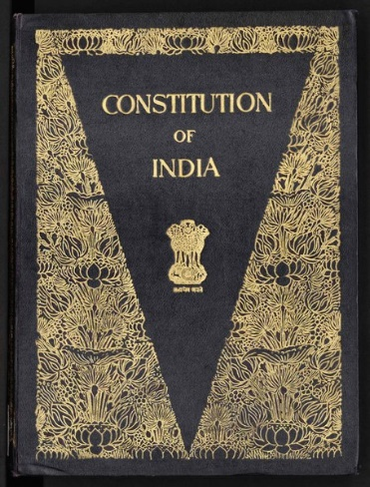
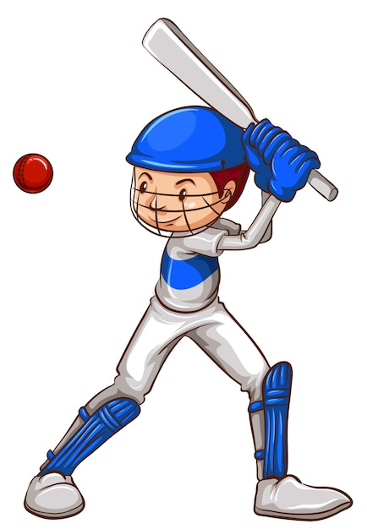
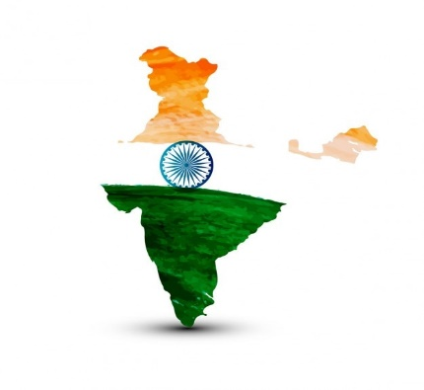
What is Constitution ?
Constitution
Set of rules and regulations to govern an organization
Organization
Family
Sports Club
Nation
Notes:
Notes for Teacher - < Information for further reference or explanation > Suggestions: <Ideas/ Images/ Animations / Others – To make better representation of the content >
Source of Multimedia used in this slide - <Please provide source URL where we find the image and the license agreement>
Family - https://www.freepik.com/free-vector/organic-flat-international-day-families-illustration_13234274.htm#query=FAMILY&position=15&from_view=search (freepik)
Rules - https://www.freepik.com/free-vector/business-people-studying-list-rules-reading-guidance-making-checklist_11235251.htm#page=2&query=rules&position=12&from_view=search (pch.vector)
Constitution - https://commons.wikimedia.org/wiki/File:The_Constitution_of_India_(Original_Calligraphed_and_Illuminated_Version).djvu
Sports club - https://www.freepik.com/free-vector/sketches-man-playing-baseball_23666154.htm#page=10&query=baseball&position=42&from_view=search
(brgfx)

Slide 3
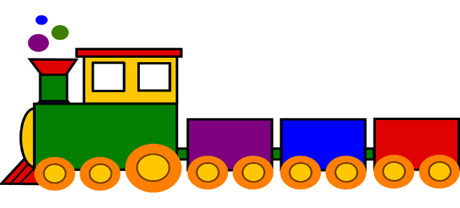
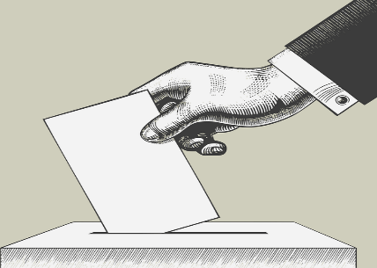
Features of Constitution
Constitution
1
Fundamental or supreme law of a nation
No other law can supersede or go against it
Criminal law
Civil law
Every law must be approved by the Constitution
Any law before enforcement undergoes debate, voting and assent by the Head Of State
2
3
Constitution is the basis of distribution of power
Power distributed between Central and State Government eg. India
Notes:
Notes for Teacher - < To explain the meaning of fundamental law, the teacher may give the example of the train engine.
Like an engine that determines the track which is followed by every other coach, the constitution sets the basic framework which is followed by every other rule and regulation of a country. Suggestions: <Ideas/ Images/ Animations / Others – To make better representation of the content >
Source of Multimedia used in this slide - <Please provide source URL where we find the image and the license agreement>
Train - https://pixabay.com/images/id-308471/
Voting - https://pixabay.com/images/id-3676577/
Parliament - https://pixabay.com/images/id-2028311/

Slide 4
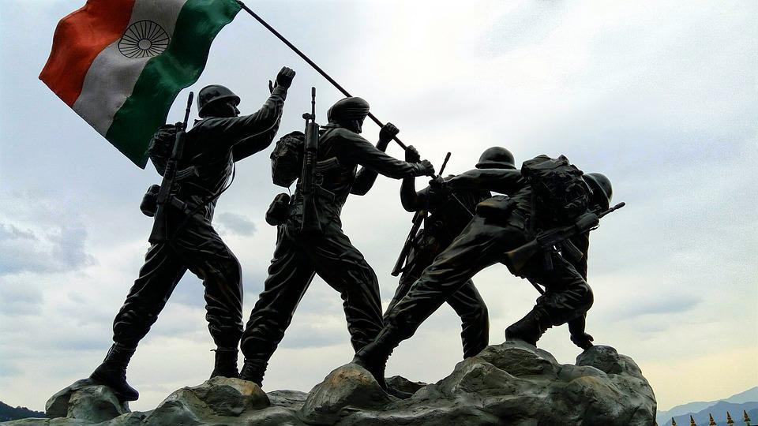
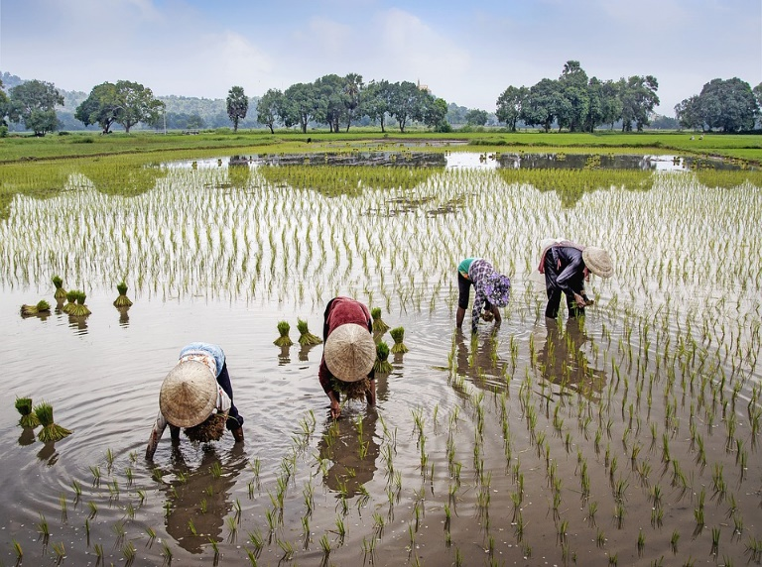
Distribution of Power
INDIA
Eg. Defence
Eg. Agriculture
Matters of national importance
Matters of local importance
Central Government
State Government
Notes:
Notes for Teacher - < Information for further reference or explanation > Suggestions: <Ideas/ Images/ Animations / Others – To make better representation of the content >
Source of Multimedia used in this slide –
Agriculture - https://pixabay.com/images/id-5430070/
Indian tricolour - https://pixabay.com/images/id-1079098/
Defence - https://pixabay.com/photos/indian-flag-indian-army-statue-2644512/

Slide 5
MM INDEX
Slide # | Thumbnail | Source link and Attribution
1 |  | https://commons.wikimedia.org/wiki/File:Constitution_of_India_(31667825533).jpg (Geospatial World)
2 |  | Family https://www.freepik.com/free-vector/organic-flat-international-day-families-illustration_13234274.htm#query=FAMILY&position=15&from_view=search (freepik) Rules - https://www.freepik.com/free-vector/business-people-studying-list-rules-reading-guidance-making-checklist_11235251.htm#page=2&query=rules&position=12&from_view=searcH (pch.vector) Constitution - https://commons.wikimedia.org/wiki/File:The_Constitution_of_India_(Original_Calligraphed_and_Illuminated_Version).djvu Sports club - https://www.freepik.com/free-vector/sketches-man-playing-baseball_23666154.htm#page=10&query=baseball&position=42&from_view=search (brgfx)
3 |  | Train - https://pixabay.com/images/id-308471/ Voting - https://pixabay.com/images/id-3676577/ Parliament - https://pixabay.com/images/id-2028311/
4 |  | Agriculture - https://pixabay.com/images/id-5430070/ Indian tricolour - https://pixabay.com/images/id-1079098/ Defence - https://pixabay.com/photos/indian-flag-indian-army-statue-2644512/
Notes:
Notes for Teacher - < Information for further reference or explanation >
Suggestions: <Ideas/ Images/ Animations / Others – To make better representation of the content >
Source of Multimedia used in this slide - <Please provide source URL where we find the image and the license agreement>

