Slide 1
Fundamental Principle In Life
Notes:
Notes for Teacher - < Information for further reference or explanation >
Suggestions: <Ideas/ Images/ Animations / Others – To make better representation of the content >
Source of Multimedia used in this slide - Maple Leaves- https://pixabay.com/vectors/leaf-autumn-autumn-leaves-fall-red-984998/

Slide 2
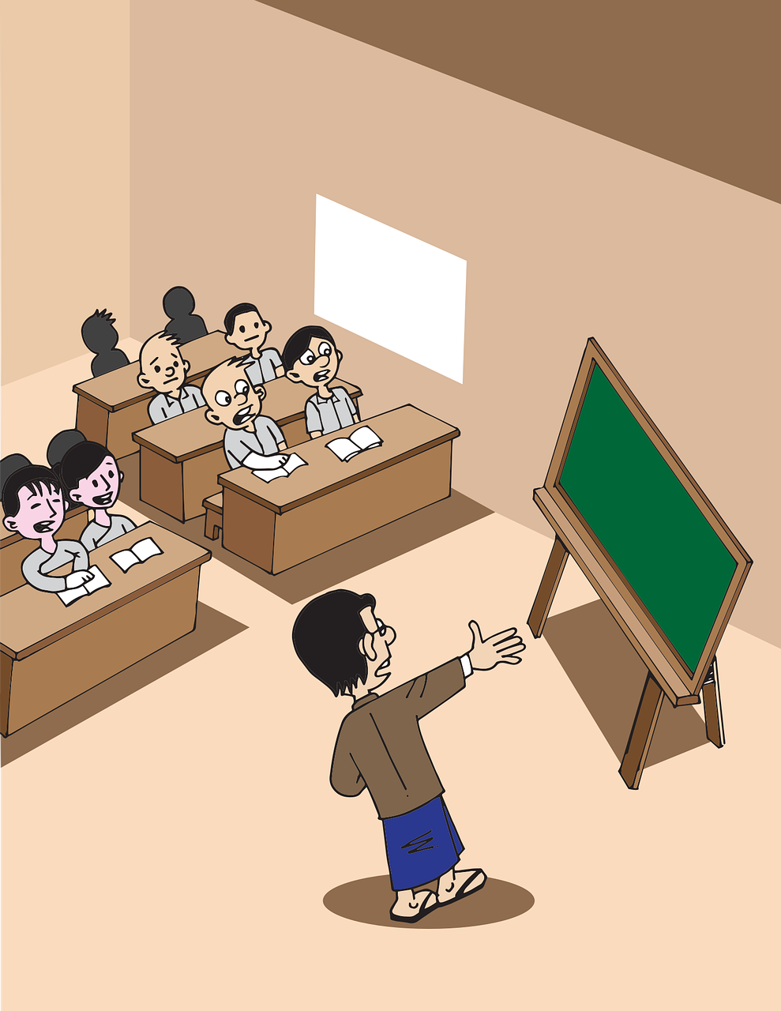
Inspector Visits Mohandas’s School
He dictated a few words to test the spelling ability.
Mohandas could not spell one of the words correctly.
Notes:
Notes for Teacher - <
In order to further explain the meaning of ‘fundamental law’, the teacher may cite the following incident from Gandhi’s childhood.
Suggestions: <Ideas/ Images/ Animations / Others – To make better representation of the content >
Source of Multimedia used in this slide -
Maple Leaves- https://pixabay.com/vectors/leaf-autumn-autumn-leaves-fall-red-984998/
Classroom - https://pixabay.com/vectors/myanmar-burma-school-classroom-5221135/

Slide 3
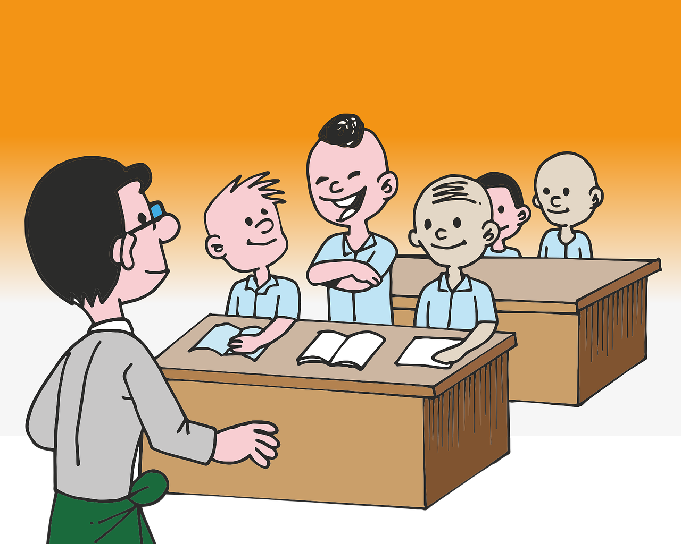
The Brave Lad
Better to be wrong than to copy sir!
Why don’t you copy it from a classmate?
Notes:
Notes for Teacher - < Information for further reference or explanation >
Suggestions: <Ideas/ Images/ Animations / Others – To make better representation of the content >
Source of Multimedia used in this slide - Classroom - https://pixabay.com/vectors/class-classroom-teacher-burma-1459570/
Maple Leaves- https://pixabay.com/vectors/leaf-autumn-autumn-leaves-fall-red-984998/

Slide 4
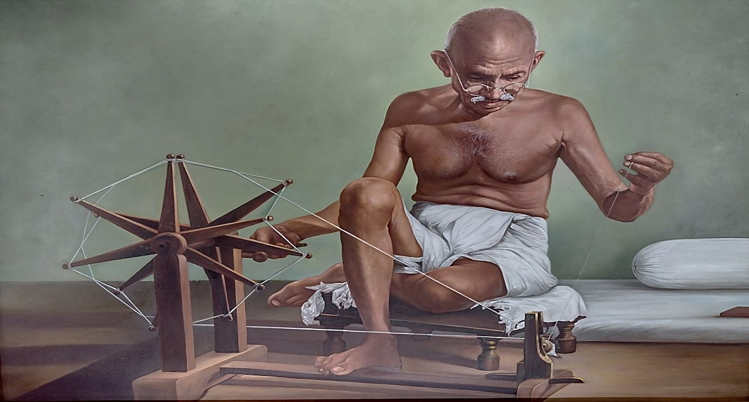
Think and Answer
Why do you think, Gandhi did not copy the right spelling of the word from his friend’s slate?
Click
“Truth” was the fundamental principle of his life.
Notes:
Notes for Teacher – Suggested answer-
For Mohandas, copying the correct spelling from a friend’s slate would mean not adopting the truth. For him, adhering to ‘truth’ was more important than spelling a word correctly. ‘Truth’ was the fundamental principle of his life. For him, every aspect of life must be based on truth.
Our constitution too has certain fundamental principles. No other law of our country can ever violate these fundamental principles.
Suggestions: <Ideas/ Images/ Animations / Others – To make better representation of the content >
Source of Multimedia used in this slide - https://pixabay.com/illustrations/gandhi-mahatma-gandhiji-6929015/
Question mark - https://pixabay.com/illustrations/question-question-mark-gold-634903/
Maple Leaves- https://pixabay.com/vectors/leaf-autumn-autumn-leaves-fall-red-984998/

Slide 5
Think and Answer
Can you cite a real-life example where you or anyone else rejected falsehood and adopted Truth?
Notes:
Notes for Teacher –
Suggestions: <Ideas/ Images/ Animations / Others – To make better representation of the content >
Source of Multimedia used in this slide - https://pixabay.com/illustrations/gandhi-mahatma-gandhiji-6929015/
Question mark - https://pixabay.com/illustrations/question-question-mark-gold-634903/
Maple Leaves- https://pixabay.com/vectors/leaf-autumn-autumn-leaves-fall-red-984998/

Slide 6
MM INDEX
Slide # | Thumbnail | Source link and Attribution
1,2,3,4,5 2 |  | Maple Leaves- https://pixabay.com/vectors/leaf-autumn-autumn-leaves-fall-red-984998/ Classroom - https://pixabay.com/vectors/myanmar-burma-school-classroom-5221135/
3 |  | Classroom - https://pixabay.com/vectors/class-classroom-teacher-burma-1459570/
4,5 |  | Question mark - https://pixabay.com/illustrations/question-question-mark-gold-634903/
4,5 |  | Gandhiji - https://pixabay.com/illustrations/gandhi-mahatma-gandhiji-6929015/
Notes:
Notes for Teacher - < Information for further reference or explanation >
Suggestions: <Ideas/ Images/ Animations / Others – To make better representation of the content >
Source of Multimedia used in this slide - <Please provide source URL where we find the image and the license agreement>

