Slide 1
Types of Constitution
Notes:
Notes for Teacher - < Information for further reference or explanation >
Suggestions: <Ideas/ Images/ Animations / Others – To make better representation of the content >
Source of Multimedia used in this slide - https://www.freepik.com/free-vector/background-with-advocacy-elements_2250047.htm (freepik)

Slide 2
Classification of Constitutions
Different ways to classify Constitutions
Evolved and Enacted Constitution
Written and Unwritten Constitution
Rigid and Flexible Constitution
Notes:
Notes for Teacher - < Information for further reference or explanation >
Suggestions: <Ideas/ Images/ Animations / Others – To make better representation of the content >
Source of Multimedia used in this slide - <Please provide source URL where we find the image and the license agreement>

Slide 3
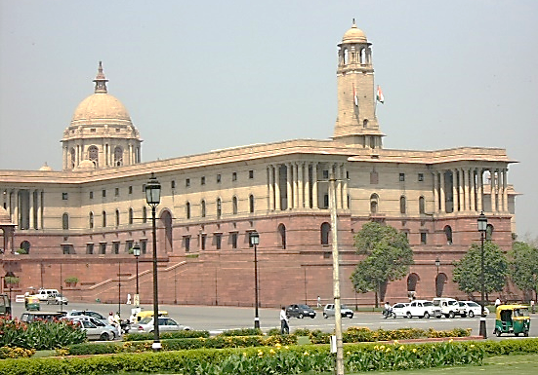
Evolved Constitution
He loves to live in a society along with his fellowmen
Accumulated rules and regulations that shape political institutions of a country
Over time the constitution is known as Evolved Constitution
(Example-Britain)
Man is a social animal
Men living in groups evolve rules and regulations to regulate human relationship
Notes:
Notes for Teacher - < Information for further reference or explanation >
Suggestions: <Ideas/ Images/ Animations / Others – To make better representation of the content >
Source of Multimedia used in this slide -
https://openclipart.org/detail/216524/many-and-few
https://openclipart.org/detail/303698/symbol-scale-of-the-justice
https://openclipart.org/detail/310511/gavel-and-sound-block-icon
https://openclipart.org/detail/282302/note
Parliament India - https://commons.wikimedia.org/wiki/File:Indian_Parliament_Building_Delhi_India.JPG (Shahnoor Habib Munmun)

Slide 4
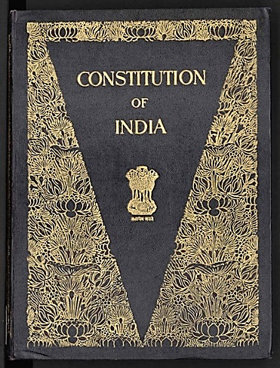
Enacted Constitution
Enacted constitution on the other hand is the outcome of human effort
It is crafted by a person or a group of persons appointed for the purpose.
The enacted constitution may be in the form of a single or multiple documents.
It has a date of origin unlike the evolved constitution.
Notes:
Notes for Teacher - < Information for further reference or explanation >
Suggestions: <Ideas/ Images/ Animations / Others – To make better representation of the content >
Source of Multimedia used in this slide - human effort -https://openclipart.org/detail/233853/interview
Group of persons- https://openclipart.org/detail/78409/conference
Constitution - https://commons.wikimedia.org/wiki/File:The_Constitution_of_India_(Original_Calligraphed_and_Illuminated_Version).djvu

Slide 5
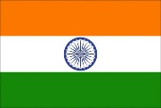
Types of Constitution
Nepal
Sri Lanka
New Zealand
Canada
Constitution
Bangladesh
Indonesia
Denmark
Saudi Arabia
Israel
Written
Unwritten
United Kingdom
India
United States of America
Rigid
Flexible
Notes:
Notes for Teacher - < Information for further reference or explanation >
Suggestions: <Ideas/ Images/ Animations / Others – To make better representation of the content >
Source of Multimedia used in this slide - "Louisiana's Statehood Flag, 1812-1817" by RegiDaws is marked with CC BY-NC 2.0.
"UK flag" by The Clear Communication People is marked with CC BY-NC-ND 2.0.
"india-flag-independence-day" by bmnnetwork is marked with CC BY 2.0.
"Denmark flag" by The Clear Communication People is marked with CC BY-NC-ND 2.0.
"Sri Lanka flag" by The Clear Communication People is marked with CC BY-NC-ND 2.0.
"Bangladesh flag" by The Clear Communication People is marked with CC BY-NC-ND 2.0.
"Indonesia flag" by The Clear Communication People is marked with CC BY-NC-ND 2.0.
"Israel flag" by The Clear Communication People is marked with CC BY-NC-ND 2.0.
https://openclipart.org/detail/194649/flag-of-the-kingdom-of-saudi-arabia
https://openclipart.org/detail/119965/newzealand#google_vignette
https://openclipart.org/detail/17772/flag-of-nepal
https://openclipart.org/detail/212804/flag-of-canada

Slide 6
Written Constitution
Convention (USA)
Who Created
Written Constitution
Constituent Assembly (India)
Single (India)
No. of Documents
Multiple (France)
Rigid (USA)
Flexible (India)
Notes:
Notes for Teacher - The teacher may explain the meaning of Constituent Assembly by stating that it is a body created for the purpose of drafting or revising a constitution.
Suggestions: <Ideas/ Images/ Animations / Others – To make better representation of the content >
Source of Multimedia used in this slide - <Please provide source URL where we find the image and the license agreement>

Slide 7
Unwritten Constitution
1
2
3
Rules and regulations
are practiced and then by continuous practice, they become part of the constitution
Unwritten constitutions may
have some written elements in it
Proportion of written documents
is much smaller
in the unwritten constitution
They are often governed by customs and traditions
Example: British constitution is evolved constitution
Example: Magna Carta-1215
Example: Magna Cartta-1215, Petition of Rights-1628 and Parliamentary Act-1911
Notes:
Notes for Teacher - While talking about the some of the written sources of unwritten British constitution, the teacher may very briefly explain the written sources stated below.
Magna Carta-1215: Magna Carta also known as the Great Charter is a document of liberties granted by King John on 15th June, 1215 under the threat of civil war.
Petition of Rights-1628: A petition sent by the British Parliament to King Charles-I during his war with Spain, not to impose taxes without the consent of the Parliament, not to imprison citizens without a cause and not to impose military law during peace time.
Parliamentary Act-1911: The Parliamentary Act of 1911 asserted the supremacy of the House of Commons in the British Parliament by passing a bill without the approval of the House of Lords.
Suggestions: <Ideas/ Images/ Animations / Others – To make better representation of the content >
Source of Multimedia used in this slide - <Please provide source URL where we find the image and the license agreement>

Slide 8
MM INDEX
Slide # | Thumbnail | Source link and Attribution
1 |  | https://www.freepik.com/free-vector/background-with-advocacy-elements_2250047.htm (freepik)
3 |  | https://openclipart.org/detail/216524/many-and-few
3 |  | https://openclipart.org/detail/216524/many-and-few
3 |  | https://openclipart.org/detail/303698/symbol-scale-of-the-justice
3 |  | https://openclipart.org/detail/310511/gavel-and-sound-block-icon
3 |  | https://openclipart.org/detail/282302/note
3 |  | https://commons.wikimedia.org/wiki/File:Indian_Parliament_Building_Delhi_India.JPG (Shahnoor Habib Munmun)
4 |  | https://openclipart.org/detail/233853/interview
4 |  | https://openclipart.org/detail/78409/conference
4 |  | Constitution - https://commons.wikimedia.org/wiki/File:The_Constitution_of_India_(Original_Calligraphed_and_Illuminated_Version).djvu
5 |  | "india-flag-independence-day" by bmnnetwork is marked with CC BY 2.0.
5 |  | "Bangladesh flag" by The Clear Communication People is marked with CC BY-NC-ND 2.0.
5 |  | "Indonesia flag" by The Clear Communication People is marked with CC BY-NC-ND 2.0.
Notes:
Notes for Teacher - < Information for further reference or explanation >
Suggestions: <Ideas/ Images/ Animations / Others – To make better representation of the content >
Source of Multimedia used in this slide -

Slide 9
MM INDEX
Slide # | Thumbnail | Source link and Attribution
5 |  | "Sri Lanka flag" by The Clear Communication People is marked with CC BY-NC-ND 2.0.
5 |  | "Denmark flag" by The Clear Communication People is marked with CC BY-NC-ND 2.0.
5 |  | https://openclipart.org/detail/17772/flag-of-nepal
5 |  | "Louisiana's Statehood Flag, 1812-1817" by RegiDaws is marked with CC BY-NC 2.0.
5 |  | "UK flag" by The Clear Communication People is marked with CC BY-NC-ND 2.0.
5 |  | https://openclipart.org/detail/194649/flag-of-the-kingdom-of-saudi-arabia
5 |  | "Israel flag" by The Clear Communication People is marked with CC BY-NC-ND 2.0.
5 |  | https://openclipart.org/detail/119965/newzealand#google_vignette
5 |  | https://openclipart.org/detail/212804/flag-of-canada
Notes:
Notes for Teacher - < Information for further reference or explanation >
Suggestions: <Ideas/ Images/ Animations / Others – To make better representation of the content >
Source of Multimedia used in this slide -

