Slide 1
Oldest Living Constitution
Notes:
Notes for Teacher - < Information for further reference or explanation > Suggestions: <Ideas/ Images/ Animations / Others – To make better representation of the content >
Source of Multimedia used in this slide - <Please provide source URL where we find the image and the license agreement>
https://www.freepik.com/free-vector/legal-statement-court-notice-judge-decision-judicial-system-lawyer-attorney-studying-papers-cartoon-character-mortgage-debt-legislation_10780023.htm (vectorjuice)

Slide 2
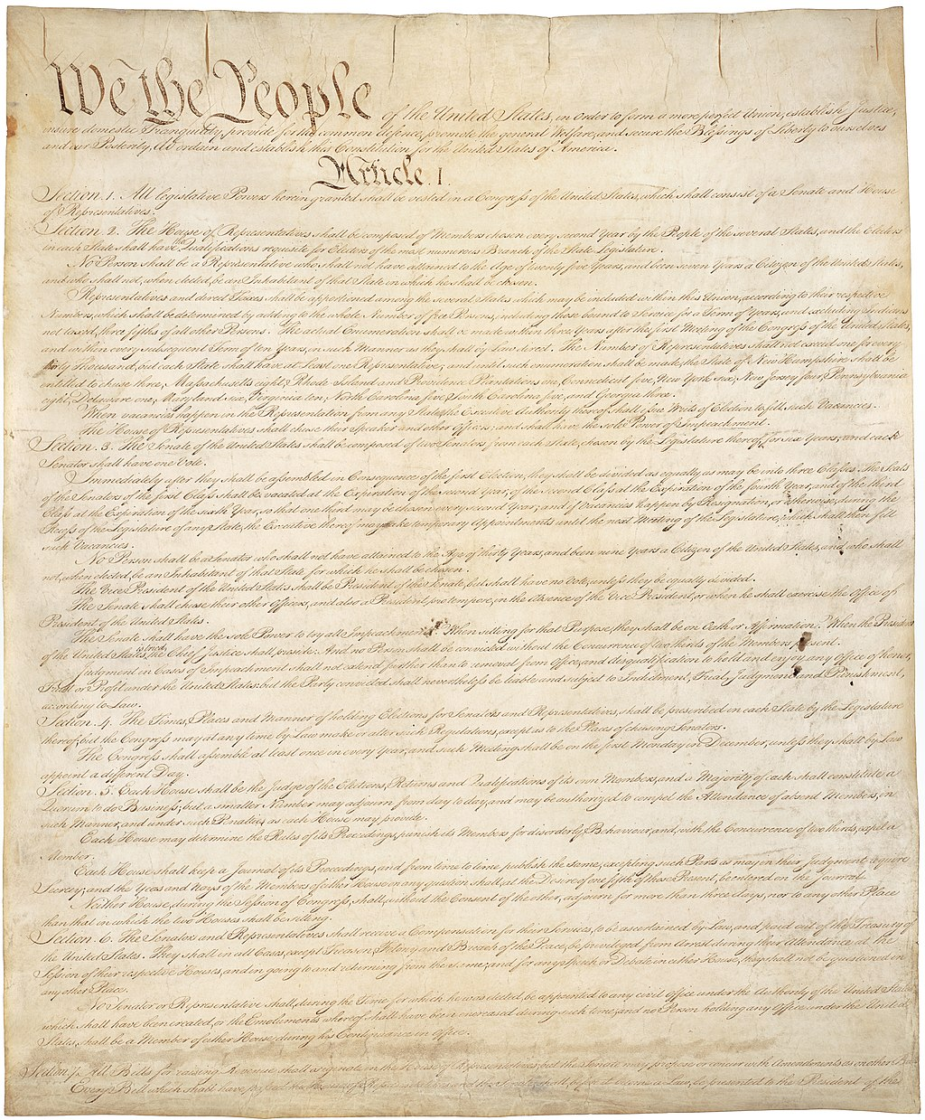
Constitution of the United States of America
Oldest national constitution of the world
Drafting started on 25th May 1787
Completed and signed on 15th September 1787
Became effective in 1788
Shortest living constitution today
Only seven articles drafted in 4400 words
Notes:
Notes for Teacher –
While presenting the picture of the American constitution the teacher may state that our preamble opens with the words "WE THE PEOPLE“ and it is in fact borrowed from the American Constitution
Suggestions: <Ideas/ Images/ Animations / Others – To make better representation of the content >
Source of Multimedia used in this slide - <Please provide source URL where we find the image and the license agreement>
Page 1 of the American Constitution - https://en.wikipedia.org/wiki/Constitution_of_the_United_States#/media/File:Constitution_of_the_United_States,_page_1.jpg

Slide 3
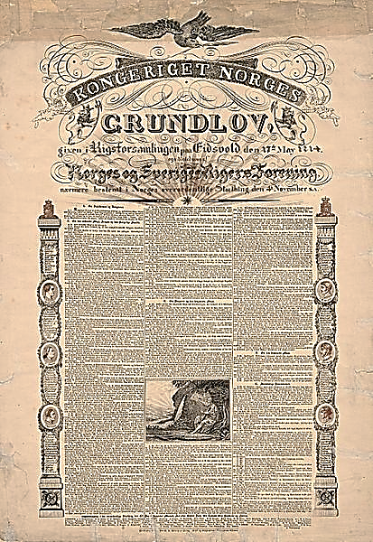
The Constitution Of Norway
Framed in 1814
2nd
oldest living constitution of the world
Notes:
Notes for Teacher - < Information for further reference or explanation >
Suggestions: <Ideas/ Images/ Animations / Others – To make better representation of the content >
Source of Multimedia used in this slide - <Please provide source URL where we find the image and the license agreement>
https://commons.wikimedia.org/wiki/File:Grunnloven_1814_plktr_05875.jpg (Nasjonalbiblioteket)

Slide 4
MM Index
Slide # | Thumbnail | Source link and Attribution
1 |  | https://www.freepik.com/free-vector/legal-statement-court-notice-judge-decision-judicial-system-lawyer-attorney-studying-papers-cartoon-character-mortgage-debt-legislation_10780023.htm (vectorjuice)
2 |  | https://en.wikipedia.org/wiki/Constitution_of_the_United_States#/media/File:Constitution_of_the_United_States,_page_1.jpg
3 |  | https://commons.wikimedia.org/wiki/File:Grunnloven_1814_plktr_05875.jpg (Nasjonalbiblioteket)
Notes:
Notes for Teacher - < Information for further reference or explanation >
Suggestions: <Ideas/ Images/ Animations / Others – To make better representation of the content >
Source of Multimedia used in this slide - <Please provide source URL where we find the image and the license agreement>

