Slide 1
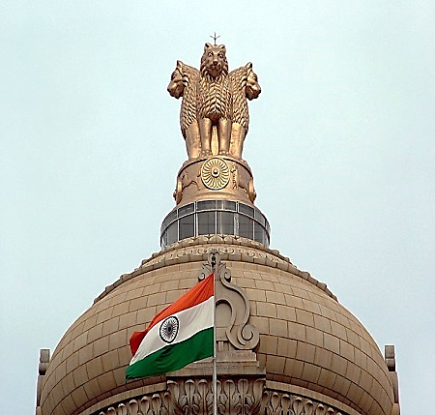
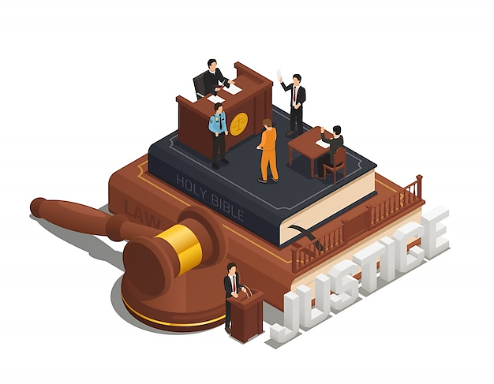
Rigid Vs Flexible Constitution
Notes:
Notes for Teacher - < Information for further reference or explanation > Suggestions: <Ideas/ Images/ Animations / Others – To make better representation of the content >
Source of Multimedia used in this slide - <Please provide source URL where we find the image and the license agreement>
Emblem: https://commons.wikimedia.org/wiki/File:India_flag_emblem.jpg (BY: Mellisa Anthony Jones at English Wikipedia)
Constitution vector - https://www.freepik.com/free-vector/law_4330672.htm (macrovector)

Slide 2
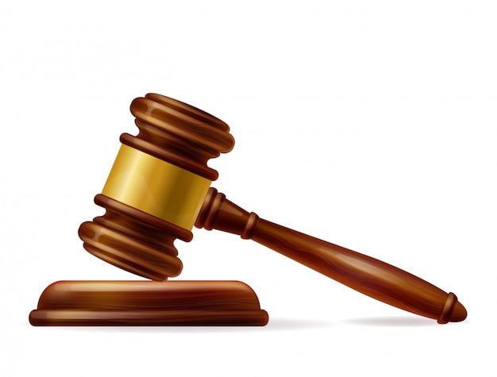
Constitution
Flexible
Rigid
Types
Flexible
Notes:
Notes for Teacher - < Information for further reference or explanation > Suggestions: <Ideas/ Images/ Animations / Others – To make better representation of the content >
Source of Multimedia used in this slide - <Please provide source URL where we find the image and the license agreement>
https://www.freepik.com/free-vector/justice-two-hands-balance_1011196.htm (macrovector)
https://www.freepik.com/free-vector/realistic-wooden-brown-judge-gavel_7776009.htm (redgreystock)

Slide 3
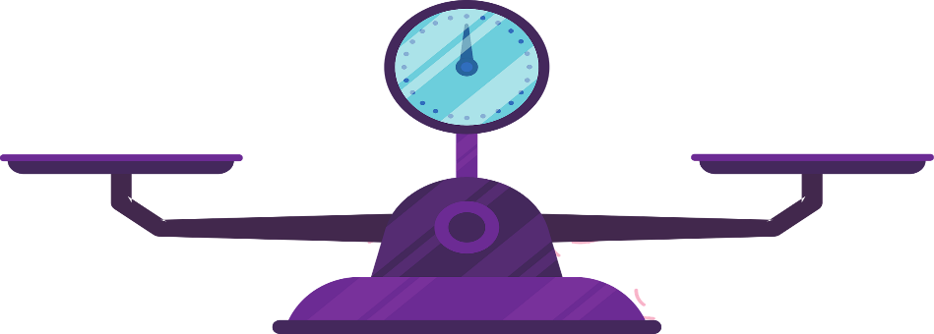
1
Rigid Constitution
Advantages
Disadvantages
Not amenable to frequent changes
Stable and continued administration
Ideal for federal structure
Conservative
Prevents party in power from becoming autocratic
Cannot keep pace with fast-changing environment
Notes:
Notes for Teacher - < Information for further reference or explanation > Suggestions: <Ideas/ Images/ Animations / Others – To make better representation of the content >
Source of Multimedia used in this slide - <Please provide source URL where we find the image and the license agreement>

Slide 4
2
Flexible Constitution
Advantages
Disadvantages
Dynamic in nature
Develops with time
Party in power may use to its benefit
Ability to change in extraordinary circumstances
Unsuitable for a federal country
eg. India
Best suited for emergency situations
May lead to instability
Notes:
Notes for Teacher - < Information for further reference or explanation >
Suggestions: <Ideas/ Images/ Animations / Others – To make better representation of the content >
Source of Multimedia used in this slide - <Please provide source URL where we find the image and the license agreement>

Slide 5
MM INDEX
Slide # | Thumbnail | Source link and Attribution
1 |  | Emblem: https://commons.wikimedia.org/wiki/File:India_flag_emblem.jpg (BY: Mellisa Anthony Jones at English Wikipedia) https://www.freepik.com/free-vector/law_4330672.htm (macrovector)
2 |  | https://www.freepik.com/free-vector/justice-two-hands-balance_1011196.htm (macrovector) https://www.freepik.com/free-vector/realistic-wooden-brown-judge-gavel_7776009.htm (redgreystock)
3,4 |  | https://pixabay.com/illustrations/scale-weight-weighing-scale-balance-5660499
Notes:
Notes for Teacher - < Information for further reference or explanation > Suggestions: <Ideas/ Images/ Animations / Others – To make better representation of the content >
Source of Multimedia used in this slide - <Please provide source URL where we find the image and the license agreement>

