Slide 1
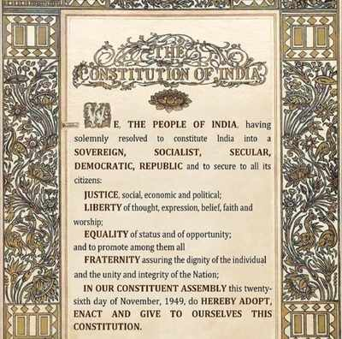
Need for a Constitution
Notes:
Notes for Teacher - < Information for further reference or explanation >
Suggestions: <Ideas/ Images/ Animations / Others – To make better representation of the content >
Source of Multimedia used in this slide - <Please provide source URL where we find the image and the license agreement>
https://commons.wikimedia.org/wiki/File:CONSTITUTION_PREAMBLE.jpg (TimesofIndia)

Slide 2
Need for a Constitution
They moved to a small island in the middle of the Pacific
Passengers were on a holiday
A ship carrying passengers was sailing through the Pacific Ocean
There was a violent storm, many died, few survived
The island had plentiful resources and they settled there
Notes:
Notes for Teacher - < Information for further reference or explanation >
1.The present story is based on ‘Thomas Hobbes’ theory of human nature. The teacher is expected to read the story beforehand and tell it in his/her own words to make it lively. The teacher may start the transaction by saying that, “Today I am going to tell you a story. ......... Are you all ready?”
2. The teacher may pause for a while and ask the students about the location of Pacific Ocean.
Suggestions: <Ideas/ Images/ Animations / Others – To make better representation of the content >
Source of Multimedia used in this slide - <Please provide source URL where we find the image and the license agreement>
Boat - https://www.freepik.com/free-vector/wooden-ships-isolated-wood-boats-with-white-sails_25581763.htm (upklyak)
Island https://www.freepik.com/free-vector/scene-with-island-sea_4882520.htm (brgfx)

Slide 3
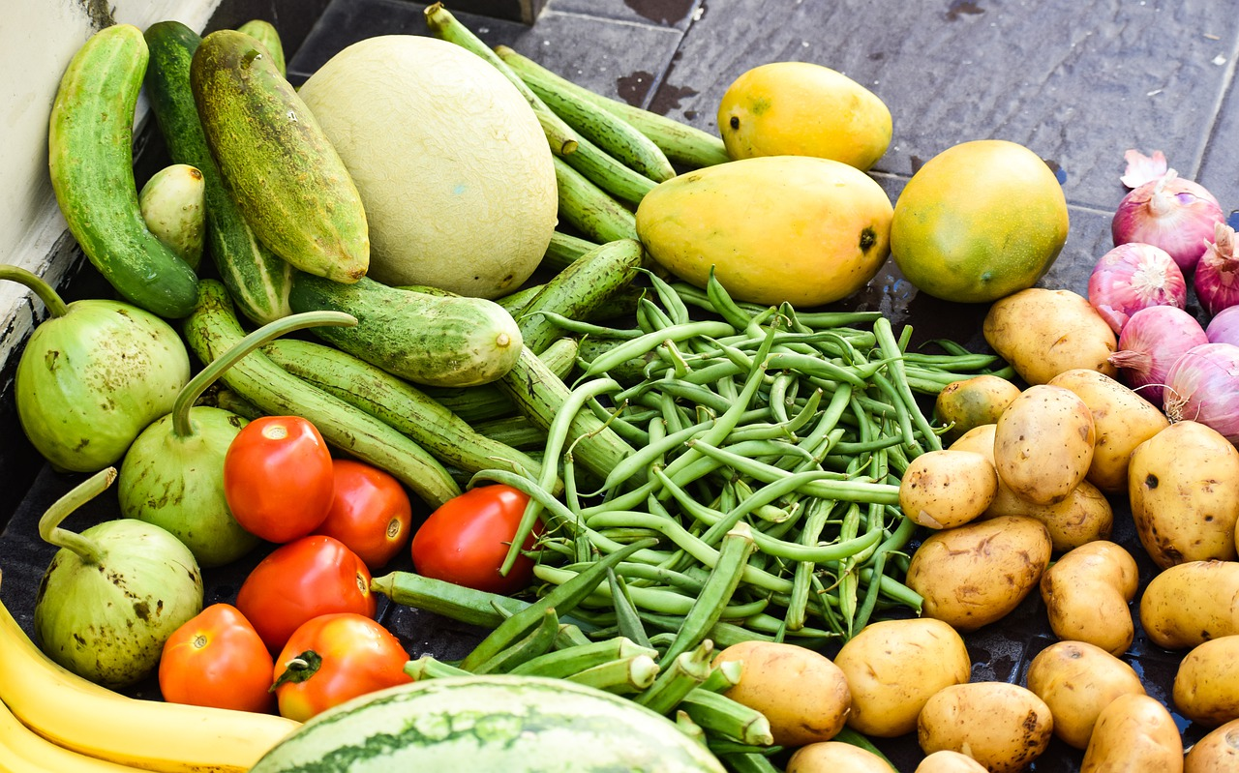
Need for a Constitution
Quarrels over food and water, mighty won against weak
Groups emerged, people divided. Peace, harmony lost
Representatives of each group met, made rules, Constitution was framed
Notes:
Notes for Teacher - < Information for further reference or explanation >
The teacher may ask the question, “Imagine, you were one of the victims of the ship wreck, what you would you have done? ……… After all the responses from the student’s side, the teacher will thank the students for their answers and say, “Now listen to what the victims of the ship wreck did”.) Suggestions: <Ideas/ Images/ Animations / Others – To make better representation of the content >
Source of Multimedia used in this slide - <Please provide source URL where we find the image and the license agreement>
Quarrel - https://pixabay.com/vectors/argument-conflict-discussion-fight-1299108/
Veggies -https://pixabay.com/photos/vegetables-fruits-food-salad-fruit-5313942/
Water -https://pixabay.com/photos/krka-waterfall-croatia-nature-park-987021/
Grp- https://www.freepik.com/free-vector/modern-pack-silhouette-avatars_1292965.htm#&position=3&from_view=detail#&position=3&from_view=detail (freepik)
Representatives- https://pixabay.com/vectors/communicate-communication-conference-2028004/
Rules-https://www.freepik.com/free-vector/pharmaceutical-policy-clipboard-researchers-tiny-people-pharmaceutical-policy-pharmaceutical-lobby-drugs-production-control-concept-pinkish-coral-bluevector-vector-isolated-illustration_11667046.htm (vectorjuice)

Slide 4
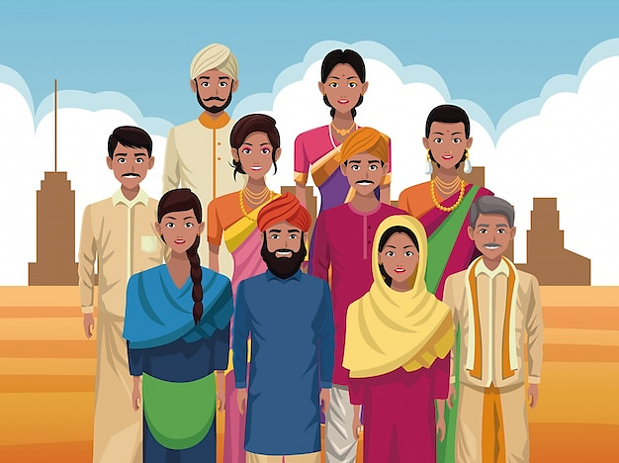
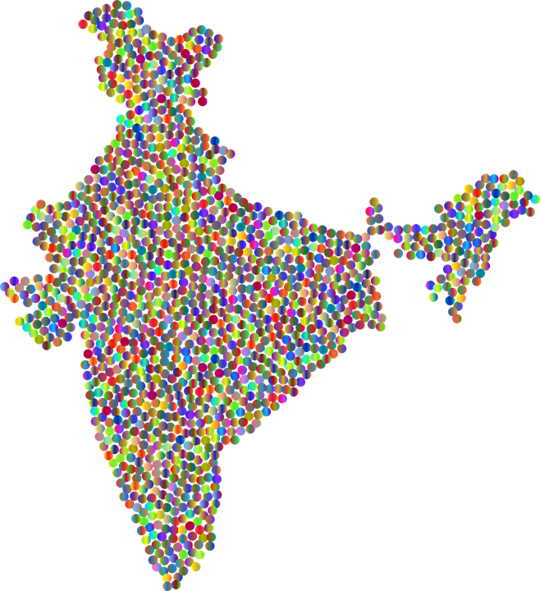
Primary Need for a Constitution
To ensure peace, order and harmony in the nation
Notes:
Notes for Teacher - < Information for further reference or explanation >
Suggestions: <Ideas/ Images/ Animations / Others – To make better representation of the content >
Source of Multimedia used in this slide - <Please provide source URL where we find the image and the license agreement>
https://pixabay.com/vectors/india-circles-dots-map-country-5901199/>
https://www.freepik.com/free-vector/indian-group-india-cartoon_4887724.htm (jemastock)

Slide 5
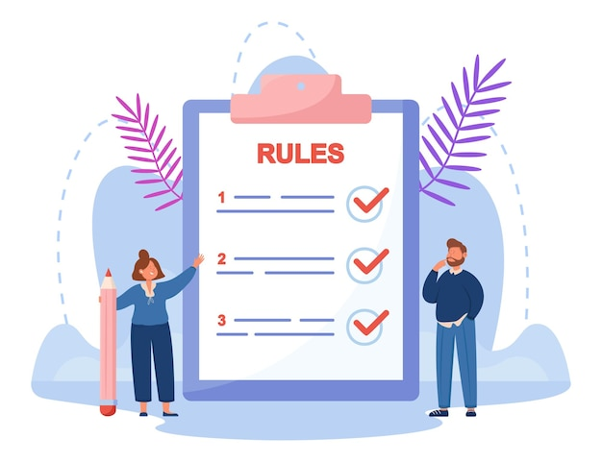
Secondary Need for a Constitution
Uniting Factor
Binds people together
Socialisation of Citizens
Everyone follows rules and regulations
Fundamental Law
Highest law of the land
Notes:
Notes for Teacher – < Information for further reference or explanation >
Suggestions: <Ideas/ Images/ Animations / Others – To make better representation of the content >
Source of Multimedia used in this slide - <Please provide source URL where we find the image and the license agreement>
1. https://www.freepik.com/free-vector/friends-showing-unity-teamwork_1577715.htm (makyzz)
2.https://www.freepik.com/free-vector/background-with-advocacy-elements_2250056.htm (freepik)
3.https://www.freepik.com/free-vector/tiny-business-people-reading-list-rules-man-woman-making-checklist-control-companys-management-huge-clipboard-flat-vector-illustration-guidance-concept_24644903.htm (pch.vector)

Slide 6
Secondary Need for a Constitution
Allocates Power
Distributes power between Legislature , Executive and Judiciary
RIGHT TO EDUCATION
Guarantees Rights
Guarantees basic rights
Notes:
Notes for Teacher – < Information for further reference or explanation >
Suggestions: <Ideas/ Images/ Animations / Others – To make better representation of the content >
Source of Multimedia used in this slide - <Please provide source URL where we find the image and the license agreement>
https://pixabay.com/vectors/rajyasabha-bhavan-election-flag-4187959/
https://www.freepik.com/free-vector/watercolor-international-human-rights-day-instagram-stories-collection_20106569.htm (freepik)

Slide 7
MM INDEX
Slide # | Thumbnail | Source link and Attribution
1 |  | https://commons.wikimedia.org/wiki/File:CONSTITUTION_PREAMBLE.jpg (TimesofIndia)
2 |  | Boat - https://www.freepik.com/free-vector/wooden-ships-isolated-wood-boats-with-white-sails_25581763.htm (upklyak) Island https://www.freepik.com/free-vector/scene-with-island-sea_4882520.htm (brgfx)
3 |  | Quarrel - https://pixabay.com/vectors/argument-conflict-discussion-fight-1299108/ Veggies -https://pixabay.com/photos/vegetables-fruits-food-salad-fruit-5313942/ Water -https://pixabay.com/photos/krka-waterfall-croatia-nature-park-987021/ Grp- https://www.freepik.com/free-vector/modern-pack-silhouette-avatars_1292965.htm#&position=3&from_view=detail#&position=3&from_view=detail (freepik) Representatives- https://pixabay.com/vectors/communicate-communication-conference-2028004/ Rules-https://www.freepik.com/free-vector/pharmaceutical-policy-clipboard-researchers-tiny-people-pharmaceutical-policy-pharmaceutical-lobby-drugs-production-control-concept-pinkish-coral-bluevector-vector-isolated-illustration_11667046.htm (vectorjuice)
4 |  | https://pixabay.com/vectors/india-circles-dots-map-country-5901199/> https://www.freepik.com/free-vector/indian-group-india-cartoon_4887724.htm (jemastock)
5 |  | https://www.freepik.com/free-vector/friends-showing-unity-teamwork_1577715.htm (makyzz) 2.https://www.freepik.com/free-vector/background-with-advocacy-elements_2250056.htm (freepik) 3.https://www.freepik.com/free-vector/tiny-business-people-reading-list-rules-man-woman-making-checklist-control-companys-management-huge-clipboard-flat-vector-illustration-guidance-concept_24644903.htm (pch.vector)
6 |  | https://pixabay.com/vectors/rajyasabha-bhavan-election-flag-4187959/ https://www.freepik.com/free-vector/watercolor-international-human-rights-day-instagram-stories-collection_20106569.htm (freepik)
Notes:
Notes for Teacher - < Information for further reference or explanation >
Suggestions: <Ideas/ Images/ Animations / Others – To make better representation of the content >
Source of Multimedia used in this slide - <Please provide source URL where we find the image and the license agreement>

