Slide 1
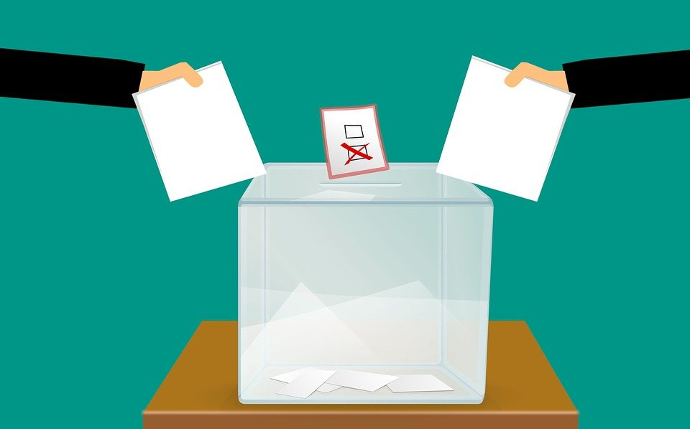
Text here
Our Role in Citizen’s Right to Vote
Notes:
Notes for Teacher - < Information for further reference or explanation >
Suggestions: <Ideas/ Images/ Animations / Others – To make better representation of the content >
Source of Multimedia used in this slide -
https://pixabay.com/illustrations/vote-voting-voting-ballot-box-3569999/

Slide 2
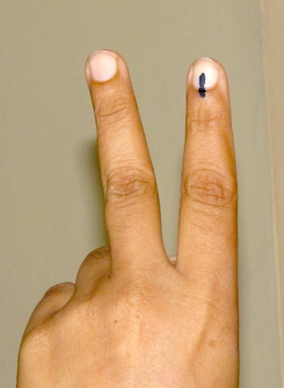
Right to Vote
18 years of age
Country
Right to elect own representatives
State
Village
No scope for outsiders to govern
Adult Franchise
The right to self-governance is the essence of being an independent nation
Notes:
Notes for Teacher - < Information for further reference or explanation >
Suggestions: <Ideas/ Images/ Animations / Others – To make better representation of the content >
Source of Multimedia used in this slide - Voting Ink Mark- SSSVV gallery
Elections- SSSVV gallery

Slide 3
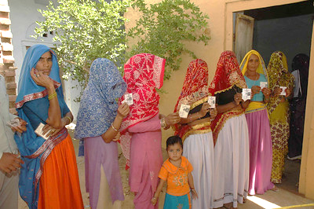
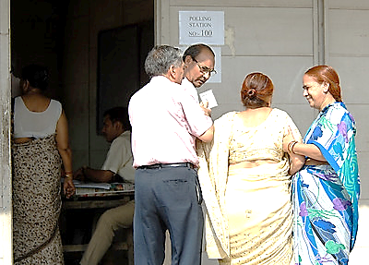
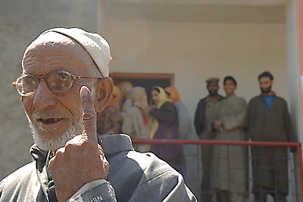
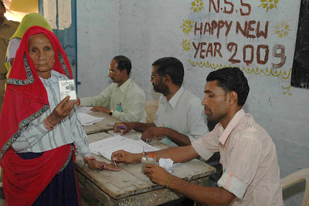
Role as a responsible citizen
Ensure every member of the family exercises his or her right to vote
Not having the right to vote now, what should be your role and responsibility as a good citizen?
Help old members of the family reach the voting station
Notes:
Notes for Teacher - < Information for further reference or explanation >
Suggestions: <Ideas/ Images/ Animations / Others – To make better representation of the content >
Source of Multimedia used in this slide
https://www.flickr.com/photos/publicresourceorg/27246140560/in/photostream/ (Public.Resource.Org)
https://www.flickr.com/photos/publicresourceorg/26914486533/in/photostream/(Public.Resource.Org)
https://www.flickr.com/photos/publicresourceorg/26914486693/in/photostream/ (Public.Resource.Org)
https://www.flickr.com/photos/publicresourceorg/27450505411/in/photostream/ (Public.Resource.Org)

Slide 4
MM Index
Slide # | Thumbnail | Source link and Attribution
1 |  | https://pixabay.com/illustrations/vote-voting-voting-ballot-box-3569999/
2 |  | Ink mark- SSSVV gallery, Elections- SSSVV gallery
3 |  | https://www.flickr.com/photos/publicresourceorg/27246140560/in/photostream/ (Public.Resource.Org) https://www.flickr.com/photos/publicresourceorg/26914486533/in/photostream/ (Public.Resource.Org)
3 |  | https://www.flickr.com/photos/publicresourceorg/26914486693/in/photostream/ (Public.Resource.Org) https://www.flickr.com/photos/publicresourceorg/27450505411/in/photostream/ (Public.Resource.Org)
Notes:
Notes for Teacher - < Information for further reference or explanation >
Suggestions: <Ideas/ Images/ Animations / Others – To make better representation of the content >
Source of Multimedia used in this slide - <Please provide source URL where we find the image and the license agreement>

