Slide 1
Constitution_Revision
Notes:
Notes for Teacher - < Information for further reference or explanation >
Suggestions: <Ideas/ Images/ Animations / Others – To make better representation of the content >
Source of Multimedia used in this slide - <Please provide source URL where we find the image and the license agreement>
https://www.freepik.com/free-vector/illustration-people-with-justice-order-icons_3776960.htm#page=1&query=laws&position=47 (rawpixel.com)

Slide 2
Section I – QI) Very Short Questions
1.
Name two countries which do not have a written constitution.
Possible answers :- Israel, New Zealand, Saudi Arabia, UK, Canada
2.
Name two countries other than India that have a written constitution.
Possible answers :- US, France, Sri Lanka, Nepal, Bangladesh
Click to get the answer
Notes:
Notes for Teacher - < Information for further reference or explanation >
Suggestions: <Ideas/ Images/ Animations / Others – To make better representation of the content >
Source of Multimedia used in this slide - <Please provide source URL where we find the image and the license agreement>

Slide 3
I) Very Short Questions
3.
Name any two types of government.
Possible answers :- Parliamentary form, Presidential form, Federal form, Democratic form
4.
Which is the oldest written constitution of the world?
Answer :- USA
Click to get the answer
Notes:
Notes for Teacher - < Information for further reference or explanation >
Suggestions: <Ideas/ Images/ Animations / Others – To make better representation of the content >
Source of Multimedia used in this slide - <Please provide source URL where we find the image and the license agreement>

Slide 4
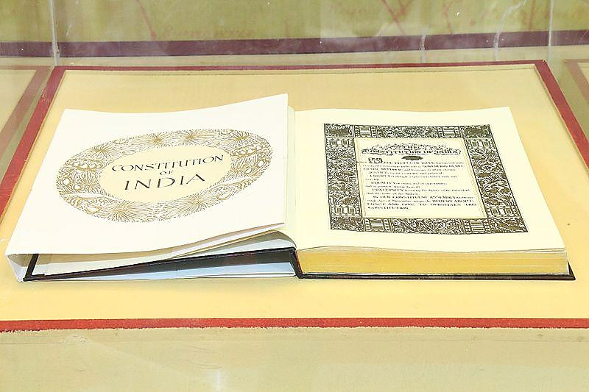
I) Very Short Questions
5.
Which article of Indian Constitution states about amendment to the constitution?
Answer :- Article-368
Click to get the answer
Notes:
Notes for Teacher - < Information for further reference or explanation >
Suggestions: <Ideas/ Images/ Animations / Others – To make better representation of the content >
Source of Multimedia used in this slide - <Please provide source URL where we find the image and the license agreement>
https://commons.wikimedia.org/wiki/File:Constitution_of_India_(31667825533).jpg (Geospatial World)

Slide 5
II) Very Short Questions
Event
Year
Constitution of USA became effective
1946
Formation of Constituent Assembly in India
1950
Magna Carta
1628
Constitution of India became effective
1789
Petition of Rights
1215
Click left box for the answer
Notes:
Notes for Teacher - < Information for further reference or explanation >
Suggestions: <Ideas/ Images/ Animations / Others – To make better representation of the content >
Source of Multimedia used in this slide - <Please provide source URL where we find the image and the license agreement>

Slide 6
Section II – QI) Short Questions
1) What is a Constitution?
2) Why is the British constitution known as a ‘living constitution’?
3) Name any conventions practised in the Indian constitution.
4) What is the specific need of a constitution in a federal form of government?
4)
Notes:
Notes for Teacher - < Information for further reference or explanation >
Question under section-II has short answers. These questions may be discussed in the class and then given as homework.
Suggestions: <Ideas/ Images/ Animations / Others – To make better representation of the content >
Source of Multimedia used in this slide - <Please provide source URL where we find the image and the license agreement>

Slide 7
Section III – Long Answer Questions
C
1. Compare written with unwritten constitution.
C
2. Differentiate between rigid and flexible constitution.
Notes:
Notes for Teacher - < Information for further reference or explanation >
Question No. 1 and 2 under section III has long answers. These questions may be given as homework.
Suggestions: <Ideas/ Images/ Animations / Others – To make better representation of the content >
Source of Multimedia used in this slide - <Please provide source URL where we find the image and the license agreement>

Slide 8
Section III – Long Answer Questions
3. State the characteristics of a good constitution.
4. Recall a real-life situation to illustrate the role of constitution in day-to-day life.
5. Imagine life without any constitution.
Notes:
Notes for Teacher - < Information for further reference or explanation >
Question No. 3, 4 and 5 under section-III are reflective in nature. The answers to these questions are not readily available in the textbook. The teacher may discuss the answers to these questions in the class to ignite the thinking skill among the students. These questions may also be given for home assignment.
For qn 4. - There could be various answers. The students should be encouraged to pick examples from their own surroundings.
Suggestions: <Ideas/ Images/ Animations / Others – To make better representation of the content >
Source of Multimedia used in this slide - <Please provide source URL where we find the image and the license agreement>

Slide 9
Attribution / Citation
Slide # | Thumbnail | Source link | Author
1 |  | https://www.freepik.com/free-vector/illustration-people-with-justice-order-icons_3776960.htm#page=1&query=laws&position=4 | rawpixel.com
4 |  | https://commons.wikimedia.org/wiki/File:Constitution_of_India_(31667825533).jpg | Geospatial World
Notes:
Notes for Teacher - < Information for further reference or explanation >
Suggestions: <Ideas/ Images/ Animations / Others – To make better representation of the content >
Source of Multimedia used in this slide - <Please provide source URL where we find the image and the license agreement>

