Slide 1
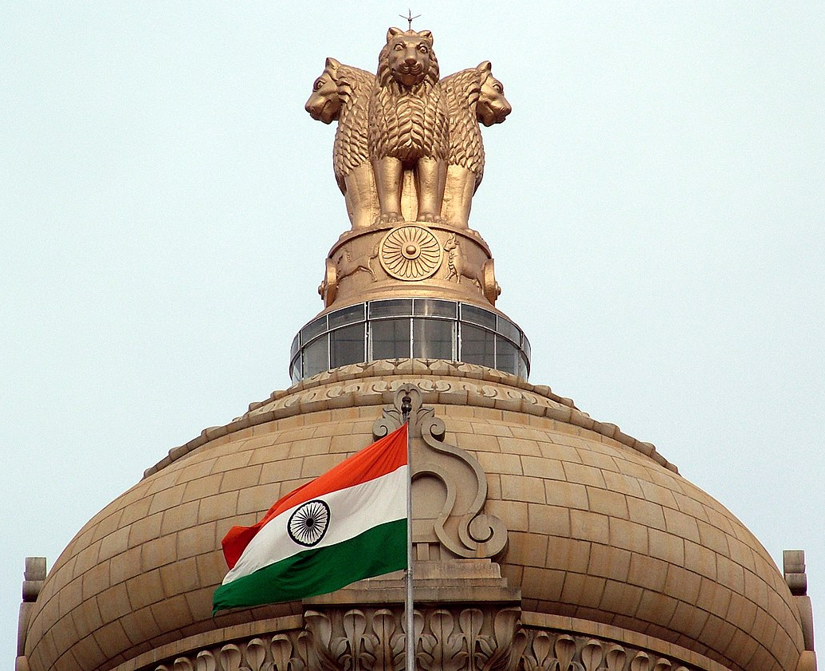
Constitution
Notes:
Notes for Teacher - < Information for further reference or explanation >
Suggestions: <Ideas/ Images/ Animations / Others – To make better representation of the content >
Source of Multimedia used in this slide - <Please provide source URL where we find the image and the license agreement>
https://commons.wikimedia.org/wiki/File:India_flag_emblem.jpg (BY: Mellisa Anthony Jones at English Wikipedia)

Slide 2
Constitution
Types -
1. Evolved or Enacted 2. Written or Unwritten
3. Rigid or Flexible
a. Set of rules for governing the nation
b. Fundamental law of the nation
Required to maintain peace and harmony in the nation
Rules and regulations required for the functioning of society
a. Binds people, helps individuals to become good citizens
b. Lays down basic principles for other laws of the nation
Notes:
Notes for Teacher - < Information for further reference or explanation >
Suggestions: <Ideas/ Images/ Animations / Others – To make better representation of the content >
Source of Multimedia used in this slide - <Please provide source URL where we find the image and the license agreement>
gavel -https://www.freepik.com/free-vector/realistic-wooden-brown-judge-gavel_7776009.htm (redgreystock)
hands – https://www.freepik.com/free-photo/empty-woman-hands-isolated-white-background_1139748.htm (nensuria)
Flag - https://freesvg.org/indian-flag-image

Slide 3
Attribution / Citation
Slide # | Thumbnail | Source link | Author
1. |  | https://commons.wikimedia.org/wiki/File:India_flag_emblem.jpg | Mellisa Anthony Jones at English Wikipedia
2 |  | https://freesvg.org/indian-flag-image
2. |  | https://www.freepik.com/free-vector/realistic-wooden-brown-judge-gavel_7776009.htm | redgreystock
2 |  | https://www.freepik.com/free-photo/empty-woman-hands-isolated-white-background_1139748.htm | nensuria
Notes:
Notes for Teacher - < Information for further reference or explanation >
Suggestions: <Ideas/ Images/ Animations / Others – To make better representation of the content >
Source of Multimedia used in this slide - <Please provide source URL where we find the image and the license agreement>

